Slide 1



DEVOPS
Golang – Do more with less
OPENAPI – Universal REST API standard

Slide 2

Overview
General concepts of Golang & OpenAPI
Typical REST API server
The go CLI to:
Manage dependencies
Build
Run
Test
And many others

Slide 3

GolAng general
Launched in 2009, by Google engineers in reaction to C++ complexity
Original authors: Robert Griesemer, Rob Pike, Ken Thompson
Compiled to machine code (like C++, unlike Java)
Garbage collected (like Java, unlike C++)
Large ecosystem & opensource modules
Simpler syntax rules
Better tooled
November 2022, the US NSA urged devs to quit C in favour to safe languages

Slide 4
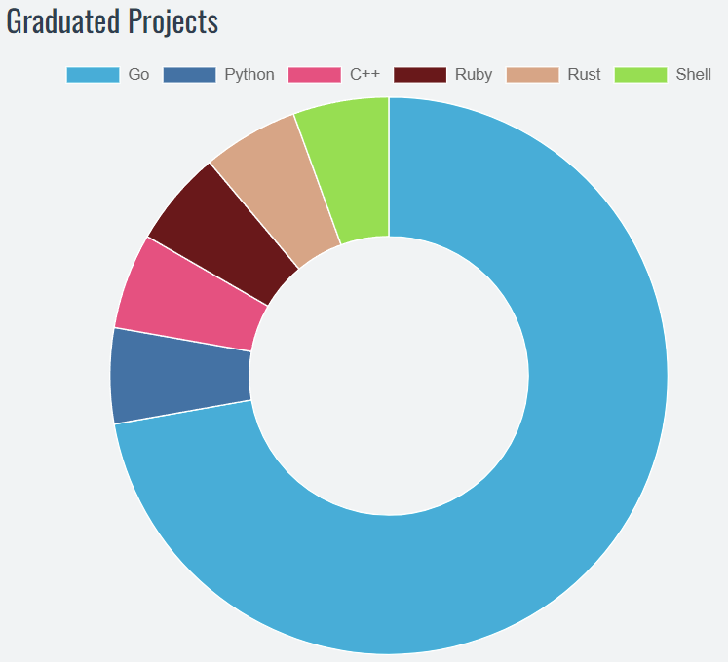
GolAng general
Cloud Native Computing Foundation projects
➡️ High perf, easy to code & maintain: favorite devops language

Slide 5
GolAng general
package main
import "fmt"
func main() {
myMessage := "Bonjour les devops"
myNumber := 3.14
fmt.Println(myMessage, myNumber)
}
➡️ We will go deeper into code syntax later
Notes:
Transition: Before we dive into the serve code, some theory about APIs

Slide 6



HTTP server and REST API

Slide 7
HTTP server and REST API
API: Application Programming Interface (how to talk to a server)
REST: REpresentational State Transfer (rules to follow like stateless, resource-oriented, …)
Method
Headers
Path
Body
Client
Server
API
DB
Code
Body

Slide 8
HTTP server and REST API
Typical Http methods
GET: retrieve a resource, idempotent (replay will give the same result)
GET: list all resources of a collection
POST: create a resource, provide attributes, get its ID in return
DELETE: delete a resource
PATCH: modify a resource
Typical Http response codes
200 to 299: message & processing OK (resource retrieved, created, deleted, …)
400 to 499: Client error (bad message, forbidden, …)
500 to 599: Server error (those should not be intended = bug)
Notes:
Transition: How the users know how to send the right messages ?

Slide 9
OPENAPI general
Published in 2011, originally named Swagger, standard way of specifying REST APIs
Single source of truth for describing the messages accepted by an HTTP server
Precisely documents the format of the data expected by the server and the responses the server gives back
Used by everyone from developers to customers
Works with Swagger UI, a tool to test the requests live

Slide 10
OPENAPI general
Swagger UI and openapi.yml on https://editor.swagger.io
Live demo ✨

Slide 11
Code tour
Syntax
Project structure
API
Live demo ✨

Slide 12
Next step: TP
Run the cloned project & send requests to it

