Slide 1

DEVOPS
Package, distribute and run with DOCKER

Slide 2

Overview
General concepts of Docker
Dockerize our application
Distribute the image to a registry
Run the image

Slide 3
Definitions & Analogies
Programs
Source code
Program
Process
Build
Execute
Docker images
Dockerfile
Image
Container
Build
Execute

Slide 4


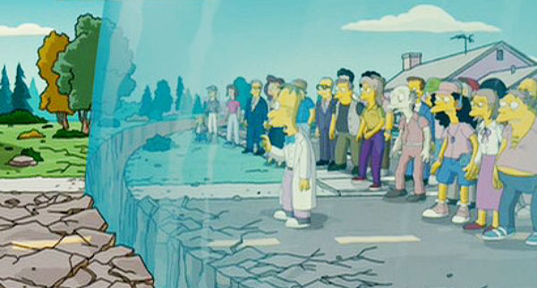
Isolation & security

Slide 5
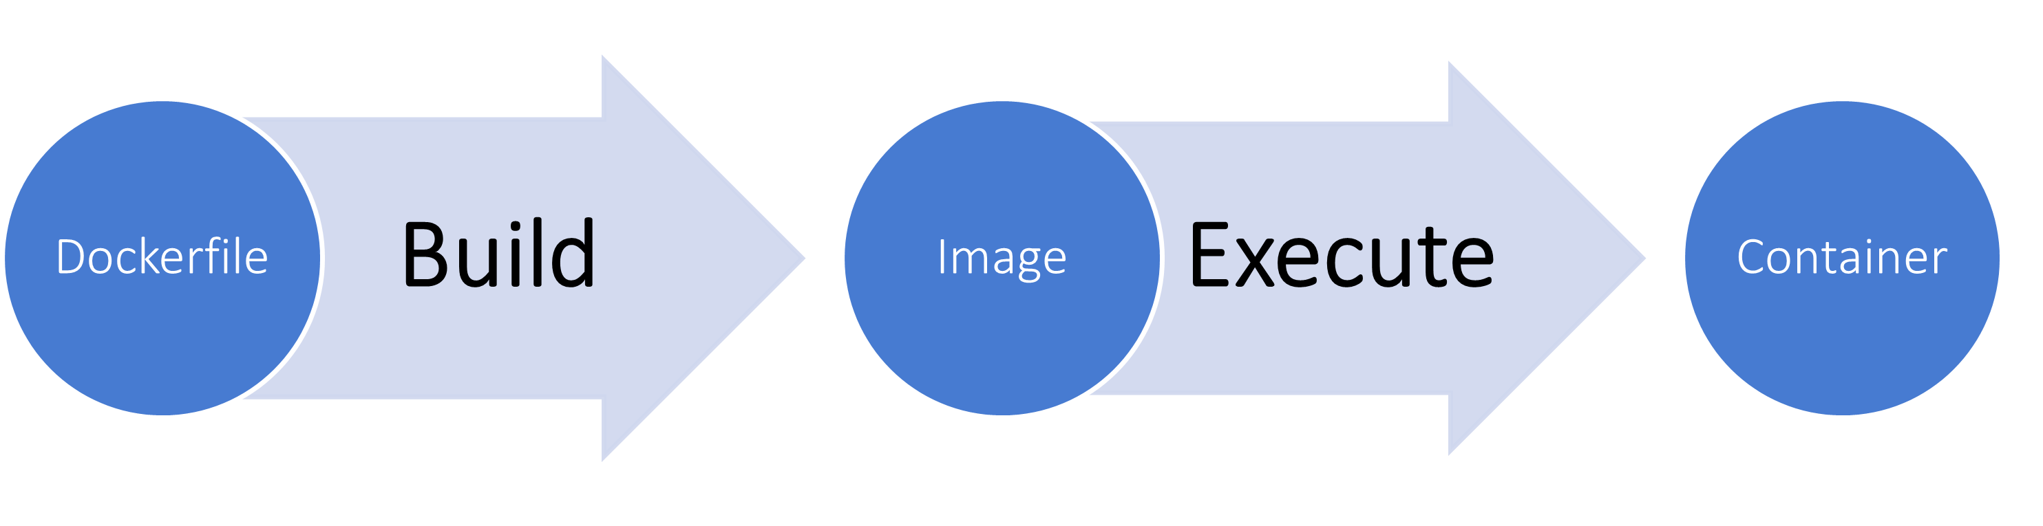

Container usages
What kind of program do we dockerize ?
Servers
  The container is kept alive
  It listens to a TCP/UDP port
One-shot programs / CLI
Ex: a program written in python ➡️ the container brings all the dependencies
the same everywhere

Slide 6
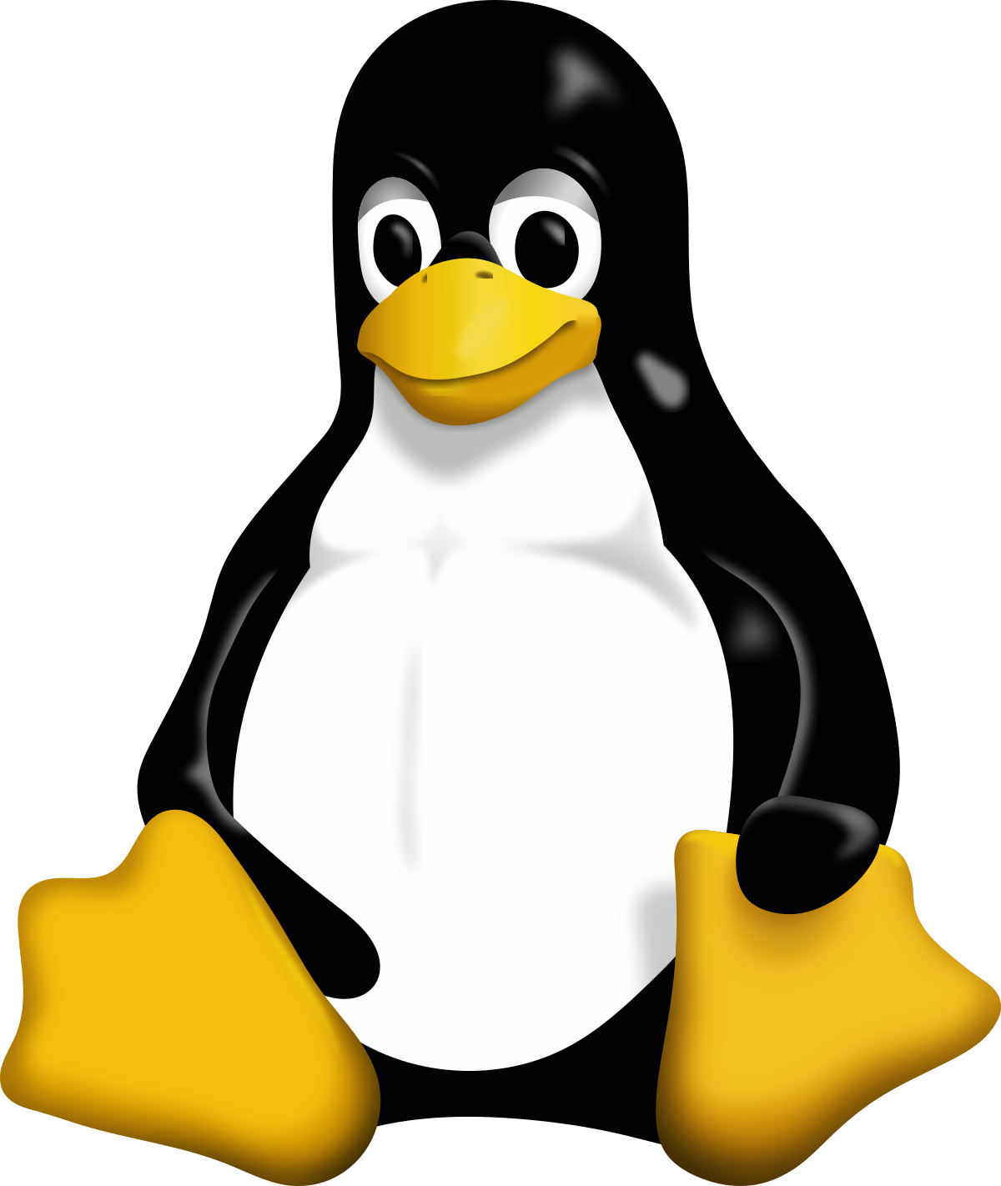
What it in the box ??
Anatomy of a Linux installation
Some base images
Linux Alpine
Busybox
Ubuntu
go, node, python, …
scratch
…
Host
Container
Root file system
➡️ tools / commands / libs
➡️ basic config files
➡️ data files
Linux Kernel

Slide 7

Docker containers isolation
Ways of communicating with the container
Host
Container
Network
port mapping
A port
Users
Filesystem
volume mounting
A folder
Storage

Slide 8
Example of wiring
docker run -it -p 80:4444 -v /var/app1:/app app1
Host
Container
http://host.com:80
TCP
4444
TCP 80
Users
File
/app/db.sqlite
/var/app1
db.sqlite

Slide 9
The Dockerfile
Official doc ➡️ https://docs.docker.com/engine/reference/builder
FROM node:21-alpine
COPY ./src /app
WORKDIR /app
RUN npm ci --production
EXPOSE 8080
CMD ["node", "main.js"]
INSTRUCTION argument
General syntax
Example of NodeJS app

Slide 10
Dockerfile instructions
FROM node:21-alpine
COPY ./src /app
WORKDIR /app
RUN npm ci --production
EXPOSE 8080
CMD ["node", "main.js"]
FROM: initial state of the build process.
Either start building using preinstalled packages in another image,
Or choose scratch for an empty start
COPY: put some files from the build host into the image
Related to ADD
WORKDIR: Changes the current directory, like cd in Linux

Slide 11
Dockerfile instructions
FROM node:21-alpine
COPY ./src /app
WORKDIR /app
RUN npm ci --production
EXPOSE 8080
CMD ["node", "main.js"]
RUN: Execute a command in the image (build time)
EXPOSE: Declare a port to open at run time
CMD: The run time command to execute
Related to ENTRYPOINT

Slide 12
Docker build
Produce an image on your host, from the Dockerfile
Docker CLI:
build
images (list the local images)
inspect
rmi (remove an image)
Live demo ✨

Slide 13
Docker RUN
Instantiate a container from the built image
Docker CLI:
run (create a container)
ps (list the containers, ex: docker ps -a)
exec (execute a command in a container, ex: a shell)
stop (shuts down a container, can be restarted)
rm (completely removes the container)
Live demo ✨

Slide 14

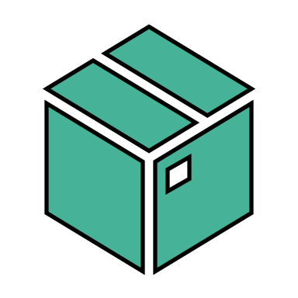


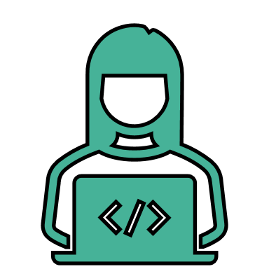
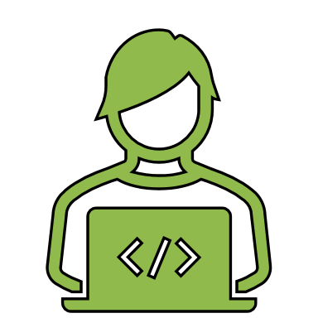
Image registry
The server hosting the images
Docker CLI:
login / logout
push / pull
Registry
dockerhub, ghcr.io, registry.gitlab.com
docker run
docker push
docker login
docker pull
Verified Publisher

Slide 15
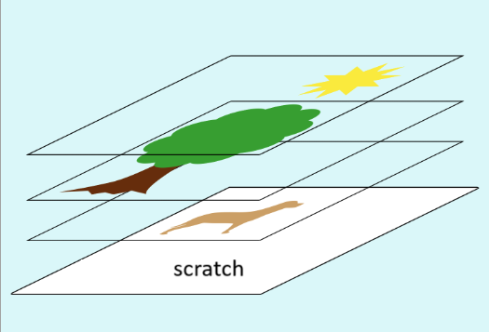
Image layers
The nature of an OCI image
Every Dockerfile instruction generates a layer during the build
Layers sit on the filesystem and have a size (Bytes)
corresponding to the NET amount of data
they bring into the image
Layers stack on each other
All the intermediate stacks get cached
➡️ changing a top fast, changing a bottom layer is slow

Slide 16
Leveraging the layers
Optimizing an image
Reduce the build time in dev phase
➡️ keep the frequently changing operations at the end of the Dockerfile
ex: try to copy the source code after having fetched the dependencies
Reduce the image size
➡️ do atomic instruction with cleanup at the end to reduce the NET size
ex: try to remove the downloaded archives right after unzipping them
RUN download tool.zip && unzip && rm tool.zip

Slide 17

Staged builds
Optimizing an image
FROM go:1.21 as builder
COPY ./src /app
WORKDIR /app
RUN go build
FROM scratch
COPY –from=builder /app/backend .
EXPOSE 8080
CMD ["backend"]
Idea: do size-intensive operations in the build “stages”
And use their minimalist output into the last stage
The intermediate stages’ layers are NOT part of the final image
Smaller image ➡️ better network perf, better security
FROM … as … : Starts a new stage that can be referred to later
COPY --from= … : Retrieve files from a build stage
Final image with only … the executable

Slide 18
Next step: TP
Let’s dockerize the project and publish the image
Create a Dockerfile
Build a local image
Inspect it
  Identify the exposed ports
  Find the command
  Find the environment variables
Try to go for a multi-staged build, check its layers
Run it to verify the app works well
Create a token on Github with registry push rights
Login into Github container registry
Push the image there
Pull the image from the registry

Slide 19
Next step: TP
Let’s inspect a public image
Get nginx:latest on your PC
Create a file tp-docker.txt (to commit & push) and answer the following questions there:
  Identify the exposed ports
  Find the command
  Find the environment variables
  Find a point of contact
  How many layers were needed to make it?
  Read the content of the file /docker-entrypoint.sh

Slide 20
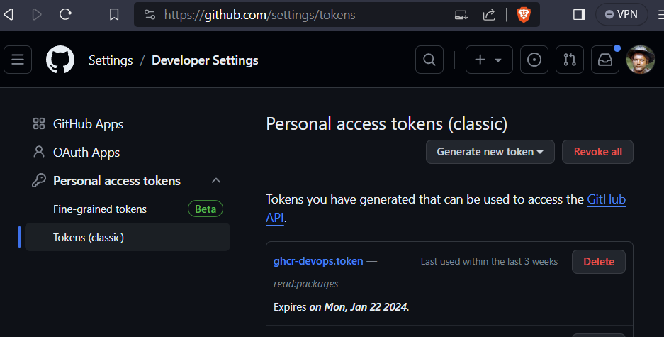
Github registry token
Click your avatar (top right) / Settings / Developer settings
Create a new token with read:packages write:packages

