Slide 1



DEVOPS
Testing Strategies

Slide 2

Overview
Some popular testing strategies
Reviewing those most fitting devops needs
Implementing tests at different levels
Preparing for CI/CD automation
Uni tests
API tests
System tests
Multilayer approach

Slide 3
Unit tests
Able to check many corner-cases, easy and fast
Heavily bound to the implementation, reserved for most complex functions
Far away from business use-cases
How to write them ?
Create a new file ending with _test.go
Test structure: input preparation, tested function call, output verification
How to run them ?
Command: go test

Slide 4
API tests
Runner
VM / container
Job
Step 1
Step 2
Service
API server
Verifies the contract is fulfilled (API working as documented)
Independent of the implementation
Requires a running instance of the server
More representative than the Unit Tests
How to write them ?
Test structure: HTTP request preparation, tested endpoint call, response verification
How to run them ?
Run the server in the background then launch the tests (depends on the chosen techno)

Slide 5
System tests
Verifies a set of applications work well together, high-level
Prone to breaking often as they are maintained on a different lifecycle, possibly by many teams
Many scenarios, long to run all
Long to setup to be representative of production
How to write them ?
Act as a system end user, i.e. a customer
Test structure: Environment preparation, sequence of actions, behaviour verification
How to run them ?
Install all the components with their appropriate versions ➡️the Qualification test environment (QA)

Slide 6
A/B tests
Verifies the new version behaves as expected on a small fraction of production traffic.
Increase the level of confidence on the new version.
Good for:
Getting usage data (is the UI easier to use ?)
Monitoring new error logs / new performance
Can trigger real production problems
S-curve deployment
✨ Example of Android OS versions

Slide 7


Focus on CYbersecurity
One way to hack a system
?
Get server info (techno, versions, …)
System seen as a black box
Exploit unpatched vulnerability
Get control
Exfiltrate data
Wreak havoc
Zero-day exploits

Slide 8
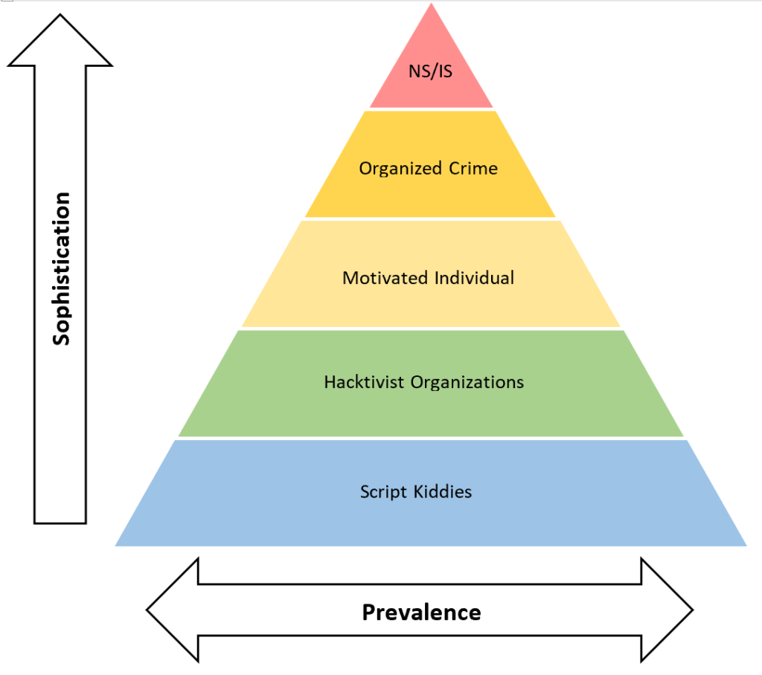
Focus on CYbersecurity
Who wants to hack you ?
➡️ Part of the threat modeling (OWASP)
?

Slide 9
CYBERSECURITY tests
Vulnerability scanners
  @Unittests level
  ➡️Golang built-in fuzzing for unit tests, AFL
  @API level: generate REST API calls with random / malicious inputs
  ➡️ OWASP’s ZAP tool
  @package level: OCI image, library, … does your package include vulnerable dependencies ?
  ➡️ Trivy image scanner
  ➡️ Gosec, Sonar, Npm audit, …

Slide 10
CYBERSECURITY tests
Penetration tests
  A team of cybersecurity experts tries to hack you
  ➡️ provides a vulnerability/compliance report
  Blackbox: done with no prior knowledge
  Whitebox: access to all documentation & code, connection to internal servers
  Greybox: a mix, some documentation, some accesses

Slide 11
Next step: TP
Let’s implement the unit tests and the API tests
Identify the key functions to cover
Get the code coverage report
  Analyse the HTML report to spot functions to cover
Test all API endpoints with HTTP requests
The test skeleton is provided in test/apitests, Utils are provided
Put the command to run the unit tests and the one for the API tests in a file named tp-tests.txt and commit/push it

