Slide 1

DEVOPS
Software deployment (Fortran) on Voyager 1,
20 billion km (22 light hours) away in October 2023
DeploymeNt

Slide 2

Overview
What is so important about deployment
Various hosting systems
Risks mitigation & Good practices
Deploying on an always-connected system
Deploying on a remote system (IOT)

Slide 3

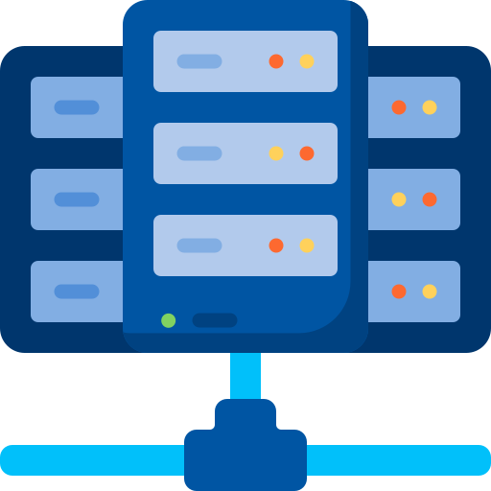
What is deployment about
Image
version n+1
Image
version n
Registry
Host
Deploy
Updating the host environment with a newer image
The environment may have customers using it

Slide 4
Hosting strategies
Levels of control
On-premise computer
Cloud VM
Serverless container runtime
Function-as-a-service
Physical security
Hardware
Cyber updates
OS updates
Network
Focus on the app version
Cloud config (as code)

Slide 5
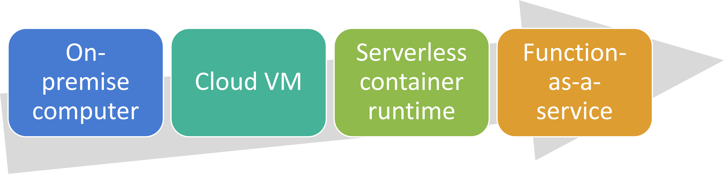
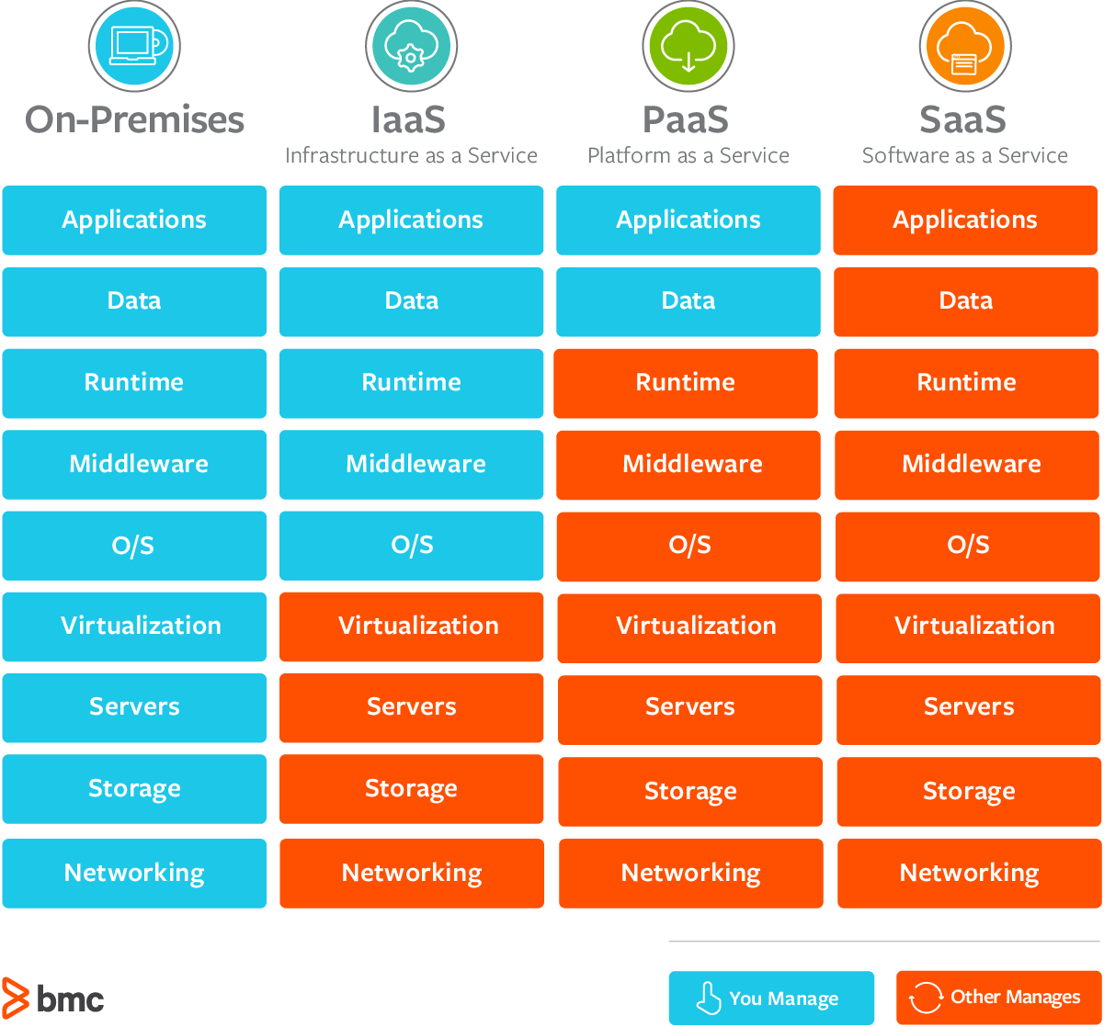
Hosting strategies

Slide 6
Hosting strategies
“On-prem” for hosting ultra-sensitive info
Cloud VM when needing specific tools to install, for non-dockerized workloads
Serverless container runtime simple single container apps to K8S microservices
FAAS get code executed in a premade environment

Slide 7

Hosting in the cloud
✅ Managed services = more focus on the app, less on the low level layers
✅ Elasticity property = scale up & down as needed, pay for what you need
Scaling issues because of variable load

Slide 8

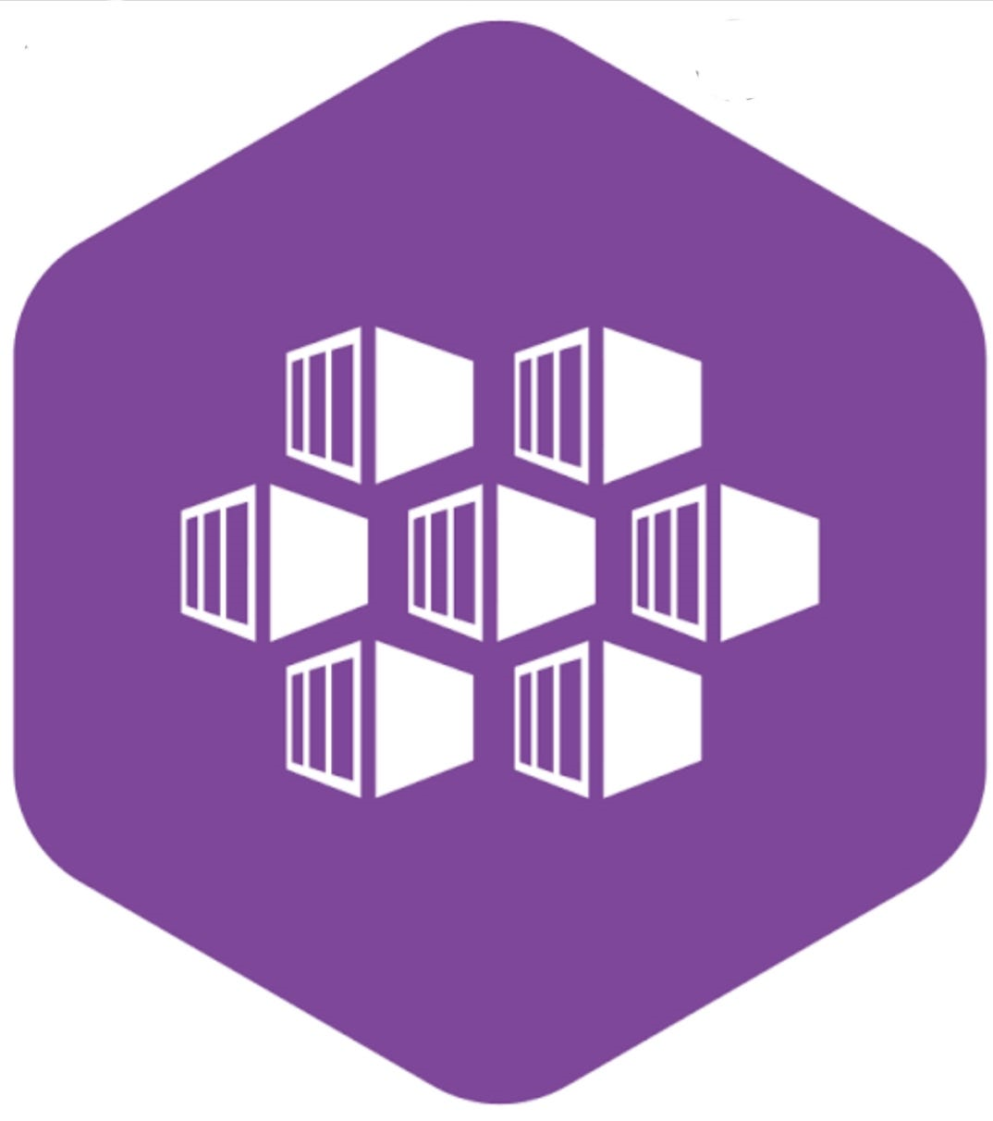
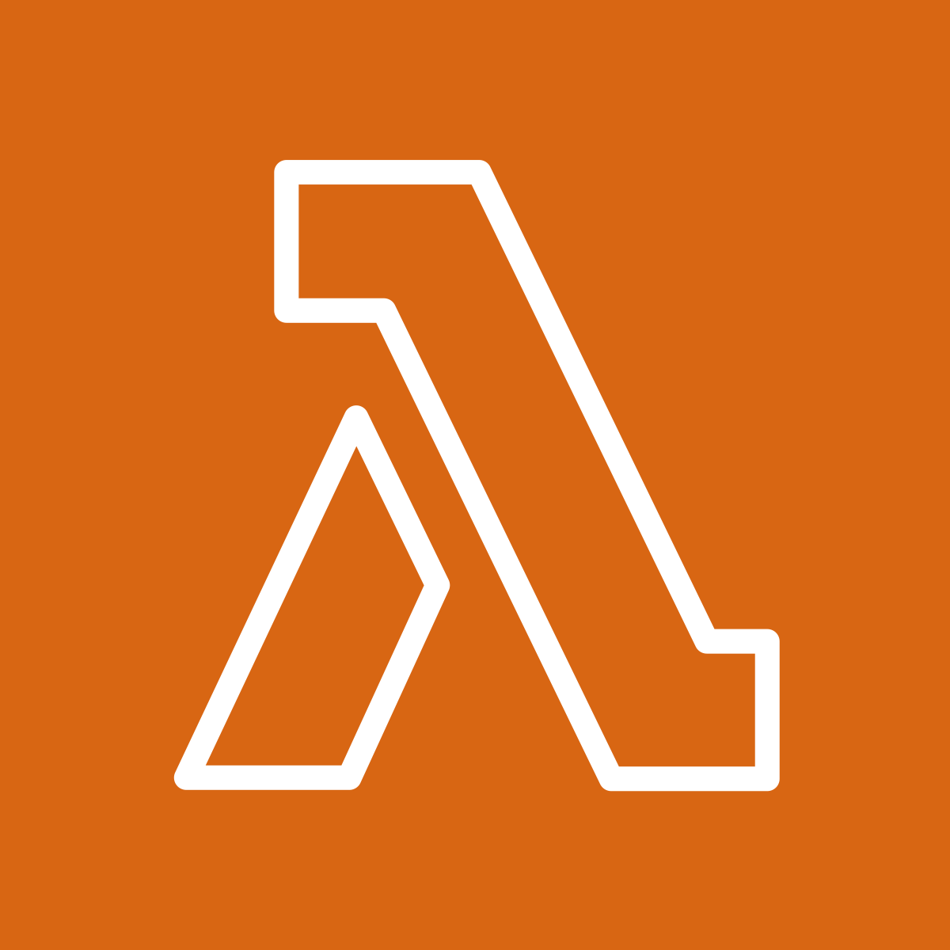



Hosting CONtainers
Some examples
Azure container instances
Azure Kubernetes service (AKS)
AWS Lambda
Google cloud run
OVH Kubernetes service
AWS Fargate

Slide 9

Risks
Data corruption
Service disruption
Bugs
Outage
Perf reduction

Slide 10
Risks mitigation
Data corruption
Service disruption
Bugs
Outage
Perf reduction
✅ Testing with prod-like data
✅ Rollback strategy
✅ Maintenance windows
✅ Testing at many levels
✅ Stress tests

Slide 11
Testing environments
Local, CI/CD
✅ unit/API tests
Deploy
Image
version n+1
Registry
dev
✅ smoke tests
Deploy
Deploy
✅ integration tests
qa
Deploy
✅ prod-like data
✅ stress tests
staging
Deploy
prod
✅ A/B tests
Best practices bible: https://12factor.net/dev-prod-parity
Step by step validation process
Early S-Curve

Slide 12
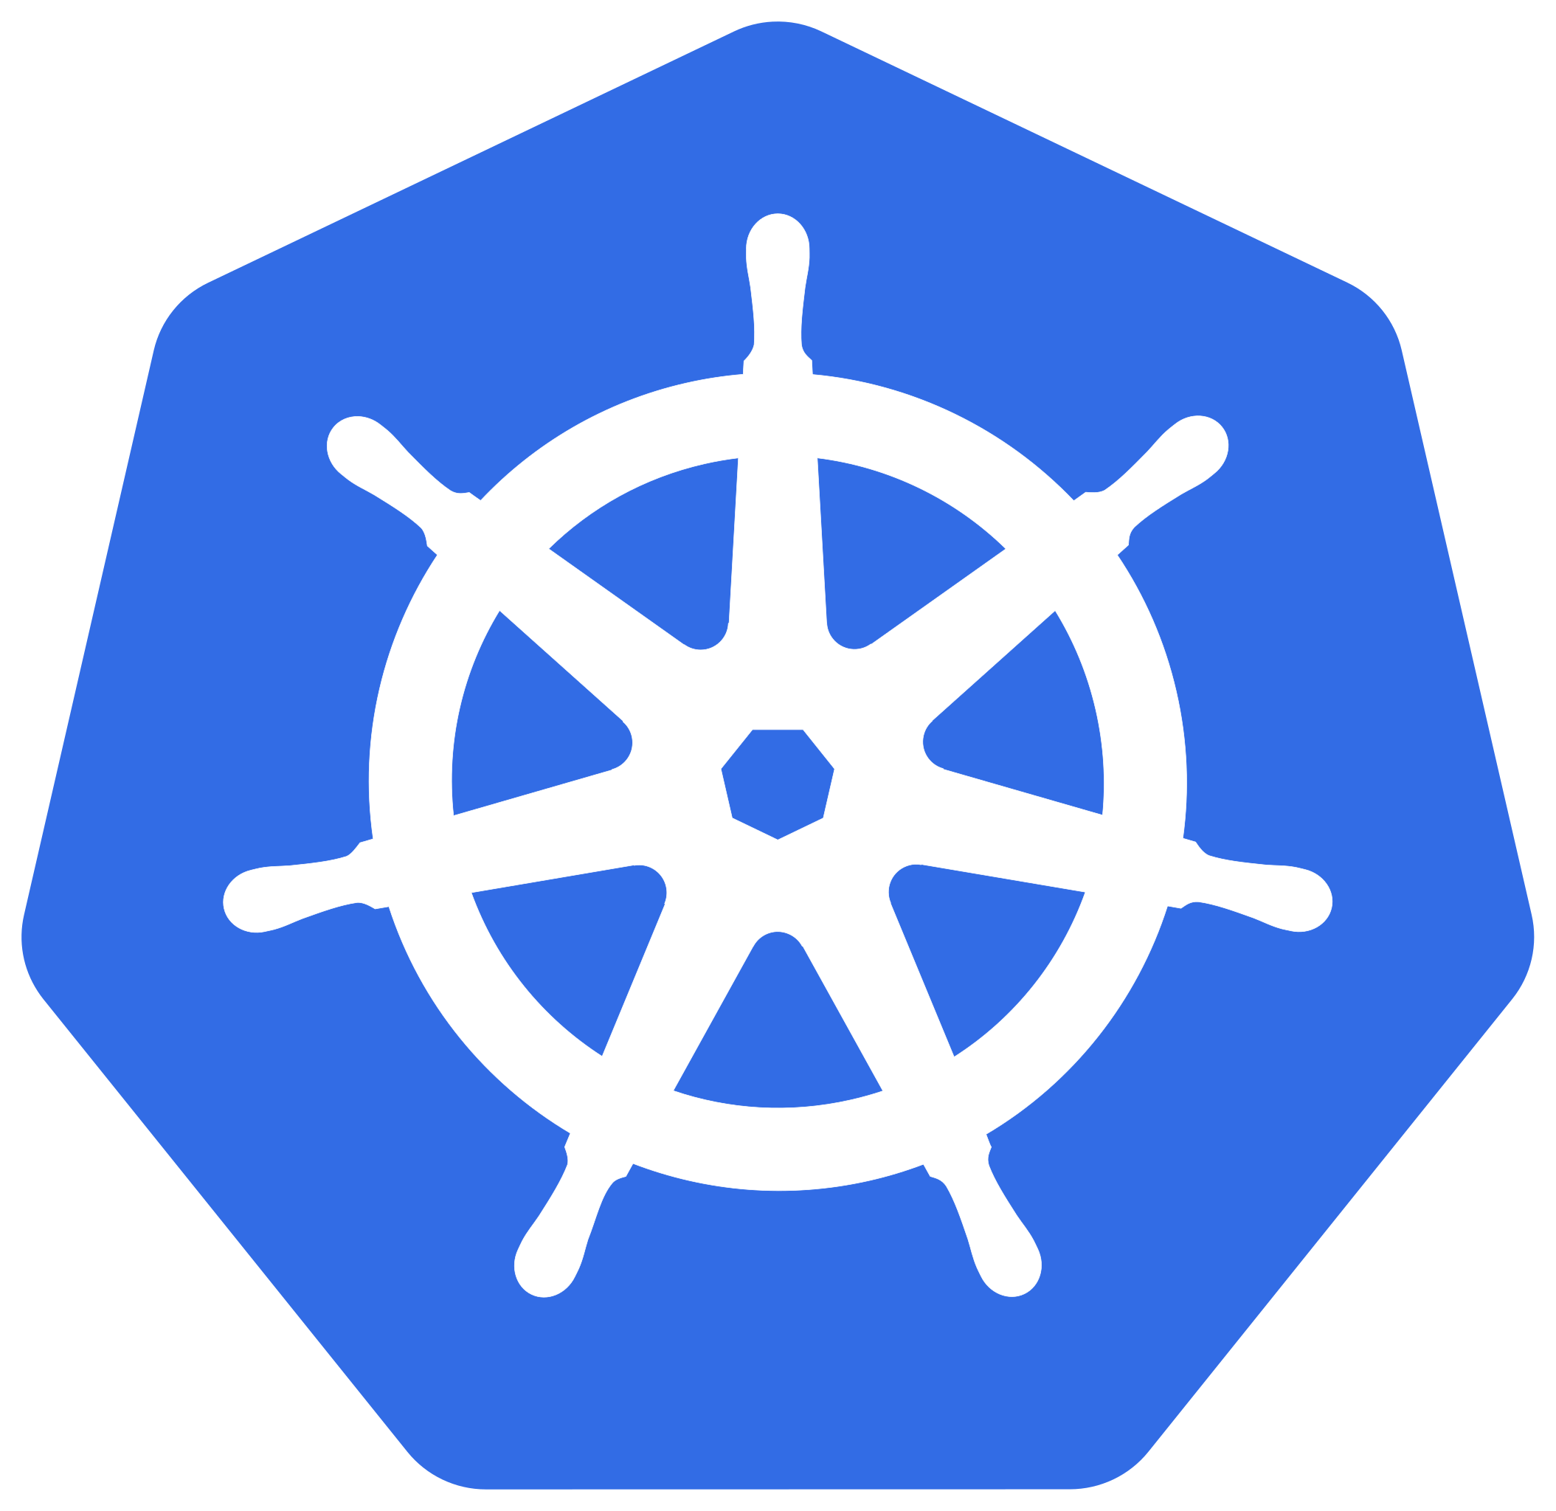

Deploying to an always-connected system
Env
Pushing the latest version, example of a K8S managed env
API Call
Manages the containers
kubectl apply
Config files
Push
The operator updates the versions
Container
version n+1

Slide 13


Deploying to a REMOTE system
Gitops paradigm: the environment pulls new versions
Env
API Call
Manages the containers
Git repo
Periodic Pull
The “gitops” repository
contains the versions
Container
version n+1

Slide 14
Deploying
Using gitops
Overview of Kubernetes
Live demo ✨

Slide 15
Next step: TP
Deploy locally the image delivered on ghcr.io

