Slide 1
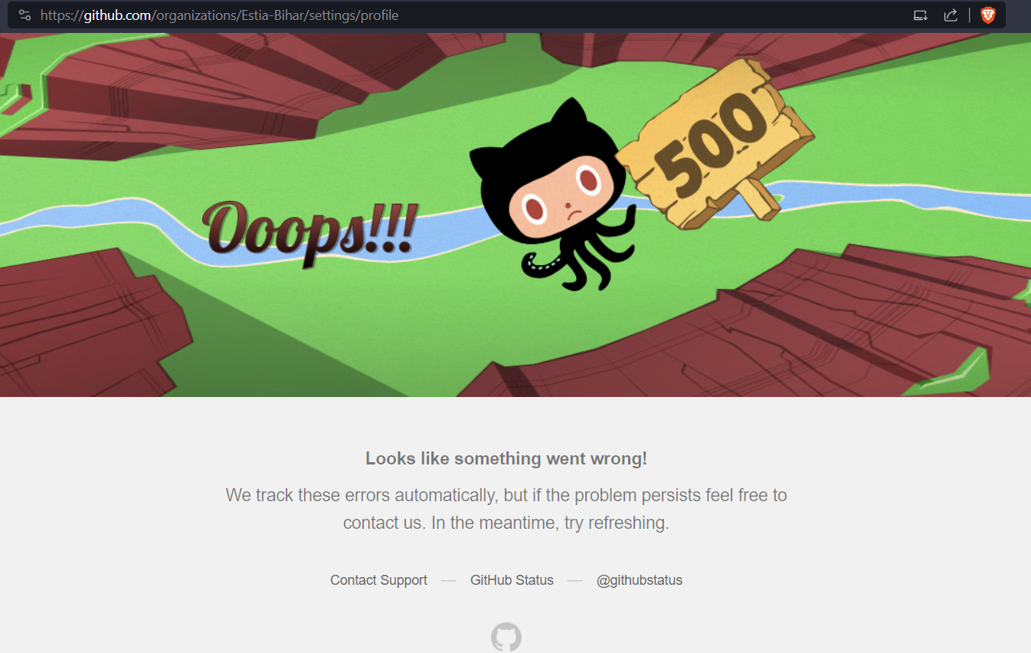
DEVOPS
Monitor & OPERATE

Slide 2

Overview
Understand what is happening with logging
Traceability with versioning
Metrics & SLA
24/7 incident response

Slide 3

Logging
It is about letting the program output what it is doing.
➡️ There is no debugger in production, there are some live loggers like Datadog
➡️ No one connects to the prod server to check the logs
Good practices
Do not generate too many or too few
Have the right log level (debug, info, warning, error)
Include the software version & timestamp inside
Structure the log (ex: using JSON format) for processing
Produce logs for cybersecurity events like an authentication

Slide 4
Traceability with versioning
What was the code like when a bug happened
Who versions the code state ?? ➡️ GIT
Using a git tag or commit id
Container
Features
CI/CD Versioning
Logs
The git tree
Pull requests
Tests reports

Slide 5
Semantic versioning
How to share valuable information via the software version ?
Tour on some well-known tools and https://semver.org
Live demo ✨

Slide 6


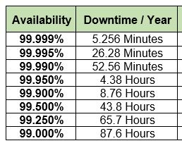
Metrics
Expose the technical & functional state of the application to analytic tools
Different to logs & complementary
Example of metrics:
Number of transactions (success / errors)
Peak response time
Hardware usage (CPU, RAM, disk)
Uptime (time when operational vs total time)
Prometheus

Slide 7
Example of metrics collection
What kind of real-world data do companies collect ?
Firefox public data report ✨
Privacy focus: amiunique.org ✨

Slide 8

24/7 Incident response
Organise an on-call roster with devops, managers, cloud engineers
Maintain a run book to document the Operation actions
ChatOps: use augmented features of the chat (like triggering an action after a special keyword)
Take actions: rollback, update the config, wait for the full team, recover data, ...
Do a Post-mortem review for continuous improvement: record time and actions.
Analyse the days after to improve the process

Slide 9
Next step: TP
Simulate some traffic on your app
Try to delete a cat
Add logs to understand what is going on
Implement the endpoint in a new version & deploy it
Verify it is fixed

