Slide 1
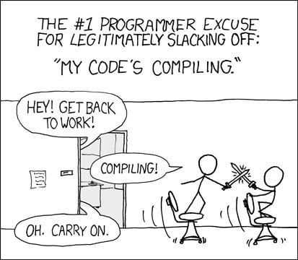
DEVOPS
Automate - CI/CD pipeline

Slide 2


Overview
The virtues of automation
GitHub workflows principles
Example of usage
TP: the CI/CD
Github actions

Slide 3


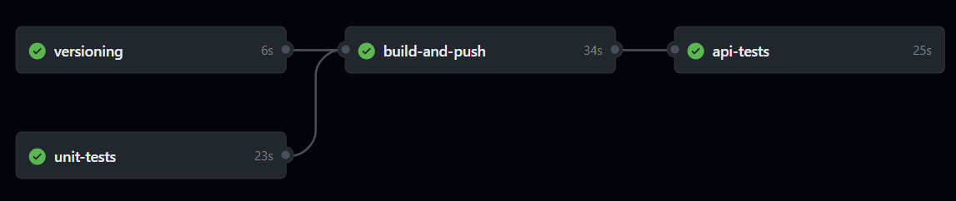
Automation
Go faster: do one action after another with no lag
  Pipelining of steps
Save dev time, let the runner do the repetitive work
No human errors
A source of documentation & knowledge sharing
  Shows the working build & tests commands
Github actions

Slide 4
Github Actions
https://docs.github.com/en/actions/learn-github-actions/understanding-github-actions
Jobs can run in parallel
Workflow
Job 1
Job 2
Steps / Actions are sequential
Step 1
Action 2
Action 1
Step 2
Step 3
Step 4

Slide 5
Github Actions example
Workflow => the main CI/CD
What do we want to do ?
  Build & publish the image
  Run the unit tests and API tests
  We need to put a version == the git commit id
Dependencies & parallelism
  Build needs version
  API tests need publish
  No build if the unit tests are not OK

Slide 6
Existing CI/CD skeleton
Live demo ✨

Slide 7
Next step: TP
Automate all the steps into a CI/CD pipeline powered with Github Actions
Versioning (done)
Unit tests
Docker build & push to ghcr.io
  Use predefined actions
API tests
  Use the commented-out service

