Slide 1
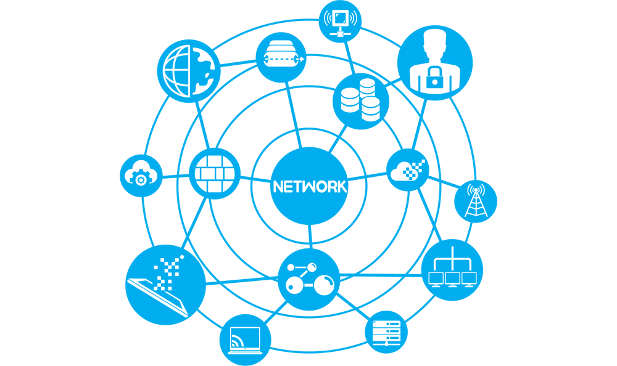
DEVOPS
Network concepts

Slide 2
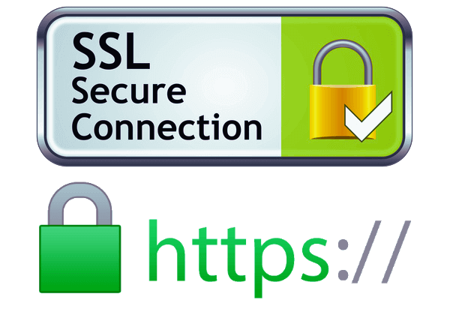

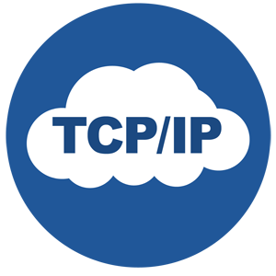

Overview
Network topology
What is an IP, masks, ranges, DNS
Focus on the certificates chain of trust
How does HTTPS work
Server authentication
Client authentication
Application: the reverse-proxy

Slide 3
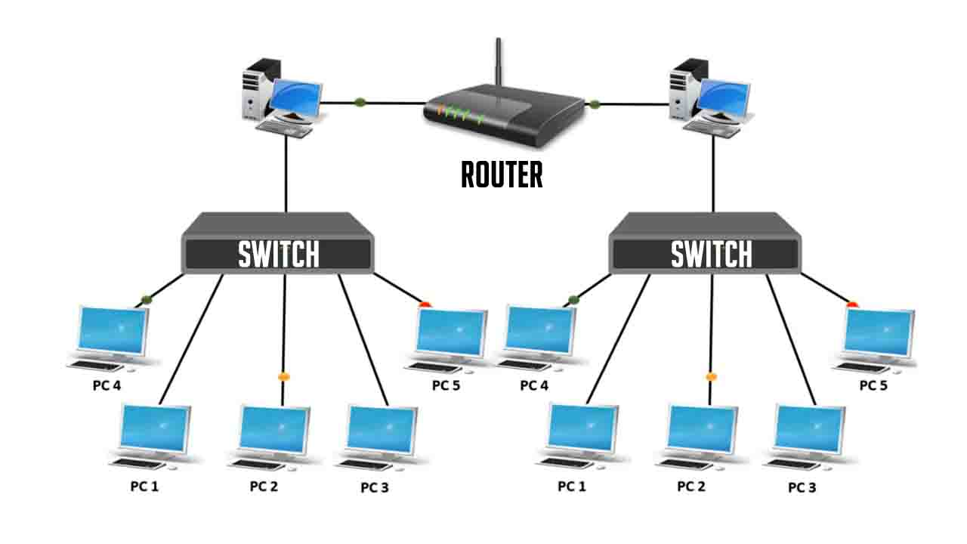
Topology
Networks are organized with routers and switches
Routers link together 2 networks (or more)
OSI level 3
Switchers link together devices in a same network
OSI level 2

Slide 4
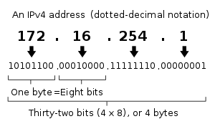
An IP is a number
➡️ It is the address to which
the switches will route the packets
How many possible IPv4 ?

Slide 5
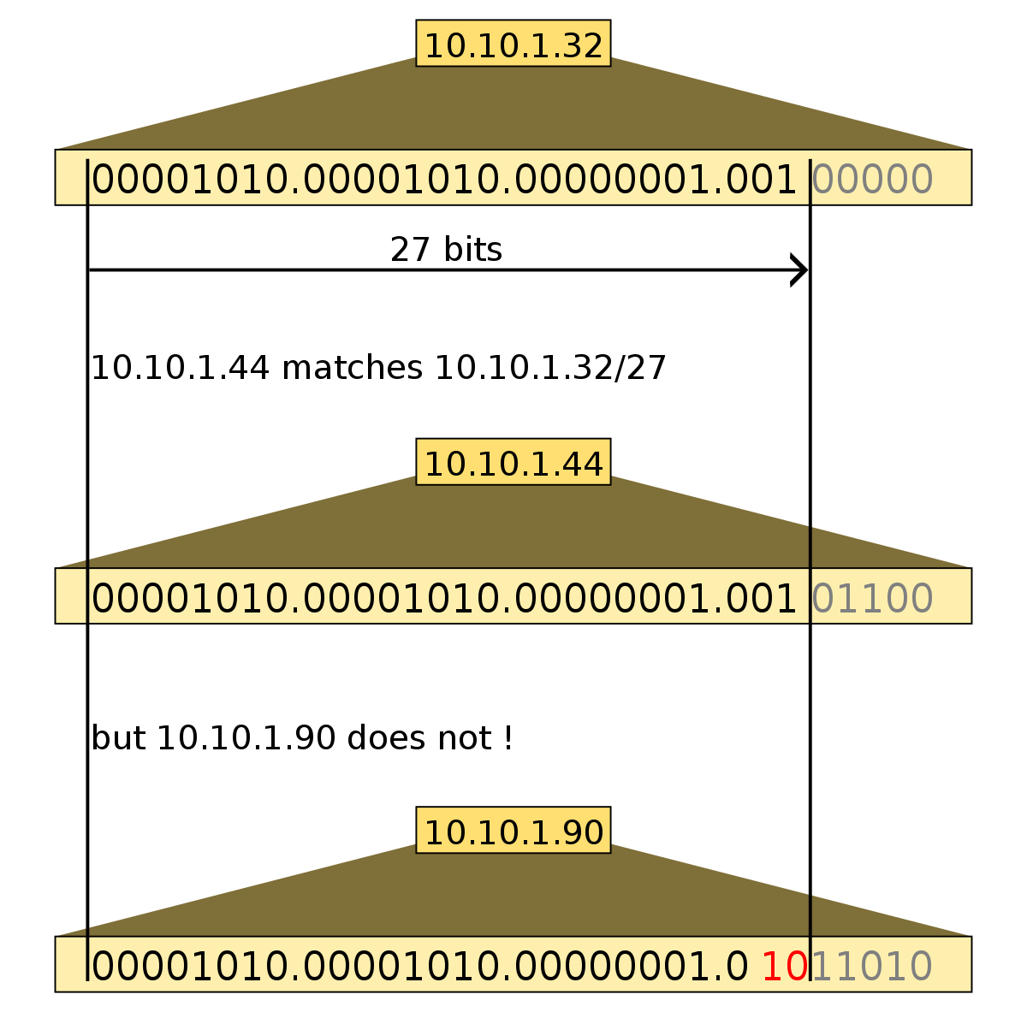
IP RANGES
Sequence of contiguous IPs
Usually sharing the same first bits
Used to create groups of devices
The mask represents the bits shared by the Ips range
The CIDR notation is a shorthand, counting the number of 1 in the mask

Slide 6
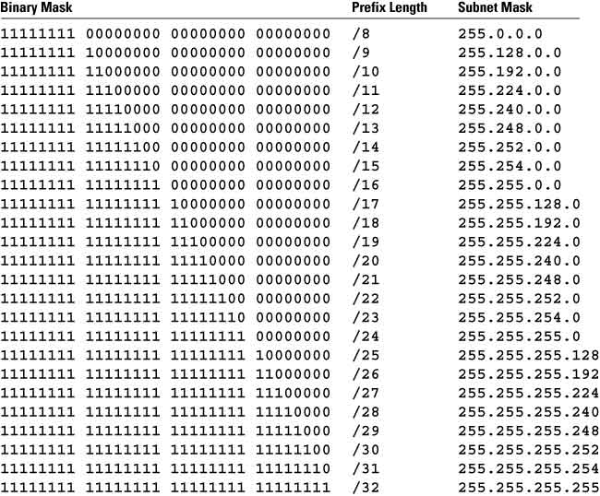
IP RANGES
Masks & CIDR example
Ex: 123.126.189.121/16
Mask: 255.255.0.0
Begin 123.126.0.0
End 123.126.255.255
Number of addresses ?

Slide 7
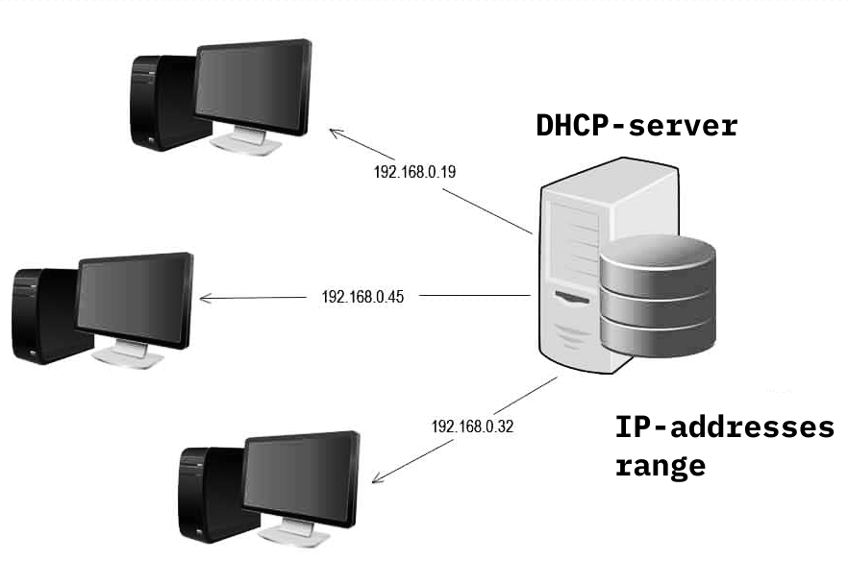
Who gives the Ips in the private networks ?
New clients broadcast their
MAC address
The DHCP server offers them an IP within the configured range

Slide 8
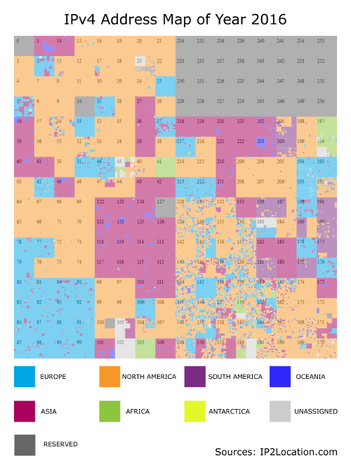
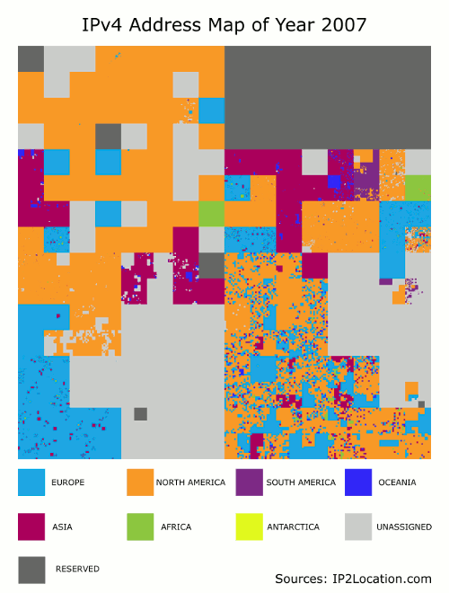
Who gives the PUBLIC Ips ?
ICANN / IANA maintains the public IP owners DB
Live demo ✨
https://www.nirsoft.net/countryip/fr_owner.html
➡️ IPv4 starvation & migration to IPv6

Slide 9
DNS resolution / Who USE the Ips ?
End users use domain names instead of IPs
Ex: go do a web search on 142.250.201.174
DNS servers maintain a cached DB of mapping IP <-> Domain

Slide 10


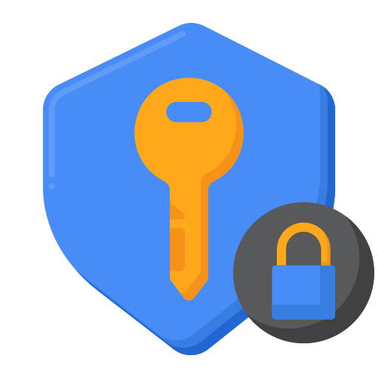

Chain of trust
Browser
TLS Certificates
Bunch of data, including an internet domain and a public key
that gets cryptographicaly signed by a private key
Trusts (3)
Trusts (0)
Server
Authority
Verifies & Signs (2)
Certificate (public)
Requests (1)
Private key
Site ownership data
Private key
Certificate (public)

Slide 11

HTTPS communication
Server authentication
Client
Server
(3) Verification
Trusted
Certificate Authorities
(1) Client Hello
(2) Server certificate
Certificate (public)
Private key
(4) Shared session key
(5) Encrypted data
exchange
(4) Shared session key

Slide 12
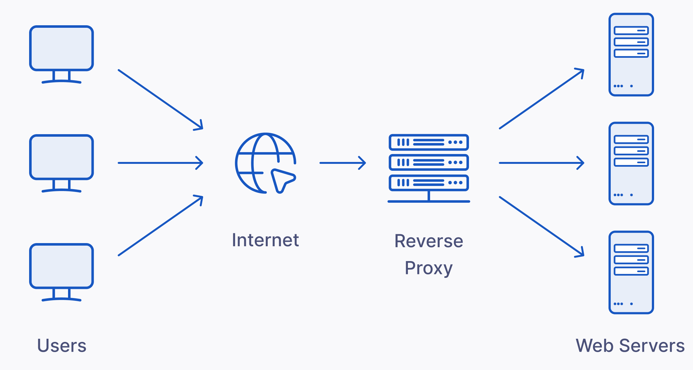


Reverse Proxy
Server that dispatches requests to other servers called backends
Act as a front door for:
Authentication (TLS / mTLS)
Logging requests
Load balancing
Hiding the complexity / internal topology
Caching
Can be implemented in Go, JS or ...

Slide 13
Reverse Proxy
Existing reverse-proxy overview
Live demo, datalab-services proxy✨

Slide 14
TP: Load balancing
Run a reverse proxy in local
Spin 2 instances of the app, listening on 2 different ports (backends)
Proxy the traffic reaching the reverse proxy to the first backend or to the second backend
Verify the requests are load-balanced:
in the backends logs
In the response (you may add a unique flag)
More info on https://github.com/estia-bihar/tp-reverse-proxy-correction

