Slide 1



Cloud Engineering
Dangers and pitfalLs

Slide 2



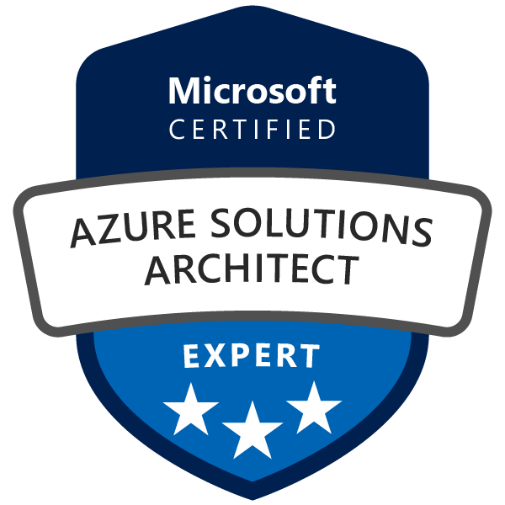
Danger : cloud provider adherence
The more provider-specific the solution,
the higher the cost to migrate to another
challenge the specific services used
stick to provider-agnostic solutions (like docker)
keep the architecture simple
keep standard interface between services (like REST API, opensource DB)
clean boundaries between domains, no shared resources (like a DB)
migration

Slide 3
Shared responsibility model
Divides security responsibilities between AWS and the customer.
AWS manages the security OF the cloud
(infrastructure, hardware, and software)
Customers are responsible for security IN the cloud
(their data, identity management, applications, and configurations)
source: https://aws.amazon.com/compliance/shared-responsibility-model

Slide 4
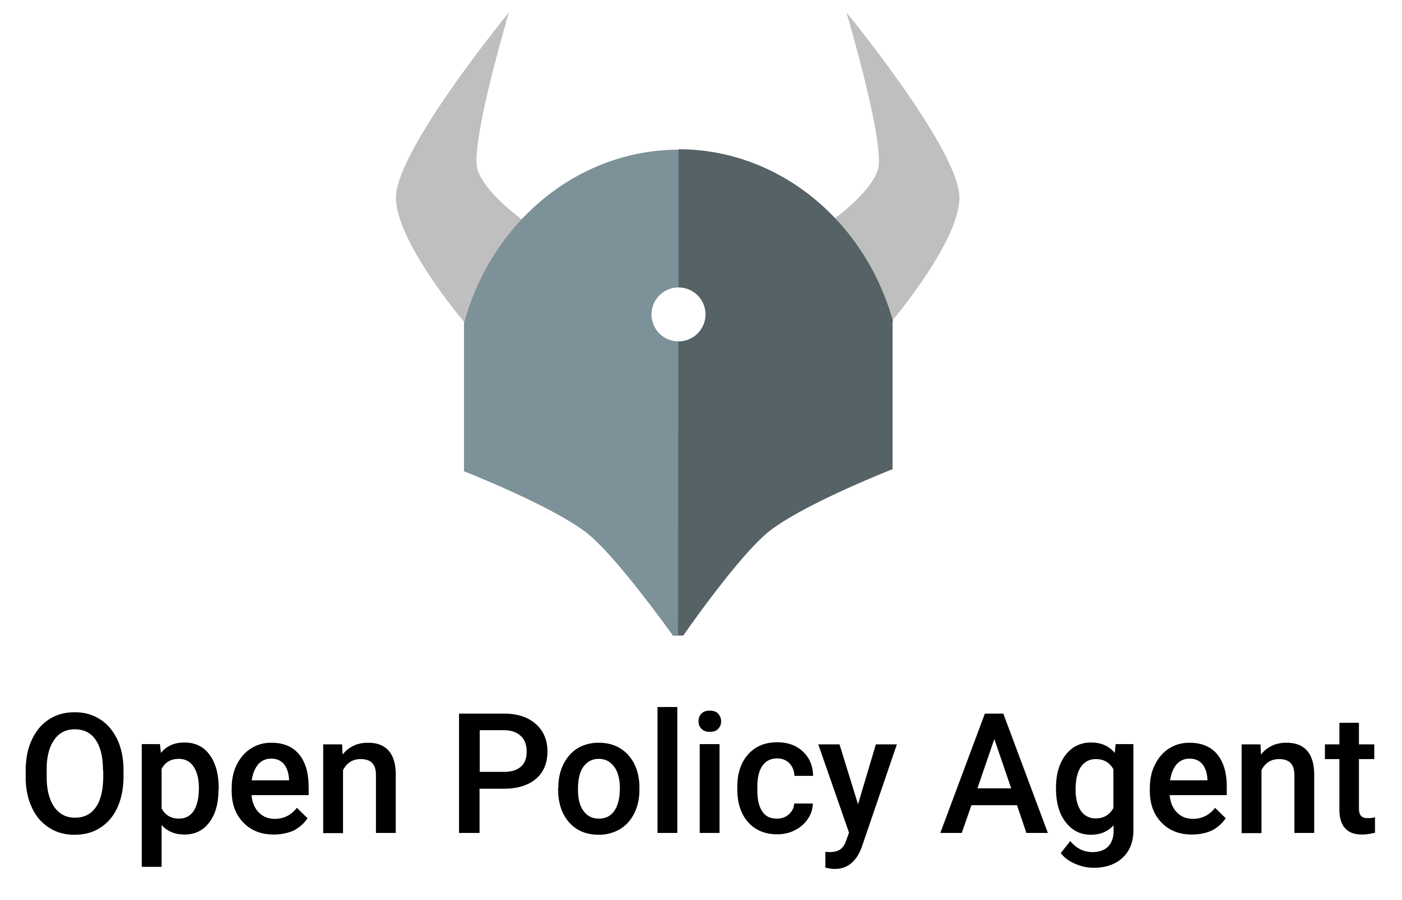
Danger : Security breach due to misconfiguration
Exposures: 80 % due to misconfiguration,
1 % due to software vulnerabilities (CVE) - thehackernews.com
Keep your infra configuration « as code »
  code review, traceability, revert
Use the security services
  to audit your setup
  to monitor the activity (logins, traffic, …)
Perform cybersecurity testing
Implement security policies
AWS Trusted Advisor
AWS Security Hub
source: https://aws.amazon.com/fr/security-hub

Slide 5
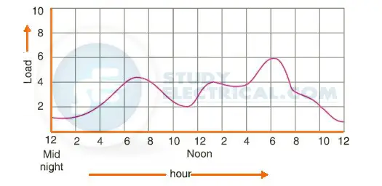
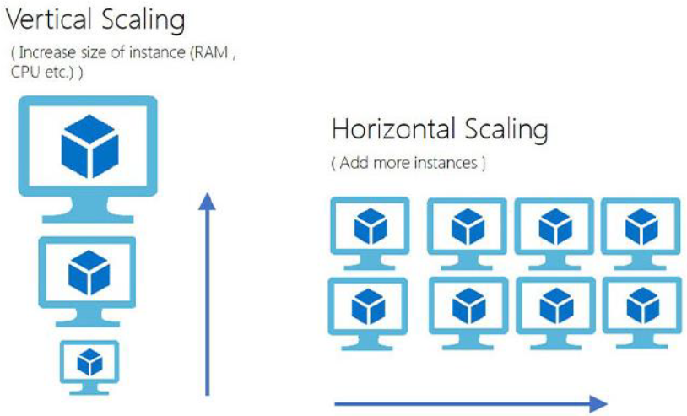
Scaling & elasticity
How to fit to a dynamic work load
Scaling issues because of variable load
Elasticity property = scale up & down as needed, pay for what you need
Example of AWS auto-scaling groups for VMs

Slide 6
Cloud billing – What is the pricing model
All depends on the service but in general:
Free tier (ex: free 10 000 requests per month)
Paying tier (ex: 1 cent per request)
Economies of scale (ex: 0.5 cent per request past 100 000)
Savings according to the commitment
and Service Level Agreement
Outgoing traffic (egress) is billed (€/GB)
 | The customer does not commit | The customer commits
The provider commits | Normal, On-demand instances | AWS Saving Plans Reserved instances (1 – 3 years)
The provider does not commit | Disruptable, AWS Spot Instances
Savings on VM prices

Slide 7
Danger : overbilling due to DDOS
Unexpected high bill after a Distributed Denial Of Service attack
source https://codestitch.app/news/netlify-charged-user-100k
Use the budget limit capabilities when available
Extra care about the pricing model
Monitor your expenses on a regular basis
For large teams, adopt finops principles

Slide 8
Danger : Data sovereiGnty
Cloud providers must obey their own country, CLOUD Act - congress.gov
Any US cloud provider must provide the data wherever it is stored
Any company operating in the US must comply
Choose your hosting carefully if sovereignty matters

Slide 9
Environmental footprint
Surface
  1ha – 10 ha per datacenter
Power
  Cloud compute is 4.1 times more efficient that on-prem (AWS)
  Global conso: 7.4 GW in 2023, a 55% increase from the 4.9 Gigawatts in 2022 (brightlio.com)
  Power Usage Effectiveness (total datacenter consumption / IT consumption): average 1.8 in Europe (infomaniak.com)
Cables
  Alcatel Submarine Networks installed 800 000 km
  NEC 400 000 km

