Slide 1

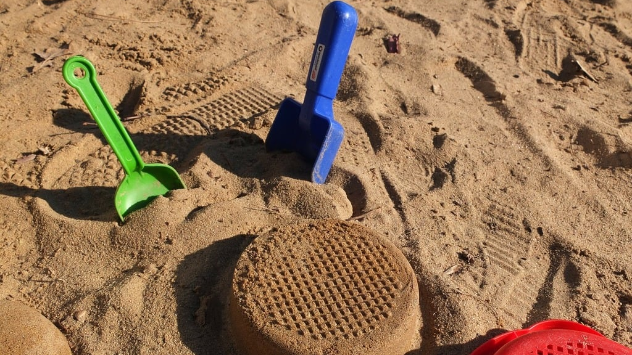
Cloud Engineering
Hands on
Basic resources and administration

Slide 2

Overview
Hands on the web UI
Monitoring the expenses
Creating and setting users
Creating resoures groups
Taggings
Infrastructure as Code setup

Slide 3
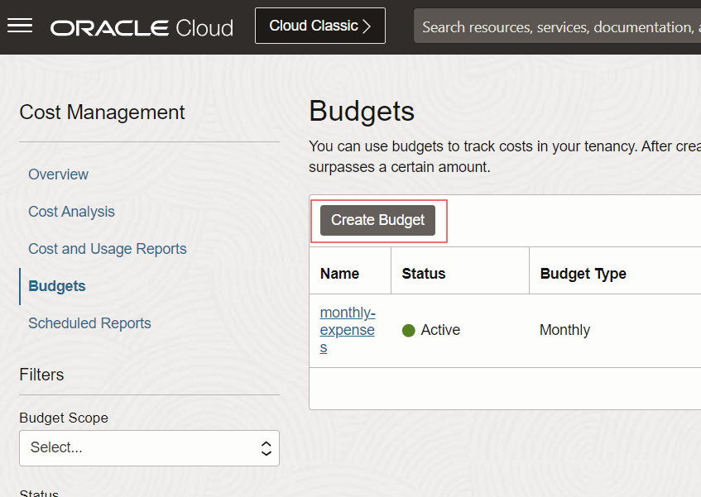
Setup a budget alert
From the top left hamburger menu
  Billing & Cost Management
  Budgets entry
OR From the search bar
  type budget
Create a budget alert
  monthly
  when the absolute spent amount is 20$
  send a mail to yourself
  add a tag (advanced options)
    key: created-by
    value: your name

Slide 4
Setup MFA on your root account
From the top left hamburger menu
  Identity & security
  domains
On the Left, select the root compartment
Select the default domain
  Check the MFA settings under security
  Check you user settings under users / your user

Slide 5
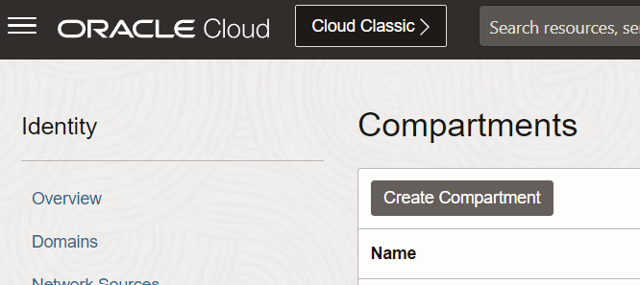
Create a resource group from the UI
From the top left hamburger menu
  Identity & security
  compartments
Create a new compartment
  parent: root compartment
  name: TP
  add a tag (advanced options)
    key: created-by
    value: your name
Create nested RGs (it is free)

Slide 6
Listing resource groups with the CLI
From the top bar, select
  developer tools
  cloud shell
This will launch a free terminal in the web UI with the oci cli installed
Start the command « oci iam » and browse the help/doc to get a list of compartments
Get it in a table format
Get only the fields name and id

Slide 7
Create & delete a resource group with the CLI
From the top bar, select
  developer tools
  cloud shell
This will launch a free terminal in the web UI with the oci cli installed
Start the command « oci iam » and browse the help/doc to create a compartments
Same operation with the deletion

Slide 8
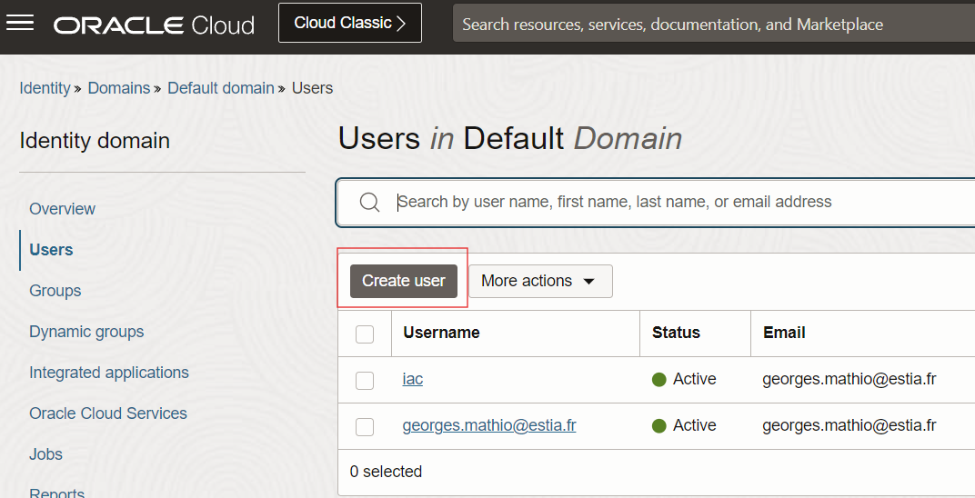
Create a USER for INfra As Code
From the identity default domain
Create a new user
  name: iac
  email: yours
  group: Administrators
Under API Keys, create a new one
  save the private key on your PC for login later
Check your email to activate the account

Slide 9
Infrastructure as code with pulumi
From the official website https://www.pulumi.com/docs/iac/download-install
Clone the template repo tp-cloud-iac-template
  It contains a pulumi project called tp already initialized
Create a pulumi stack representing a deployment environment
  pulumi stack choose <create a new stack>, call it dev.
  edit the new file Pulumi.dev.yaml to set the OCI connection parameters (see README for an example)
Login to your account
  create a file oci_api_key in the pulumi folder, chmod 400 oci_api_key for the correct rights
  pulumi login –local
    this will store the state locally in ~/.pulumi

Slide 10
pulumi basics
View the status of a given stack
  pulumi stack
  pulumi stack ls
  pulumi stack select dev
Only preview the creation of the initial resources
  pulumi preview
Preview and create resources (there is a first compartment code implemented)
  pulumi up
Check it in the web UI
Destroy it
  pulumi destroy

Slide 11
Update a compartment
In main.js create an object (key: string, value: string)
  add a key called « created-by » with value « pulumi »
  add a key called « environment » with the stack name
Set the compartment tags with it
Rename the compartment <env>-pulumi-tp
Type pulumi preview to check
commit & then apply the change with pulumi up
DOC https://www.pulumi.com/registry/packages/oci/api-docs/identity/compartment/#inputs

