Slide 1

Cloud Engineering
Computing resources

Slide 2

Overview
Tour of the computing resources
VMs
Containers
Functions
Variations of the cloud services: Anything AAS

Slide 3
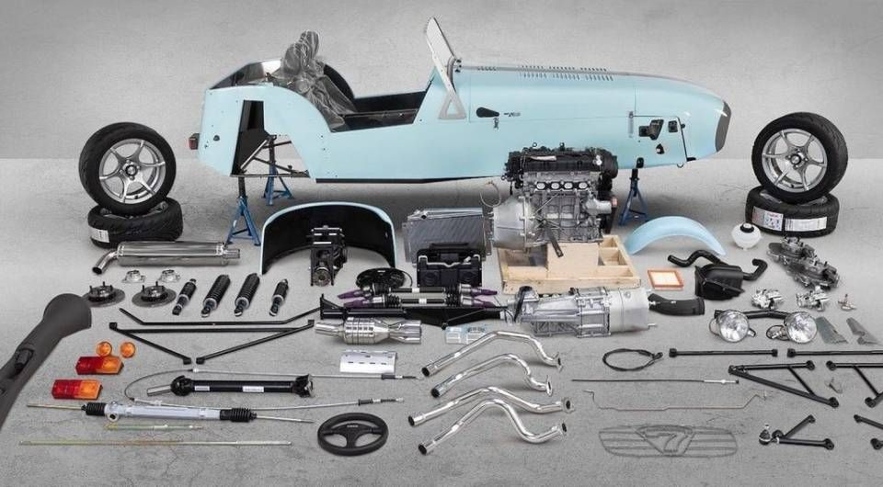
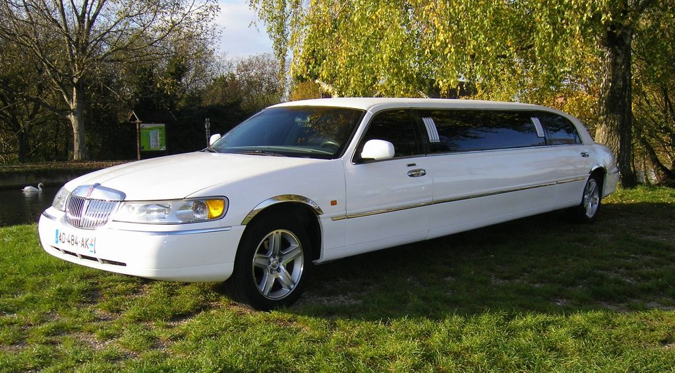
Anything AAS
You arrive in town and need transportation…
Do you build your own car or rent a limo with a driver ?

Slide 4
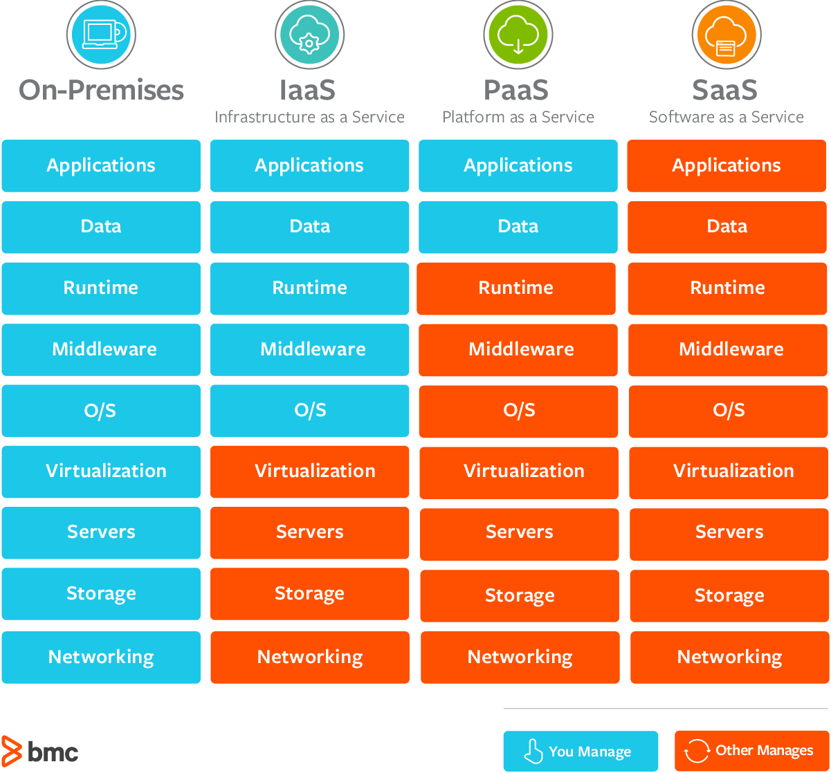
What are Compute resource
CPU time
On prem = Dedicated server, room, power supply, …
IAAS = VMs
  AWS EC2
  OVH VPS
PAAS = Container runtime (docker, k8s)
  Azure AKS, AWS EKS
  Az Container instances, AWS Fargate
FAAS = provide source code to be executed
  AWS Lambda
  OVH / Azure Functions
SAAS/Managed services = Turnkey services
  Managed DB, Webmails, online apps, games

Slide 5

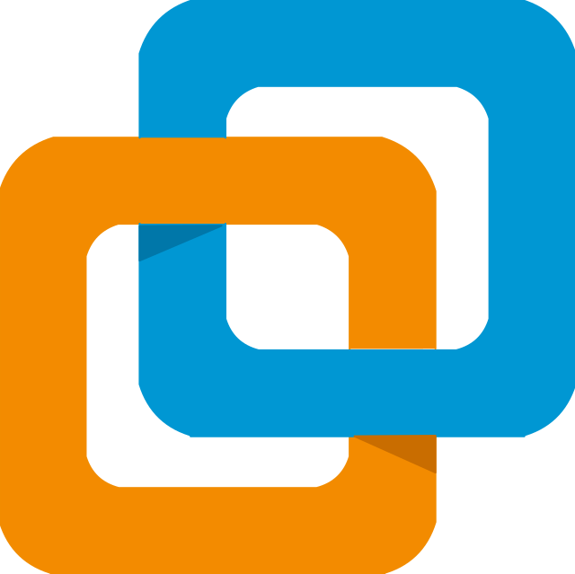
Infra
As
A
Service

Slide 6
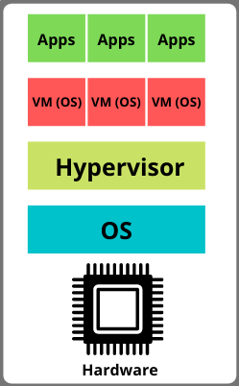
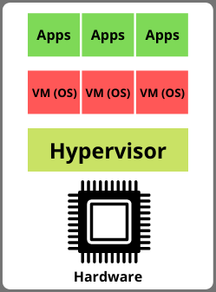
Virtual machines
You manage the VM OS and above
According to the Shared Responsibility Model
the provider is responsible about:
  Physical security
  Hardware & Hypervisor
  Network (provide an IP address)
The customer is responsible about:
  The OS updates
  all installed software within the VM
Type 1 hypervisor
=> cloud servers
Type 2 hypervisor
=> dev VM
Source: stackoverflow.com

Slide 7

How to work with a VM
Some technical info
OS
Image
Virtual machine image (Source: openstack.org)
  A virtual machine image is a single file which contains a virtual disk
  that has a bootable operating system installed on it
Cloud init script
  Launch custom commands to provision your VM at creation time
  Install packages, enable linux services, create secret keys
State
  The VM is connected to a virtual disk storing the filesystem
  AWS calls it Elastic Block Storage (like a network drive)
Network*
  An IP address is assigned to the virtual Network Interface Card (NIC)
  Can be public and/or private
CPU/GPU/NPU
+ RAM
cloud init
IP
FS volume

Slide 8
VM Pricing options
Tradeoff between customer commitment (paying upfront), provider commitment (SLA) and price
 | The customer does not commit | The customer commits
The provider commits | Normal, On-demand instances | AWS Saving Plans (1 – 3 years)
The provider does not commit | Disruptable, AWS Spot Instances

Slide 9
Scaling horizontally
VM Pool
Common Config
VM 1
Load Balancer
Observes metrics
for scaling
VM 2
VM 3

Slide 10



VM specificities by Cloud providerS
Name: Elastic Cloud Compute (EC2)
Free tier: 1 small VM for 1 year
Name: Azure VM
Free tier: 1 small VM for 1 year
Name: Compute Instances
Free tier: 2 small VMs, no time limit

Slide 11
VM creation and options
In oracle cloud
✨ Live demo
step by step setup

Slide 12
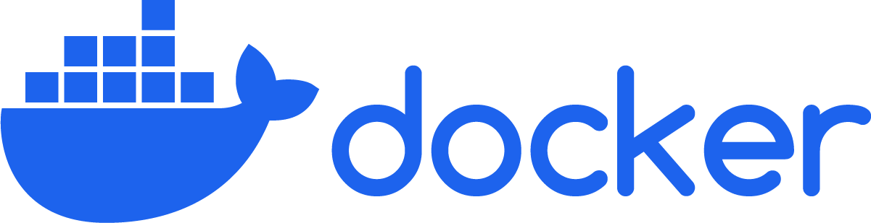
Platform
As
A
Service

Slide 13
Definitions & Analogies
Recall from Devops course
Source code
Program
Process
Build
Execute
Programs
Docker images
Dockerfile
Image
Container
Build
Execute

Slide 14

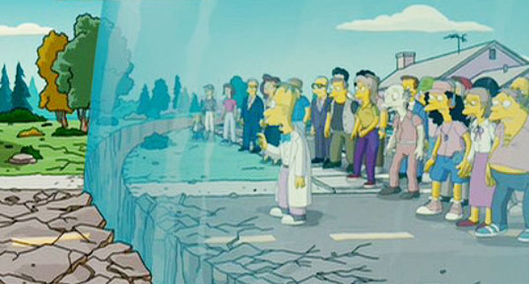
Isolation & security
Recall from Devops course

Slide 15
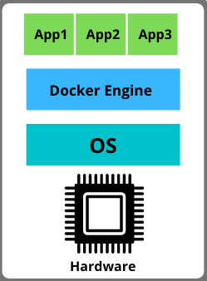
PAAS / Container runtimes
You manage only the dockerized app
Smaller footprint:
  Small size on disk
  Small bandwidth consumption for deployment
  Small CPU/RAM usage
Less responsibility for the customer:
  The provider manages the OS and Docker version
Less control / state
  Containers are volatile and not intended to
  retain their state for long
  Microservice architecture
Minimal adherence to the cloud provider
  Works in any cloud
  Works the same in local
Type 1 hypervisor
=> VM
Container runtime
Source: stackoverflow.com

Slide 16

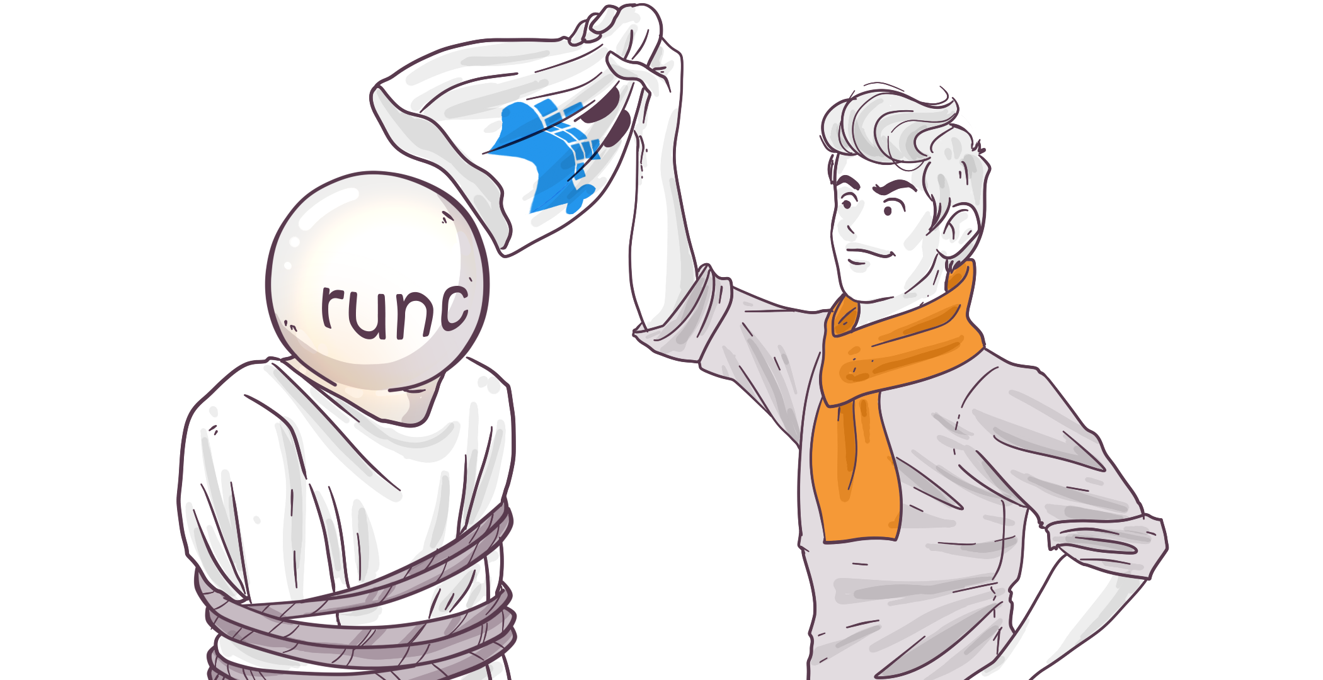
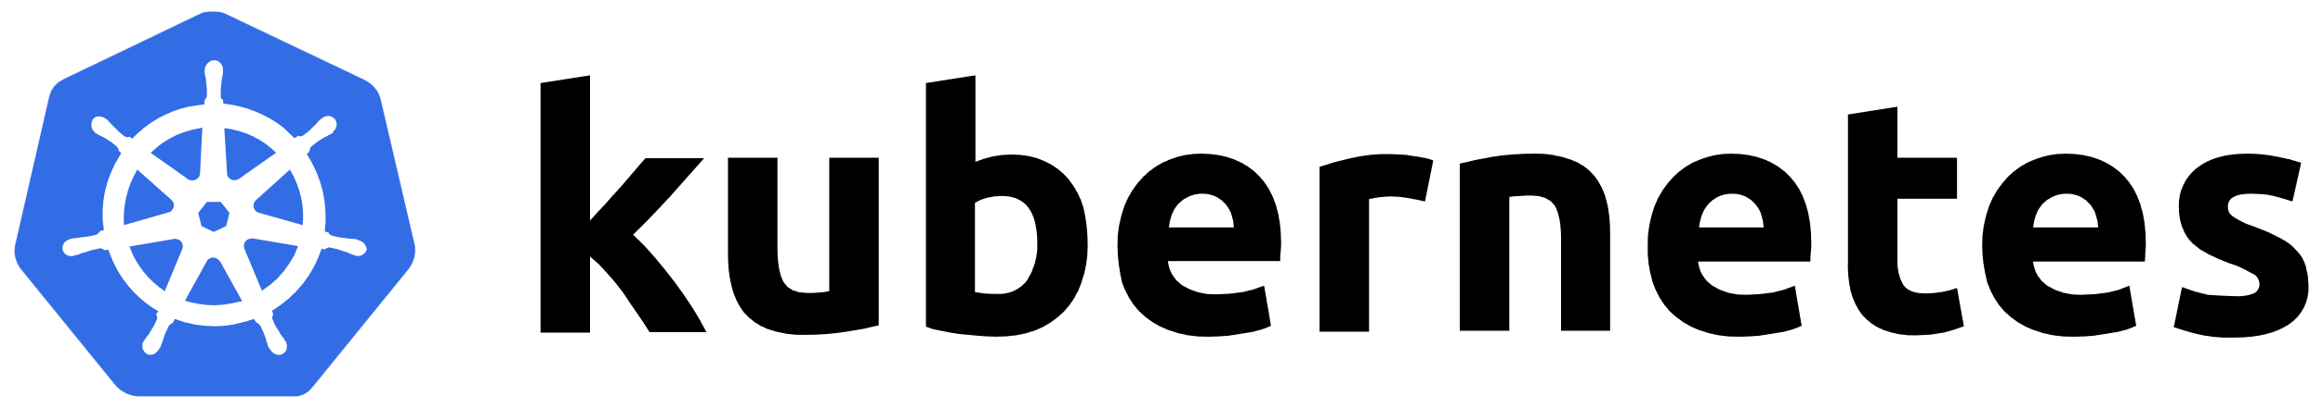

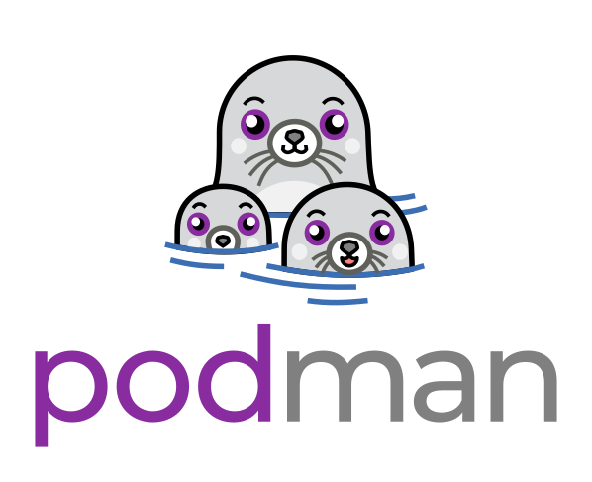


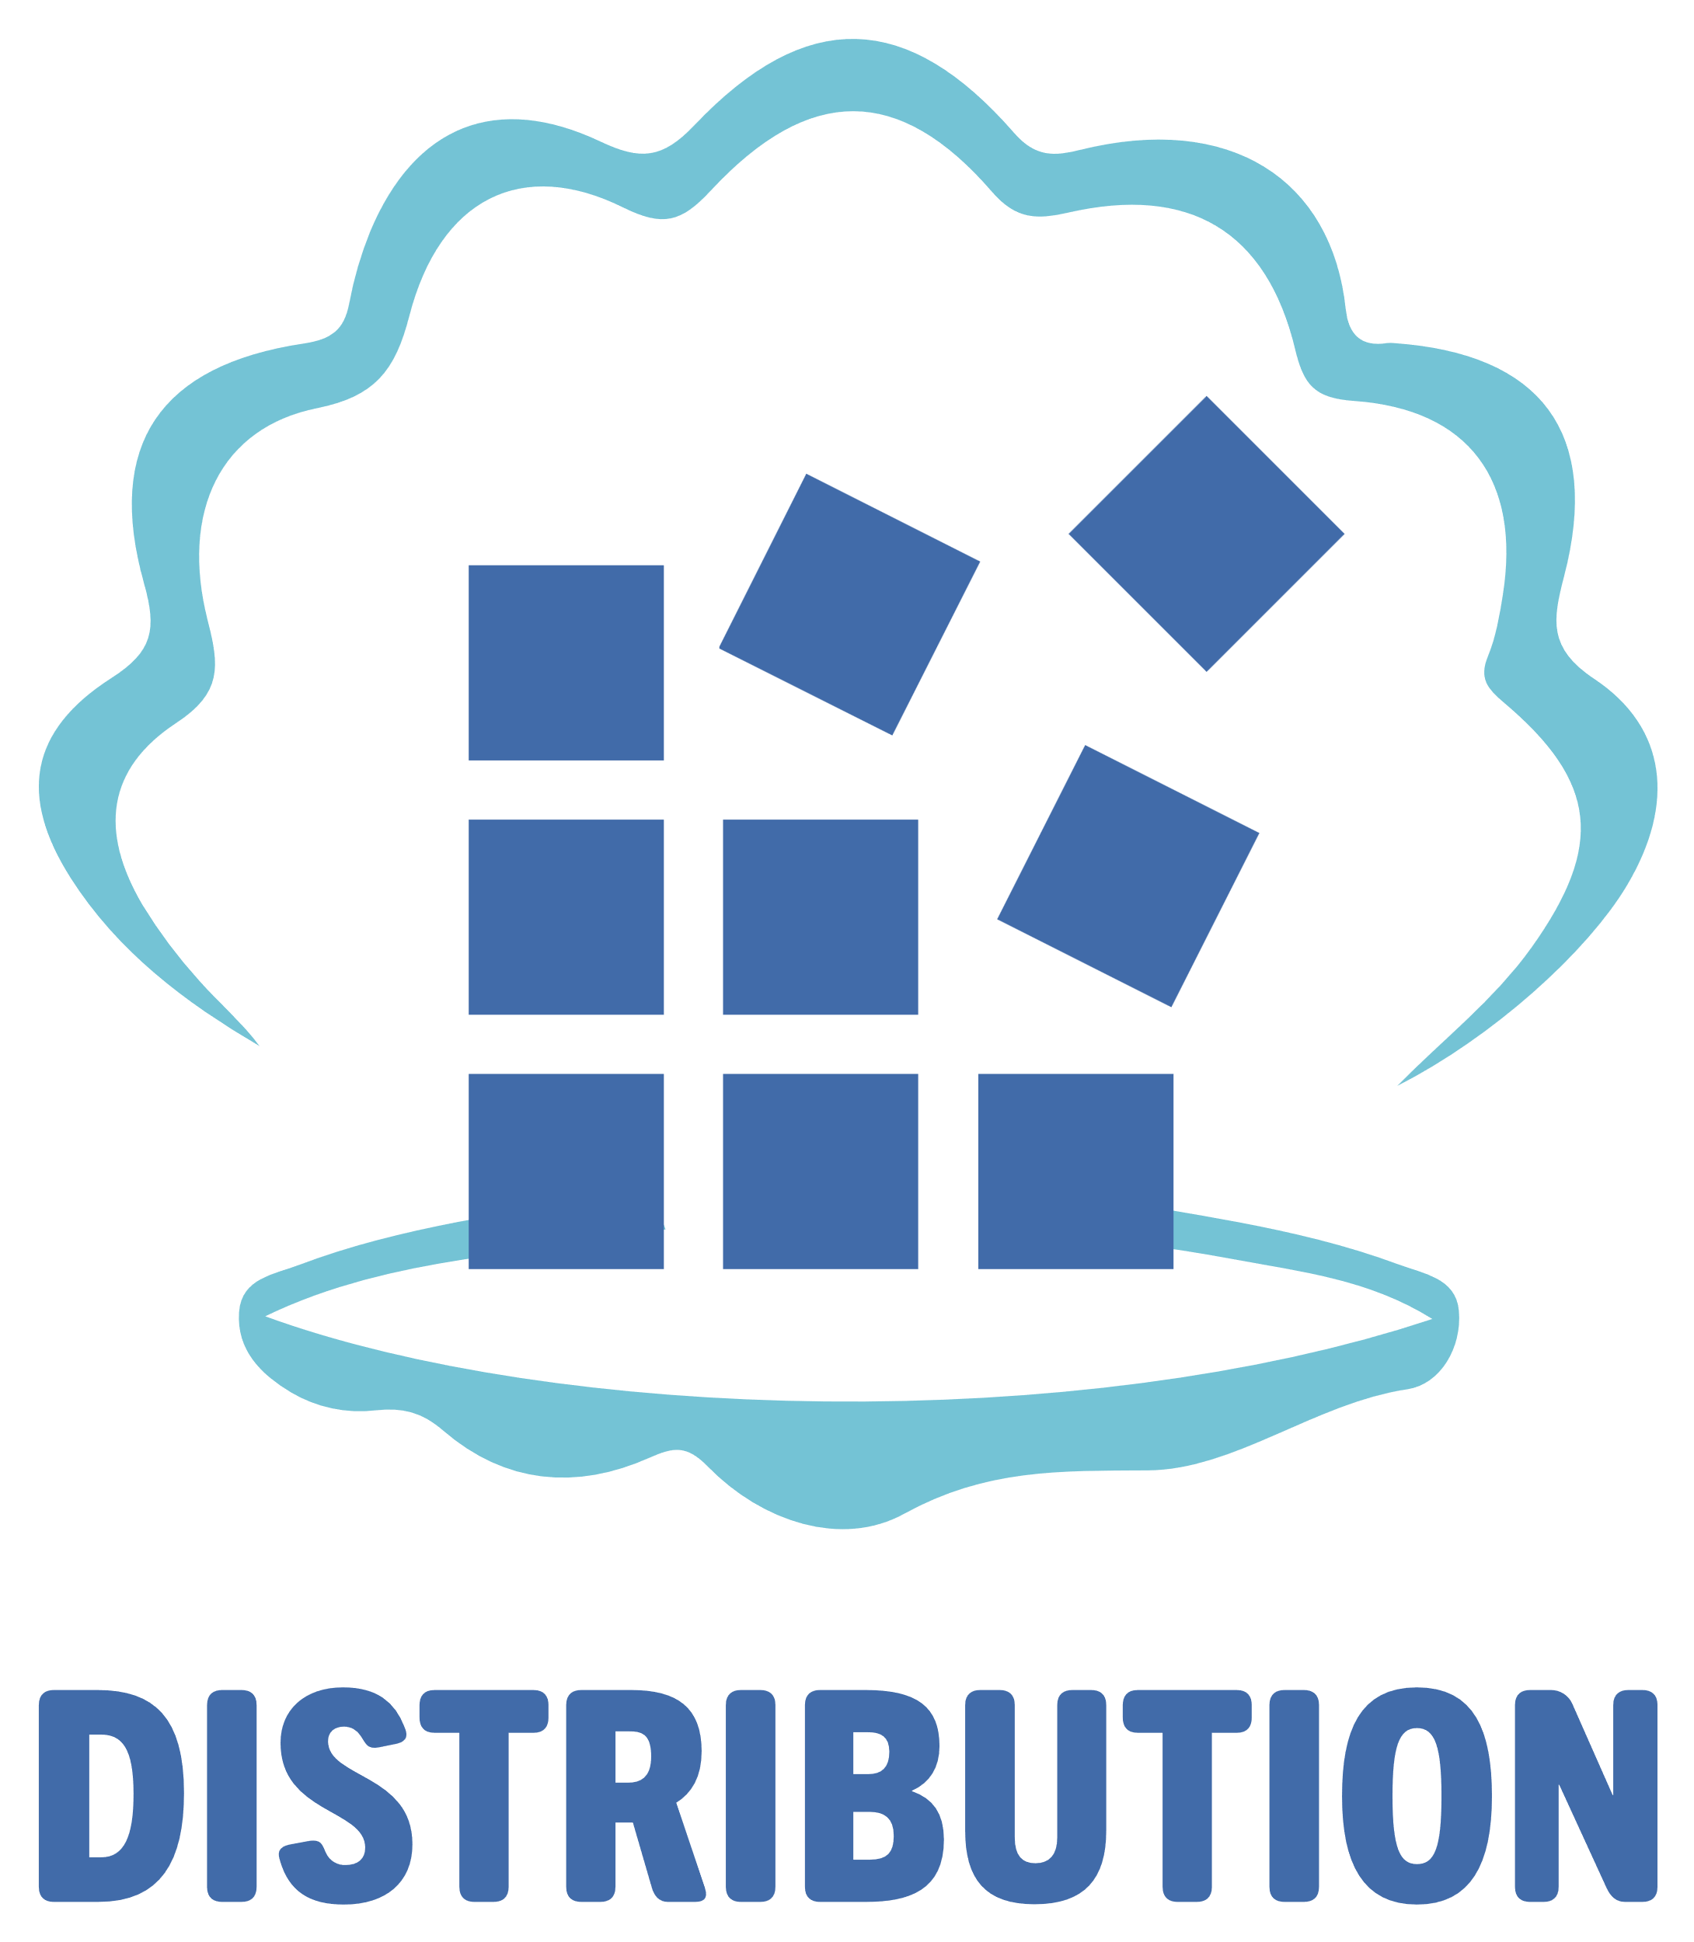

PAAS: There is more than only docker
Other container runtimes
Owns the specifications of:
container
image
registry
The core of docker run:
Notable software
container
image
registry

Slide 17
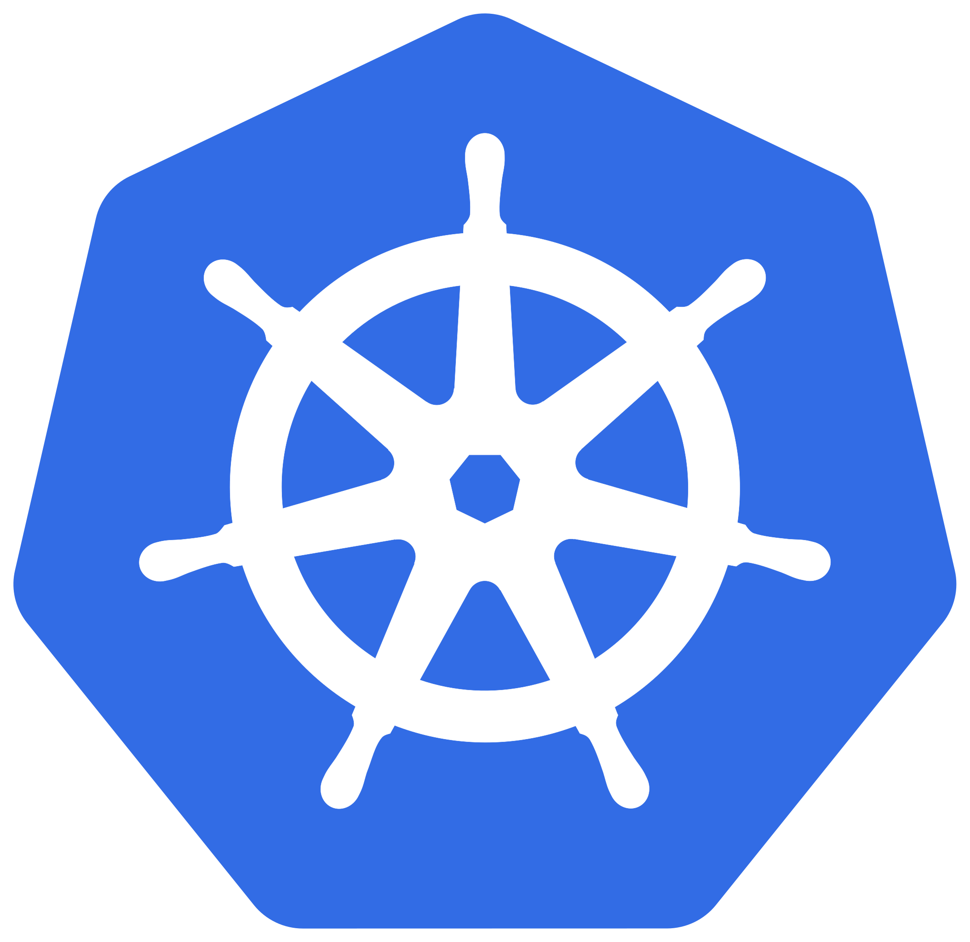
PAAS / Container runtimes / Kubernetes
Ze orchestrator
An abstraction for distributed compute machines (cluster / nodes)
Powerful to manage complex usecases requiring redundancy of the nodes (HA)
Will run containers (PODs) on the right machines (nodes)
Will route the network traffic to the right pod
Supports app configuration & secrets management
All based on declarative YAML configuration files
Resources:
  Official tutorial
  Kubernetes by example
  Official documentation, must read: https://kubernetes.io/docs/concepts/workloads/pods

Slide 18
Main resources organisation
Many points of view…
Placing apps on the hardware
Node
hardware
Deployment
placement, replication
POD
contains the process
Connecting apps to the network
Ingress (Rules + Controller)
routing requests
Service
load balancing
POD
contains the process

Slide 19
Kubernetes config overview
✨ Overview of a simple Kubernetes config

Slide 20

Real world usage with HELM
Packaging K8S resources
Kubernetes resources of a real world application can take 1000+ lines
and have redundant config (like port number to listen / call)
They are packaged together and distributed with HELM
this is called a helm chart
Generic config + specific variables using Golang templating language
✨ Overview of a chart from Helm examples

Slide 21
Container RUNTIME specificities by Cloud providerS
Fargate: manages containerized apps
Elastic Kubernetes Service: managed Kubernetes
Azure Web Apps: manages containerized apps
Azure Kubernetes Service: managed Kubernetes
OCI Kubernetes Engine: managed Kubernetes

Slide 22

Function
As
A
Service

Slide 23
Side note about Serverless
No VM/OS to manage
A cloud service that does not require the user to setup a VM to make it run.
  There is a server but it is managed by the provider
  Good for small to medium usage, higher billing price than a VM
Usecases
  I do not need that much level of control and prefer to focus on my app
    Azure Web App service, select the docker image of a server and have it listening on a public URL
    AWS Lambdas let you execute source code without provisioning any resource
  I only use the APIs of the cloud service (like a database)
    AWS Aurora DB, select the DB stack (Postgres, …) and start sending SQL requests to it

Slide 24
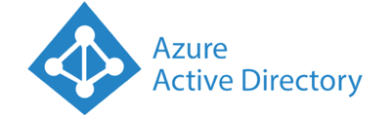
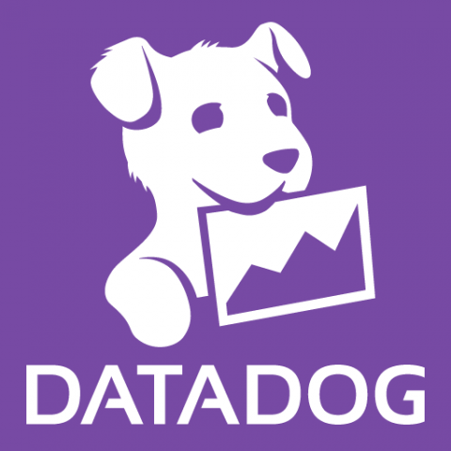

Managed services ans SAAS
Turnkey solutions
✅ Serverless
Managed service = a whole standalone working bloc of your cloud
  The pricing can be by volume of transactions/compute/storage
  Ex: Datadog, the log aggregator and monitoring service
SAAS = a specific 3rd party application accessible via the web,
not tightly integrated to your cloud
  The pricing can be by user or by plan (free, business, premium)
  Ex: Github, Gmail, Jira

Slide 25
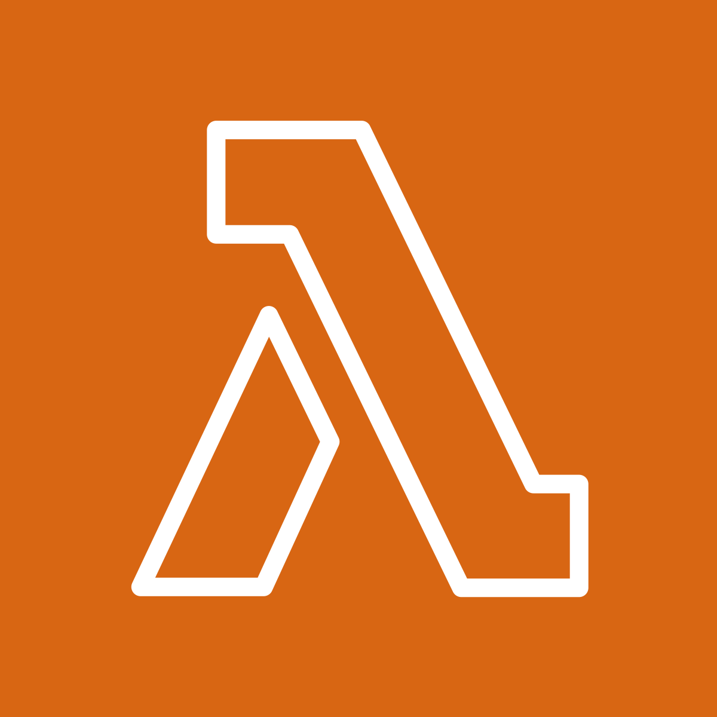
Function As A Service
Provide source code to be executed
A runtime engine like node, python, go run, … to execute code
Linked to other cloud resources and to the triggering event data
Usecases
  Execute a simple callback after receiving an HTTP request on your API Gateway
  Execute a script to transform an event and insert data into a DB
FN project,
opensource engine
AWS Lambda

Slide 26
FAAS Demo
Using python
✨ Live demo
OCI Functions

