Slide 1
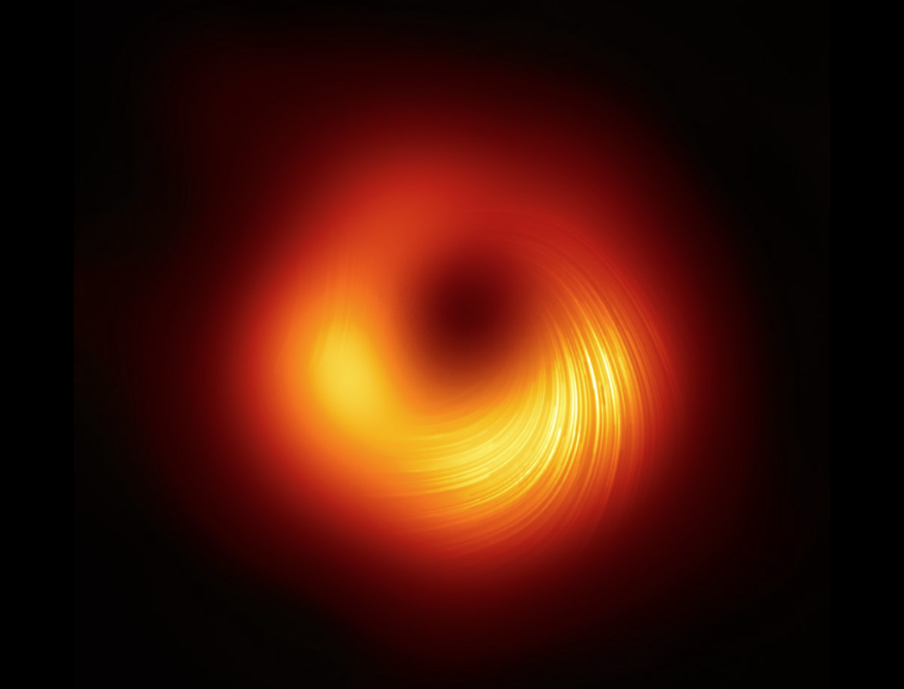
Cloud Engineering
Storage resources
It took 5 petabytes of raw data to generate the first direct image of the black hole M87* in 2021 - NASA

Slide 2

Overview
VMs Disks
Network storage
Blob storage - S3
Databases
Archiving (hot / cold)
Security storage : Vaults
Edge compute & storage

Slide 3
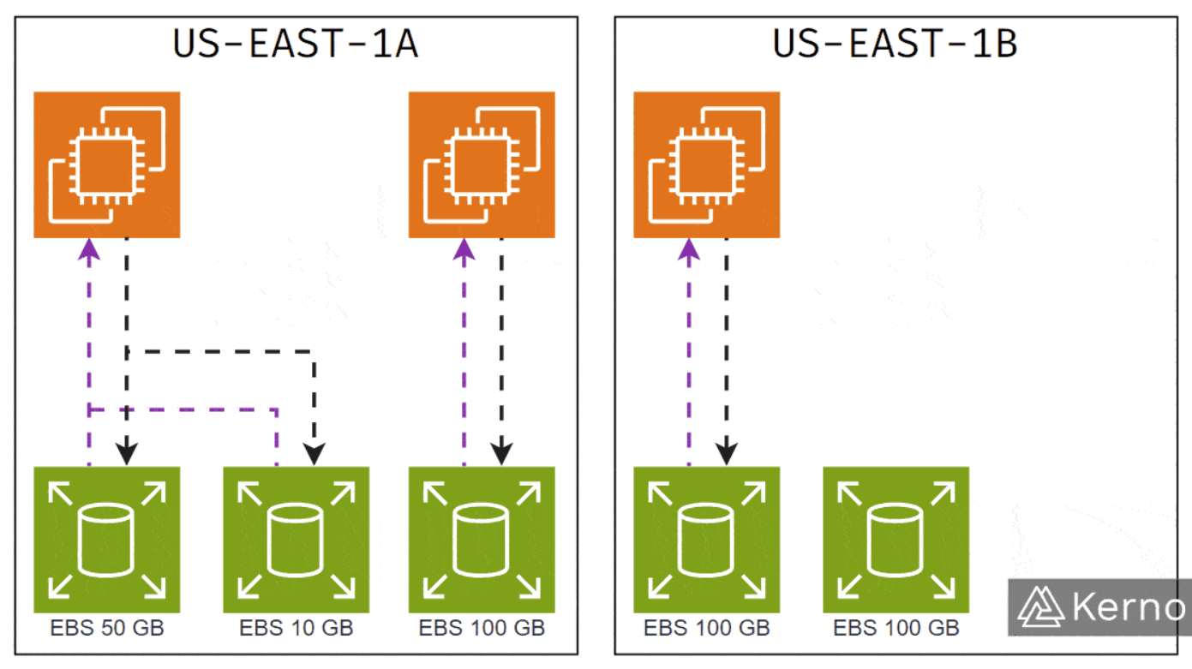
VM’s Local virtual disk
Similar to a physical disk
The disk (block storage) carrying the VM’s
Root File System and local files
Intended for access by a single VM
Backup (snapshot) into long term storage
Azure equivalent is « Azure Managed Disks »
AWS Elastic Block Storage (EBS)
Ref: https://learn.microsoft.com/en-us/azure/architecture/aws-professional/storage

Slide 4
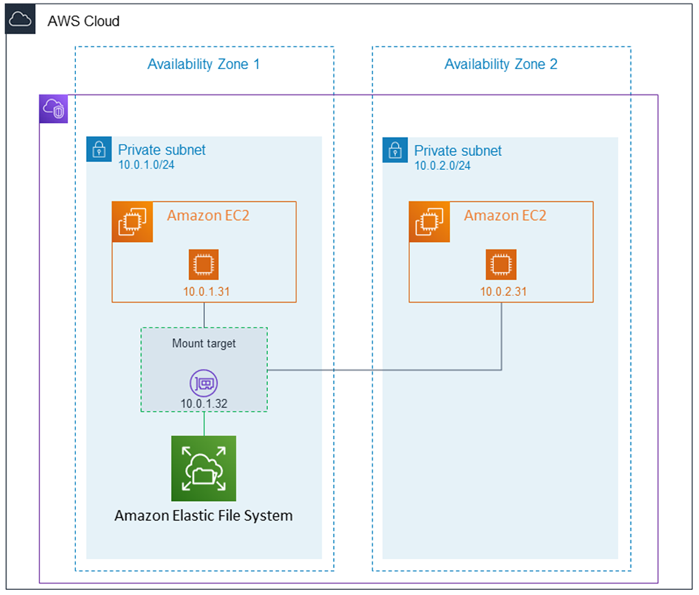
Network File System
Similar to a Samba or NFS
File storage meant for use as shared storage for many VMs.
Can be mounted by on-prem PCs
Azure equivalent is « Azure Files »
AWS Elastic File System (EFS)

Slide 5
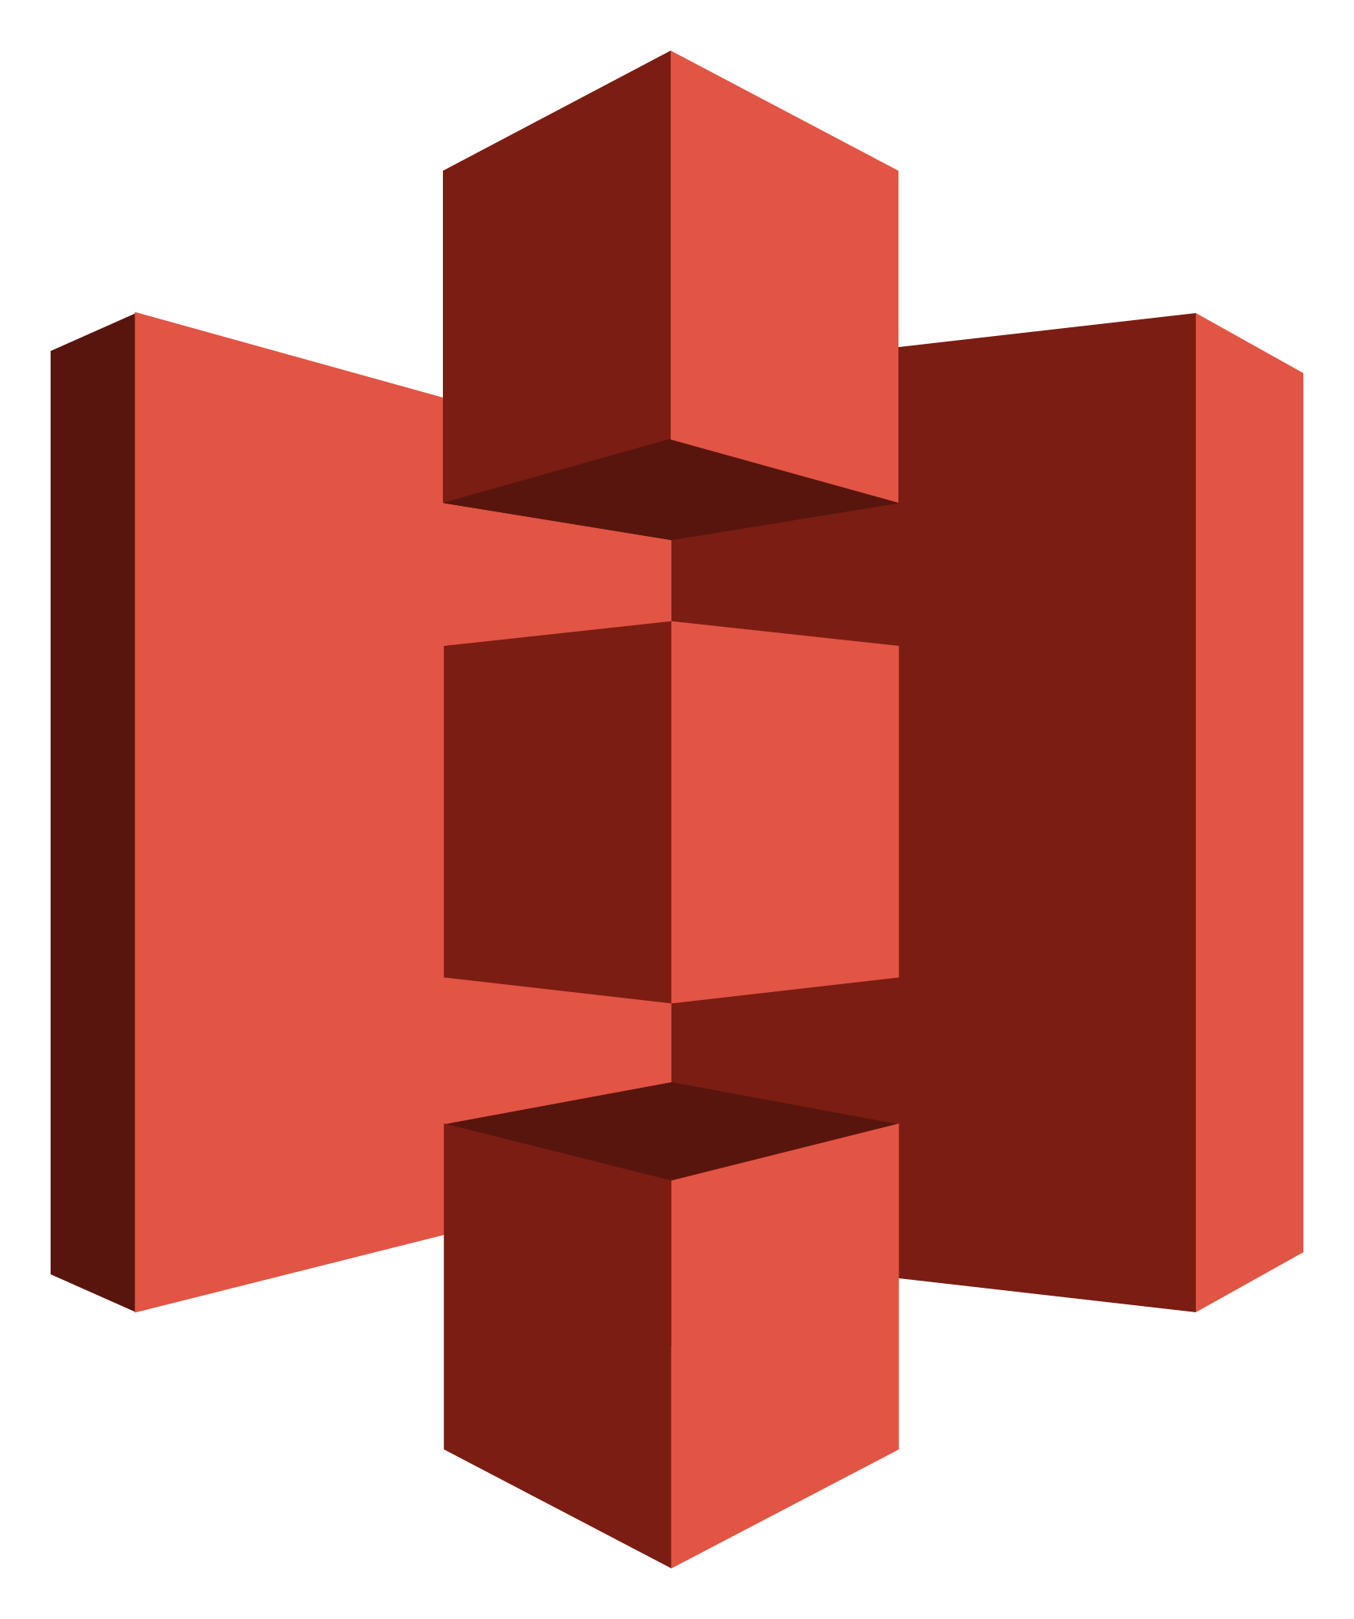
Simple Storage Service : S3
Serverless object storage
Bucket ➡️ directory, globally unique, per region
Object ➡️ file
the data is accessed through an HTTP API
  GET https://my-unique-bucket.s3.eu-west-1.amazonaws.com/photos/puppy.jpg
  bucket name region object key
  SDK & CLI often use s3://my-unique-bucket/photos/puppy.jpg
can easily serve a static website (index.html + assets, no server code)
built-in versioning (modification history, deletion)
Azure equivalent is « Blob Storage »
Ref: https://docs.aws.amazon.com/AmazonS3/latest/userguide/UsingBucket.html

Slide 6
Pricing TIERS
€€€
Archive
« Tape »
Cold
Cool
Hot
Latency
backups
logs
CDN
Ref: https://azure.microsoft.com/en-us/pricing/details/storage/blobs/#pricing

Slide 7
Simple Storage Service : S3
In oracle cloud
✨ Live demo
using S3 to host a static site

Slide 8

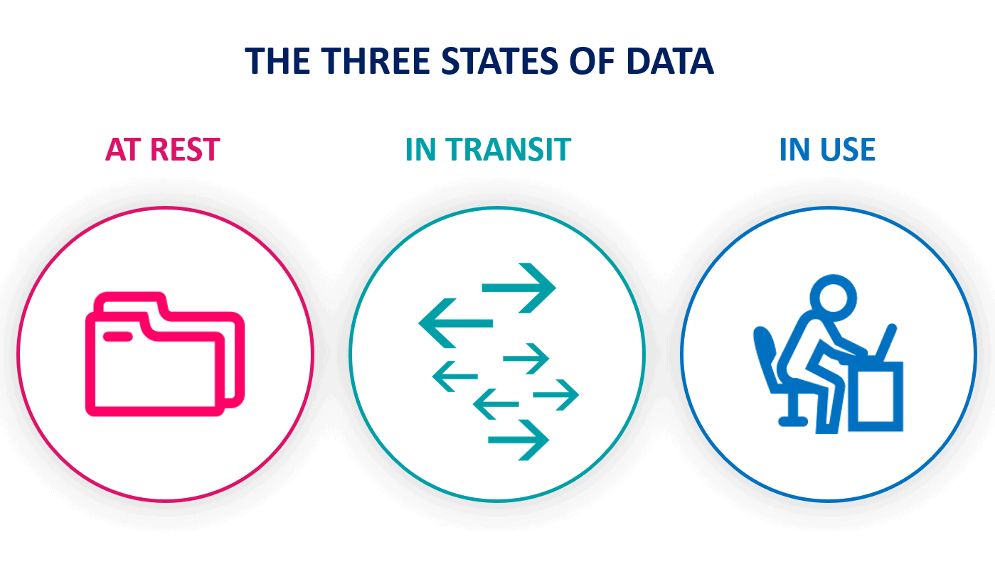
Storage security
Harvest now, decrypt later ?
Encryption
At rest
  the data is encrypted right before being stored
  or the whole disk is encrypted
During transfer
  the communication protocol encrypts the packets
  like HTTPS, SSH, VPN
Bring Your Own (encryption) Key
  the decryption key should not be stored in the cloud
  the data can also be encrypted before being send to the cloud
  backdoors can exist (Cloudflare article about NSA)

Slide 9
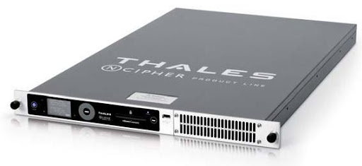
Storing secretS
Trusted Platform Module (TPM)
  a chip on the motherboard to perform cryptographic operations
  interacts with 1 PC
Hardware Security Module (HSM)
  a device to perform advanced crypto operations
  communicates via a REST API with all devices connected
Cloud services Azure key vault, AWS KMS use them to
generate and store your secrets / certificates
Hardware Security Module HSM used by Azure

Slide 10
Vaults
In oracle cloud
✨ Live demo
create a secret in a vault

Slide 11
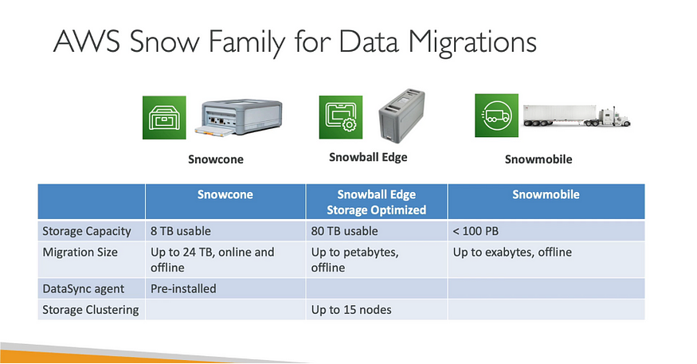
Edge compute & storage
Remember the 5 Petabytes ?
Rugged physical devices provided by AWS and designed for compute and storage at the edge
Can run some cloud services like VMs
Used for remote sites (like a quarry) partially disconnected from internet
Used for large data migration from on-prem to the cloud
Source: https://melchiorre-andrea.medium.com

