Slide 1


Cloud Engineering
Hands on
Storage resources

Slide 2
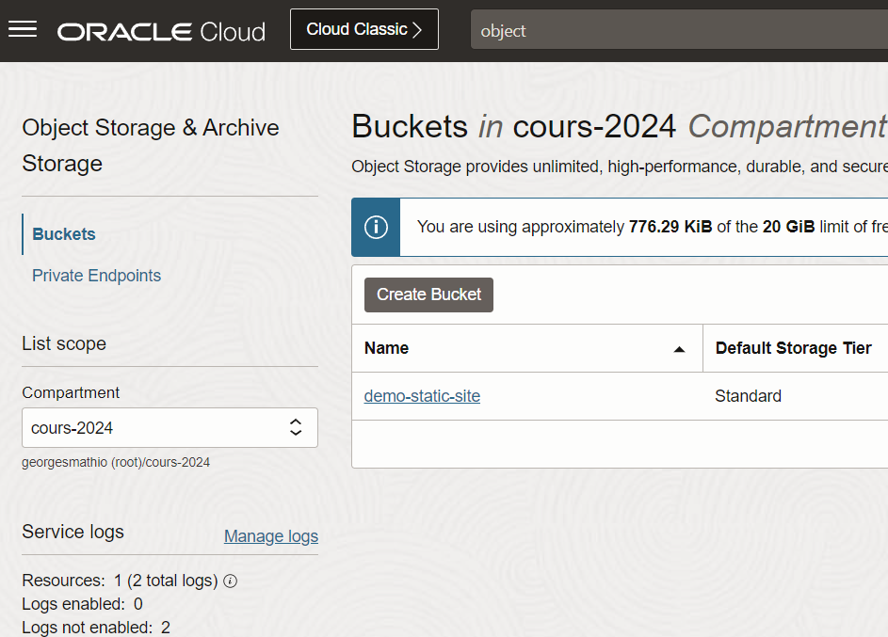
Create AN object storage
From the top left hamburger menu
  Storage
  Buckets
From the left entries
  select the TP compartment
Create a bucket
  put the usual creation tags

Slide 3
Expose A static website FROM the object storage
Update objects in the storage (you have an example in the static-site folder)
Set it public
Browse to its url
Update the assets (image, CSS, …)
Observe the updated site
Do not forget to set it back to private at the end of the session

Slide 4
Create a bucket as code
Create a pulumi resource of type oci.objectstorage.Bucket
Put it in the tp compartment
Set the namespace to <env>-pulumi-bucket-ns
Use the same tags as before
Type pulumi preview to check
commit & then apply the change with pulumi up
DOC https://www.pulumi.com/registry/packages/oci/api-docs/objectstorage/bucket/#inputs

Slide 5
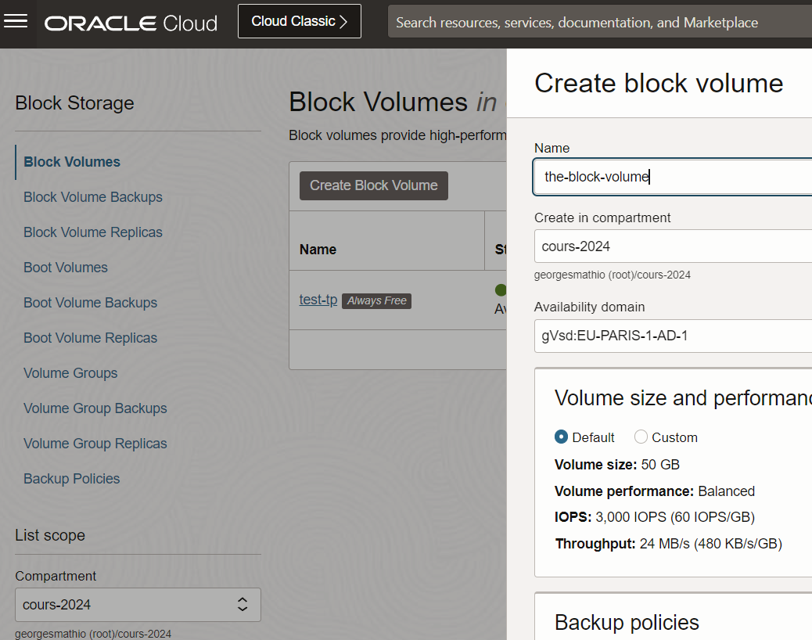
Create a blocK volume
From the top left hamburger menu
  Storage
  Block Volumes
From the left entries
  select the TP compartment
Keep the default parameters
  size, replication, backup, encryption
Add the usual tags

Slide 6
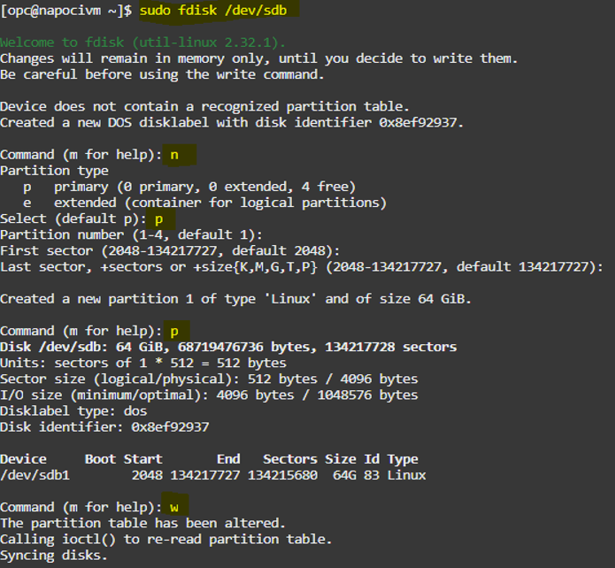
Attaching a block volume
Open the volume details, go to Attached Instances ➡️ Attach to instance
Select one of your VM
Use Paravirtualized attachment type and leave the rest as default
Mount the volume, SSH into your VM
  sudo lsblk ➡️ observe a block named sdb of type disk
  sudo fdisk /dev/sdb
  sudo mkfs –t ext4 /dev/sdb1
  mkdir folder
  sudo mount –t auto /dev/sdb1 folder
Use it as any folder, create a file inside
If you attach it to another VM you can verify the file is found
Source eclipsyssolutions.com

Slide 7
Create AN Autonomous DB
From the top left hamburger menu
  Oracle Database
  Autonomous transaction processing
From the left entries
  select the TP compartment
Name the database tp
Choose Secure access from allowed IPs and VCNs only in the network access
  click to the button Add my own IP address
  keep mutual TLS unchecked

Slide 8
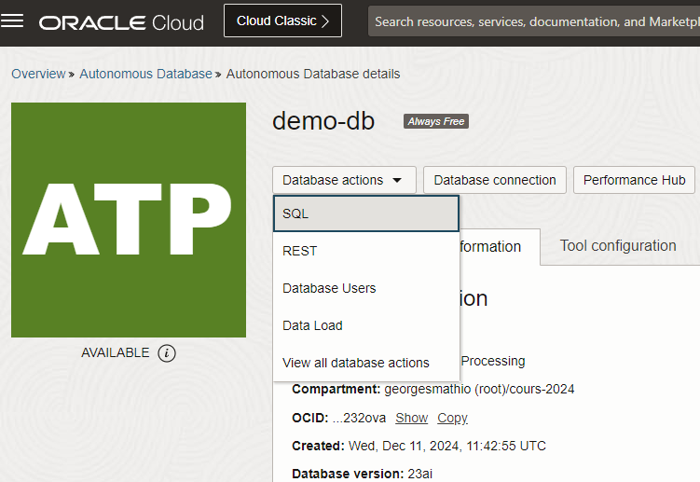
Use the Autonomous DB
We will send SQL requests to the DB
From the button Database actions
  select SQL
In the SQL editor, send the appropriate requests to create a table and insert elements in it
From the button Database connection on the main page,
  Observe the connection strings

Slide 9
Create an autonomous DB as code
Create a pulumi resource of type oci.database.AutonomousDatabase
Put it in the tp compartment
Use the same parameters as we did manually
Use the same tags as before
Type pulumi preview to check
commit & then apply the change with pulumi up
Get the generated connection strings from the pulumi output
https://www.pulumi.com/registry/packages/oci/api-docs/database/autonomousdatabase

