Slide 1
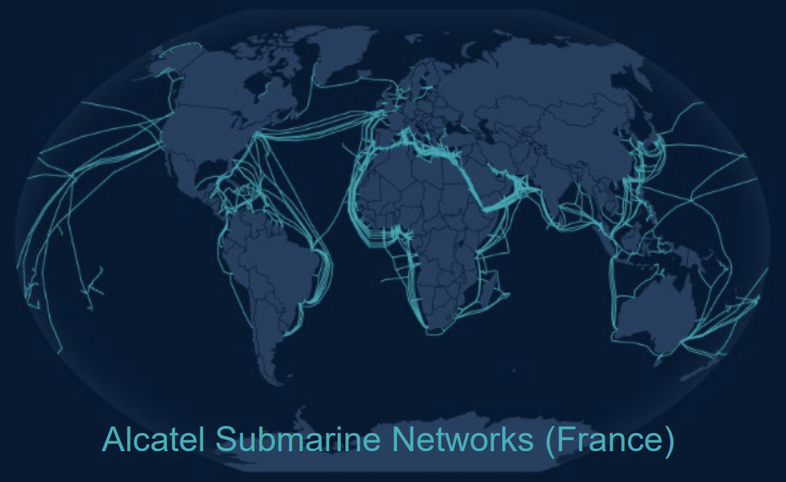
Cloud Engineering
Networking

Slide 2

Overview
Recall from the devops course
Main network & subnets
Connecting to internet: gateways
DNS
Frontal services
Load balancing
CDN / 5G edge content deployment

Slide 3
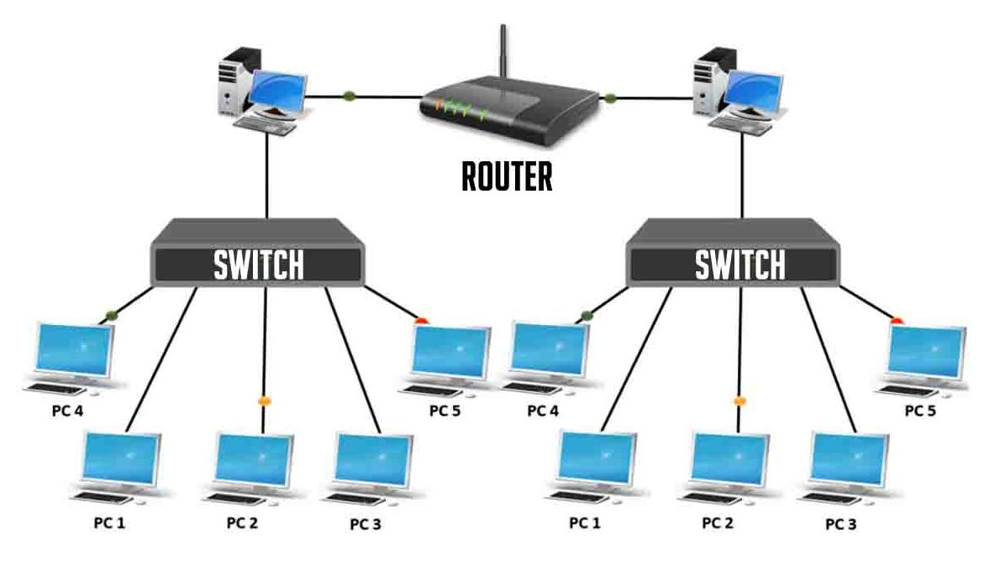
Topology
Recall from Devops course
Networks are organized with routers and switches
Routers link together 2 networks (or more)
OSI level 3
Switches link together devices in a same network
OSI level 2
Excellent learning material: Network Chuck’s Free CCNA Course

Slide 4
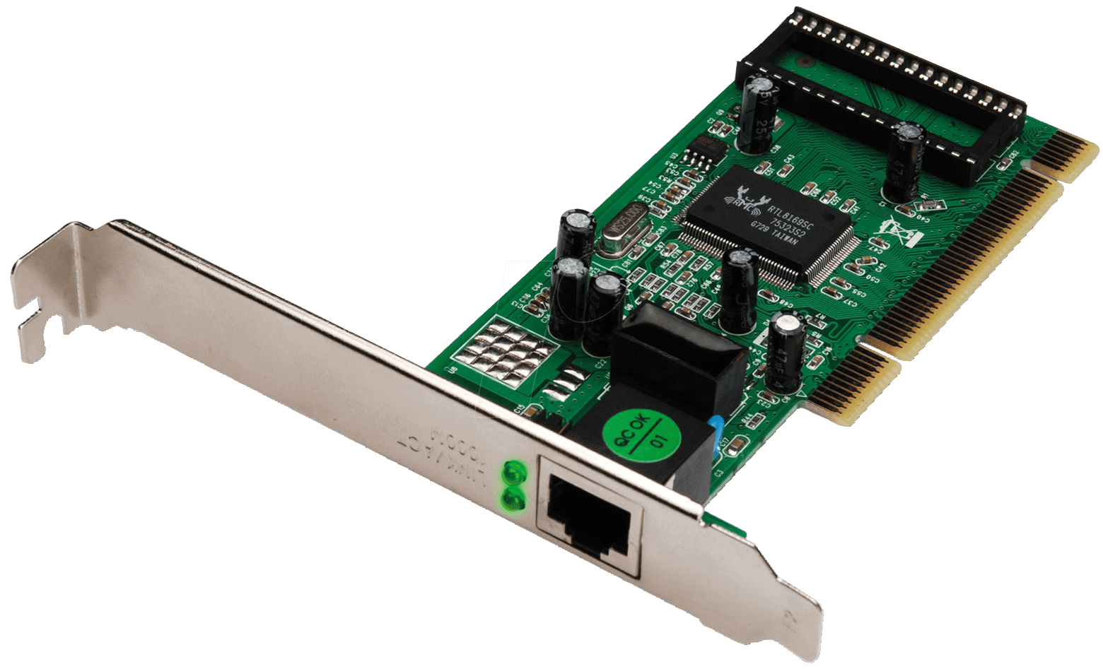
Network Interface CarD
Recall from Devops course
A NIC carries its own unique MAC address
like 07:27:2d:40:83:gg (OSI level 2)
The MAC is mapped from an IP thanks to
the ARP resolution
NICs are virtual in the cloud,
VMs can have many attached

Slide 5
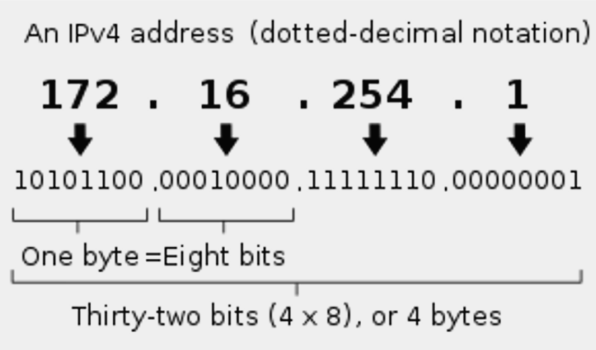
An IP is a number, within a RANGE
Recall from Devops course
A serie of 32 bits
IPs that share the first N bits are part of a same network
The DHCP server assigns IPs to the connected devices, the new IP is within the defined network
CIDR Notation:
10.20.30.0/24 network of all IPs starting with 10.20.30 ➡️24 common bits, 8 specific bits = 256 devices
10.20.30.1 is the default gateway IP, 10.20.30.255 is the broadcast IP

Slide 6
Networks organisation
High level networks contain a large number of IPs: /16 CIDR
They can be peered to external networks for network to network communication
Have high level firewalling
AWS: Virtual Private Cloud VPC, Azure: Virtual Network VNet, OCI: Virtual Cloud Network VCN
Subnets are contained in the high level networks
Have low level firewalling
Gather resources working closely
VPC 1.2.0.0/16
Subnet 1.2.1.0/24
Subnet 1.2.2.0/24

Slide 7
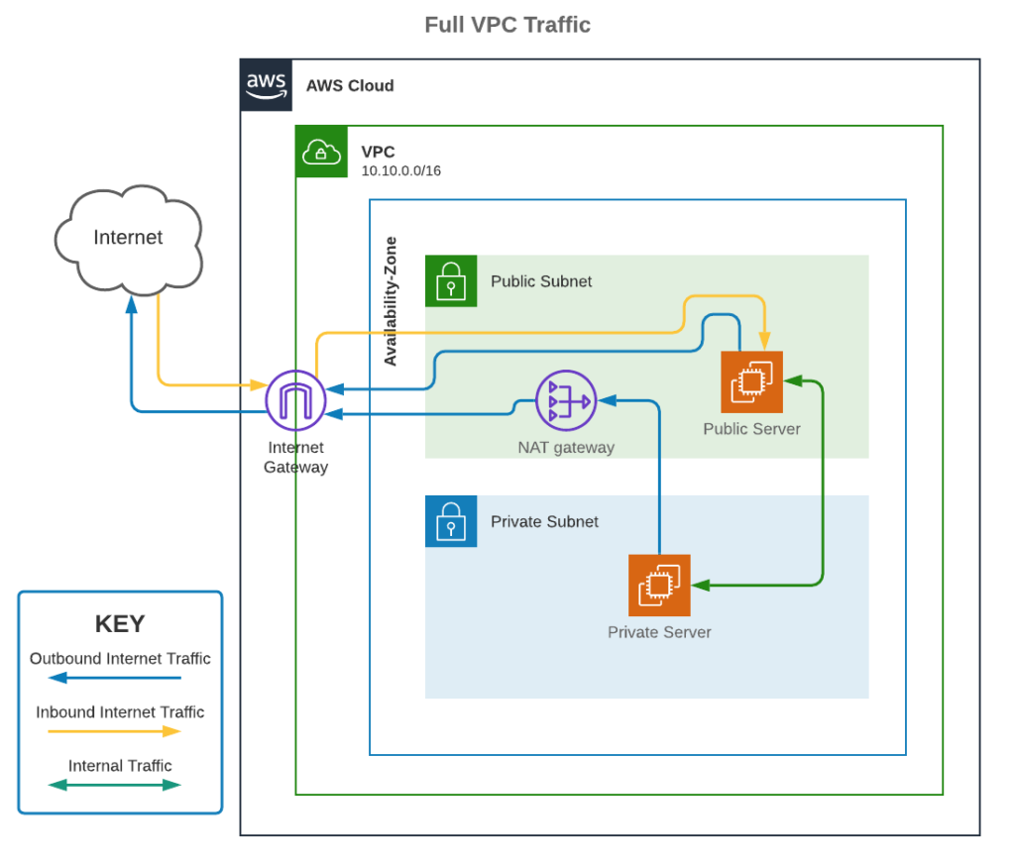
Private & public subnets
Internet Gateway allows instances to access the internet (same as the box wire to the ISP)
Public subnet = being connected to an IG
NAT Gateway = intermediate between instances in private subnets and an IG
Source: uturndata.com

Slide 8
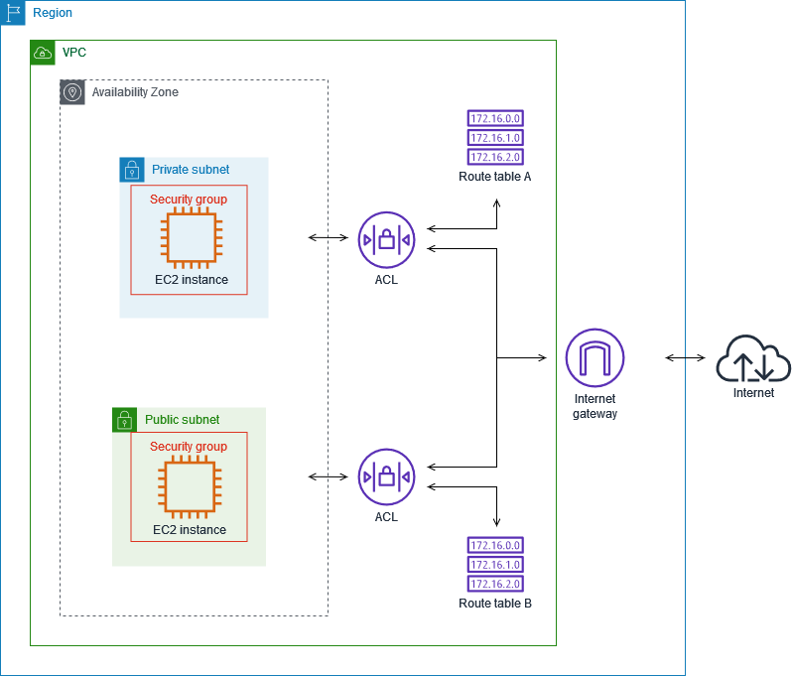
Complete route to internet
Example of AWS
VM (EC2 instance)
Security group: acts as a firewall @VM level
Access Control Lists: act as a firewall @subnet level
➡️ Exit the subnet
(optional) Other subnet (if NAT)
Route table: tells who handles the traffic next
Internet Gateway
Source: medium.com/awesome-cloud

Slide 9
Ingress & Egress TRAFFIC
INGRESS
EGRESS
Relative to a subject:
region, AZ, subnet, …
Ingress is typically free (AWS, Azure)
Egress is billed (€/GB)
This includes traffic within an account, from one region to another
Rule of thumb: the farthest the more expensive but…
complex pricing
North – South traffic
Region
VM
VM
East – West traffic
Source: https://azure.microsoft.com/en-us/pricing/details/bandwidth

Slide 10
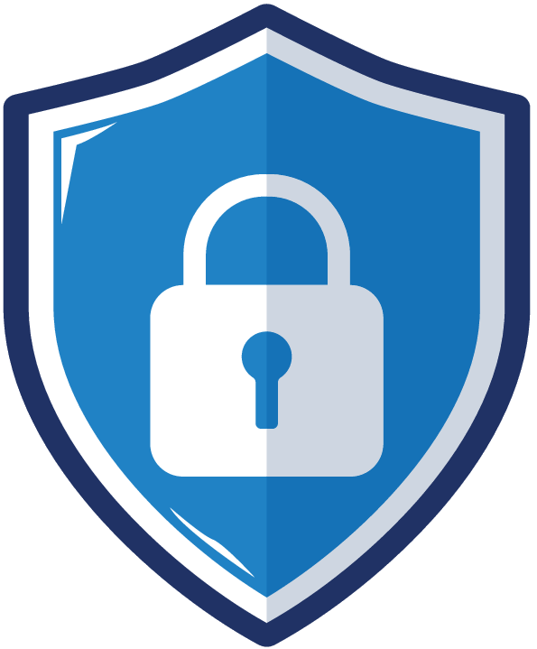
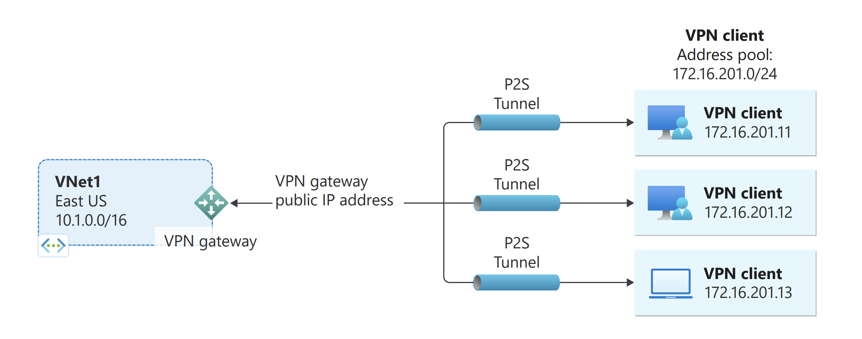
Virtual Private NetworkS
For hybrid clouds, connect the Cloud to on-premise
(Site-to-Site S2S)
  AWS Site-to-Site VPN
  Azure VPN Gateway
  Needs a dedicated machine
  on the other end, on-premise
To secure a remote worker / single machine connection to the VPC (Point-to-Site P2S)
  AWS Client VPN
  Azure VPN Gateway (again)
Cloud
Internet
On-prem
Source: https://learn.microsoft.com

Slide 11
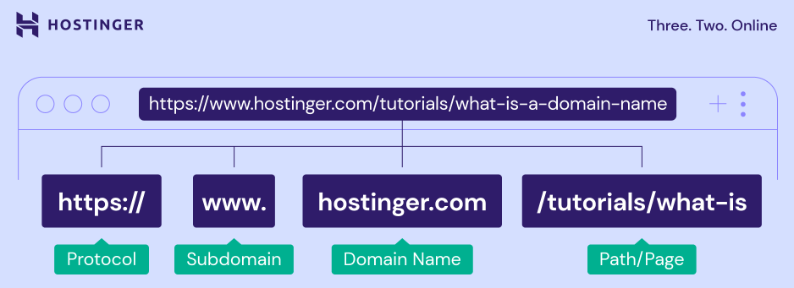
DNS
1 owner purchases a domain name
The money is shared
  ICANN (assigns IP ranges to countries)
  the registry (manages a Top Level Domain database: .fr, .com, …)
  the registrar (shopping platform for domain names)

Slide 12
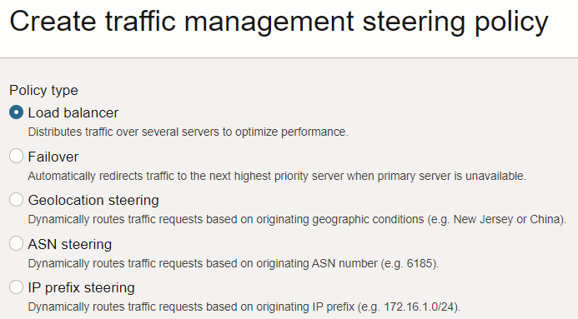
DNS
Configuration of your domain name and subdomains
Setting of the records
  “A” record maps a name to an IPv4
  “CNAME” record maps a name to another name
Used to verify a domain ownership before certificate issuance for HTTPS
Can perform Load Balancing
AWS Route 53 & Azure DNS offer similar functionalities
Load balancing modes of OCI DNS

Slide 13
Frontal security services
DNS
Shield
Example of AWS
INGRESS
Load balancing and securing the VPC
Route53
DNS service
Shield
Protects against DDoS attacks at the network edge
CloudFront
Reverse-proxy to optimize and cache traffic for global distribution
Can perform TLS offload
WAF
Reverse-proxy to filter traffic for application-level (layer 7) security
ex: blocks requests looking like SQL injection
API Gateway
Reverse-proxy to dispatch requests to the right service
Cloud
Front
WAF
API
Gateway
Internet
Gateway

Slide 14
Tour of the existing network resources
Set up by default
✨ Live demo
in depth tour

Slide 15
Architectural tip
For a modest OCI setup
Keep the network structure simple and understandable
Use firewalls to allow only intended inbound traffic
  all the rest should be closed
  possible strict IP whitelisting for services like SSH
Delegate TLS to a frontal service
Reduce the risks due to exposing VMs directly to internet by using a NAT Gateway

