Slide 1


Cloud Engineering
Hands on
Network resources

Slide 2

Overview
Using security services
to diagnose our install

Slide 3
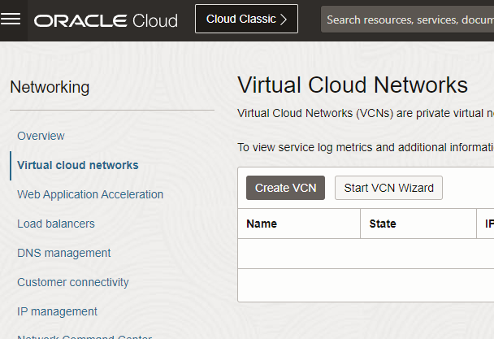
Create A new VCN
From the hamburger menu
  select Networking / Virtual Cloud Networks
Create a new one in the tp compartment
CIDR: 10.X.0.0/16
No IPv6
Usual tags

Slide 4
Create A Subnet & A VM inside
From the VCN details
CIDR: 10.X.0.0/24
No IPv6
Browse the existing manual VM
Under the « Attached VNICs » entry, create a new one in the new subnet
Detach the previous one
=> now the VM has a new IP

Slide 5
Add an internet gateway to the the new VCN
From the VCN details,
Click on the « Internet Gateways (0) » entry
Create it
Click on the « Route Tables (0) » entry
Create a new one:
  type: internet gateway
  destination: 0.0.0.0/0

Slide 6
Create A new VCN as code
Create a pulumi resource of type oci.Core.Vcn
Put it in the tp compartment
Set the range to 10.Y.0.0/16
Use the same tags as before
Type pulumi preview to check
commit & then apply the change with pulumi up
https://www.pulumi.com/registry/packages/oci/api-docs/core/vcn

Slide 7
Observe the network graph
From the hamburger menu
  select Networking / Network vizualizer
Let it cook
Observe the topology with the VCN & Internet Gateway

