Slide 1
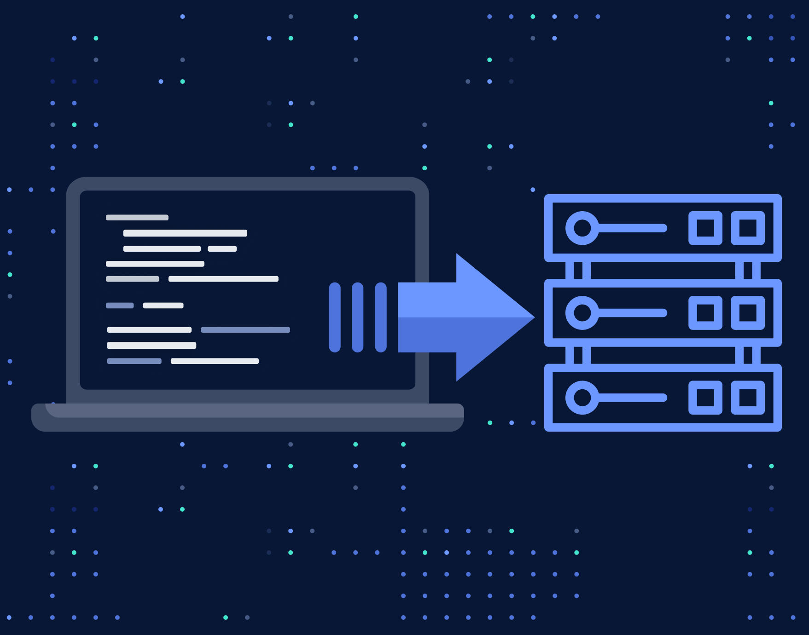
Cloud Engineering
Infrastructure as Code

Slide 2

Overview
Core concepts
Technology landscape
Terraform specific langage
Pulumi concepts
Hands-on

Slide 3







Technology solutions
Specific Agnostic
Azure ARM templates
AWS CloudFormation

Slide 4
Terraform Syntax
Market leader
resource "oci_identity_compartment" "main" {
compartment_id = var.tenancy_ocid
description = "Compartment for Terraform resources"
name = join("-", [var.env, "cats“])
}
This is a « domain specific language » called HCL
Notes:
Transition: Before we dive into the serve code, some theory about APIs

Slide 5
PULUMI Syntax
It is plain JS / TS / Python / Go !
const pulumi = require("@pulumi/pulumi")
const aws = require("@pulumi/aws")
// Create an S3 Bucket object
const bucketObject = new aws.s3.BucketObject("index.html", {
bucket: bucket.id,
source: new pulumi.asset.FileAsset("./index.html"),
})
Reference: Pulumi doc for JS/TS
Notes:
Transition: Before we dive into the serve code, some theory about APIs

Slide 6
Architecture
Tells what resources are managed by Pulumi
Can be hosted on:
cloud.pulumi.com
a dedicated Object Storage
in the CI/CD engine
the dev PC
Cloud provider
resources
State
sync via login
up / destroy
Runs on a PC or in a pipeline

Slide 7
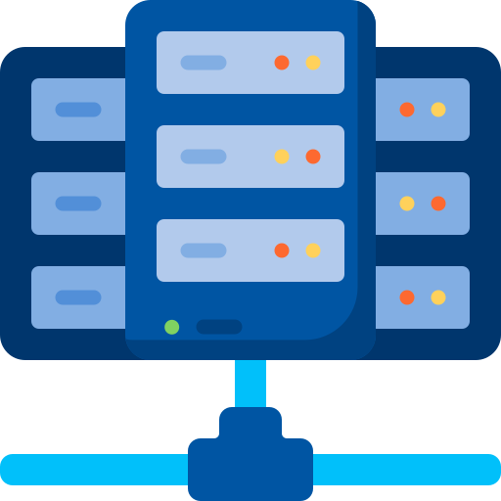

TEST environments
Recall from Devops course
Local, CI/CD
✅ unit/API tests
Deploy
Image
version n+1
Registry
dev
✅ smoke tests
Deploy
Deploy
✅ integration tests
qa
Deploy
✅ prod-like data
✅ stress tests
staging
Deploy
prod
✅ A/B tests

Slide 8
Project organisation
The top-level object is called a project
it is described in the Pulumi.yaml file
Pulumi can create many copies of almost the same resources via stacks
The stacks can be used to create environments
They can have specificities depending on the needs (more CPU in prod, …)
The source code can import the configuration and inject it in the resources specs

Slide 9
UPDating environments
Local, CI/CD
✅ unit/API tests
Update
Infra Code
version n+1
dev
✅ smoke tests
Update
Update
✅ integration tests
qa
Update
✅ prod-like data
✅ stress tests
staging
Update
prod

