Slide 1


Cloud Engineering
End to end project
Web application with DB storage

Slide 2

Overview
More realistic application
connected to a DB

Slide 3

Architecture
https
API Gateway
TLS offload
Certificates
http
Security list
firewall
Load Balancer
dispatching
VM pool
servers
Bucket
site files

Slide 4
Compute part 1: Create aN Instance configuration
We setup the way to create VMs dynamically
From the hamburger menu
  Compute / Instance configurations
Use the same tags as before
We will come later on the init-script to start an http server on port 4444

Slide 5
Compute part 2: Create aN Instance POOL
We setup the dynamic pool of VMs to scale horizontally
From the hamburger menu
  Compute / Instance configurations
During the VNIC setup, select the previous VCN / subnet

Slide 6
Compute part 3: Attach a load balancer
We setup the dispatcher
From the hamburger menu
  Networking / Load balancer
In the listener details, choose HTTP instead of HTTPS
Wait for the creation
Back to the instance pool, in the resources choose Load balancers
Attach the load balancer you just created
  select the port 4444 on the VMs of the pool

Slide 7
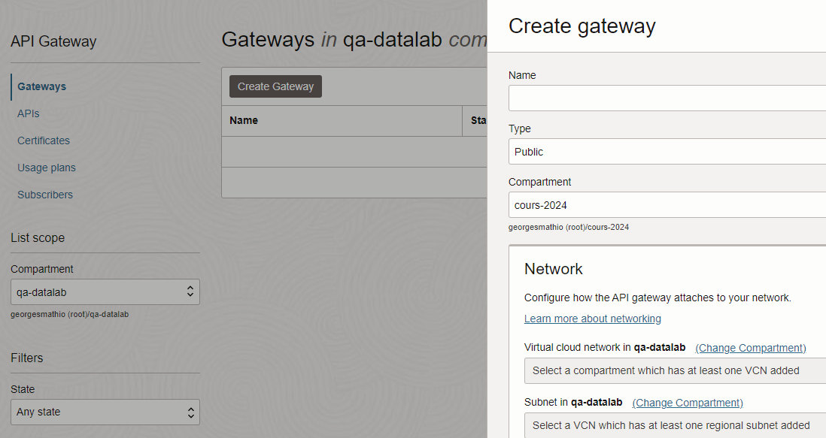
Frontal part 1: Create an API gateway for the TLS offload
We create the frontal service
From the hamburger menu
  Developer services / API Management / Gateways
Use the same tags as before
Set it as public
Use either of your VCN / subnet
Use the default certificate options to let oracle manage them

Slide 8
Frontal part 2: Connect the API gateway to the LB
We configure it
Route any request reaching the gateway to the load balancer
Route them as http traffic
Update the security list to let http traffic reaching the LB

Slide 9
End-to-end testing
Time to start a server listening on the port 4444 on the VMs
Either connect to the instance via SSH and start the http server (like during the compute TP)
OR
make a cloud-init script to do it
Once the servers are up, try to perform e2e testing and debug

Slide 10
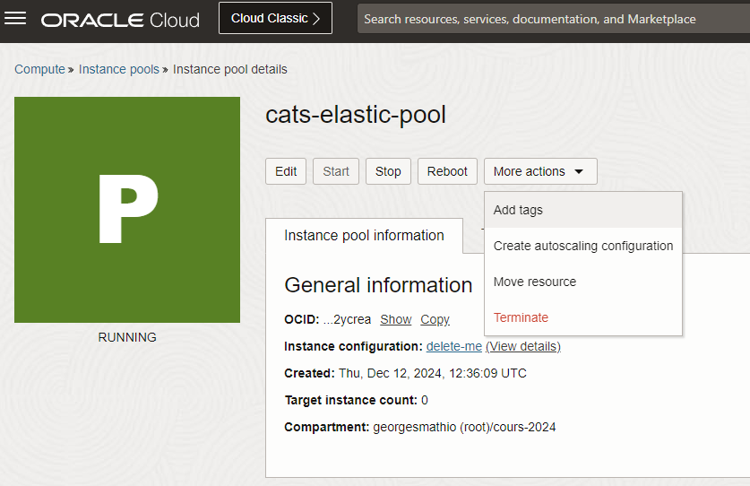
Elasticity
Let the pool dynamically start & stop instances
Back to the Instances pool,
Under the menu « More actions »,
  select create autoscaling configuration
Implement the rules:
  Scale up when the load is above 90%
  Scale down when the load is below 70%
  Keep at least 1 instance
  Have max 5 instances

Slide 11
testing the elasticity
We need to use a tool / script to send a large number of requests to our url.
This can be achieved in JS like so:
  setInterval(fetch(url), 100)
Observe the metrics and adjust the throughput to trigger scaling

Slide 12
Serve files stored in a bucket
Reuse the bucket with your static website files
Proxy the requests from / to the object index.html url the bucket

