Slide 1

Maze Difficulty Sorting
HW5
Data Structures 2020
NTHU EECS

Slide 2
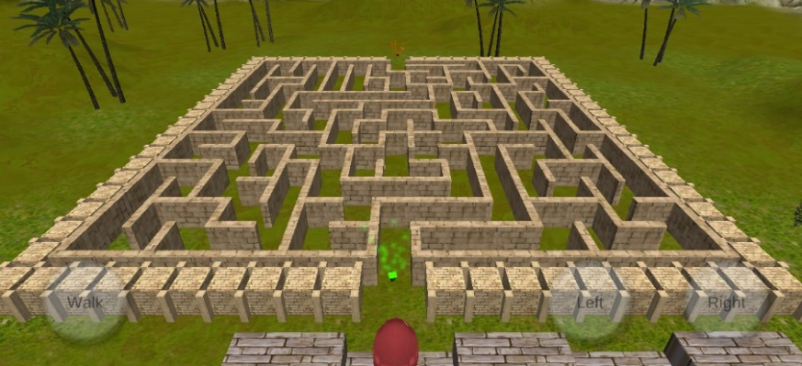
Mazes are not all Equal
We are developing a computer game, and we need to sort mazes according to their difficulty
So, game levels can begin from easy mazes to difficult mazes and achieve a good game experience
Let’s develop a program to do so!

Slide 3
Sort Mazes According to Difficulties
Difficulty factors (larger is better)*
N1: Number of forks along the correct path
N2: Number of dead ends
L1: Length of the correct path
L2: Medium length of incorrect paths apart from the correct path
For a even number of incorrect paths, take the average of the medium two
Overall difficulty
((N1 + N2) * (L1 + L2))
Tie breaker
N1 → N2 → L1 → L2 → Larger serial number is more difficult
*https://puzzling.stackexchange.com/questions/5919/whats-the-best-way-to-rate-how-difficult-a-maze-is

Slide 4
Example 1
…
Overall Difficulty |  | 0
N1 | Number of forks along the correct path | 0
N2 | Number of dead ends | 0
L1 | Length of the correct path | 19
L2 | Medium length of incorrect paths apart from the correct path | 0
len. = 19
target

Slide 5
Example 2
Note here two forks are along the correct path
Fork
Fork
Fork
len. = 2
dead end
len. = 1
dead end
Overall Difficulty |  | 119
N1 | Number of forks along the correct path | 3
N2 | Number of dead ends | 4
L1 | Length of the correct path | 13
L2 | Medium length of incorrect paths apart from the correct path | 4
len. = 6
dead end
len. = 7
dead end
len. = 13
target

Slide 6

Input
Number of mazes ($≥1$)
2
1
9 8
NNNNNNNNN
.....NN.N
NN.NN...N
N.....NNN
NN.NN...N
NN.NNNNNN
NN.......
NNNNNNNNN
2
10 7
NNNNNNNNNN
...NN....N
NN.NN.NN.N
NN.NN.NN.N
NN....NN.N
NNNNNNNN..
NNNNNNNNNN
Width and height
Serial number of each maze
9
Rules of each maze
Four valid moving directions, up, down, left, and right
Characters ‘N’ are walls, and characters ‘.’ are paths.
No cycle
Entry is at (0, 1) and the target is at (width-1, height-2)
Surrounded by walls excepting the entry and target
8
10
7

Slide 7
Output
Serial number
2
0 0 0 19 0
1
119 3 4 13 4
Ascending order according to the difficulties
Overall difficulty, N1, N2, L1, L2

Slide 8
Regarding Quiz (上機考)
Quiz will focuses on sorting things, especially sorting vectors with tie-breaking rules
Quiz may have a similar input format but will not require students to solve mazes or generate trees

