Slide 1


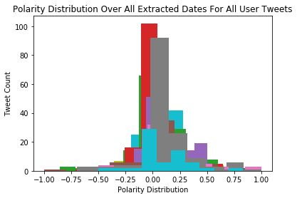
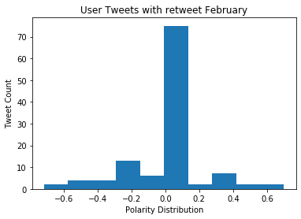
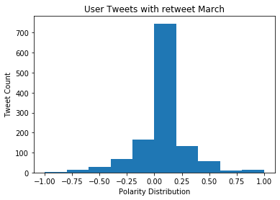
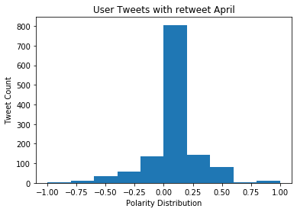
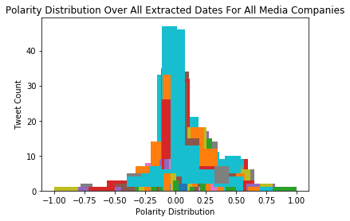
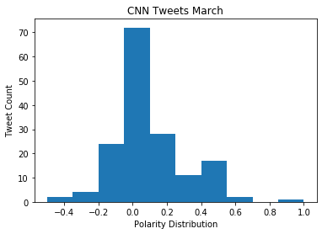
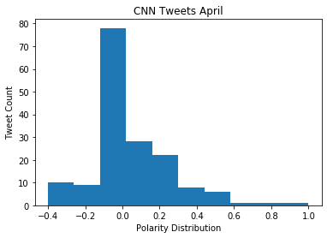
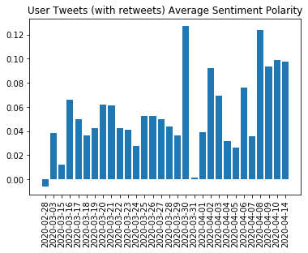
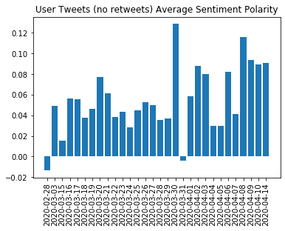
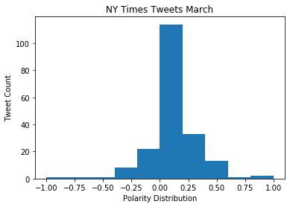
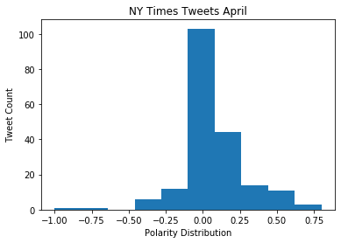
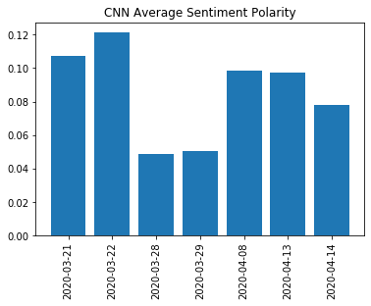
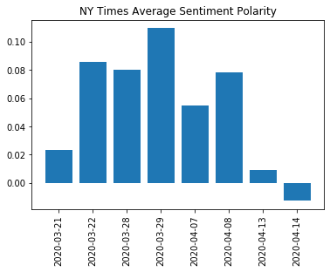
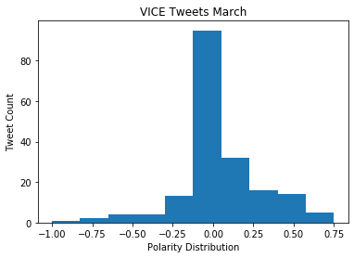
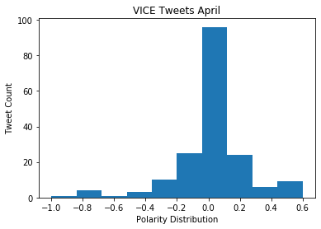
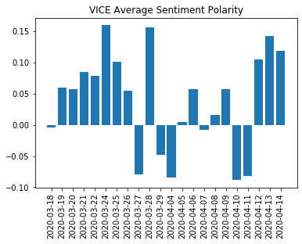
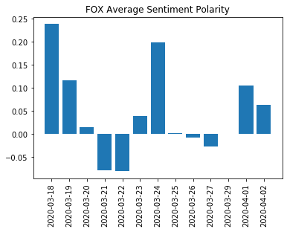
Analysis of COVID-19 Twitter Trend
Nicholas Ferry
University of South Carolina Beaufort, Computational Science
Future Works
For the future, we would like to perform the Tweet extraction based on geographic location to analyze the change in sentiment linked to geographical locations. By doing this, we can understand how the opinion changes in relation to different locations who are also impacted differently by COVID-19. Also, we would like to analyze the emojis used in Tweets as emojis help to understand the tone trying to be conveyed within the syntax.
Abstract
Twitter is an excellent source to get a population's opinion on a particular topic. Through ‘Tweets’ users can express their thoughts in a clear and concise character-limited manner. The project aims to analyze the Tweets created in response to COVID-19 by both users and several well-known media companies, respectively. The analysis performed is sentiment analysis that takes into account the syntax used to construct the Tweet, and creates a polarity ranging from [-1, 1] where 1 is the maximum for a positive sentence, and -1 is the maximum for a negative sentence.
Introduction
Figure 9
Figure 10
Figure 11
To extract the Tweets, a sandbox development environment was set up within the Twitter developer management portal. Python was then used as the base language for extraction and sentiment analysis. The API used to connect to Twitter and extract data via Python was the SearchTweets API. To perform the sentiment analysis, TextBlob API was used. Once the Tweets were collected they were exported to a csv file utilizing the Pandas API. The columns in the csv file are: User Name, Statuses, Time Created At, Sentiment Analysis, and Polarity
Figure 1
Next we wanted to analyze the polarity distribution over monthly periods (i.e. polarity distribution over March). The axis in the histogram plots are the polarity distribution over the range [-1, 1] and the Tweet count for that particular polarity number. For figures 9 – 12 we have displayed the plots for user Tweets with and without recounts. For figures 15-19 we have selected 3 media companies to display: CNN, NY Times and Fox. From these figures we can see the user Tweets tended to center around neutrality and the media companies transitioned from negative in March to positive in April.
Figure 2
The figures above show histograms of the distribution of polarity across all extracted dates. Figure 1 shows the distribution of all of the collected user tweets with each color representing a different extracted date (30 in total). Similarly figure 2 displays the distribution of polarity of all media companies collected across each extracted date from all media companies (83 in total).
Figure 12
Figure 13
Figure 14
Figure 15
Figure 3
Figure 4
Figure 5
Figure 6
Tweet Average Sentiment Polarity Per Day
Figure 16
Figure 17
In order to visualize the polarity analysis the extracted csv data was imported using Pandas, manipulated using self-created functions, and then Matplotlib was used to plot this data aggregation. The first objective was to find the average polarity per every day within the Time Created At field in each respective csv file. Above the average polarity per extracted day for the user tweets (with and without retweets) is shown.
References:
http://www.twitter.com
https://www.python.org/
https://pypi.org/project/searchtweets/1.0/
https://textblob.readthedocs.io/en/dev/
https://matplotlib.org/
https://pandas.pydata.org/
https://numpy.org/
https://www.nytimes.com/article/coronavirus-timeline.html
https://abcnews.go.com/Health/timeline-coronavirus-started/story?id=69435165
Figure 7
Figure 8
The average polarity per extracted date for four chosen media companies can be seen above. The four chosen companies are: Fox News, CNN, VICE News, and NY Times. Significant events that occurred on the extracted dates can be found in reference links 8 and 9.

