Slide 1
Transparency
GNI
GDP
Competition
POLITICs
ECONOMICs
FRAGILITY
CLIMATE
Forrest
SOCIety
Diseases
Diaster
Homicides
Arable land
Schooling

Slide 2
Transparency
GNI
GDP
Extreme
Climate
Competition
POLITICAL
ECONOMICs
FRAGILITY
CLIMATE
Forrest
SOCIAL
precipitation
Diseases
Diaster
Homicides
Arable land
Schooling
Extreme
Climate
Cereal yield

Slide 3
Primary
Indiator System
TASK II
PCA
Clustering
Algorithm
Fragile Country
Determine the impact of climate change
Multiplier System
Indiator Selection
Construct Comprehensive Index
Measure of Three-Level Fragility
TASK III
Non-Fragile Country
Identify the fragility and analysis
TASK I
Able to measure direct and indirect effects of the climate through two submodels.
Applying Model to Different Regional Scale
TASK IV
Constract Human Intervention Model
Sensitivity Anaylsis
Identify the Risk of Climate Change
Establishment of Benefit-cost Model
Predict the
Overall Cost
TASK V

Slide 4
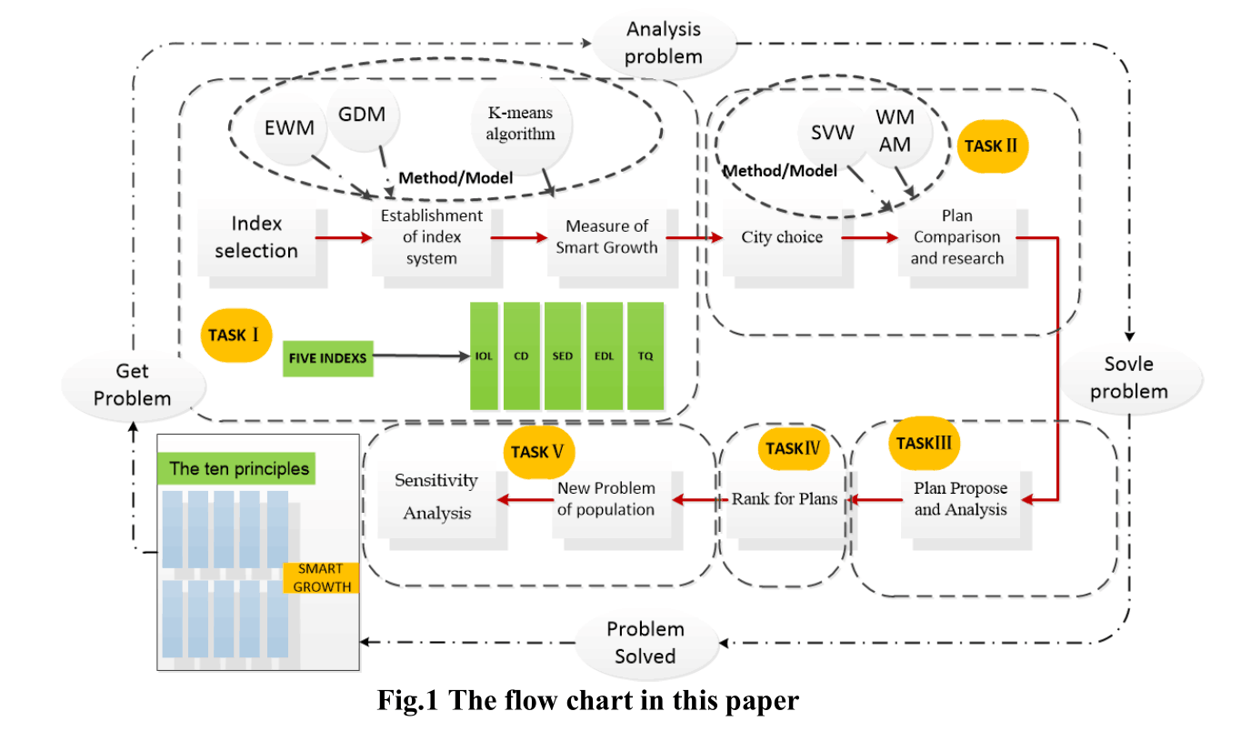

Slide 5
rank | country | fragility
1 | Mauritania | 96.84205
2 | Burundi | 96.58321
3 | West Bank and Gaza | 96.27652
4 | Yemen, Rep. | 96.26727
5 | Somalia | 96.10368
6 | Mali | 96.01151
7 | Burkina Faso | 95.73676
8 | Djibouti | 95.71822
9 | Haiti | 95.67908
10 | Sudan | 95.50645

