Slide 1
Cultural Service
Pollution
Regulating Service
Beijing
PART II
Biodiversity
Provisioning Service
The Cost of
Ecosystem Services Loss
The Cost of
Environmental Degradation
Large National Projects
NPV & BCR
Construct Ecological
Cost Evaluation Model
Cost and
Benefit Analysis
Environmental Cost
Evaluation and Cost-benefit Analysis
Community-based projects
PART I
Able to measure direct and indirect effects of the climate through two submodels.
Power Plant
Potential Changes of Model over Time
PART III
Implication on
planners and managers
Sensitivity Anaylsis
Conclusion
Pigovian Tax & Tradeable Pollution Rights
Help planners
for site selection
Help managers
for urban planning
PART V
PART IV
Production-possibility Frontier

Slide 2
Regulating Services
Biodiversity Loss
Purification of the air
Carbon fixation
Oxygen release
Biodiversity Regulator
Biodiversity service
Biodiversity good
Ecosystem
Services
Environmental
Degradation
Provisioning Services
Reduced sediments in rivers
Conservation of water
Reduced waste lands
Land fertility
Pollution
Air
Water
Solid Waste
Ammonia
Hydride
Metals
COD
SO2
NO2
Dust
Discharge
Storage
Cultural Services
Willingness to pay
Ability to pay

Slide 3
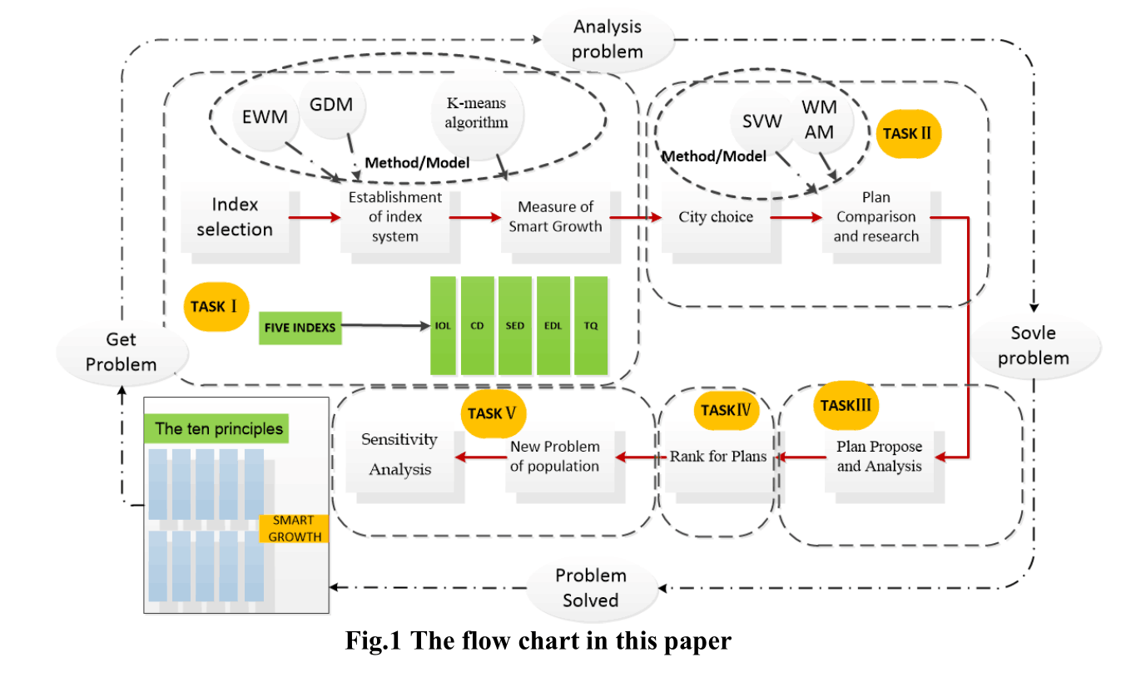

Slide 4
The decrease of externality means some environmental costs have been calculated into the accounting costs, so the corresponding components in the model should be removed.
MODEL
The government could apply the model to economics means. This can effectively reduce the externalities of economic activities.
Externality
Government
Provides methodology to calculate environmental costs which can help the government to internalize externalities.

Slide 5
The model will need to change as the response to the decline of market externalities
MODEL
Apply the model into economics means to reduce the externalities
Externality
Government
Provides methodology to calculate environmental and true economics costs

