Slide 1
Hedging & Derivatives Lunch & Learns (London Trading Office)
VERSION 1
June 2018

Slide 3
1 PRICING BASIS EXPOSURE
Grane cargo bought and sold off different pricing periods
2 GEO ARBITRAGE
Midland sweet cargo, bought off WTI, delivered into Europe, sold of dtd
3 TIME ARBITRAGE
CPC Blend cargo bought and stored in our MOT tank
4 PRICING BASIS EXPOSURE
Qua Iboe sale to HPCL
5 BASRAH OPTIONALITY
Basrah cargo optionality
6 GEO ARBITRAGE
CPC Blend cargo sold into Singapore
ARAB GULF DESTINATION
OPTIONALITY
Saudi cargo optionality

Slide 5
EXAMPLE 1

Slide 6
Pricing Methodology
Cash BFOE
EFP
ICE Future
CFD
DFL = monthly
Dated Brent
Price US$/bbl
March Forward Cash BFOE
March
Future
ICE Brent
Dated Brent
Dtd Brent = ICE - DFL
Cash BFOE = Dtd Brent + CFD
ICE = Cash BFOE - EFP

Slide 7
Example 1: Grane pricing basis exposure
Bought: Slagen refinery is long a Grane cargo and EMS&S purchase the cargo from ENAS pricing on the average of the five Dated Brent quotations after B/L (0/0/5 B/L). Estimated load date of 16th November. Cargo size is 630KB. Deal Date is 15th November.
The purchase price is DTD - 0.8
Sold: The cargo will be sold to ENED (Rotterdam refinery) and will price over the period that an alternate crude would have priced when this cargo will be ran. These dates are fixed at 18-22 December pricing on Dated Brent.
The sale price is DTD – 1.0

Slide 8
Example 1: Grane pricing basis exposure
EMS&S buy physical from ENAS - DTD
126
KB
126
KB
126
KB
126
KB
126
KB
18-Dec
22-Dec
Deal Date
15 Nov
17-Nov
23-Nov
126
KB
126
KB
126
KB
126
KB
126
KB
EMS&S sell physical to ENED - DTD
Why hedge?
Protect the Dated Brent exposure between 17-23 November and 18-22 December
Lock in any contango structure in the market
Questions
Are we neutral, long or short PRICE?
How would you hedge this cargo using Futures only?
How would you hedge this cargo using a swap?

Slide 9

Hedging Tool: Futures - Brent
Futures are standardised “paper” contracts that are traded on a regulated exchange
Futures for Brent Crude Oil are traded on the ICE
One contract equals 1,000 barrels (159 m3).
Contracts are quoted in U.S. dollars.
Each tick lost or gained equals $10.
Cash settle on expiry
Based/derived from physical value
ICE provides an instantaneous current price of oil loading in future months (up to 3 years ahead) - Very liquid market with a large number of participants
Daily settlement price for each month
Front month (currently traded) ICE is M+2 out and expires on the last day of M-2
Todays date | Front Month ICE | FM Ice Expires
28th March | May ICE | 31st March

Slide 10
Example 1: Grane pricing basis exposure - futures
EMS&S buy physical from ENAS - DTD
EMS&S buy paper - ICE
126
KB
126
KB
126
KB
126
KB
126
KB
126
KB
126
KB
126
KB
126
KB
126
KB
18-Dec
22-Dec
Deal Date
15 Nov
17-Nov
23-Nov
126
KB
126
KB
126
KB
126
KB
126
KB
126
KB
126
KB
126
KB
126
KB
126
KB
EMS&S sell paper - ICE
EMS&S sell physical to ENED - DTD
Method 1: Execute futures during the physical pricing periods to offset physical
17 - 23 Nov : Sell 126KBD of ICE Brent Futures for January
18 - 22 Dec : Buy 126KBD of ICE Brent Futures for February
Problem : January ICE Brent expires on 30th November
Solution 1: Roll the hedge from January to February before expiry
Solution 2: Sell February futures rather than January
Solution 3: Execute futures on deal date to “lock-in” the spread and unwind during the physical pricing period
Notes:
Solution 1 – roll may change or become backwardated etc.
Solution 2 – as above – don’t know what structure will be at the time
Solution 3 – takes current structure, done deal on these economics

Slide 11
Example 1: Grane pricing basis exposure - futures
EMS&S buy physical from ENAS - DTD
EMS&S buy paper - ICE
EMS&S buy paper - ICE
630
KB
126
KB
126
KB
126
KB
126
KB
126
KB
126
KB
126
KB
126
KB
126
KB
126
KB
18-Dec
22-Dec
Deal Date
15 Nov
17-Nov
23-Nov
126
KB
126
KB
126
KB
126
KB
126
KB
126
KB
126
KB
126
KB
126
KB
126
KB
EMS&S sell paper - ICE
EMS&S sell paper - ICE
EMS&S sell physical to ENED - DTD
630
KB
Method 2: Execute futures positions on deal date and unwind the hedge over physical pricing period to “lock in” the spread
15 Nov : Buy 630KB January ICE Brent, Sell 630KB February ICE Brent
17 - 23 Nov : Sell 126KBD of ICE Brent Futures for January
18 - 22 Dec : Buy 126KBD of ICE Brent Futures for February
Problem: Physical cargo is pricing on Dated Brent and hedging action is on ICE Brent
Solution: Use a different instrument – e.g. “Dated Swap”

Slide 12
Hedging Tools: Dated Swap
A “Dated Swap” is a tool with 2 legs/trades – fixed / floating:
You Buy or sell the fixed component
Brokers will tell you what is being offered or bid
This is the price you secure at the time of doing the swap
The floating leg is the opposite action – a sell or a buy priced at the ACTUAL price over the price out period
If you combine buying/selling swaps of different time periods you can lock in contango (the differential in fixed legs) and use the second floating leg to offset physical price exposure
Example | Trade 1 | Trade 2
Buying a March swap | EMS&S buys at a fixed number per barrel | EMS&S sells at the average of all dtd brent quotes for 1-31st March
 | Trade date is day swap is completed | Trade date is the day FOLLOWING the last day of the swap period and floating price is known e.g 1-31st March deal will completed 1st April

Slide 13
Example 1: Grane pricing basis exposure - swap
EMS&S buy physical from ENAS - DTD
EMS&S buy floating - DTD
EMS&S buy fixed - DTD
630
KB
126
KB
126
KB
126
KB
126
KB
126
KB
126
KB
126
KB
126
KB
126
KB
126
KB
18-Dec
22-Dec
Deal Date
15 Nov
17-Nov
23-Nov
126
KB
126
KB
126
KB
126
KB
126
KB
126
KB
126
KB
126
KB
126
KB
126
KB
630
KB
EMS&S sell floating - DTD
EMS&S sell physical to ENED - DTD
EMS&S sell fixed - DTD
Method: Execute a dated swap on deal date which automatically unwinds over physical pricing period and “locks-in” the spread on DATED BRENT
15 Nov : Buy 630KB Dated Brent 17- 23 Nov @ Fixed Price
Sell 630KB Dated Brent 18 - 22 Dec @ Fixed Price
17 Nov to 23 Nov : Sell 126KBD of Dated @ Floating Price (actual price) - automatic
18 Dec to 22 Dec : Purchase 126KBD of Dated @ Floating Price (actual price) - automatic
Physical and floating cancel out over both pricing periods leaving the fixed swap only

Slide 14
Example 1: Grane pricing basis exposure – Actuals!
EMS&S buy physical from ENAS - DTD
EMS&S buy floating - DTD
EMS&S buy fixed - DTD
630
KB
126
KB
126
KB
126
KB
126
KB
126
KB
126
KB
126
KB
126
KB
126
KB
126
KB
18-Dec
22-Dec
Deal Date
15 Nov
17-Nov
23-Nov
126
KB
126
KB
126
KB
126
KB
126
KB
126
KB
126
KB
126
KB
126
KB
126
KB
630
KB
EMS&S sell floating - DTD
EMS&S sell physical to ENED - DTD
EMS&S sell fixed - DTD
15 Nov: Bought Nov 17-23 Dtd Brent Fixed @ 61.00
15 Nov: Sold Dec 18-22 Dtd Brent Fixed @ 61.20
Collected 0.20 $/bbl. contango
17-23 Nov: Sell Nov 17-23 Dtd Brent Floating
18-22 Dec: Buy Dec 18-22 Dtd Brent Floating
EMS&S purchased Grane cargo FOB from ENAS at DTD (17-23 Nov) - 0.8
EMS&S sold to ENED FOB at DTD (18-22 Dec) - 1.00
EMS&S Paper Loss
Nov Dated: 733.95 K$
Dec Dated: - 1823.85 K$
Net Loss: - 1089.00 K$
Overall EMS&S Loss (Physical and Paper) = -3.34K$
Why is the overall P/L not +0.20 $/bbl.?
Why is the overall P/L not zero?
EMS&S Physical Gain
Nov Dated (purchase from ENAS): -38541.58 K$
Dec Dated (sale to ENED) : 39628.14 K$
Net Gain: 1086.56 K$

Slide 15
EXAMPLE 2

Slide 16
Example 2: US Arb into Europe
Bought: EMS&S purchased 520KB of Midland Sweet from EMOC for export to Fawley refinery pricing on WTI from month NYMEX Calendar Month Average of load. The load window is January 18-20. Deal date 14th December.
The FOB purchase price is WTI CMA (Jan) + 4.1
The estimated freight cost is 2.35 $/bbl.
Sold: The cargo will be sold to EPCO (Fawley refinery) on a DES basis with a fixed pricing window around delivery. Estimated delivery date is 8-10 February and hence the pricing period will be 5-9 February on the average of front month ICE Brent quotations.
The sale price is ICE Brent (5-9 Feb) + 4.1 + Freight
Assumed Landed Price DTD + 1.20

Slide 17
Example 2: US Arb into Europe
EMS&S buy physical from EMOC - WTI
5-Feb
9-Feb
Deal Date
14 Dec
1-Jan
31-Jan
104
KB
104
KB
104
KB
104
KB
104
KB
EMS&S sell physical to EPCO - ICE
Why hedge?
Fix the WTI/Brent as per deal economics
Protect the price exposure between CMA Jan WTI and Apr ICE, in case WTI gets stronger in relation to ICE
Fix other elements contained within deal economics (e.g. freight)
Questions
How would you convert WTI CMA to ICE Brent for the sale?
When would you execute the derivatives transactions?
What instruments would you use?

Slide 18
Hedging Tools: Futures – WTI
West Texas Intermediate (WTI) –U.S. crude sent via pipeline to Cushing, Oklahoma.
WTI is the main benchmark for oil consumed in the United States.
Unlike Brent there is no physical/”dated” WTI equivalent – WTI is solely a futures based contract that is traded on the New York Mercantile Exchange (NYMEX) on a calendar month basis
Daily settlement price on the NYMEX for each monthly contract
Front month WTI expires mid month, e.g. on January 22nd 2018 February WTI expired and March became the front month for the remained for January
Formula/calendar to determine expiry date

Slide 19
Example 2: US Arb into Europe
EMS&S buy physical from EMOC - WTI
EMS&S buy paper - ICE
~25
KBD
~25
KBD
5-Feb
9-Feb
Deal Date
14 Dec
2-Jan
31-Jan
104
KB
104
KB
104
KB
104
KB
104
KB
EMS&S sell paper - WTI
EMS&S sell physical to EPCO - ICE
Method 1: Execute futures during the physical pricing periods to offset physical
2 – 22 Jan : Sell 24/25 KBD of Feb WTI
23 – 31 Jan : Sell 24/25 KBD of March WTI
5 - 9 Feb: Buy 104KBD of April ICE Brent
Problem: Futures positions aren’t balanced as they are on different basis
Problem: Subject to a change in the Brent / WTI spread vs deal economics
Solution: Set the Brent/WTI spread at the time of the deal by “locking in” the spread
> Similar to the Dated Swap mechanism!

Slide 20
Example 2: US Arb into Europe
EMS&S buy physical from EMOC - WTI
EMS&S buy fixed - WTI
EMS&S buy paper - ICE
520
KB
~25
KBD
~25
KBD
104
KB
104
KB
104
KB
104
KB
104
KB
5-Feb
9-Feb
Deal Date
14 Dec
2-Jan
31-Jan
104
KB
104
KB
104
KB
104
KB
104
KB
~25
KBD
~25
KBD
EMS&S sell fixed - ICE
EMS&S sell paper - WTI
EMS&S sell physical to EPCO - ICE
520
KB
Method 2: Execute futures on deal date and unwind over physical pricing period “locking-in” the spread between ICE and WTI (on the deal date)
14 Dec : Sell 520KB April ICE Brent @ Fixed Price
Buy 346KB Feb WTI @ Fixed Price
Buy 174KB March WTI @ Fixed Price
2 – 22 Jan : Sell 24/25 KBD of Feb WTI
23 – 31 Jan : Sell 24/25 KBD of March WTI
5 - 9 Feb: Buy 104KBD of April ICE Brent
Physical and “floating” cancel out over both periods leaving the fixed prices only

Slide 21
Example 2: US Arb into Europe
EMS&S buy physical from EMOC - WTI
EMS&S buy WTI - fixed
EMS&S buy paper ICE
520
KB
~25
KBD
104
KB
104
KB
104
KB
~25
KBD
104
KB
104
KB
5-Feb
9-Feb
Deal Date
14 Dec
2-Jan
31-Jan
104
KB
104
KB
104
KB
104
KB
104
KB
~25
KBD
~25
KBD
EMS&S sell ICE - fixed
EMS&S sell paper WTI
EMS&S sell physical to EPCO - ICE
520
KB
Method 2: Execute futures on deal date and unwind over physical pricing period “locking-in” the spread between ICE and WTI (on the deal date)
Problem: Typically we sell on Dated Brent, we have hedged to ICE Brent
Solution: Hedge the exposure between ICE and DTD Brent using CFD’s/DFL
For a future session! But what is the spread we saw between DTD and ICE for our cargo?

Slide 22

Example 2: US Arb into Europe – Actuals!
EMS&S purchased from EMOC at Jan CMA WTI + 4.10 FOB
EMS&S hedged to April ICE locking in April ICE to Jan CMA WTI of 5.038
EMS&S sold to EPCO DES at April ICE Brent – 0.938 (-5.038+4.10) + Freight
EMS&S Paper Gain for the Price Conversion from Jan CMA WTI to April ICE Brent
April ICE Brent: -2,049.89 K$
Jan CMA WTI: +3,529.02 K$
Net Gain: +1,479.13 K$
EMS&S Physical Loss as follows:
Why is the overall P/L not zero?
Overall EMS&S Loss (Physical and Paper) = -1.08 K$
Actual Cargo Economics:
At time of deal:
Estimated Freight = 2.32 $/b
Estimated Landed Price into Fawley = Dtd + 1.20 $/b
We did not hedge CFD’s for this cargo.
Actual Freight = 1.79 $/b
Actual DTD vs. April ICE Brent for the Feb 5-9 time period = -0.376
So, including above 2 factors:
Final Landed EPCO price for the cargo:
April Br (Feb 5-9) – 0.938 + 1.79 (Freight) + 0.376
= DTD (Feb 5-9) + 1.228 $/b

Slide 23
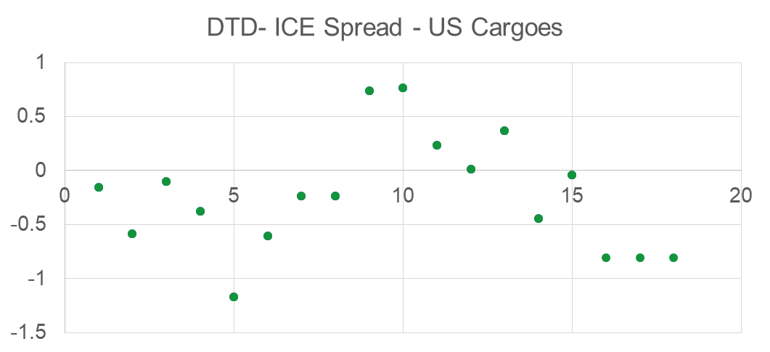
Dated/ICE Spreads and Assumed v Actual Freight

Slide 24
EXAMPLE 3

Slide 25
Example 3: Attractive cargo in tank
Bought: EMS&S purchased 600KB of CPC at an attractive differential from a distressed Seller, pricing on Dated Brent 3-7 April 2017. The load window was 31/3 – 2/4. Deal was done on the 2nd March. The cargo is to be delivered in Rotterdam and subsequently stored in tank.
The FOB purchase price is Dated Brent -2.20
The estimated freight cost is 0.62 $/bbl.
Sale: The cargo will at some point in the future be sold to an affiliate or third party. The sale will happen when Differential economics improve or when value has been captured on the market structure.

Slide 26
Example 3: Attractive cargo in tank
EMS&S buys CPC from third party
120
KB
120
KB
120
KB
120
KB
120
KB
Deal Date
2 March
3-April
7-April
30-April
31-May
30-June
31-July
Why hedge?
Eliminate the exposure to flat price movements, to safeguard differential incentive
Capture market structure (Preferably a Contango)
Questions
How would you hedge against the flat price movements?
When would you execute the derivatives transactions?
What instruments would you use?

Slide 27
Example 3: Attractive cargo in tank
600
KB
EMS&S buys CPC from third party
120
KB
120
KB
120
KB
120
KB
120
KB
Deal Date
2 March
3-April
7-April
30-April
31-May
30-June
EMS&S sell paper – ICE Brent
Method 1: Execute futures during the physical pricing periods to offset physical
3 – 7 Apr : Sell 120 kbd of June ICE Brent
.. – 30 Apr : Asses the Hedge roll and take action to roll the hedge to next month
Buy 600 kb of June ICE Brent
Sell 600 kb of July ICE Brent
Repeat roll until sale of cargo
At sale of cargo buy 120 kbd of September ICE Brent to close out the hedge and offset the physical
Physical and “floating” cancel out over both periods leaving the fixed prices only

Slide 28
Example 3: Attractive cargo in tank
600
KB
EMS&S buys CPC from third party
120
KB
120
KB
120
KB
120
KB
120
KB
Deal Date
2 March
3-April
7-April
30-April
31-May
30-June
EMS&S sell paper – ICE Brent
What are the considerations with above example?
- Typically we sell on Dated Brent, we have hedged to ICE Brent
Hedge the exposure between ICE and DTD Brent using CFD’s/DFL
- We haven’t taken into account the rental costs for the storage of the tank
Tank rental costs estimated at 0.35 $/bbl/month
- We haven’t taken into account the Heels
- Most importantly we haven’t compared versus alternative opportunities in tank
Currently estimated value of tank for usage in refinery is at 0.86 $/bbl

Slide 29
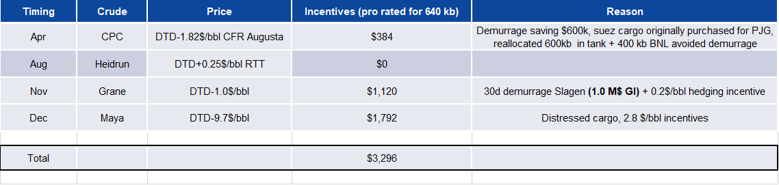
MOT Tank
2017 Activity
Rented MOT Tk4 since April 2017
Two physical cargoes put into tank - CPC and Heidrun
Tank empty (for trading) since mid September due to market backwardation
Market went from contango to backwardation in August
Option to rent TEAM tank not exercised due to market backwardation
MOT Tank handed back to refinery in 4Q due to market structure and refinery opportunities (distressed Maya)
Financial Results (MOT Tk4, as of 1 Nov 17):
Additional Benefits
Cargo | Volume | Duration | Contango Capture | Dated/ICE Capture | Differential Capture | Tank Rental | Total P/L
CPC | 600KB | April – Aug | $0.83M | $0.56 | $1.0M | -$1.0M | $1.4M
Heidrun | 630KB | Aug - Sep | $0.0M | $0.0M | $0.2M | -$0.2M | $0.0M
Heels | 50KB | Sep - Present | $0.0M | $0.0M | $0.0M | -$0.5M | -$0.5M
Total |  |  | $0.83M | $0.56 | $1.2M | -$1.7M | $0.9M

Slide 30
EXAMPLE 4

Slide 31
Example 4: Pricing basis exposure Qua Iboe Sale to HPCL
EMS&S buy fixed - DTD
EMS&S buys 950 kb Qua Iboe from Upstream & 950 kb Qua Iboe from 3rd Party
EMS&S Buys floating – DTD Cal Jun
EMS&S Buys floating – DTD Cal July
380
KB
380
KB
380
KB
380
KB
380
KB
32 KBD
31 KBD
Deal Date
25 April
1-June
11-June
15-June
31-July
30-June
EMS&S sell floating – DTD
EMS&S Sells 1900 kb Qua Iboe into HPCL on Dated Calendar Month Average Jun-July
EMS&S sell fixed - DTD
Method: Execute a dated swap on deal date which automatically unwinds over physical pricing period and “locks-in” the spread on DATED BRENT
Today:
- Buy 950 kb Dated Brent 11-15 June @ Fixed Price
- Buy 950 kb Dated Brent 11-15 June @ Fixed Price
- Sell 950 kb Dated Brent June Cal @ Fixed Price
- Sell 950 kb Dated Brent July Cal @ Fixed Price
For doing this we will have to pay or receive a consideration for the structure (Today’s market in Backwardation)
- In this case we would have to pay 7 Cents/bbl for locking in June and 57 Cents/bll for locking in July
- On Average this operation will cost us 33 Cents/bbl
When cargos are pricing, the hedge will unwind automatically, and thus no action should be taken

Slide 32
EXAMPLE 5

Slide 33
Pricing Option
EMS&S purchases Basrah from SOMO on 2 different pricing bases dependent on destination of the cargo:
Typically a refinery would purchase this Basrah cargo on back to back pricing terms from EMS&S
Assumption : Cargoes destined for US are placed into the system as an alternative to LatAm barrels ie price around delivery
Therefore there is the below pricing option dependent on destination :
Destination option Purchase Price timing Refinery Price
Europe 14 days after B/L 14 days after B/L
Basrah cargo
US Month of Load Arrival at refinery
Assumptions:
Basrah cargo can go to either the US or Europe affiliate
There are requirements for Basrah in both US and European refineries
It is possible to back fill the requirement either the US or European refinery up to the date of load of the Basrah cargo
Basis risk of ASCI to WTI is managed
It is possible to charter a vessel that is flexible to go to either Europe or US at no additional cost

Slide 34
Option : Purchase 1MB Basrah cargo from SOMO loading 30th March - destination free
Option 1 : Sell 1 MB to US affiliate
If cargo goes to US then purchase physical based on month of load and sell to affiliate based on alternative Lat Am barrels that price on delivery
Paper purchase -200 KBD
Deal Date
24th Jan
Physical purchase - 45 KBD
Paper sale - 45 KBD
Physical sale to affiliate 200 KBD
1-March
30–March
Cargo loads
30 - April
4 -May
Option 2 : Sell 1 MB to European affiliate
If cargo goes to Europe then buy from SOMO and sell to affiliate 5 quotes 15 days after B/L - no hedging required as physical purchase and sale back to back
200 KBD
Deal Date
24th Jan
1-March
200 KBD
30–March
Cargo loads
16 - April
21 - April
Destination declared 14 days after load but have to advise ship of destination before this

Slide 35
Catch up hedge example
1st March : Basrah cargo originally going to Europe no hedge
Paper purchase -200 KBD
Deal Date
24th Jan
Physical purchase - 45 KBD
Sell
450kb
1-March
Paper sale - 45 KBD
Physical sale to affiliate 200 KBD
30–March
Cargo loads
30 - April
4 - May
14-March
14th March - decision taken to send cargo to US
Therefore need a “catch up hedge” ie sell the hedge that has been missed = 45 x 10 (quote days) = 450kb

Slide 36
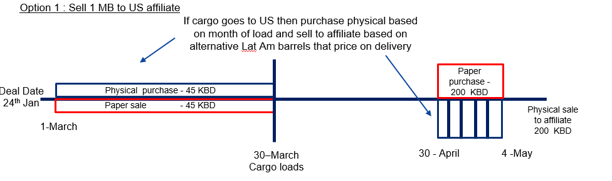
March Basrah - Hedge optionality example
1 MB Basrah cargo loading on 30th March and can go either to US or Europe, 22 WDs in a month , 45 kb pricing /day
Destination free, declaration 15 days after load
WD 1 assume that cargo goes to US therefore sell paper WTI daily as buy physical cargo on ASCI quote
Maintain hedging action for WD2, WD3 and WD4 whilst daily WTI price above rolling month average

Slide 37
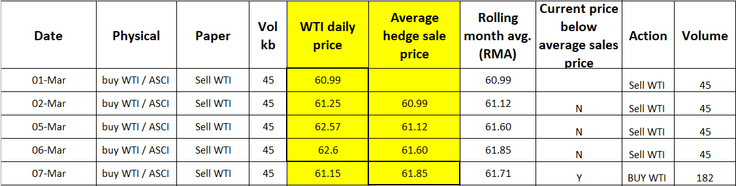
March Basrah - Hedge optionality example
On WD 5 / 7th March daily WTI price $61.15 falls below the average price of the paper sales in WD 1-4 = $61.85 then change cargo destination to Europe
As no hedging action is required if cargo goes to Europe then take off WTI paper position ie buy back hedge at $61.15
Hedge close generates P/(L) eg sold $61.85 buy $61.15 on 182kb = $0.128M profit

Slide 38
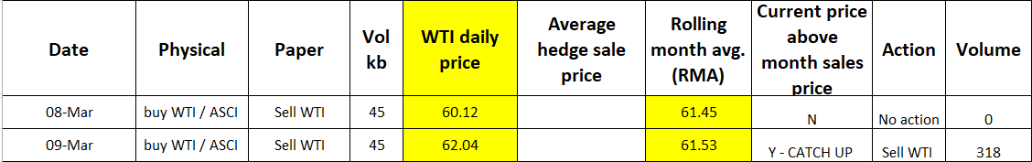
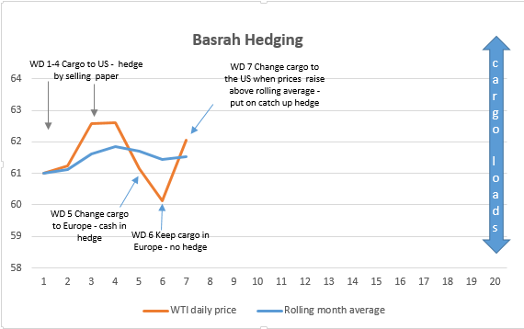
March Basrah - Hedge optionality example
Start to compare current hedge price with the Rolling Month Average ie price we should have sold the hedge at if the cargo was going to the US
On WD 6 / 8th March the WTI price continues to fall cargo destination maintains in Europe
On WD 7 / 9th March the WTI price $62.04 rises above the RMA $61.53 therefore if we change the destination of the cargo to the US we will hedge cargo again and sell a “catch up” hedge to cover the prior trade days. Therefore sell 7 x 45.4 = 318 kb at the todays price of $62.04.
Catch up hedge generates P/(L) eg month average price is $61.53, catch up hedge sales price is $62.04 ie P/(L) = 0.51 x 318 = $0.162 M (if cargoes goes to US)

Slide 39
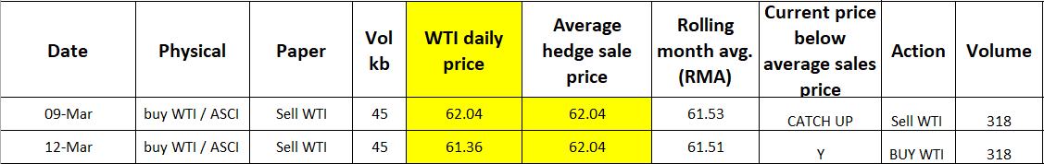
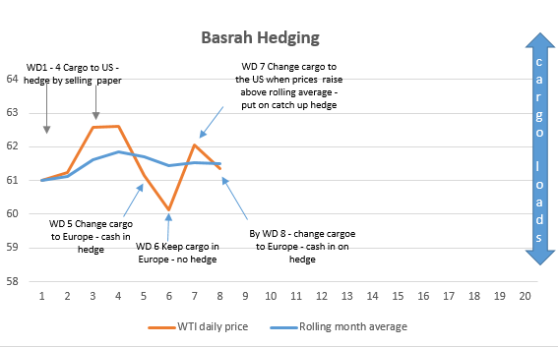
March Basrah - Hedge optionality example
On WD 8 / 12th March the WTI daily price falls to $61.36 and below the price that we have sold paper the previous day $62.04 therefore the cargo destination would flip to Europe.
The paper hedge will be closed out, buy back 318kb on WTI P/(L) = ($62.04 - $ 61.36) x 318kb = $0.216 M
Total paper P/(L) on WD 8 = $0.128 M + $0.216 M = $0.344M

Slide 40
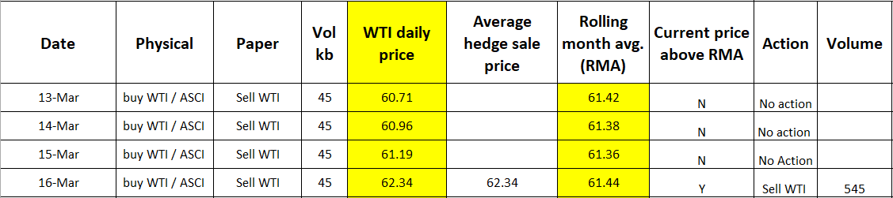
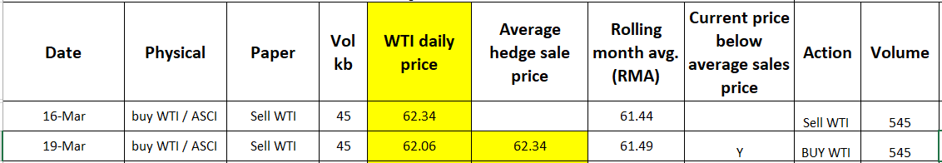
March Basrah - Hedge optionality example
WD 9 -11 / 13 – 15 Mar the WTI daily price remains below the RMA ie loss if sell hedge so keep cargo in Europe
WD 12 / 16th March current price $62.34 above RMA $61.44 so re assign cargo to US and put on catch up hedge 12 x 45.4 = 545 kb
Potential paper gain P/(L) = $ 0.90 ($62.34 - $61.44 ) x 545 kb = $0.491 M (if cargo goes to US)
WD 13 / 19 Mar the WTI daily price falls below the average sales price ie redirect cargo Europe and buy WTI / take off hedge
Paper hedge P/(L) = $ 0.28 ($62.34 - $62.06 ) x 545 kb = $0.153 M
Total paper P/(L) on WD 8 = $0.128 M + $0.216 M + $0.153 = $0.497M

Slide 41
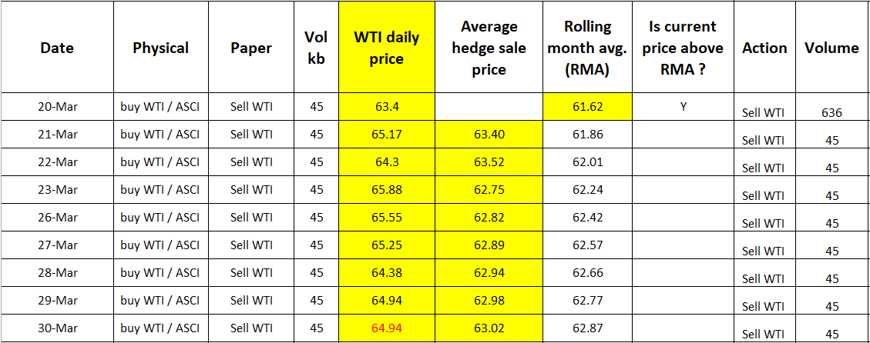
March Basrah - Hedge optionality example
WD 14 / 20 Mar the WTI daily price rises above the RMA sales price ie redirect cargo to US , sell catch up hedge
Paper P/(L) = $1.78 ($63.40 - $61.62) x 636 (14 x 45.4) = $1.1M (if cargo goes to the US)
As prices continue to rise then keep cargo into US and capture the P/(L) on the hedge
Total paper P/(L) on WD 22 = $0.128 M + $0.216 M + $0.153 + $ 1.1 = $1.6 M ☺

Slide 42
EXAMPLE 6

Slide 43
EXAMPLE 6 : CPC BLEND SALE INTO ASIA
Bought:
An equity 1050kb CPC Blend cargo from the Kashagan Field has been made available to our Singapore refinery. The equity volume loads on Apr 13-14, pricing is per inter affiliate FOB transfer price = Dtd (BOL 0/1/5) +X –Y (where X= prevailing CPC trading differential as published by Platts CIF Augusta, average of 6 quotes 25 days prior to BoL and Y = the freight net back from augusta to CPC terminal)
Sold:
The 1050kb CPC would be consumed by EMCAP as:
300 kb against alternative Apr Murban
750 kb against alternative May Murban
The requirement for a hedge is therefore to price convert the cargo and reduce EMCAP’s exposure to:
Brent vs Dubai (for 1050 kb)
0/1/5 vs WMA (for 1050kb)
Apr vs May (for 750 kb)

Slide 44
How will it work
EM KAZAKHSTAN SELLS PHYSICAL 1050kb CPC TO EMSS AT Dtd (BoL 0/1/5) +X-Y
EMSS PRICE CONVERTS
EMSS SELLS PHYSICAL 1050kb CPC BLEND TO EMCAP AT DUB+Z+ACTUAL FREIGHT
The price conversion is in two parts:
Marker convert 1050kb from Brent to Dubai
Time convert 1050kb from 5 days after BoL to:
300kb Apr wma
750kb May wma

Slide 45
How will it work
The proposed Price Conversion will consist of two parts:
Marker convert 1050kb from Brent to Dubai.
Time convert 1050kb from 5 days after BOL to:
300kb Apr WMA
750kb May WMA – volume is pre-coverage for May demand.
Detailed Mechanics of the Price Conversion as follows:
Assuming BOL = Apr 13, then price-in period is 6x 175kb between Apr 13-20:
Utilizing ICE Brent as the instrument, acknowledging it is not a perfect price conversion as there will be a residual basis risk between Dtd and ICE.
Front-line ICE Brent quotes during the price-in period is Jun ICE.
We will execute the Price Conversion in three steps:
1) Marker convert (EFS):
Buy 1050kb Jun EFS, consisting:
Buy 1050kb Jun ICE Brent
Sell 1050kb Jun Dubai swap, consisting:
Sell 1050kb Dubai fixed
Buy 1050kb Dubai floating (Jun 1-30)
2) Time convert (intermonth spread):
Sell 750kb May/Jun Dubai spread consisting of:
Sell 750kb May Dubai fixed
Buy 750kb Dubai (May 1-31)
Buy 750kb Jun Dubai fixed
Sell 750 Dubai (Jan 1-30)
Sell 300kb Apr/Jun Dubai spread
Sell 300kb Apr Dubai fixed
Buy 300kb Dubai (Apr 1-30)
Buy 300kb Jun Dubai fixed
Sell 300kb Dubai (Jun 1-30)
3) Unwind Jun ICE Brent during the period when the physical cargo prices-in, by selling Jun ICE 6x 175kb Apr 13-20:

Slide 46
June
fixed
ICE Brent
1050Kb
Dubai
fixed
June
750Kb
Dubai
fixed
June
300Kb
APRIL
APRIL
MAY
MAY
JUNE
EFS
Physical buy 1050KB 0/1/5
Paper buy 1050kb June floating
Paper buy 750kb May
EFS
Deal Date
Paper buy 300kb April
Physical sale 750KB wma May
EFS
Paper sale 1050KB 0/1/5
Dubai
fixed
April
300Kb
Dubai
fixed
May
750Kb
Dubai
fixed
Jue
1050Kb

Slide 47
EXAMPLE 7

Slide 48
AG Global Destination Flexibility Global Crude Advisor Global Feed & Product Management
May 2018

Slide 49
The enablers

Slide 50
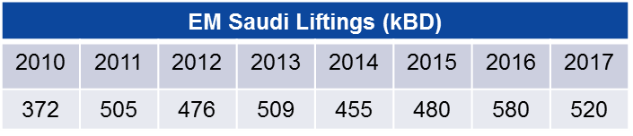


Global AG program
Main AG destinations in Europe: Gravenchon, Fawley, Antwerp, Rotterdam, Augusta and Miro. Saudi offers in tank transfers in Rotterdam
Suez Canal: VLCC (2.1MB) need to drop ~ 650 kb via SUMED pipe; pick up at Sidi Kerir (D&P = Drop and Pick)
Saudi offers FOB sales in Sidi Kerir
3
Singapore ships AG on multigrade / multiport VLCC due to lack of tanks
3
1
2
2
Suez Route (S)
VLCC (2.1MB) with AG into USGC. Lightering (500 kb) into sites
2
Cape Route(C)
Loadports for Saudi, Basrah and Kuwait.
Aramco sells Saudi / KPC sells Kuwait / SOMO sells Basrah
AG barrels into
USGC: BT / BR
AP: SIN / ETL / MONZ
NWE: GRA / FAW / ROT / ANT
MED: AUG / MIRO
Shipping Days
NWE
26(S) / 39(C)
Asia Pac
AG
12
USGC
38(S) / 45(C)

Slide 51

Loadports and Logistics
BOT (Basrah Oil Terminal)
MAA (Mina Al Ahmadi) Kuwait
US / NWE / Med
Suez Canal
22 / 12 / 3 days Voyage from Sidi Kerir
3 days through Canal incl Drop and Pick
Ceyhan (Kirkuk)
Ras Tanura / Juaymah (Saudi)
Sidi Kerir
SUMED Pipeline
Straight of Hormuz
2 Pipelines for Light (AL) and Heavy (Basrah/AH)
1.5 day Voyage
AP
P/L - Arab Light only
Ain Sukna
12 days voyage to Singapore
Yanbu
12 days Voyage
SUMED
Barrels lifted in Sidi Kerir that are delivered to a refinery can be “borrowed” from another affiliate, to be re-balanced in the following month.
Gulf of Aden
US / NWE via Cape
45 / 39 days voyage

Slide 52
Contract Pricing Summary
Saudi Aramco prices based on monthly published Official Sales Price (OSP) vs. regional marker:
USGC : Argus Sour Crude Index – Mars, Poseidon and SGC
Europe : ICE BWave
AP : 50/50 Oman/Dubai
Period differs between regions
USGC : average ASCI quotes of month M-1 CD26 through month M CD25, where M is month of load
Europe : NWE : average of 20 quotes starting B/L +35 days / MED: average of 20 quotes starting B/L +15 days
AP : average month M, where M is month of load

Slide 53
The optimization

Slide 54
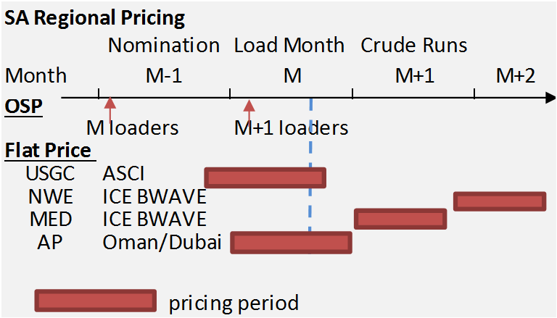
Global Destination Flexibility
EM AG contracts have global destination flexibility enabling global optimization
Regional swaps monetize month on month differences in Official Sales Price (OSP) and Flat Price (FP) between regions, enabled by price disclosure on FP and OSPs between initial and final nomination
Final destination is declared ~10 days before loading ship (final load instructions)
Re-allocation can be driven by optimizations or by operational reasons
Planned regional swaps require reversal in next month loading program
SUMED allows to switch destination West using affiliate inventories in SUMED without impacting physical destination
Approved derivatives programs in place to lock flat price exposure allowing earlier decisions
AP program is constrained by lack of tankage (Singapore <8MB vs 16MB Design Practice) but initiated East – West optimization early 2018
Example West Optimization
1
Original nomination ARL to USGC (at nomination)
2
Final nomination ARL to NWE (following price disclosure)
3
ARL discharged in SUMED and retitle from NWE to USGC
4
Physical barrels ARL discharged in USGC
1
Reverse transaction in next month program
2
5
4
3

Slide 55
Regional retitling swaps – example West USGC vs NWE
Initial AG program includes following ships:
4/27 VLCC loading ARL to USGC
5/10 VLCC loading ARL to NWE
~ Apr 20, we decide title on 4/27 loader. Price discovery:
OSPs for April and May loaders
~ 80% FP discovery for USGC

Slide 56
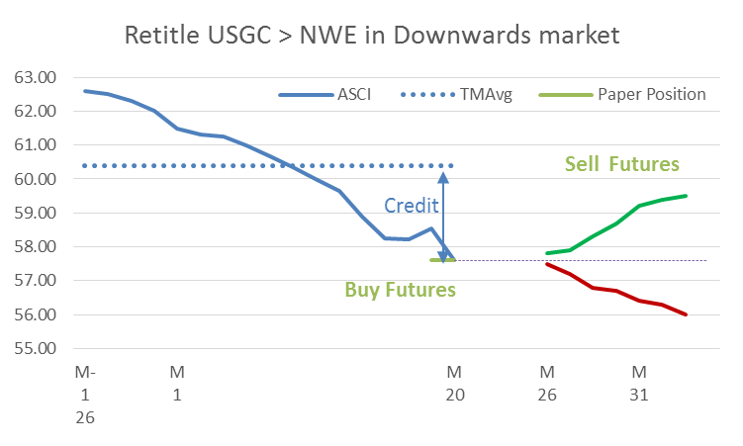
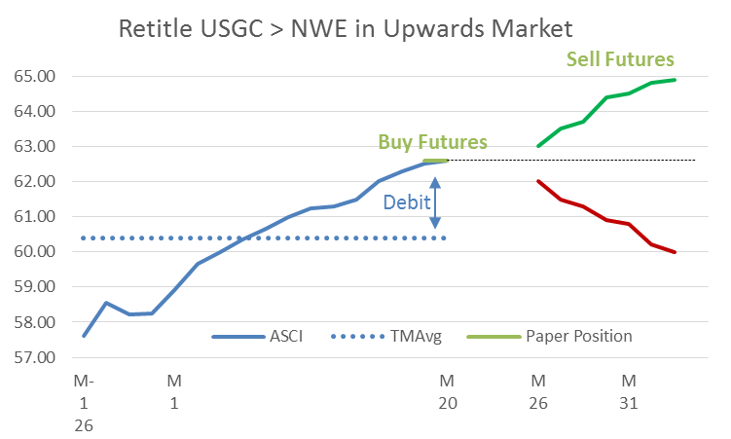
Regional retitling swaps - paper
Approved derivatives programs in place to lock flat price exposure
Mars/TI flat price locked in via purchase/sale of Mars and TI futures
ICE locked in only in case of significant change in pricing period via similar program

Slide 57
Regional retitling swaps – West vs East
Case For Action
Regional title swaps focused in past years only West via Sumed (USGC vs. Europe)
AP price structure has price discovery for month-end AP barrels
Past AP optimizations not successful due to logistics constraints
Optimization developed 1Q 2018 to leverage AP’s potential
Schedule distinct VLCC ARL in AP as mid month arriving ship
Schedule offsetting month end West bound vessel
Decide optimized load month around ~ month M / CD 20
Critical Enablers
Saudi allocation requires two VLCC in each month, one at month start, one at month end. Saudi Aramco ‘good’ dates leveraged via commercial
~ up to 10 days of incremental demurrage

Slide 58


East-West Detailed Example
VLCC ARL planned in AP program for arrival mid month M+1 / CD 11-13
optionality on load month M (CD 30-31) or load month M+1 (~1-2)
destination declared ~ 10 days before B/L so by month M CD ~ 20. Optimization through OSP and FP
Flat price locked in AP and West
Original
Title Swap Optimum

Slide 59
Conclusion
Regional swaps are GI optimizations monetizing month-on-month differences in Official Sales Price (OSP) and Flat Price (FP) changes between regions, enabled by price disclosure on FP and OSPs by time discovery between initial and final nomination
This is Asset Backed Trading …. but we have been doing these swaps for years capturing value from EM’s global destination flexibility. Historically these optimizations have delivered ~ 30-50 M$ per year.
In the past ~ 12 months we have added hedging options to lock in flat price gains as part of these swaps
In a regional title swap, there is no change in delivery of the physical barrels into the system
Western bound barrels requires ships to sail via Suez for retitle in Sumed
East / West optimization has been added early 2018
Having month end and one month start distinct VLCC of fungible grade (ARL) on the water is a key enabler. This can explain why sometimes we are nominating ARL at times in to marginal economic layers.

Slide 60
APPENDIX

Slide 61
Dated Brent = ICE BT + CFD + EFP
EFP = BFOE – ICE BT – physical trading mechanism
MOPS EFP = BFOE – ICE BT (4.30pm vs 4.30pm minute marker)
CFD = Dated Brent – BFOE (4.30pm vs 4.30pm)
DFL = Dated Brent – ICE BT settlement (4.30pm vs 7.30pm)
(CMA) Calendar monthly average WTI futures = (²/₃ M+1) +(¹/₃ M+2)
(CMA) ICE BT futures = M+2
(CMA) Dubai Swap = Dubai partial M+2
Spread values are expressed as
Month A-Month B : if negative A < B ; if positive A>B
DFL = Dated to frontline futures
EFP = Exchange of futures for physical
EFS = Exchange of futures for swaps

Slide 62
