Slide 1

NoGAN: New Generation of Synthetic Data Vincent Granville, PhD Chief AI Scientist MLtechniques.com vincentg@mltechniques.com
GenAI Breakthrough: Fast, High Quality Tabular Data Synthetization

Slide 2
What is Synthetic Data?
Artificially generated data to mimic some real data
Images, sound, time series, text (LLM), tabular data, geospatial
Potential goals:
Data augmentation to enrich predictive models
Compute confidence intervals
Benchmarking algorithms on bigger and more varied data
Increasing sample size of small segments
Algorithmic bias removal
Imputing missing values
Addressing security and privacy issues
Low-cost option when data is hard to get (clinical trials)

Slide 3
Techniques for Data Synthetization
Method | Comment
Copula | Reproduce marginal distributions, correlations
Agent-based modeling | Weather patterns, virus propagation
Parametric methods | Gaussian mixture Models (GMM), EM algorithm
Deep neural networks | GAN, Wasserstein GAN
Multivariate interpolation | Time series, geospatial data
White noise perturbation | Easiest, but noise must be properly calibrated

Slide 4
Why NoGAN, and where does it fit?
NoGAN is to GAN what NoSQL is to SQL
No neural network involved, 1000x faster
Consistently better results, based on sound evaluation metrics
Explainable AI, intuitive method and hyperparameters
Easy to fine-tune, leading to auto-tuning
Case studies: telecom, insurance, healthcare, cybersecurity, education
Open source: Python library, available here

Slide 5
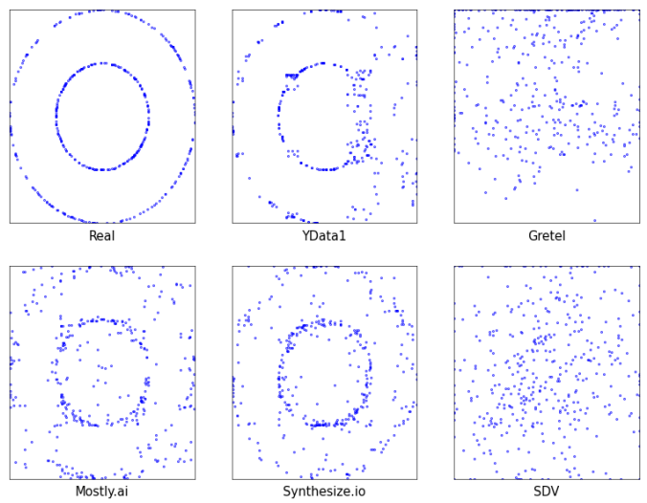
GAN: Vendor Comparison
Circle dataset: all vendors rate their synthetization as excellent

Slide 6
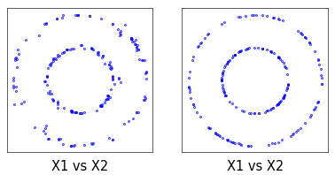
NoGAN
Performance on circle dataset: synthetic data (left) vs validation set (right)
Source code: on GitHub

Slide 7
NoGAN Algorithm in a Nutshell
Train the “model” with training data:
Bin each feature separately based on empirical quantiles evenly spaced out
Create static multivariate bins (hyperrectangles), based on above slices
Let p_{k} be the proportion of training set observations in hyperrectangle B_{k}
Generate N synthetic observations:
For each k, generate a count n_{k} attached to hyperrectangle B_{k}
(n₁, n₂, n₃, …) ~ Multinomial(N; p₁, p₂, p₃, …)
For each k, generate n_{k} vectors uniformly distributed in B_{k}
The synthetic data is the collection of the above vectors, with n₁+ n₂ + n₃ + … = N.

Slide 8
Why is NoGAN so fast?
The training set data is visited only once, sequentially, as follows.
For each observation in the training set:
Create a new static hyperrectangle if the current observation is not in any hyperrectangle built so far, and set the number of observations to 1 for that hyperrectangle
Otherwise increase by 1 the observation count for the corresponding hyperrectangle
The hyperrectangle structure is a key-value pair table
The key is the coordinate vector of the hyperrectangle in the feature space
The value is the number of training set observations in that hyperrectangle
Categorical features are efficiently handled with smart encoding

Slide 9
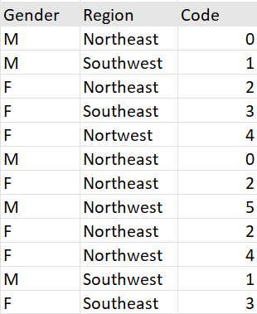
Smart Encoding of Categorical Features
Create new codes sequentially as you browse the training set.
Aggregate codes with few observations into bundles.
Create two key-value mappings. Ex:
Category_to_Code[‘M’, ‘Northwest’] = 5
Code_to_category[5] = [‘M’, ‘Northwest’]
Replace the categorical features by the newly created feature, “Code”.
Number of codes ≤ number of obs.

Slide 10
Cross-validation with Holdout Method
To avoid over-fitting and get a better assessment of how the method performs on future observations, proceed as follows:
Split your real data into two sets: training data, and validation set (50/50).
Use the training data to train the model, to generate synthetic data.
Compare your synthetic data with the validation set (the holdout data)
KS is the distance between both sets (more precisely, between the two underlying joint empirical distributions, called multivariate ECDFs)
Likewise, Base KS is the distance between the training and validation sets
If and only if KS ≈ Base KS, then your synthetic data is good
KS and Base KS range from 0 (best fit) to 1 (worst fit)

Slide 11
Best Evaluation Metric
Metrics used by vendors fail to capture complex feature dependencies, see circle dataset. Avoid this problem by using the ultimate distance:
The multivariate Kolmogorov-Smirnov distance (KS) between two empirical distributions: validation set vs synthetic data.
Belongs to the family of Integral Probability Metrics.
Successfully Implemented in high dimensions for the first time, for NoGAN evaluation (case studies with both categorical and numerical features)
Fast implementation based on approximated formula.
Open source: GenAI-Evaluation library (Python)

Slide 12
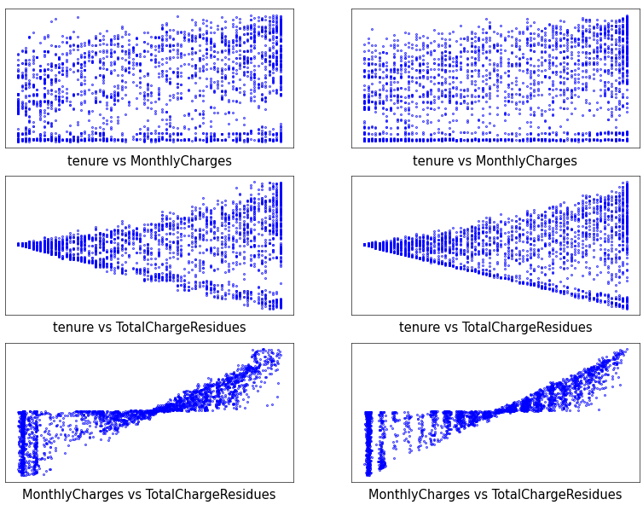
NoGAN Visual Evaluation – Scatterplots
Telecom dataset, numerical features for category “churn = No”

Slide 13
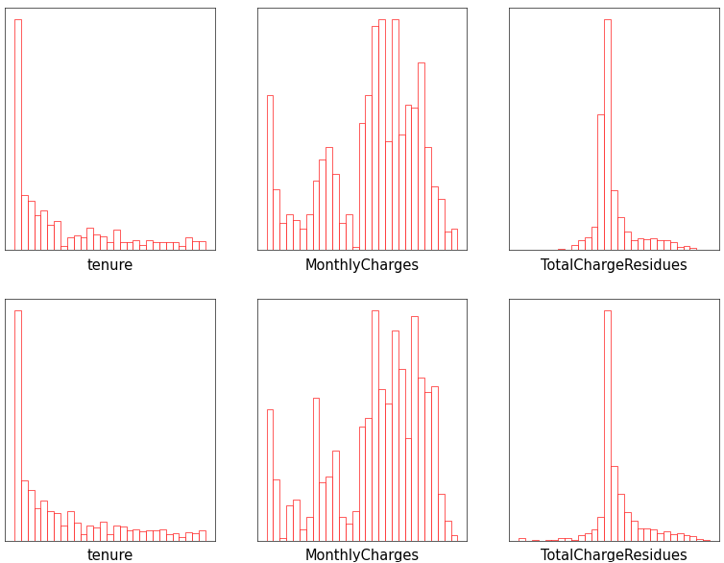
NoGAN Visual Evaluation – Histograms
Telecom dataset, numerical features for category “churn = No”

Slide 14
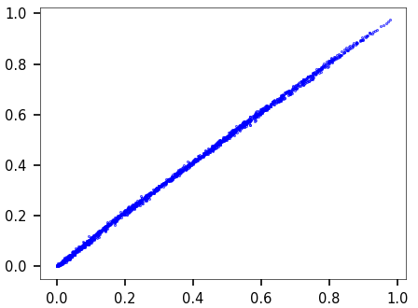
NoGAN – Multivariate ECDF scatterplot
Telecom dataset, joint distribution, 4 features (3 numerical, 1 categorical)
Comparing ECDF values: synthetic data vs validation set
Part of the KS evaluation metric (main diagonal = perfect fit)

Slide 15
NoGAN Hyperparameters, Auto-tuning
Hyperparameter vector with one value for each feature, specifying the number of univariate bins when slicing the corresponding empirical distribution. Large values always do well but can lead to overfitting and “holes”.
High values result in many hyperrectangles with very few observations.
Auto-tuning: for each feature, set the value to the minimum so that categories / intervals with few observations are not missed in the synthetization. Mathematical formula available for automation.
The seed parameter allows for replicability, unlike neural network methods.

Slide 16
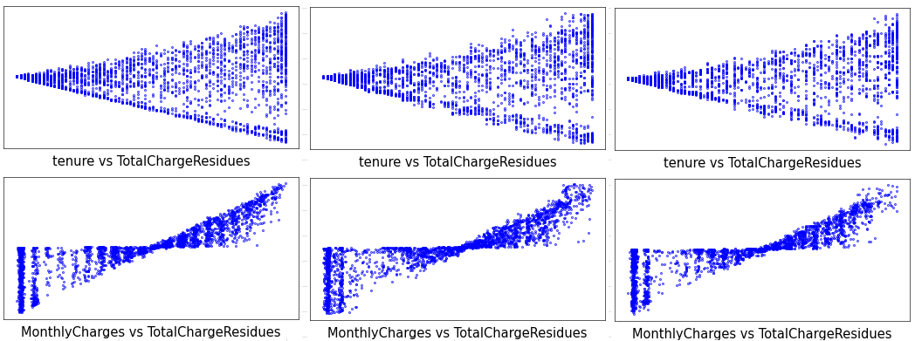
Gaussian NoGAN – Telecom Dataset
Validation set (left), NoGAN (middle), Gaussian NoGAN (right)

Slide 17
Gaussian NoGAN (Cont.)
Replace uniform by Gaussian sampling in each hyperrectangle.
Two extra hyperparameters: the stretching vectors.
Stretch_type[k] specifies the sampling type for feature k (uniform or Gaussian)
Stretch_value[k] specifies the stretching factor (scale) for feature k
Stretching value between 0 and 1 keeps generated observations inside each hyperrectangle (with uniform sampling)
Gaussian sampling allowed for numerical features only
Stretching value > 1 not allowed for categorical features; increases data variety for numerical features
Source code on GitHub, here. Back-compatibility with NoGAN.

Slide 18
NoGAN Enhancements
The KS distance does not require categorical features to be handled differently, thanks to smart encoding. No Cramer’s V needed.
Data transforms such as decorrelation, prior to NoGAN and followed by inverse transforms, can help.
To sample outside the range of observations, Gaussian NoGAN can help. Quantile extrapolation is another approach.
NoGAN2 (based on resampling and hierarchical Bayesian models) uses a loss function that approximates KS. In NoGAN3, the loss function will be based on the NoGAN hyperrectangle structure, for better approximation.
Auto-tuning will soon be implemented.

Slide 19
Acknowledgements & References
I am very grateful to Shakti Chaturvedi, Rajiv Iyer, Mulyadi Kurniawan, Avinash Das, Oliver Chikumbo, and Willie Waters, for their outstanding contributions to shape this new technology, when attending the MLT GenAI certification program. Also, a big thank you to Fabiana Clemente, CDO at Ydata.ai, for many insightful discussions on the topic.
References:
New Python Library to Evaluate Synthetic Data.
Fast Data Synthetization with Hierarchical Bayesian Models.
NoGAN: Spectacular Performance of New Synthesizer.
Optimization for GenAI and ML. Upcoming book.

