Slide 1
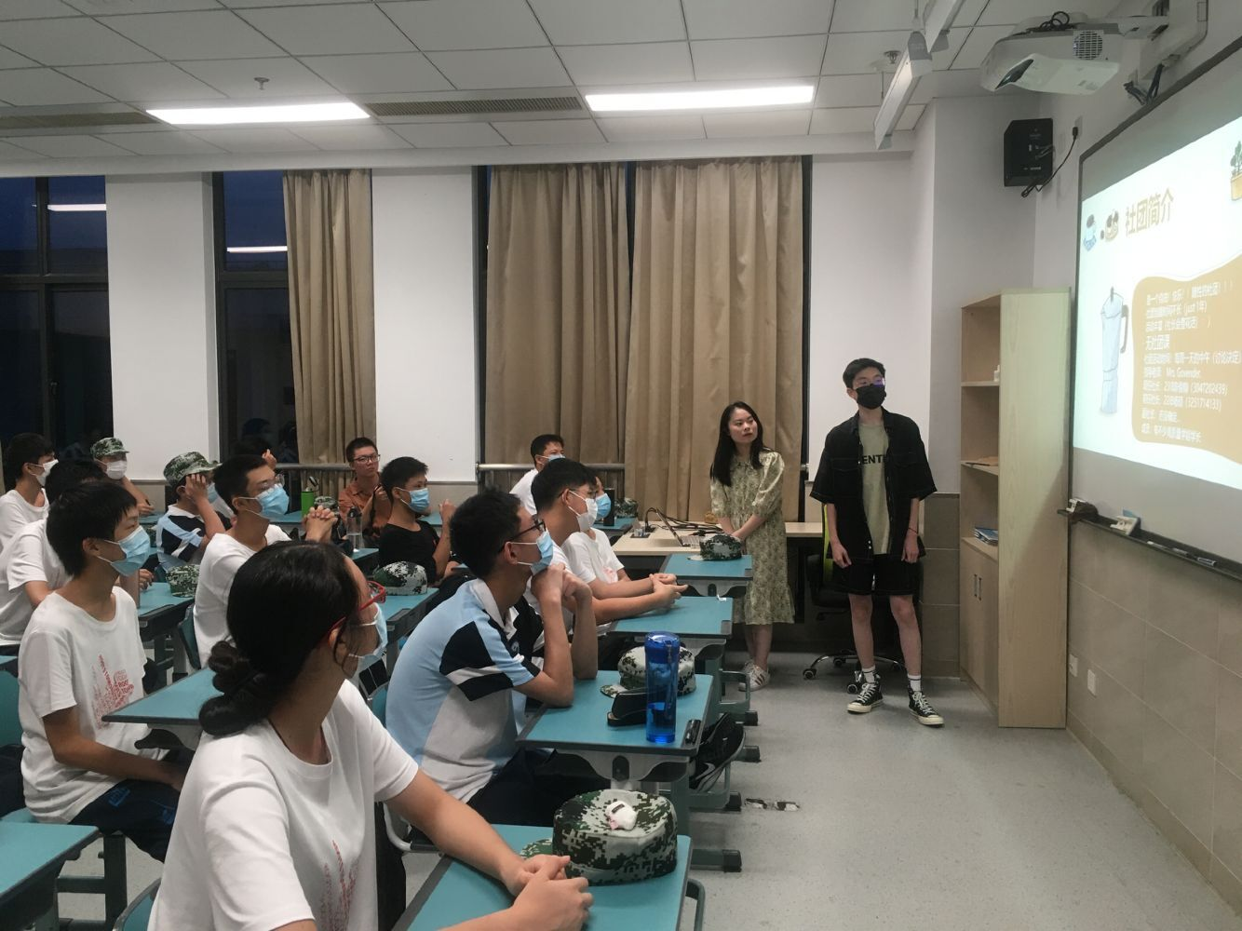
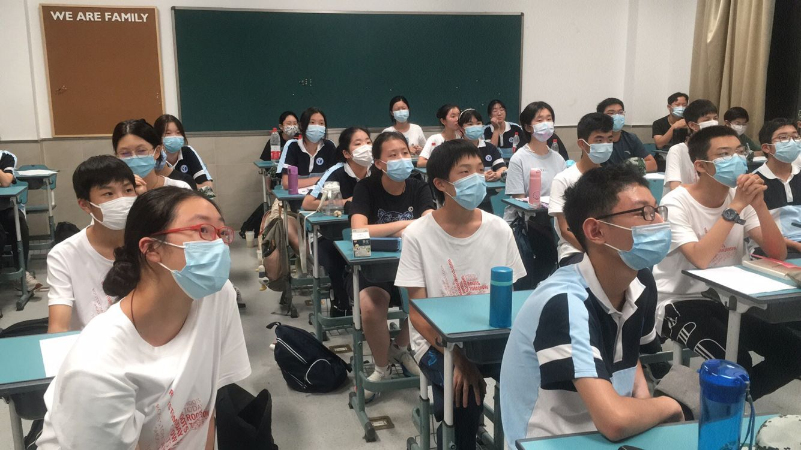
军训
Military
training

Slide 3
军训
Military
training
Military
training
Military
training
Military
training
Military
training
Military
training
Military
training
Military
training
记24IB01班四日军训
Military
training
Military
training
Military
training

