Slide 1
Module 7: Conversational AI and the Azure Bot Service

Slide 2
Module Agenda
Bot Basics
Implementing a Bot

Slide 3
Lesson 1: Bot Basics

Slide 4



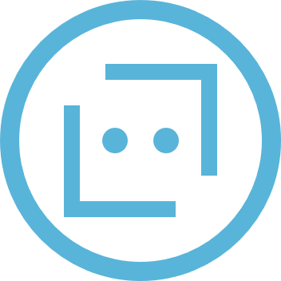



Conversational AI and Bots
Bot: an application with a conversational interface
Users interact with a bot by initiating activities in turns
Activities are events, such as a user joining a conversation or sending a message
Messages can be text, speech, or visual interface elements (such as cards or buttons)
A flow of activities can form a dialog, in which state is maintained to manage a multi-turn conversation
Activities are exchanged across channels, such as web chat, email, Microsoft Teams, and others
Bot
Channels

Slide 5
Azure Bot Service and the Microsoft Bot Framework SDK
Azure Bot Service
Cloud service for bot delivery and integration
Bot Framework Service
A component of Azure Bot Service that provides a REST API for handling bot activities
Bot Framework SDK
A set of tools and libraries for end-to-end bot development that abstracts the REST interface
Azure Bot Service
Bot delivery and integration
Bot Framework Service
REST interface
Bot Framework SDK
Bot development

Slide 6
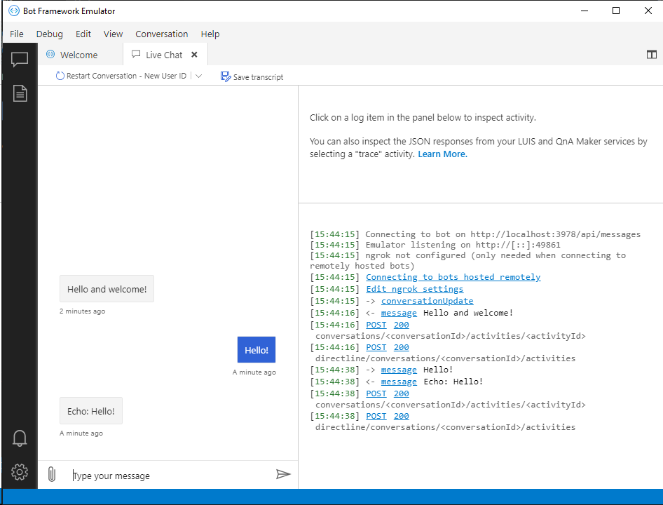
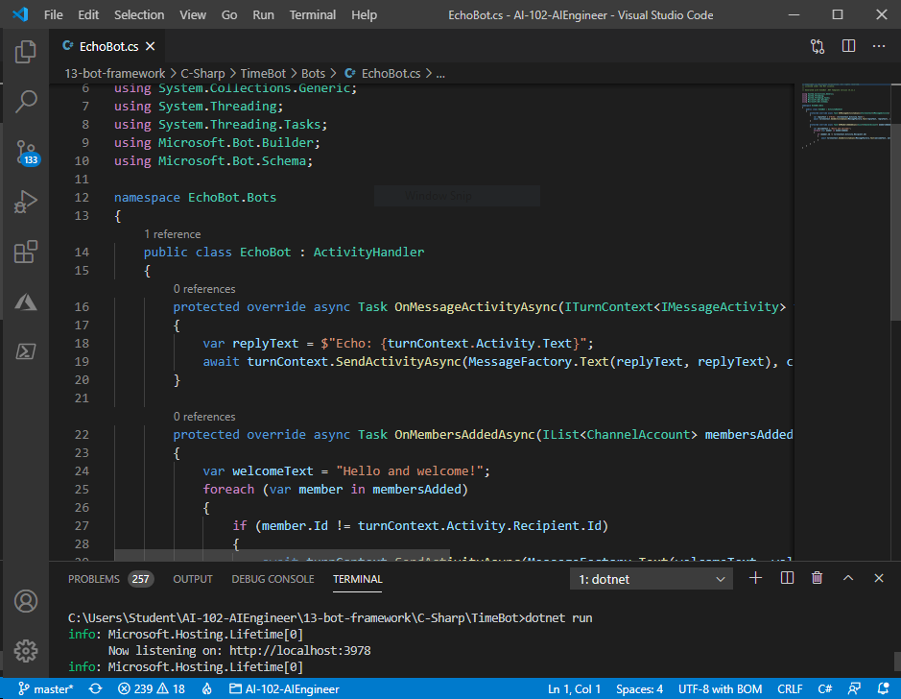
Developing a Bot with the Bot Framework SDK
Start with a template
Empty Bot - Basic bot skeleton
Echo Bot – Simple "hello world" example
Core Bot – Includes common bot functionality, like Language Understanding integration
Bot Application Structure
Adapter receives activities from channel (via Bot Framework Service), and calls bot turn handler
Bot processes activities using:
Activity Handlers
Dialogs
Test in the Bot Framework Emulator
Interactive testing application for bots

Slide 7

Activity Handlers
Process turns for different kinds of event
Bot Framework Service
Adapter
Activity Handler
HTTP POST ConversationUpdate (user joins)
MembersAdded(turnContext) {
SendActivity("Welcome")
}
Welcome
"Welcome"
Hello
HTTP POST Message "Hello"
MessageActivity(turnContext) {
msg = "You said" +
turnContext.Activity.Text
SendActivity(msg)
}
You said Hello
"You said Hello"

Slide 8
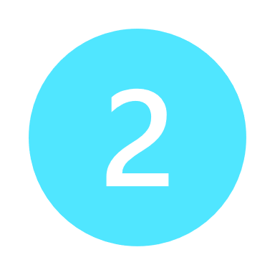
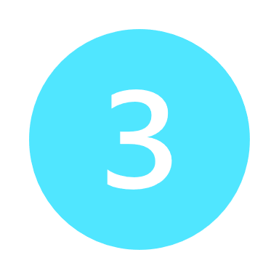

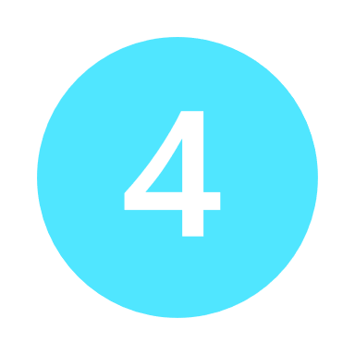
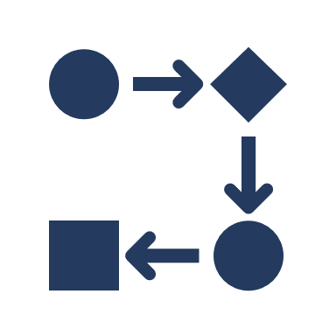
Dialogs
Manage stateful, multi-turn conversations
ComponentDialog Container
AdaptiveDialog Container
Bot Class
Bot Class
ComponentDialog
AdaptiveDialog (rootDialog)
AdaptiveDialog (pizzaDialog)
Dialog Set: [WaterfallDialog, ChoicePrompt, TextPrompt]
Recognizer
Recognizer
WaterfallDialog:
{
Step1: GetSize (ChoicePrompt),
Step2: GetToppings (TextPrompt),
…
}
Choose size
[S, M, L]
Triggers:
orderPizzaIntent
Triggers:
cancelIntent
M
Choose size
Enter Toppings
Hello
Actions:
Actions:
Pepperoni
I want pizza

Slide 9
Deploying a Bot to the Azure Bot Service
Create Azure resources
Register an app for bot authentication and identity
Provision resources using templates provided with Bot templates
Prepare bot for deployment
Create files for deployment dependencies
Deploy bot as a Web app
Zip bot files for deployment
az ad app create ...
az deployment group create ...
az bot prepare-deploy ...
az webapp deployment source config-zip ...

Slide 10
DEMO #1
Create a Bot from Azure Portal

Slide 11
Lab – Create a Bot with the Bot Framework SDK
Create a Bot

Slide 12
Lesson 2: Implementing a Bot

Slide 13
Bot Design Principles
Factors influencing a bot's success:
Is the bot discoverable?
Is the bot intuitive and easy to use?
Is the bot available on the devices and platforms that users care about?
Can users solve their problems with minimal use and bot interaction?
Does the bot solve the user issues better than alternative experiences?
Factors that do not guarantee success:
How ‘smart’ the bot is
How complex the bot's AI integration is
Depth of natural language support
Speech capabilities
Guidelines for responsible bot development:
https://www.microsoft.com/research/publication/responsible-bots
Notes:
Responsible Bot Guidelines: https://www.microsoft.com/en-us/research/publication/responsible-bots/

Slide 14

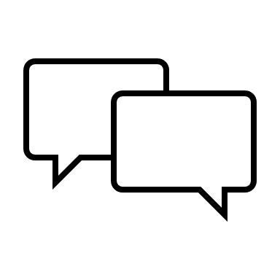

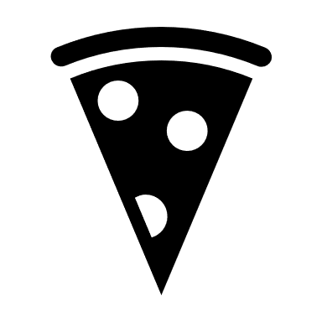



Designing Conversation Flow
Use dialogs to implement conversation flow
Traditional Application
Bot
Process based on sequence of "screens"
Process based on dialogs
Hi
---
---
Main screen
---
---
Root dialog
Select Pizza screen
Select Pizza dialog
Place Order screen
Place Order dialog

Slide 15
Designing for Interruptions
Allow for non-linear interactions
Your order:
1 medium pepperoni pizza
Your order:
1 medium pepperoni pizza
Checkout
Checkout
Choose an option:
Pickup
Delivery
Choose an option:
Pickup
Delivery
vs
Add another pizza
Add another pizza
Invalid choice
Choose an option:
Pickup
Delivery
OK, what size?
Small
Medium
Large

Slide 16

Designing the User Experience
How can I help?
Consider appropriate interface elements
Text
Speech
Rich user controls
Cards:
Adaptive
Audio
Animation
Hero
Thumbnail
Text
I want to order a pizza
>
Card Carousel
Receipt
SignIn
SuggestedAction
Video
Card carousel
Whole pizza
Slice
Hero Card
Customize

Slide 17
DEMO #2
Adaptive Card

Slide 18
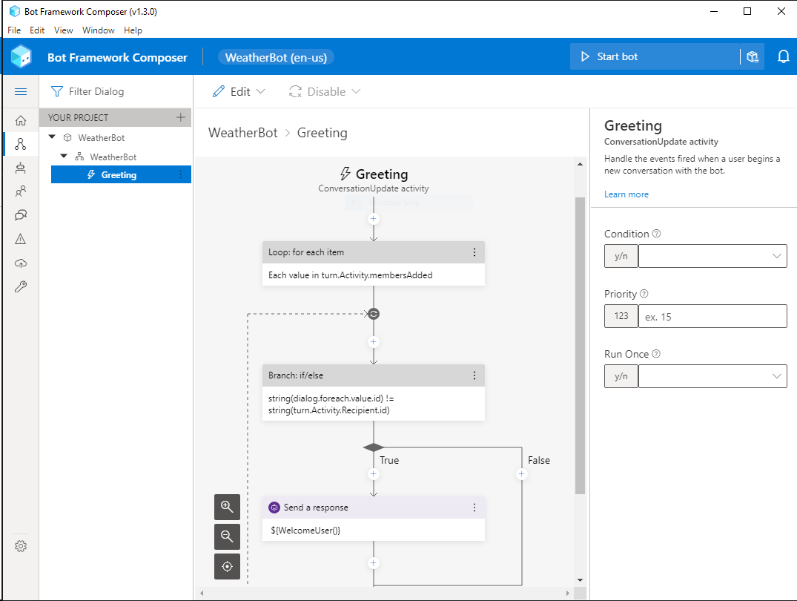
Bot Framework Composer
Graphical bot designer
Define dialog flows
Create triggers to initiate child dialogs
Built-in support for language understanding integration

Slide 19
DEMO #3
Bot Composer

Slide 20
Lab – Create a Bot with Bot Framework Composer
Create a Bot with Composer

Slide 21

Module Review
You want to enable a conversational customer support solution through both email and web chat. What should you do?
Create a bot for web chat. Send an automated response to email, directing users to web chat.
Create a bot for email, and a second bot for web chat.
Create a single bot and deliver it through both web chat and email channels.
You have created a bot using a Bot Framework SDK template.
Which tool should you use to test it locally?
Visual Studio Code
Bot Framework Emulator
Bot Framework Composer
When might you use a waterfall dialog?
When you do not want to maintain state between bot activities.
When you need to cancel an activity.
When you want to guide the user through a sequential series of steps.
Notes:
Use the slide animation to reveal the correct answers.

Slide 22
LABs
13 - Create a Bot with the Bot Framework SDK
14 - Create a Bot with Bot Framework Composer - (1.5h)

Slide 23
Closing slide

