Slide 1

PITCH DECK for SAD
An Integrated Business Management
Information System for Drabbit Marketing
Drabbit Marketing
Zian Wayne G. Matunding • Vincent Jon V. Libranza
CS103/L • CHERRY LISONDRA

Slide 2
PRESENTATION ROADMAP
Part I: Analysis
Part II: Design
Part III: Development
Part IV: Testing & Results

Slide 3
ORGANIZATION BACKGROUND
Business Profile
Drabbit Marketing is a sole proprietorship at Plainview Village KM.10 Sasa, Davao City, engaged in distribution and supply of plastic bags, trash bags, containers, cling wrap, aluminum foil, and related packaging products.
Vision
To become a leading packaging supply business in Davao City by leveraging technology-driven operations that ensure accurate, efficient, and transparent service delivery.
Mission
To provide quality packaging products while continuously improving operational efficiency through digital tools that automate order management, inventory tracking, invoicing, and customer service processes.
Products/Services
Plastic bags, trash bags, containers, cling wrap, aluminum foil, packaging products
Target Users
Retail and commercial customers throughout the Davao region

Slide 4
BUSINESS ENVIRONMENT
Industry Overview
Drabbit Marketing operates in the local packaging and household supply distribution sector in Davao City.
Single-location sole proprietorship with the proprietor as primary decision-maker.
Current Challenges
Orders received through phone calls or in-person visits only; no digital ordering channel.
Inventory tracked through manual physical stock counts.
Invoices and receipts prepared by hand, causing delays in billing.
Existing ICT Infrastructure
One desktop computer (Windows) + one mobile phone for communication only.
Active broadband internet connection. No enterprise software, accounting system, or POS.

Slide 5
CURRENT SYSTEM OVERVIEW
Current Workflow
Orders received via phone/walk-in; manually recorded on paper.
Inventory levels checked by manual physical stock counts.
Invoices manually prepared and delivered in person or via messenger.
Deliveries coordinated manually with no formal audit trail.
Existing Documents
Handwritten order records, physical customer files, manual logbooks.
Current Pain Points
Order errors and missed deliveries from pen-and-paper recording.
Risk of stock shortages or overstock due to lack of real-time inventory.
No centralized system; data loss risk from misplaced physical files.

Slide 6
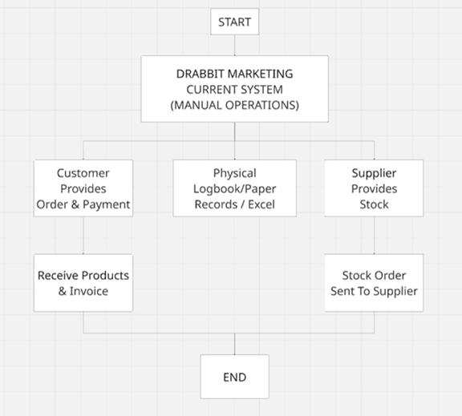
CURRENT SYSTEM DIAGRAM

Slide 7
PROBLEM STATEMENT
Performance – Manual order recording causes frequent errors and missed deliveries.
Information – No centralized database for customer information and order history.
Economics – Delayed invoicing slows revenue collection; high manual labor costs.
Control – No audit trail for transactions; difficulty detecting delivery discrepancies.
Efficiency – Repetitive manual tasks consume majority of daily working hours.
Service – No order status visibility; complaints handled informally with no documentation.

Slide 8
CRITICAL SUCCESS FACTORS
1. Accurate Order Management
Elimination of manual order errors through a digital order entry and tracking module.
2. Real-Time Inventory Visibility
A live inventory dashboard ensuring stock levels are always current and visible.
3. Automated Invoicing and Billing
System-generated invoices reducing delays in revenue collection and improving cash flow.
4. Customer Data Integrity
A centralized digital customer database protecting contact details and transaction history.
5. Audit Trail and Control
Complete transaction logging enabling the proprietor to detect and resolve discrepancies.

Slide 9
OBJECTIVES
General Objective
To develop a web-based business management application that automates core operational workflows of Drabbit Marketing, including order management, inventory monitoring, invoice generation, customer records, sales reporting, delivery tracking, and complaints handling.
Specific Objectives
Develop a web-based order management module to eliminate manual pen-and-paper recording.
Implement a real-time inventory dashboard with automated low-stock alerts.
Automate invoice generation upon order confirmation to reduce billing delays.
Build a centralized customer database to prevent data loss from physical file misplacement.

Slide 10
FEASIBLE ALTERNATIVES
Alternative 1: Spreadsheet-Based System
Manage orders, inventory, and invoices through Excel/Google Sheets formulas and manually maintained tables.
Alternative 2: Off-the-Shelf Accounting Software
Use commercial platforms (e.g., QuickBooks, Wave) offering ready-made modules for invoicing, basic inventory, and customer records.
Alternative 3: Custom Web-Based Information System (Proposed)
A custom-built web application developed specifically for Drabbit Marketing's workflows — tailored to order management, inventory, invoicing, reporting, and complaint handling needs without unnecessary features.

Slide 11
FEASIBILITY ANALYSIS
• Technical
Uses React, TypeScript, Node.js/Express, Turso (LibSQL), and Vercel — mature, widely-supported technologies that require only a browser and internet connection.
• Operational
Designed around the proprietor's daily workflow. Proprietor confirmed willingness to use a web-based system accessible via desktop and mobile phone.
• Economic
Higher Year 1 investment (Php 74,900) but recurring costs of only Php 21,900 from Year 2. ROI expected within 18–24 months.
• Schedule
Estimated 4–6 months for full development, testing, training, and deployment. Feasible within the academic term.

Slide 12
PROPOSED SOLUTION
System Name
An Integrated Business Management Information System for Drabbit Marketing
Overview
A custom web-based application designed to streamline Drabbit Marketing's core operations through digital order management, real-time inventory monitoring, automated invoicing, and centralized customer records.
Value Proposition
Eliminates manual, paper-based processes that cause order errors, billing delays, inventory stockouts, and data loss — providing the proprietor with a reliable, integrated platform for day-to-day business management.

Slide 13
FUNCTIONAL REQUIREMENTS
FR-01: User Authentication – Secure login with role-based access control.
FR-02: User Management – Create, update, deactivate accounts; assign Proprietor/Staff roles.
FR-03: Order Management – Create, track, update customer orders with auto-generated reference numbers.
FR-04: Inventory Monitoring – Real-time inventory levels with auto-update upon order fulfillment.
FR-05: Low Stock Alerts – Automated alerts when product stock falls below minimum threshold.
FR-06: Customer Database – Digital profiles with contact, address, order history, and transaction records.
FR-07: Invoice Generation – Auto-generated invoices upon order confirmation with payment status tracking.
FR-08: Sales Dashboard – Reports on sales trends, top products, and revenue over selected periods.
FR-09: Report Exporting – Export reports in PDF or spreadsheet format.
FR-10: Audit Trail – Full transaction logging with timestamps and user IDs.

Slide 14
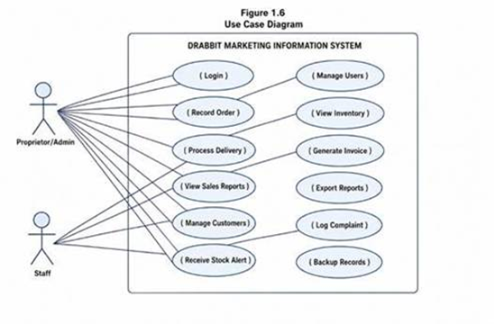
USE CASE DIAGRAM
Actors: Proprietor/Administrator (primary) • Staff (secondary)

Slide 15
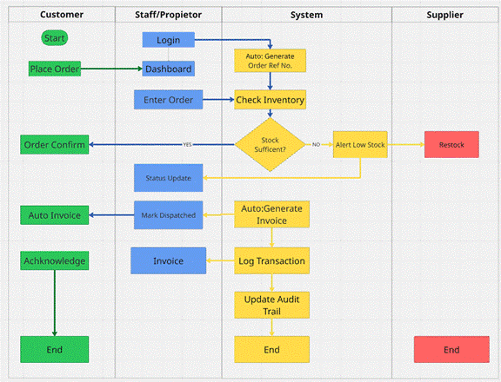
PROPOSED SYSTEM ARCHITECTURE

Slide 16
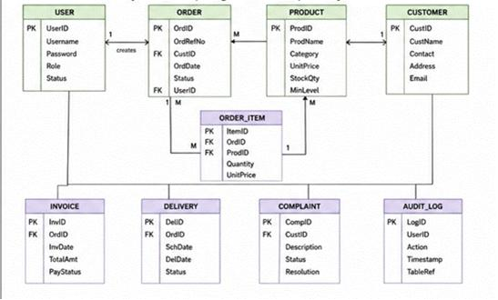
DATABASE DESIGN
Entities
USER – Account and authentication info (UserID, Username, Password, Role, Status)
CUSTOMER – Contact details, delivery address, transaction history
PRODUCT – Name, category, unit price, stock quantity, minimum threshold
ORDER / ORDER_ITEM – Reference number, status, date, quantities, prices
INVOICE – Date, total amount, payment status (Unpaid / Partial / Paid)
DELIVERY – Scheduled date, actual date, status (Pending / In Transit / Delivered)
COMPLAINT – Description, status (Open / In Progress / Resolved), resolution notes
AUDIT_LOG – Action, timestamp, affected table reference

Slide 17
TECHNOLOGY STACK
Frontend
React 19 + TypeScript 5.x • Tailwind CSS 4.x • Recharts (data visualization) • jsPDF (invoice/report export)
Backend
Node.js + Express – API routes, business logic, database connections
Turso Authentication – Secure login and session management
Database
Turso (LibSQL) – Edge-compatible SQL database for all relational data
Tooling & Hosting
Vite 6.x (build) • Git + GitHub (version control) • Cursor/VS Code (IDE) • Vercel (cloud deployment)

Slide 18
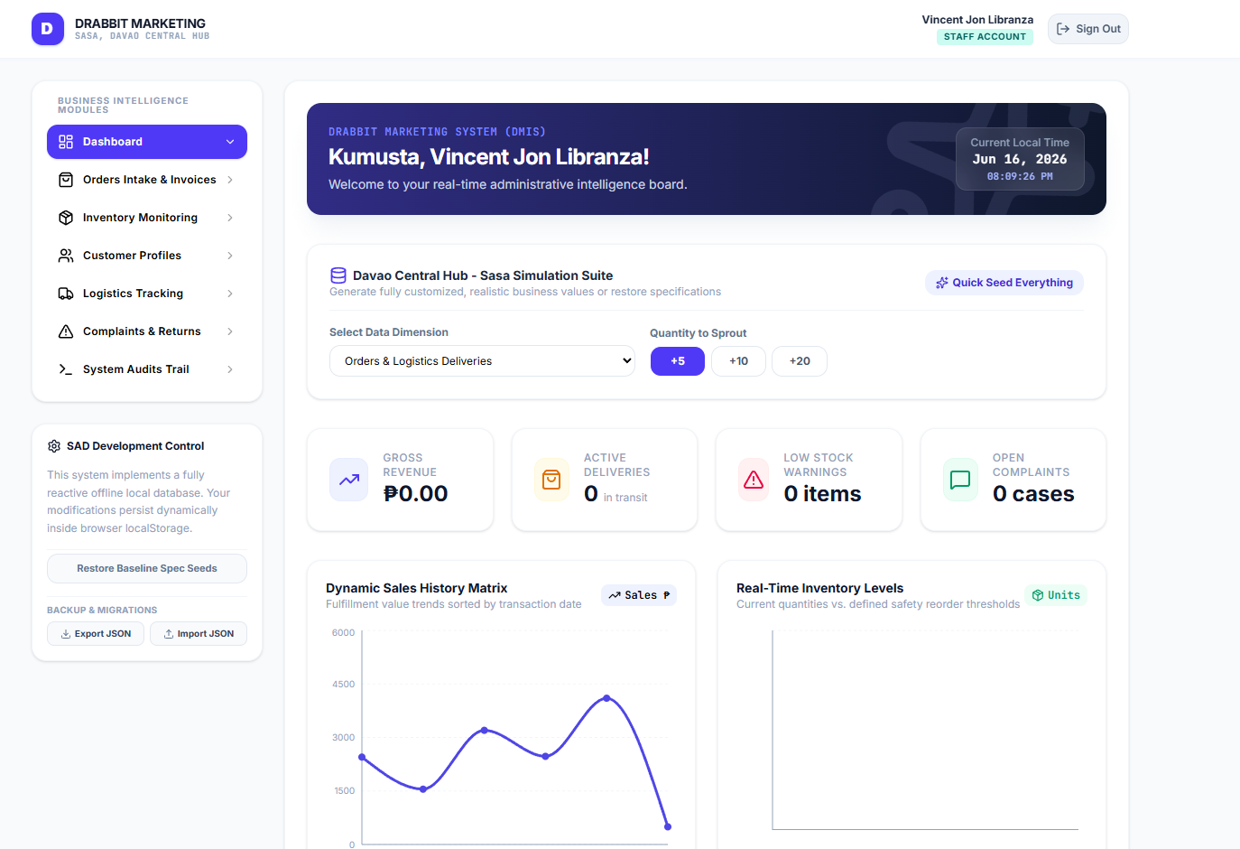
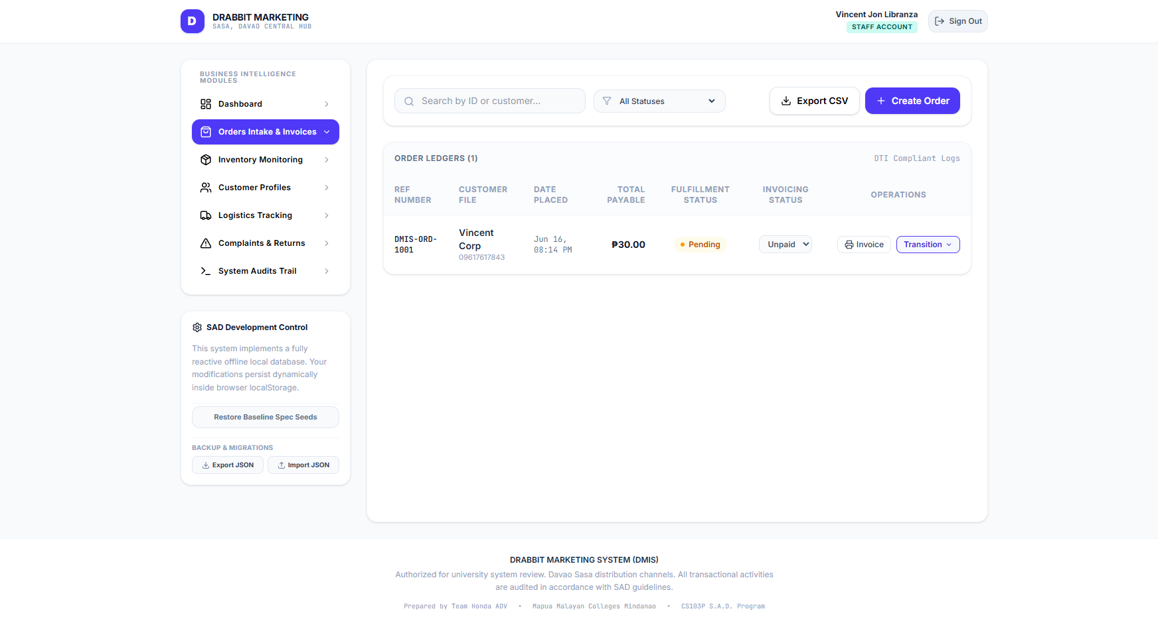
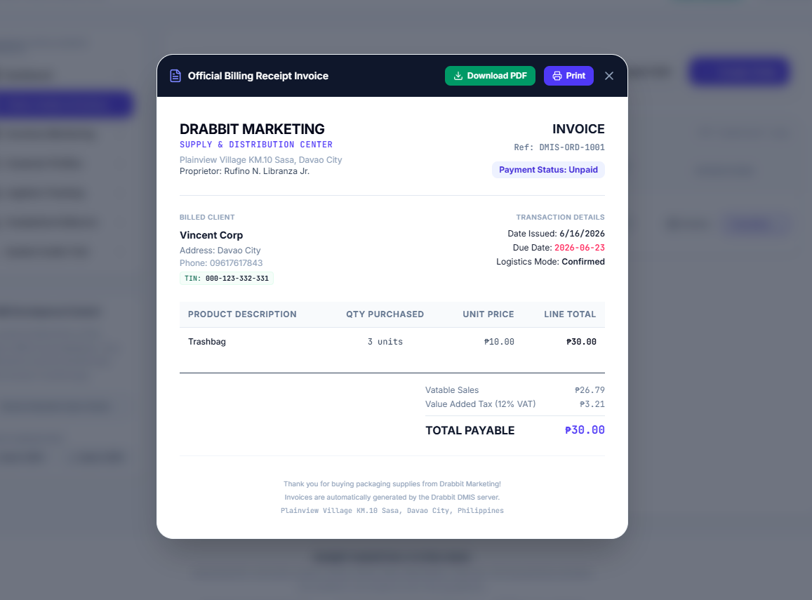
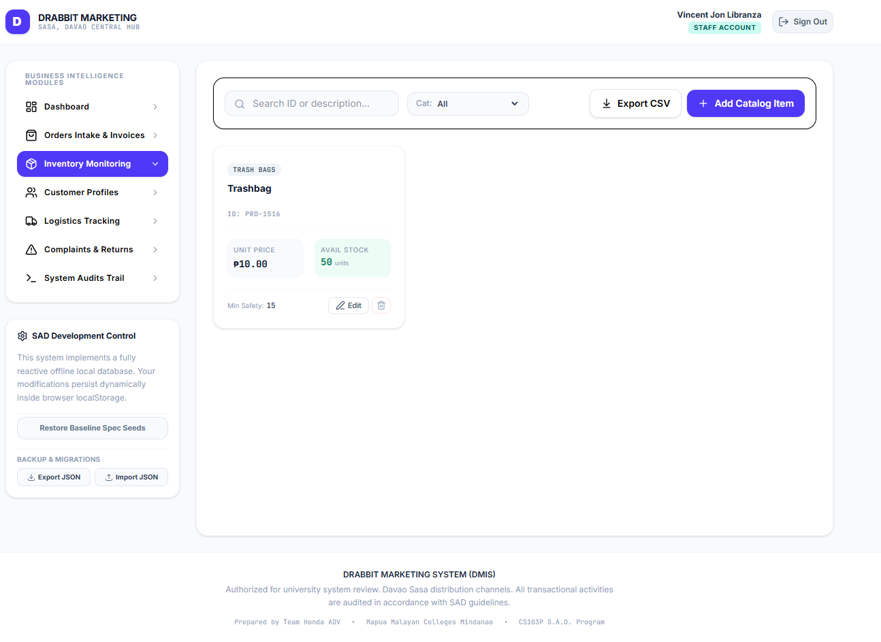
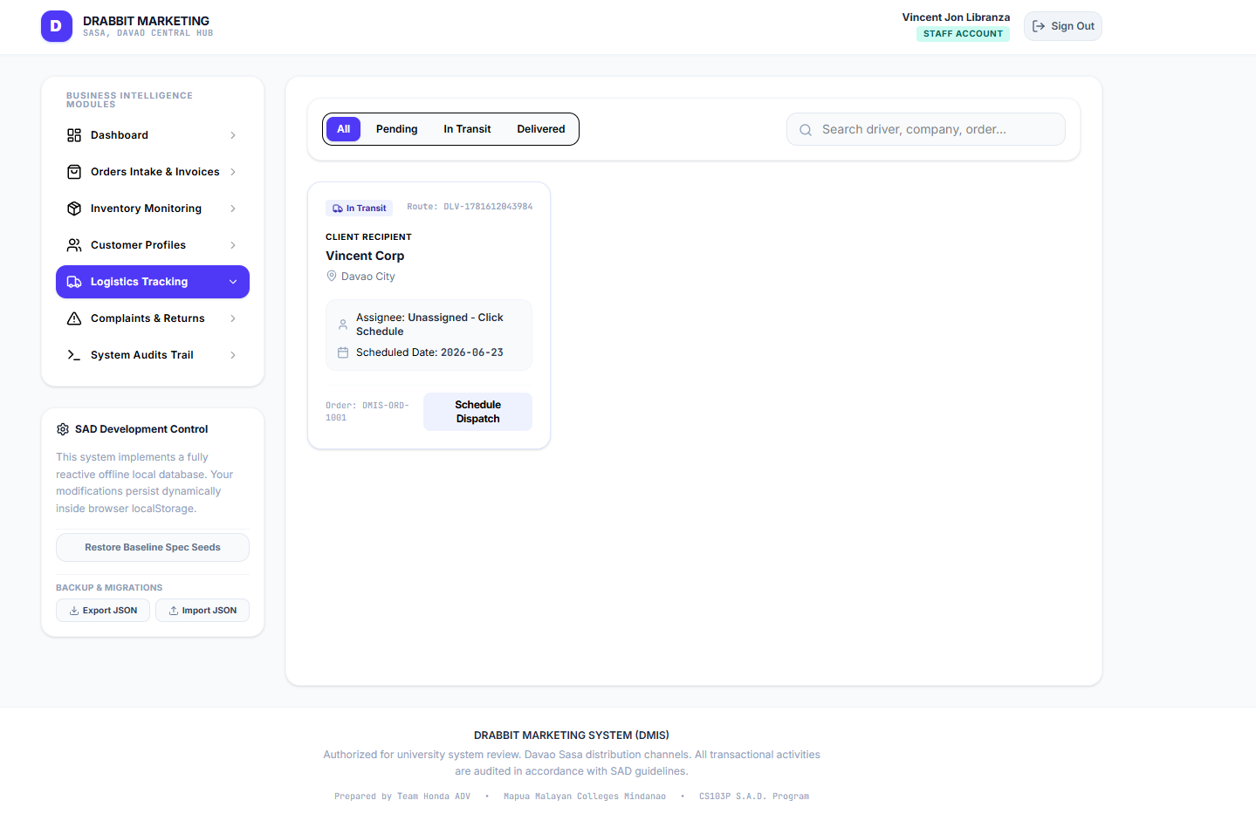
USER INTERFACE DESIGN
Dashboard
Order Entry
Invoice
Inventory
Delivery Reports

Slide 19
SYSTEM DEVELOPMENT
Development Methodology
Agile Scrum – Sprint-Based Development across 4 phases
Modules Developed
User Authentication and Access Control
Order Management
Inventory Monitoring and Low Stock Alerts
Invoice Generation
Customer Database Management
Sales Dashboard and Reporting
Delivery Tracking and Complaints Management
Audit Trail and Automated Backup

Slide 20
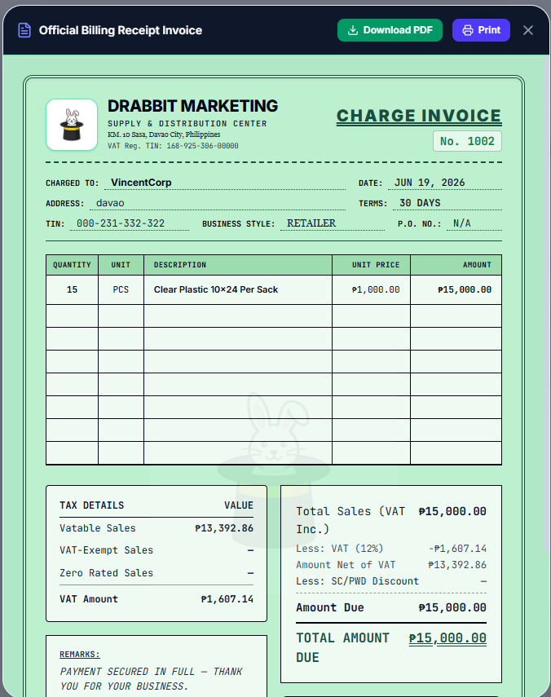
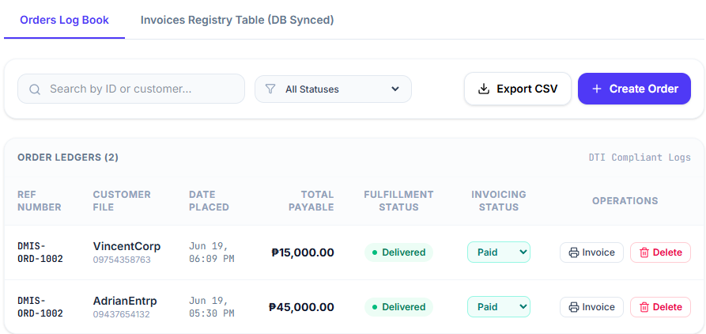
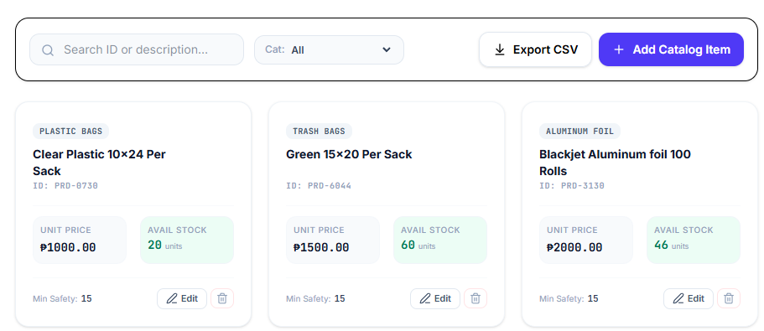
KEY FEATURES DEMO
Order Management
Auto Invoice
Real-Time Inventory

Slide 21
TESTING METHODOLOGY
Testing Procedures
Functional Testing – Verified each module against defined functional requirements.
Integration Testing – Confirmed modules interact correctly as a unified system.
User Acceptance Testing (UAT) – Evaluated by proprietor and staff for functionality, usability, and accuracy.
Parallel Testing – System results cross-validated against existing manual process outputs.
Testing Environment
Desktop Computer (Windows) • Active Broadband Internet • Vercel-Hosted System

Slide 22
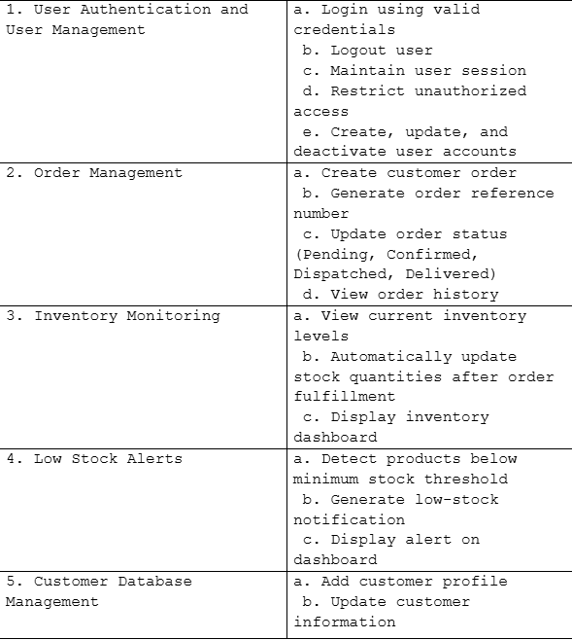
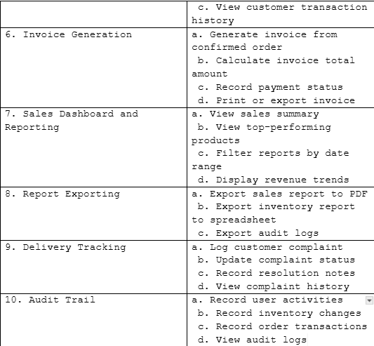
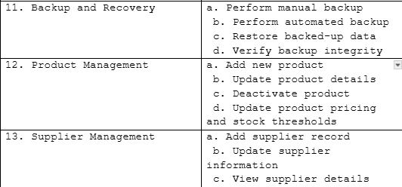
TEST CASES
[Test Cases Table Placeholder]
13 functional modules tested across authentication, orders, inventory, invoicing, reporting, delivery, complaints, and audit trail.

Slide 23
USER ACCEPTANCE TESTING
Respondents
Representatives of Drabbit Marketing
Evaluation Instrument
UAT form evaluating functionality, usability, data integrity, and suitability of the Drabbit Marketing Information System.
Testing Dates
June 13–16, 2026

Slide 24
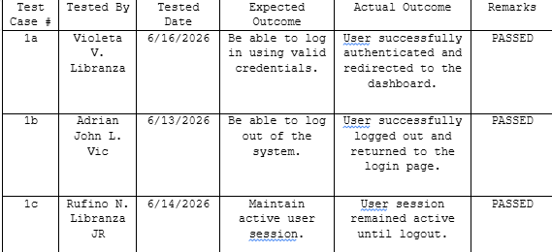
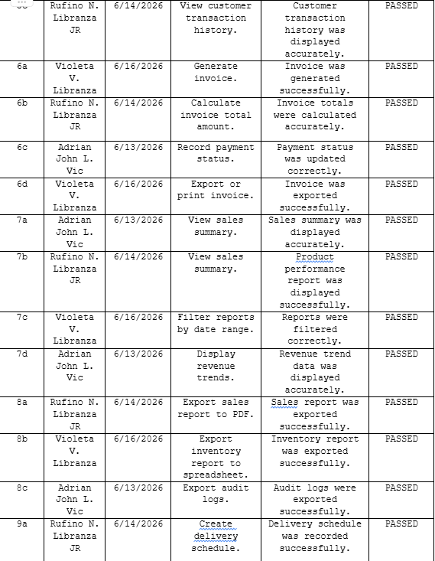
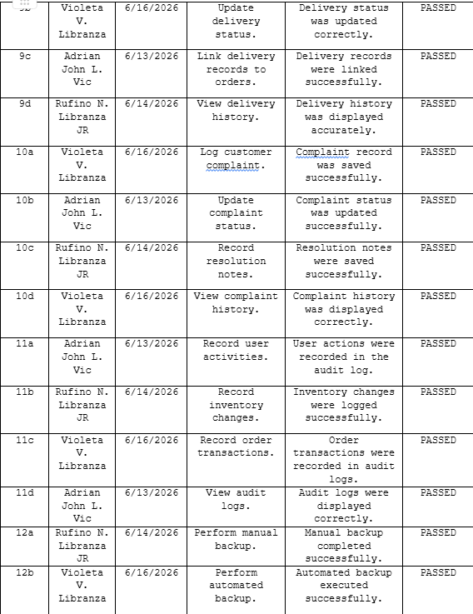
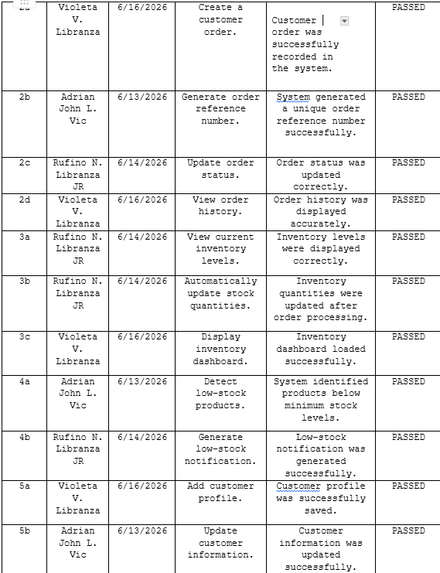
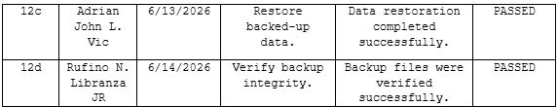
UAT RESULTS
[UAT Results Table Placeholder]
All test cases — covering authentication, orders, inventory, invoicing, reporting, delivery, complaints, and backup — returned PASSED.

Slide 25
FINDINGS
Major Findings
Drabbit Marketing's manual processes resulted in order errors, inventory stockouts, billing delays, and data loss risk due to sole reliance on pen-and-paper record-keeping and informal coordination.
Major Achievements
The Drabbit Marketing Information System successfully digitized and automated all core business operations — providing real-time inventory, digital order management, auto-invoicing, centralized customer records, delivery tracking, complaints handling, and full audit trail capabilities.

Slide 26
CONCLUSIONS
Objective 1: Develop a web-based order management module.
Conclusion: Achieved through the digital order entry module with auto-generated reference numbers and status tracking.
Objective 2: Implement real-time inventory with low-stock alerts.
Conclusion: Achieved through the live inventory dashboard with automated threshold-based notifications.
Objective 3: Automate invoice generation.
Conclusion: Achieved through system-generated invoices upon order confirmation with payment status tracking.
Objective 4: Build a centralized customer database.
Conclusion: Achieved through secure digital customer profiles with full transaction history.

Slide 27
RECOMMENDATIONS
Implement a supplier management and procurement module with purchase order generation.
Integrate SMS and email notification services for order status, delivery, and low-stock alerts.
Add advanced sales forecasting, demand prediction, and inventory trend analysis features.
Incorporate barcode or QR code scanning for faster inventory monitoring.
Expand to support multi-branch operations with centralized management.
Integrate accounting systems and develop a mobile application for improved accessibility.

Slide 28
THANK YOU!

