Slide 1
Introduction
The practice of segmenting a client base into groups of people who are similar in particular aspects significant to marketing, such as age, gender, interests, and purchasing patterns, is known as customer segmentation.
Customer segmentation is a strategy used by businesses to target particular, smaller groups of consumers with appropriate messaging that would encourage them to make a purchase. This strategy is based on the idea that each and every customer is unique. In order to more effectively target marketing materials at each client segment, businesses also want to obtain a deeper understanding of the preferences and demands of their customers.
In order to segment customers into targetable groups, it is necessary to discover important differentiators that separate them. When determining customer segmentation practices, factors including a customer's demographics (age, race, religion, gender, family size, ethnicity, income, and level of education), geography (where they live and work), psychographics (social class, lifestyle, and personality traits), and behavioral (spending, consumption, usage, and desired benefits) tendencies are taken into account.

Slide 2
Description of dataset
Here is a brief version of the data description file.
InvoiceNo: Invoice number. Nominal. A 6-digit integral number is uniquely assigned to each transaction. If this code starts with the letter C, it indicates a cancellation.
StockCode: Product (item) code. Nominal. A 5-digit integral number is uniquely assigned to each distinct product.
Description: Product (item) name. Nominal.
Quantity: The quantities of each product (item) per transaction. Numeric.
InvoiceDate: Invoice date and time. Numeric. The day and time when a transaction was generated.
UnitPrice: Unit price. Numeric. Product price per unit.
CustomerID: Customer number. Nominal. A 5-digit integral number uniquely assigned to each customer.
Country: Country name. Nominal. The name of the country where a customer resides.

Slide 3
ML Technique
Finding patterns in data is done using a type of machine learning algorithms called unsupervised learning. Since the input variables (X) for unsupervised algorithms are not labeled, there are no corresponding output variables provided. Unsupervised learning allows the algorithms to find intriguing data structures on their own.
You can categorize your customers with the use of some analytics techniques. These are particularly helpful if you have a huge customer base and find it challenging to identify patterns in your customer data by simply examining transactions. The most popular is clustering, an exploratory method for datasets where correlations between various observations may be too subtle to be seen with the naked eye.

Slide 4
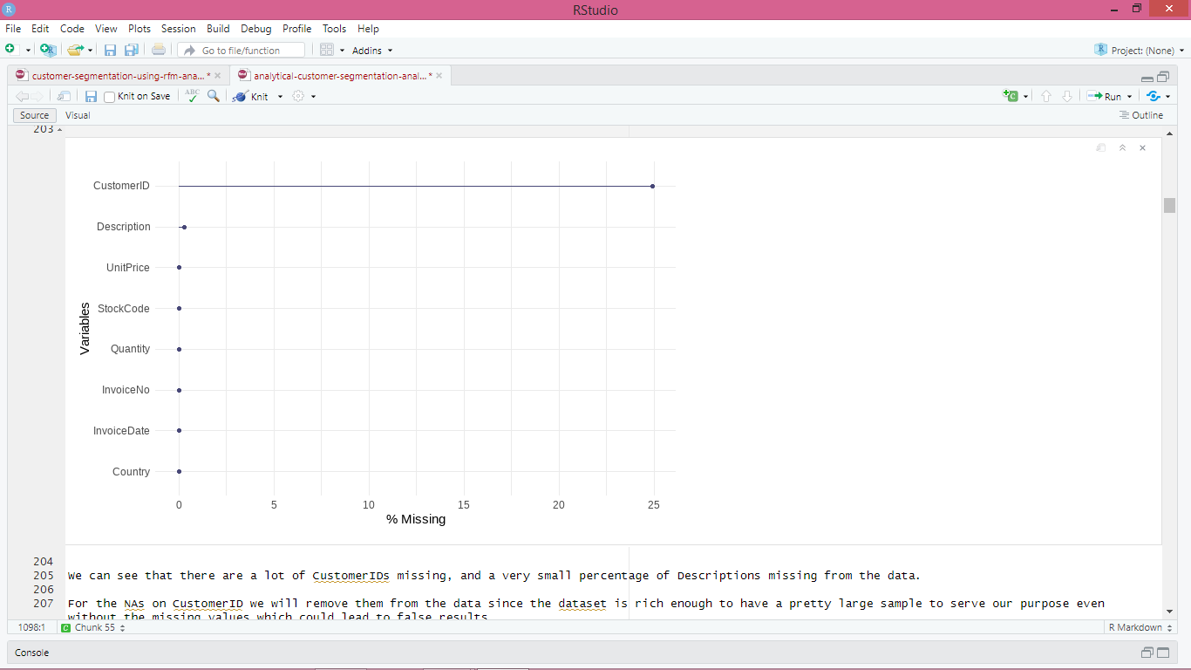
Data Cleaning Checking & Dealing with missing values

Slide 5
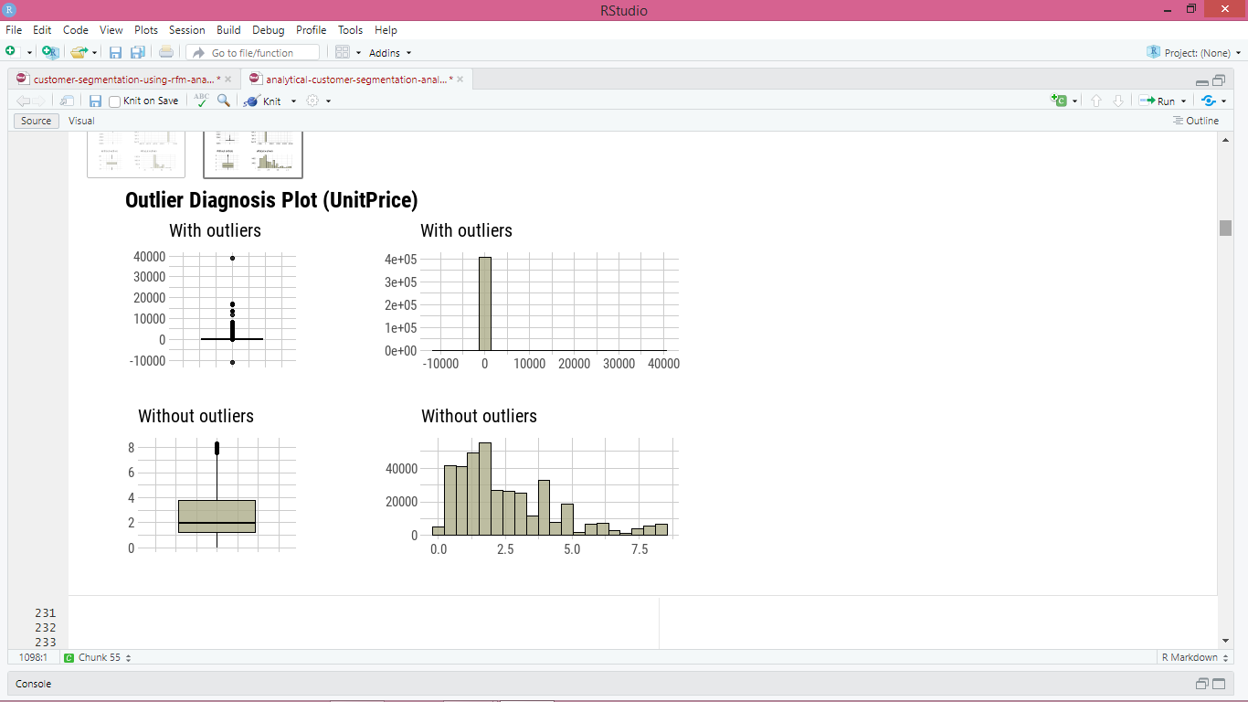
Dealing with outliers
For reliable results, dealing with and treating outliers in the data is always crucial.
I used the straightforward tool dlookr for data diagnosis and exploration, which I believe performs a great job of plotting valuable information to discover abnormalities and outliers in just a single line of code.

Slide 6
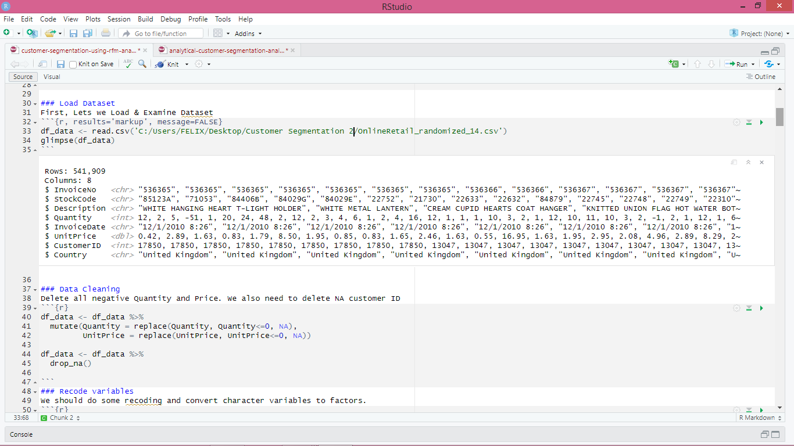
Dataset info

Slide 7
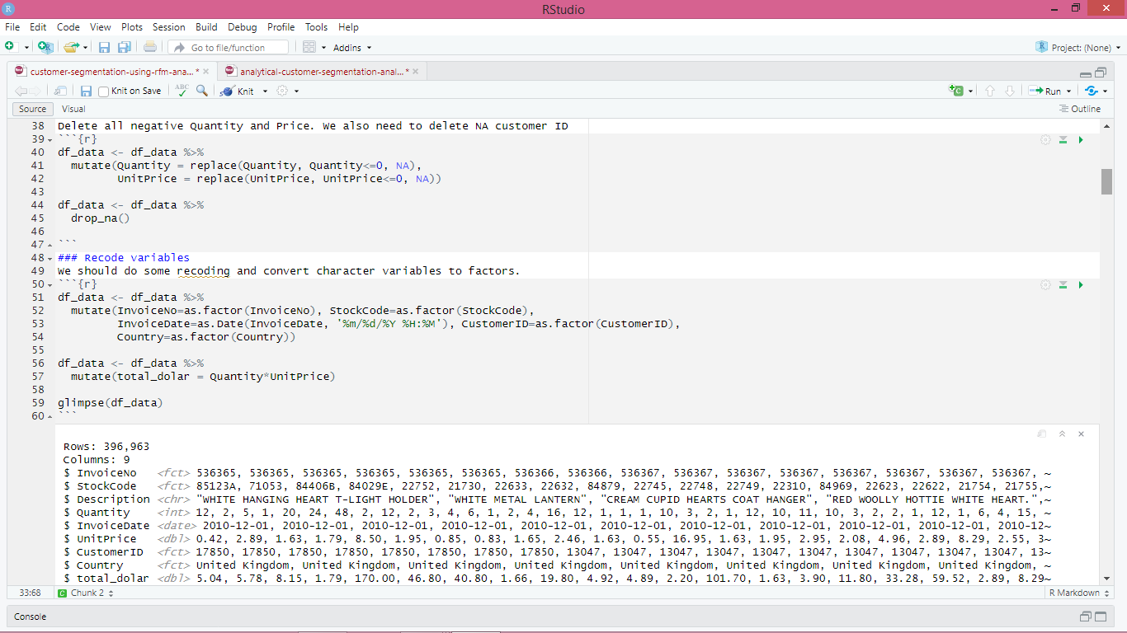
Cleaning and recoding variables

Slide 8
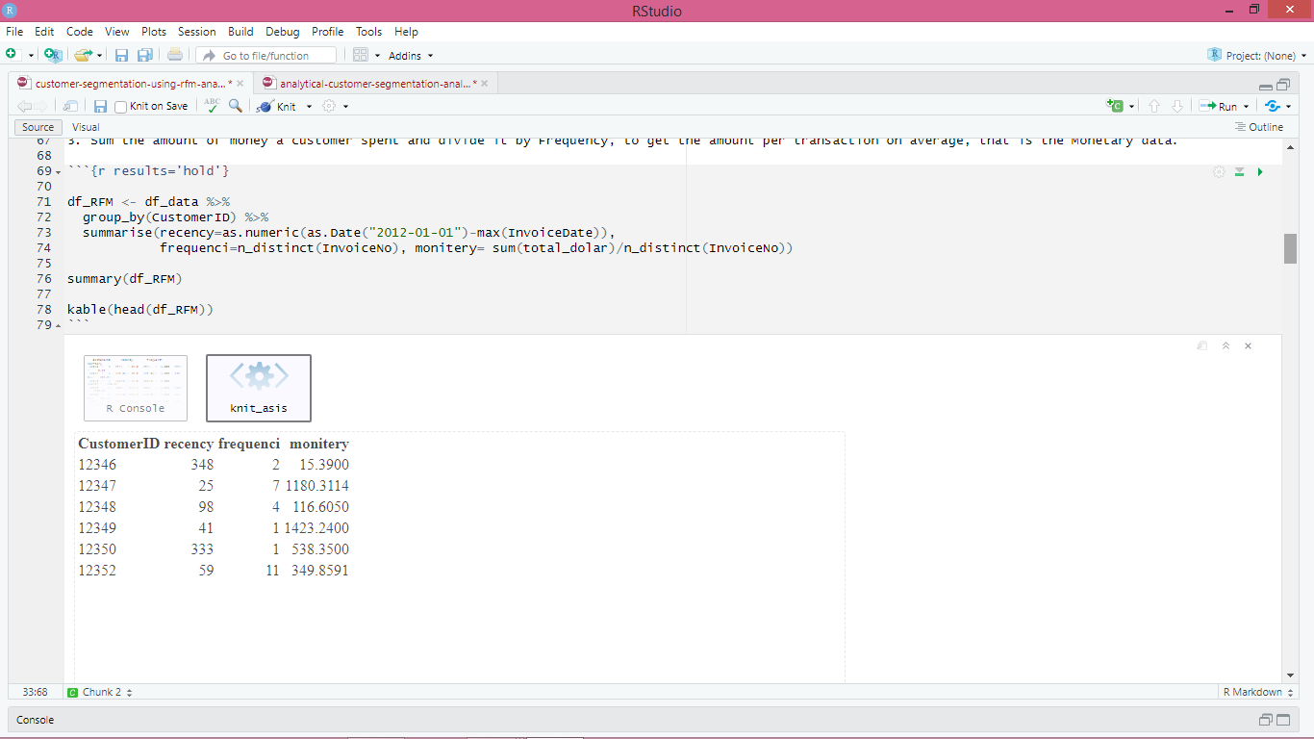
RFM Statistics

Slide 9
Clustering
K-means Clustering
Scaling the data
Why we need to normalize the data
Clustering is the process of calculating the similarity between two samples by integrating all of their feature data into a numeric number. When combining feature data, the data must be of the same scale. By scaling the data, you can bring numerous features to the same scale.
Calculating how many clusters we need
Before we do the actual clustering, we need to identify the Optimal number of clusters (k) for this data set of wholesale customers. The popular way of determining number of clusters are
Elbow Method
Silhouette Method
Gap Static Method
Elbow and Silhouette methods are direct methods and gap statistic method is the statistics method

Slide 10
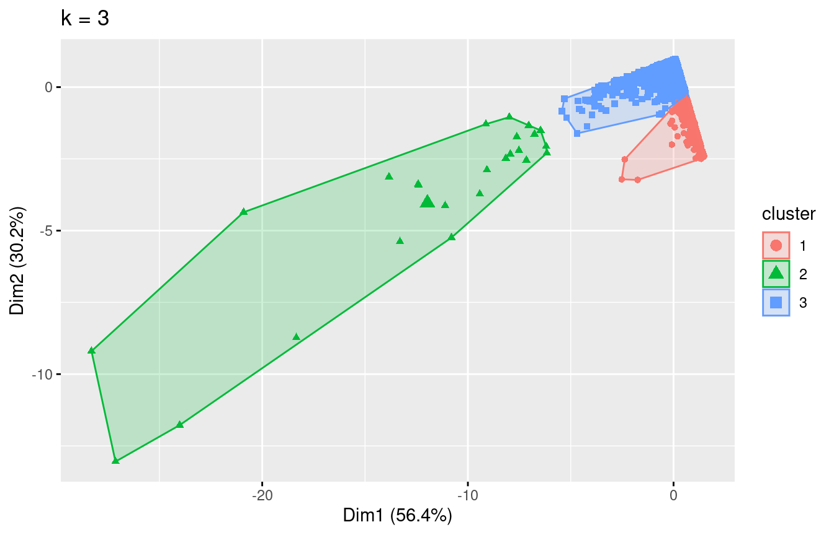
Clustering results

Slide 11
Clustering
First of all we see this extreme distribution because of the k-means disadvantage at dealing with outliers.
We have 3 demonstrable clusters, with cluster 2 containing the most valuable customers.
So we can see that cluster 2, is our MVP customers that have generated the most revenue having Spent the most money in the products of the store. In cluster 1 we have different kind of groups who can be potential valuable customers for the business, as either they purchase a lot or have made a transaction recently signaling new opportunities.

Slide 12
RFM Analysis
To find our most valuable customers based on RFM analysis I will also use the rfm package, which based on the input will give automate RFM scores for our customers.
According to the Pareto principle, 20% of the customers (the vital few) contribute more to the revenue of the company than the rest. It argues that 80 percent of effects can be traced back to as few as 20% of all causes — these 20% of causes are vital, and the remaining 20% of effects is then naturally dispersed to be mapped with the remaining 80% causes — they are trivial numerous. These 20% are the high-value, important consumers that the company would like to keep.
Creation of interactive customer data table with RFM scores, to observe values
Creation of interactive customer data table with RFM scores for approximately the top 20% of customers, who are the most vital for the business
These are the customers that according to Pareto they generate most of the revenue and they are vital for the business, as such retaining these customers and conducting good business with is essential for the business long-term health and success!
However, a point that needs to be made is that for the calculation of the total RFM score, all three of the attributes had the same weight. Thus, we could debate that probably monetary value (amount), should have a bigger weight than recency or number of transactions.
Also the data we have contains transactions of just over one year of business, which is not that much to accurately distinguish the customer base appropriately.

Slide 13
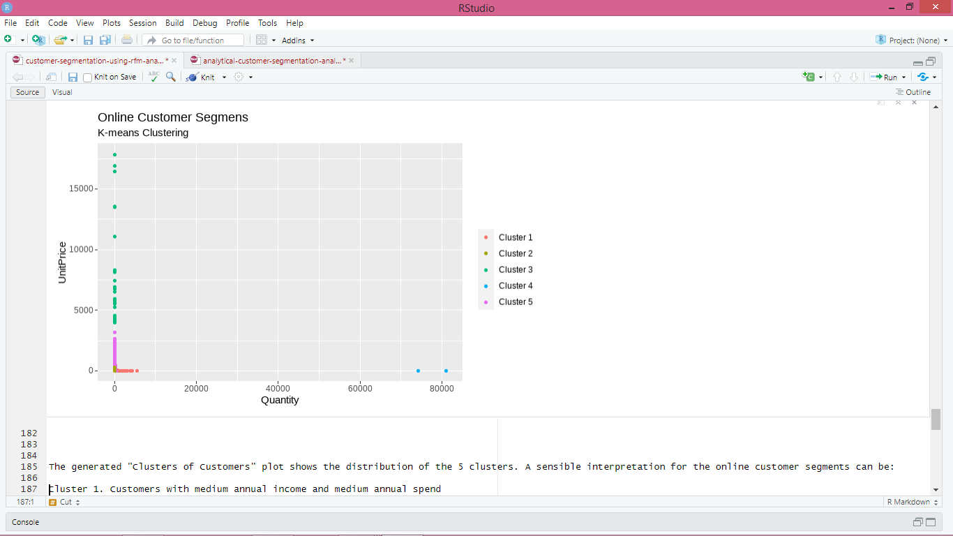
Customer Segments

Slide 14
Interpretation
The generated "Clusters of Customers" plot shows the distribution of the 5 clusters. A sensible interpretation for the online customer segments can be:
Cluster 1. Customers with medium annual income and medium annual spend
Cluster 2. Customers with high annual income and high annual spend
Cluster 3. Customers with low annual income and low annual spend
Cluster 4. Customers with high annual income but low annual spend
Cluster 5. Customers low annual income but high annual spend
Having a better understanding of the customers segments, a company could make better and more informed decisions. An example, there are customers with high annual income but low spending score. A more strategic and targeted marketing approach could lift their interest and make them become higher spenders. The focus should also be on the "loyal" customers and maintain their satisfaction.
We have thus seen, how we could arrive at meaningful insights and recommendations by using clustering algorithms to generate customer segments. For the sake of simplicity, the dataset used only 2 variables — income and spend. In a typical business scenario, there could be several variables which could possibly generate much more realistic and business-specific insights.

Slide 15
Conclusion
In this study, I looked at the online retail data to try to identify key business drivers and segment the client base into actionable information for improved customer relationship management.
More specifically, using the k-means approach, I was able to isolate three key customer clusters, one of which contained 25 of the company's most valuable MVP customers.
In order to motivate actions, I applied an RFM analysis and divided the clients into more focused groups. CRM procedures can be referenced from the interactive datatable above.
Other key differentiators For more in depth division of customers into appropriate groups, other data that could be used include:
Demographics (age, race, religion, gender, family size, ethnicity, income, education level)
Psychographic (social class, lifestyle and personality characteristics)
Geography (more specific locations)

Slide 16
References
Usama, M., Qadir, J., Raza, A., Arif, H., Yau, K. L. A., Elkhatib, Y., ... & Al-Fuqaha, A. (2019). Unsupervised machine learning for networking: Techniques, applications and research challenges. IEEE access, 7, 65579-65615.
Hahne, F., Huber, W., Gentleman, R., Falcon, S., Gentleman, R., & Carey, V. J. (2008). Unsupervised machine learning. Bioconductor case studies, 137-157.
Alloghani, M., Al-Jumeily, D., Mustafina, J., Hussain, A., & Aljaaf, A. J. (2020). A systematic review on supervised and unsupervised machine learning algorithms for data science. Supervised and unsupervised learning for data science, 3-21.
Kassambara, A. (2017). Practical guide to cluster analysis in R: Unsupervised machine learning (Vol. 1). Sthda.
Bhavsar, H., & Ganatra, A. (2012). A comparative study of training algorithms for supervised machine learning. International Journal of Soft Computing and Engineering (IJSCE), 2(4), 2231-2307.

