Slide 1
Introduction
Creating a model to forecast survival rates using data from the Titanic is a well-known binary classification issue. The objective is to create a model that, given a collection of input data like age, gender, and other characteristics, can properly predict whether a certain passenger will survive or not.
When tackling a challenge like this, we usually start by performing exploratory data analysis to better understand the dataset and find any patterns or connections between the various attributes and the goal variable (in this case, survival). Depending on the requirements of the machine learning technique we intend to apply, we might additionally need to clean and preprocess the data, filling in missing values, encoding categorical variables, and scaling numerical features.

Slide 2
The titanic dataset
A well-known dataset called the Titanic dataset contains details about the people who traveled on the Titanic during its tragic maiden voyage, which perished on April 15, 1912, after colliding with an iceberg in the North Atlantic Ocean. Each passenger's numerous characteristics, including age, gender, passenger class, fare paid, cabin number, port of embarkation, and whether or not they survived the accident, are included in the dataset.
With the help of these characteristics, you may learn a wealth of details on each passenger, such as their socioeconomic status, family structure, and demographics. They can be used to investigate trends and connections between various variables and to create survival predictions for the event.
For training, testing, and forecasting purposes, there are two datasets: the train dataset and the test dataset.

Slide 3
Analytical objectives
The objective of this project is to understand the factors that contribute to the survival of the Titanic accident and to build a model in Alteryx to estimate the survival probability of passengers. In more detail we will:
i.Perform data cleaning and validation techniques to prepare data for analysis.
ii.Analyse resulting dataset to discover correlations between features and compare different passenger groups.
iii.Build a model to estimate survival probability of Titanic passengers.

Slide 4
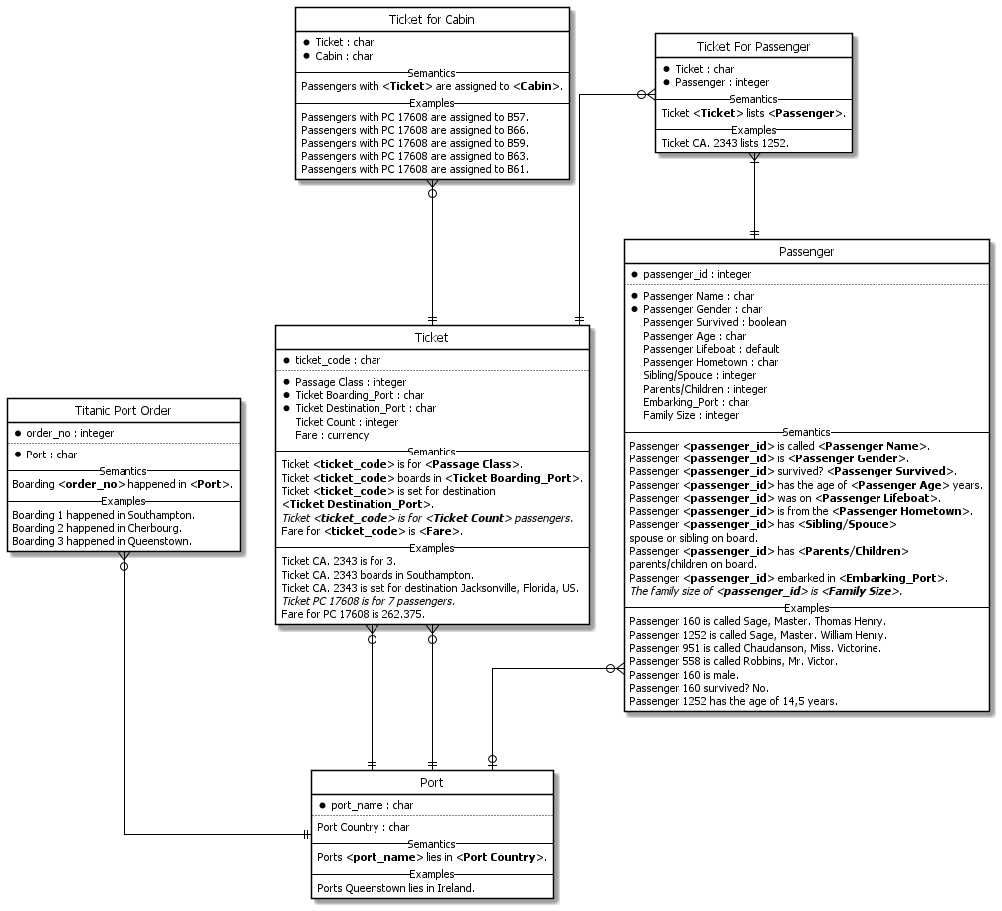
Entity Relationship Diagram

Slide 5
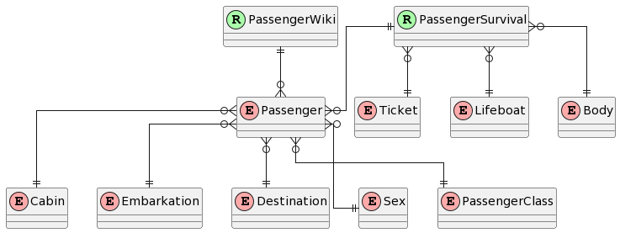
Entity Relationship Diagram

Slide 6
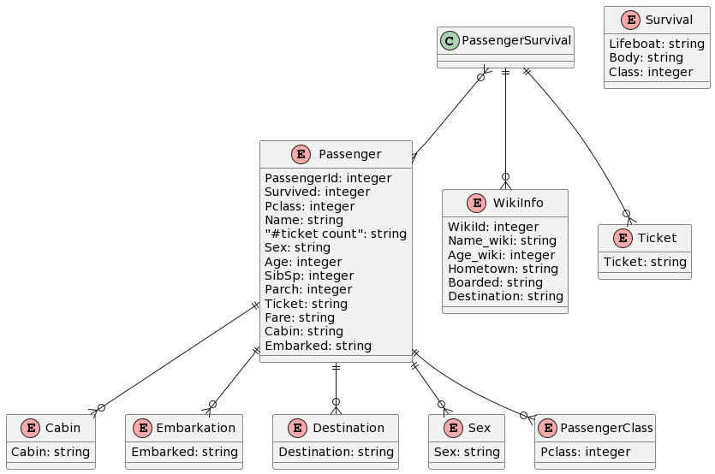
Entity Relationship Diagram

Slide 7
Entity Relationship Diagram
In the Titanic dataset, the main entity is the passenger, and the attributes (or columns) represent different aspects of each passenger, such as their age, gender, passenger class, and survival status. The following is an example of how some of the attributes in the Titanic dataset might be related in an ERD:
Passenger entity: This would be the main entity in the ERD, representing each individual passenger in the dataset.
Age attribute: This attribute would be a simple attribute of the Passenger entity, indicating the age of each passenger.
Gender attribute: This attribute would also be a simple attribute of the Passenger entity, indicating the gender of each passenger.
Passenger class attribute: This attribute would also be a simple attribute of the Passenger entity, indicating the passenger class of each passenger.
Survived attribute: This attribute would be a simple attribute of the Passenger entity, indicating whether each passenger survived or not.
Siblings/Spouses attribute: This attribute would be a relationship attribute, indicating the number of siblings and/or spouses that each passenger was traveling with.
Parents/Children attribute: This attribute would also be a relationship attribute, indicating the number of parents and/or children that each passenger was traveling with.

Slide 8
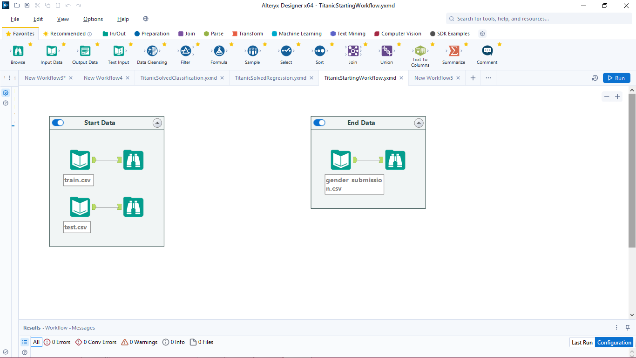
Workflow
Starter

Slide 9
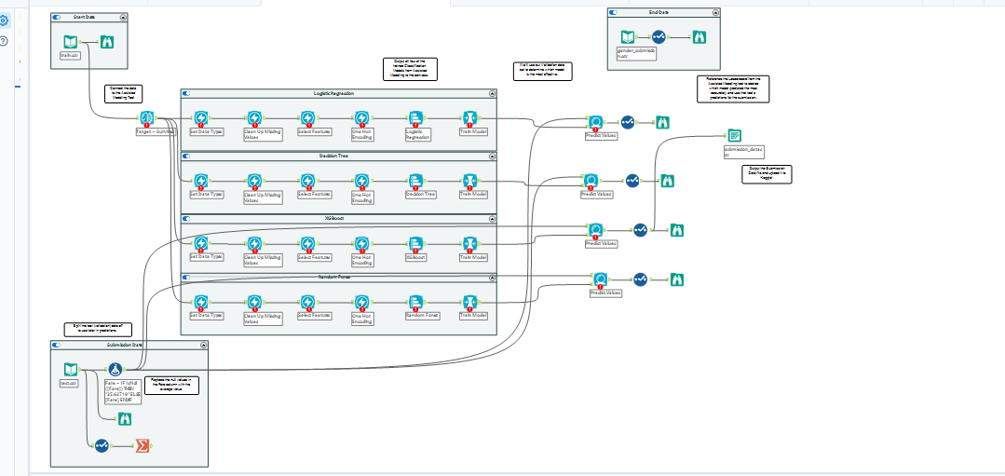
Workflow
Classification

Slide 10
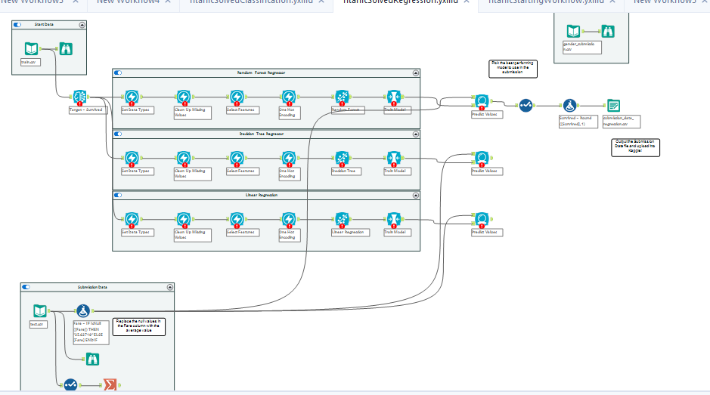
Workflow
Regression

Slide 11
Workflow description
To do data processing, cleaning, and blending in Alteryx using the Titanic dataset, the following steps were followed:
Open Alteryx Designer and create a new workflow.
Add a "Input Data" tool to your workflow and select the Titanic dataset as your data source. The Titanic dataset is commonly available in CSV format.
Add a "Data Cleansing" tool to your workflow. This tool will help you clean and filter your data by removing missing values, duplicates, and other irrelevant data. Configure the tool to remove any missing or null values, as well as any columns that are not relevant to your analysis.
Add a "Data Preparation" tool to your workflow. This tool allows you to transform your data by creating new fields, changing data types, or applying functions to your data. Use this tool to convert any text fields to numeric, and create new features from the existing data, such as age range or family size.
Add a "Join" tool to your workflow if you have other datasets you want to blend with the Titanic dataset. This tool will allow you to combine different datasets based on common fields, such as passenger ID or name.
Add a "Output Data" tool to your workflow and select a location to save your cleaned and blended data. You can save your data in various formats, such as CSV or Excel.
Once your workflow is complete, run it to process and clean your data. You can then use the output data for further analysis or modeling.

Slide 12
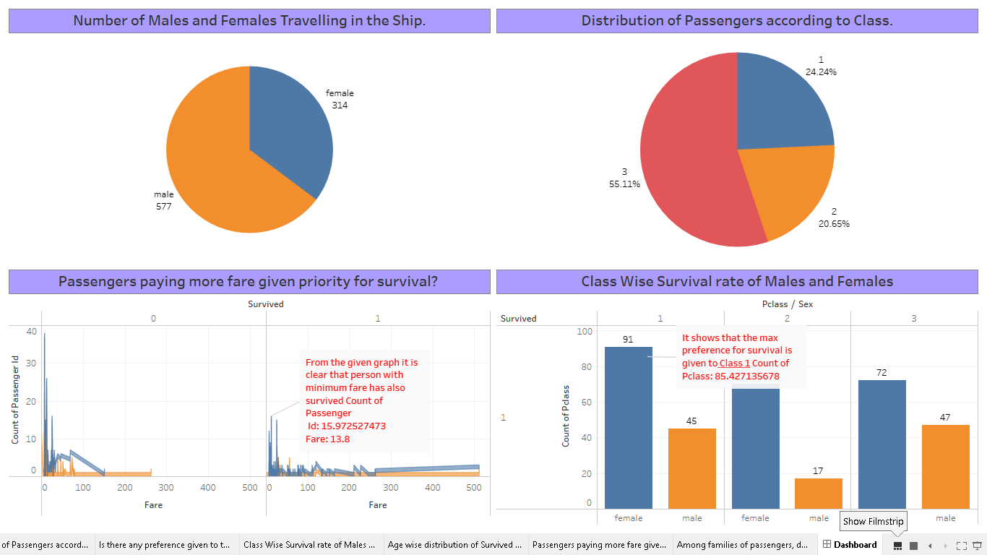
Tableau Visualizations
Overall data

Slide 13
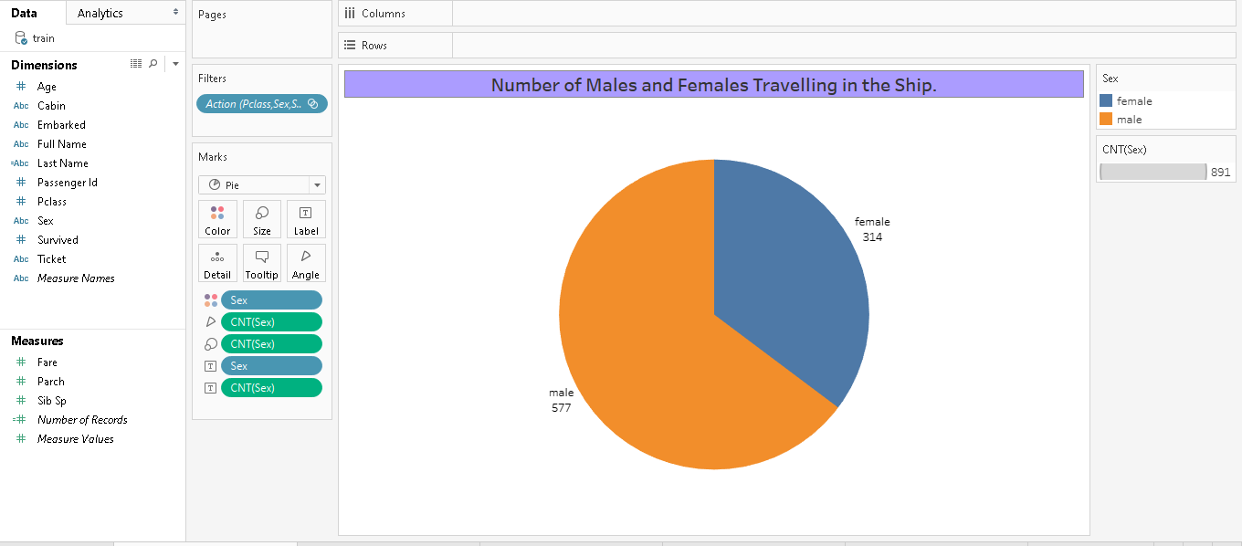
Tableau Visualizations
Distribution of passengers by gender

Slide 14
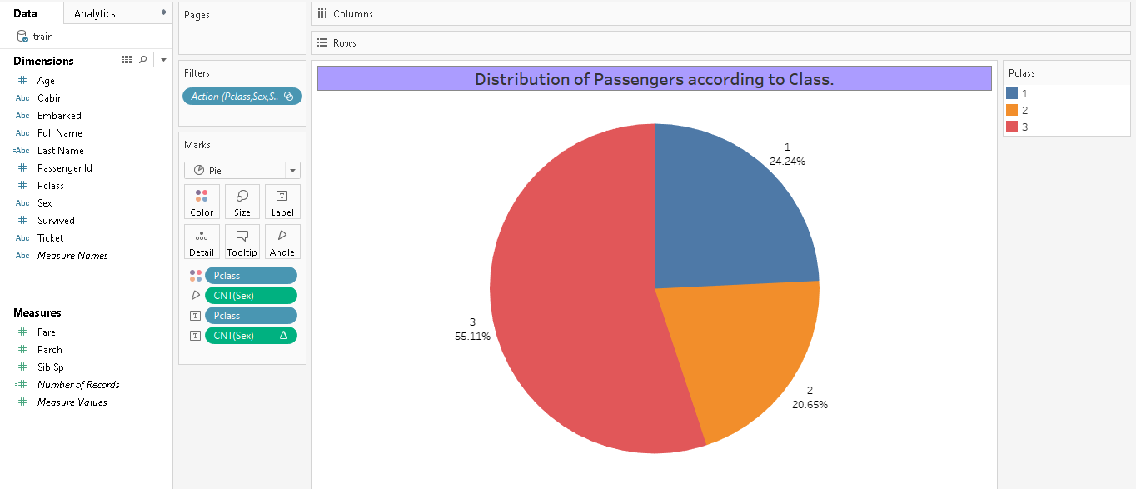
Tableau Visualizations
Distribution of passengers according to class

Slide 15
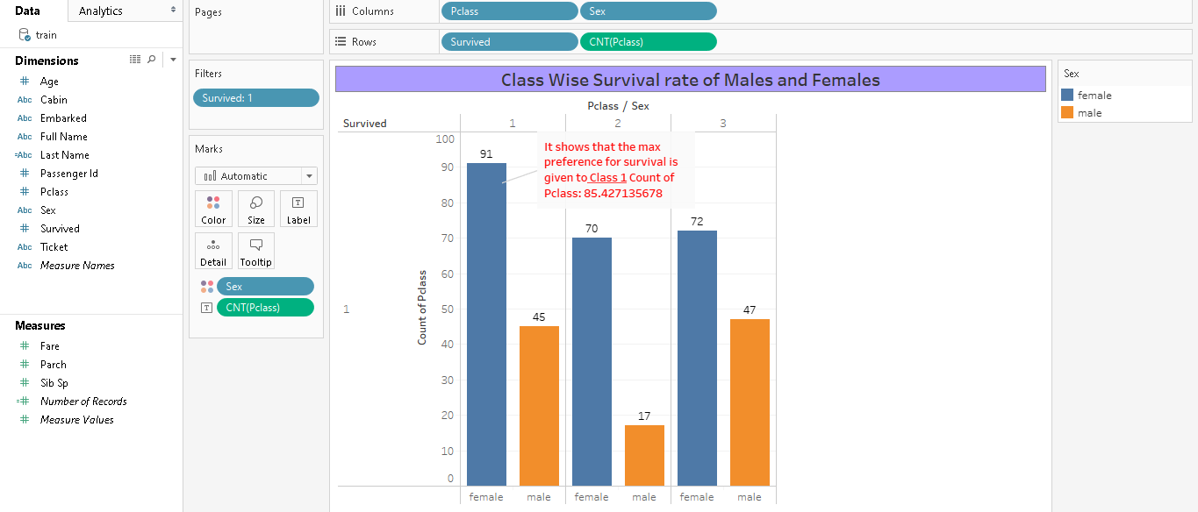
Tableau Visualizations
Classwise survival rate

Slide 16
Mongodb aggregate functions
To demonstrate how MongoDB can be used to perform aggregate operations on the Titanic dataset, let's design some analytical targets and write some queries to achieve them:
Calculate the total number of passengers in each passenger class:
db.titanic.aggregate([ {$group: {_id: "$Pclass", count: {$sum: 1}}} ])
This query groups the data by Pclass and calculates the total count of passengers in each class.
Calculate the survival rate of passengers by gender:
db.titanic.aggregate([ {$group: {_id: "$Sex", total: {$sum: 1}, survived: {$sum: "$Survived"} }}, {$project: {survival_rate: {$divide: ["$survived", "$total"]}}} ])
This query groups the data by Sex, calculates the total count of passengers and the count of passengers who survived for each gender, and then calculates the survival rate by dividing the count of survivors by the total count of passengers.

Slide 17
Mongodb aggregate functions
Calculate the average age of passengers who survived vs. those who did not
db.titanic.aggregate([ {$group: {_id: "$Survived", avg_age: {$avg: "$Age"} }} ])
This query groups the data by Survived and calculates the average age of passengers for each group.
Calculate the top 5 most common surnames among passengers:
db.titanic.aggregate([ {$project: {surname: {$arrayElemAt: [{$split: ["$Name", " "]}, -1]}}}, {$group: {_id: "$surname", count: {$sum: 1}}}, {$sort: {count: -1}}, {$limit: 5} ])
This query extracts the surname from the Name field using the $split operator, groups the data by surname, calculates the count of passengers for each surname, sorts the results by count in descending order, and returns the top 5 most common surnames.

Slide 18
Conclusion
In this report we have explored the association of the different attributes with the survival chance of passengers of the Titanic using the dataset from the Kaggle which has helped in building logistic regression models to predict the class for unseen data.
Our analysis determine that all variables except Age, SibSp and FamilySize are significantly associated with Survived at a 95% confidence level although the strength of such association is not very strong. Furthermore, the model that uses the attributes Pclass, Sex, Parch, Embarked and Title as regressors has been the chosen model to predict with according to resulting AIC values amongst the tested models.
This model allows us to explore the relationships between regressors and the target attribute as well as predict probability of survival for passengers. In particular we have determined that lower classes, large families, passengers with a title of Mr or Other and passengers who embarked at Southampton have a significantly lower chance of survival, according to the coefficients from the regression model that turned out to be signifificant.

Slide 19
References
Peter Dalgaard (2008). Introductory statistics with R. Springer Science & Business Media.
Jiawei Han, Micheine Kamber, Jian Pei (2012). Data mining: concepts and techniques. Morgan
Kaufmann. Chapter 3.
Jason W. Osborne (2010). Data Cleaning Basics: Best Practices in Dealing with Extreme Scores.
Newborn and Infant Nursing Reviews; 10 (1): pp. 1527-3369.
Pandya, D., Srivastava, A., Doherty, A., Sundareshwar, S., Needham, C., Chaudry, A., & KrishnaIyer, S. (2018, April). Increasing production efficiency via compressor failure predictive analytics using machine learning. In Offshore Technology Conference. OnePetro.
Batt, S., Grealis, T., Harmon, O., & Tomolonis, P. (2020). Learning Tableau: A data visualization tool. The Journal of Economic Education, 51(3-4), 317-328.

Slide 20
**Thank for listening to my presentation**
**THE END**

