Slide 1
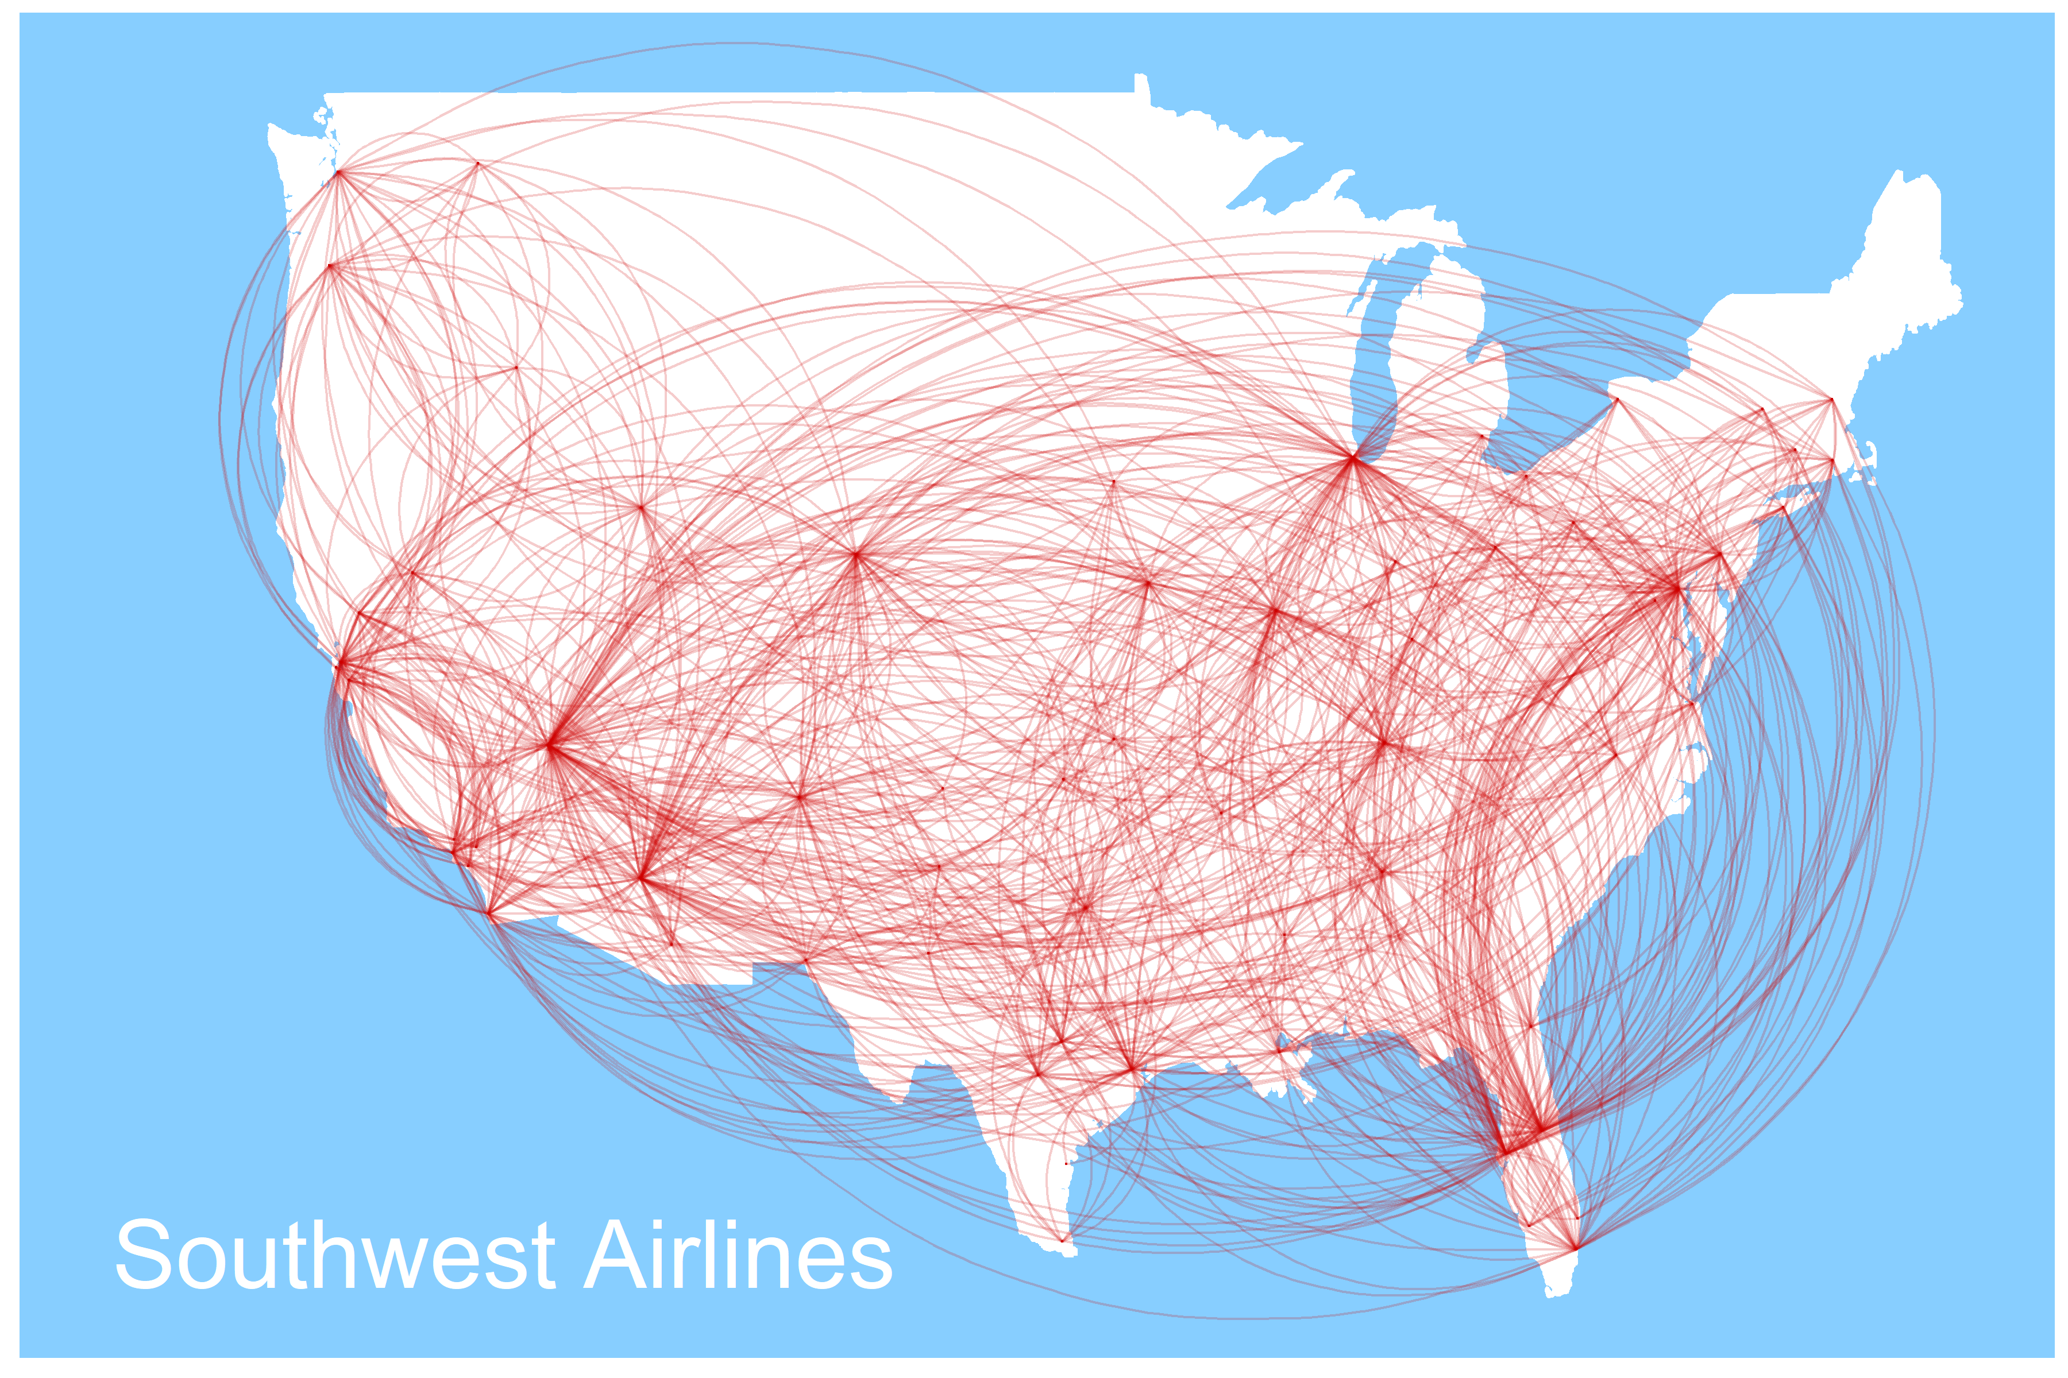
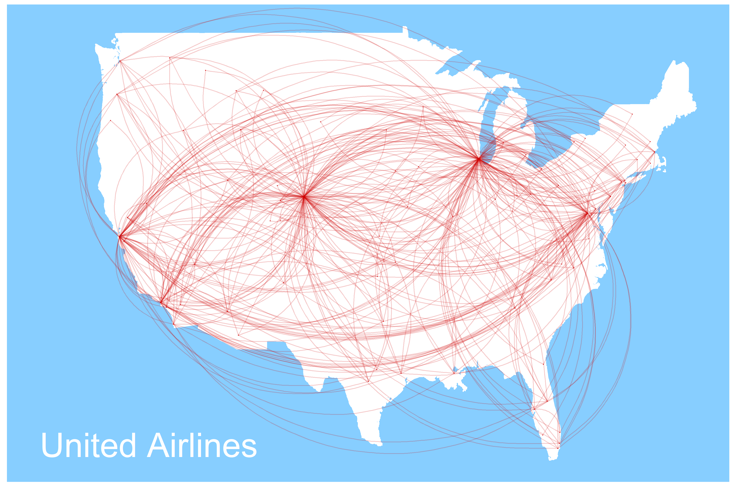
Thanksgiving with the family is stressful enough without being late.
This Thanksgiving, Southwest Airlines will get you where you need to go. On time.
Southwest Airlines operates more flights than any other domestic carrier
(twice as many as the next guy).

Slide 2
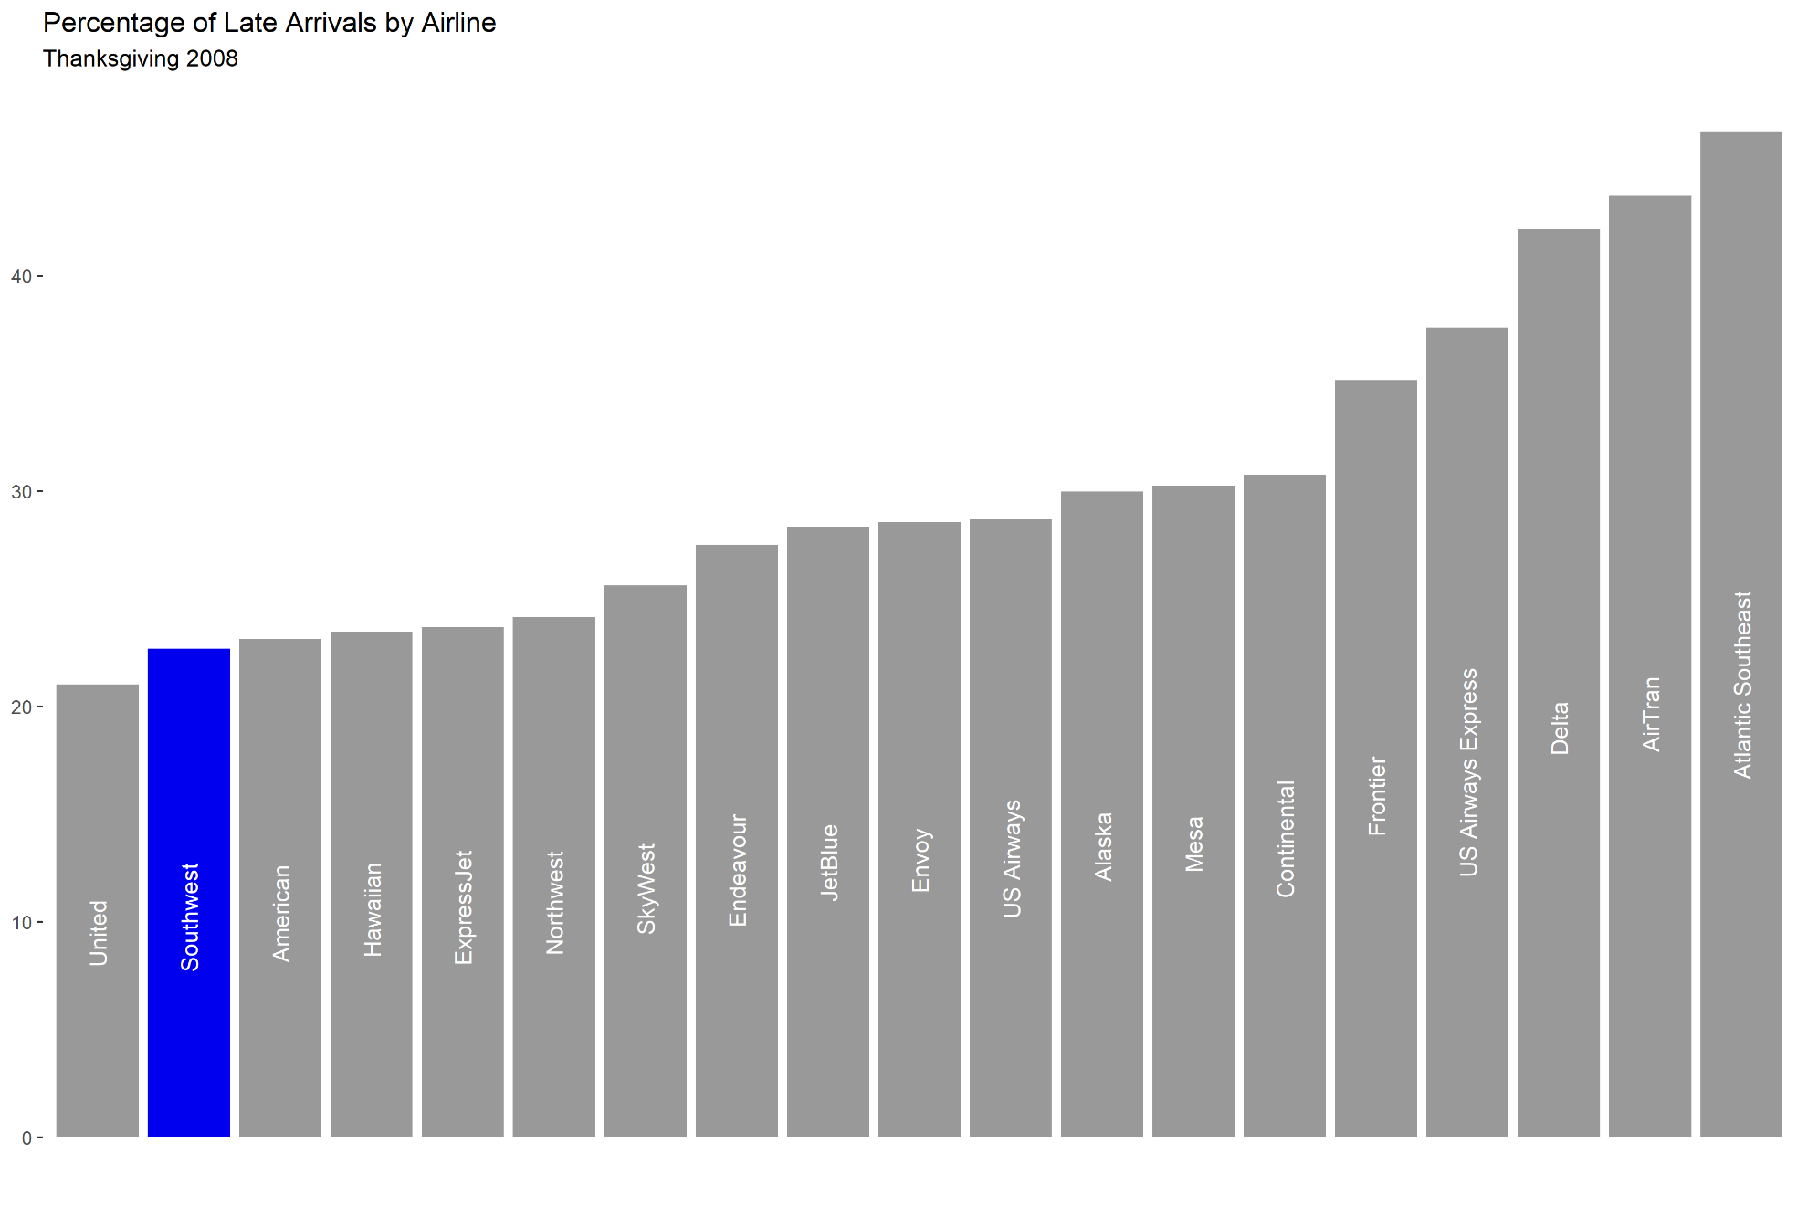
Southwest Airlines placed second for lowest arrival delays in the industry during Thanksgiving week 2008
Southwest Airlines: More Turkey, Less Waiting

