Slide 1
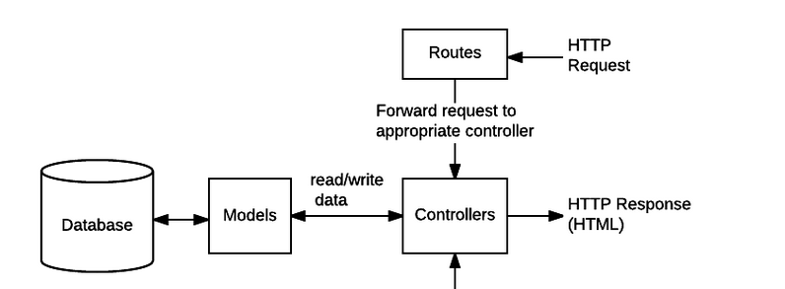
Models
movies.js
matches.js
users.js
swipes.js
Services
movieService.js
userService.js
matchService.js
swipeService.js
HTTPS-Request
Routes
Daten-
bank
HTTPS-Response
Controller
Services
Models

Slide 2
Controller
movieController.js
userController.js
matchController.js
swipeController.js
Router
movieRouter.js
userRouter.js
matchRouter.js
swipeRouter.js

