Slide 1
CS 9.2 NativeOS DPK Install Tutorial
Colton Fischer

Slide 2
Introduction
This is the step-by-step process that I took to successfully install the Campus Solutions 9.2 application to a Windows 7 64-bit system using the NativeOS deployment kit (DPK) provided by the PeopleSoft Update Manager (PUM).

Slide 3
Preparation
Create two folders in the base of your C drive. Name the first one CS92_DPK (path: C:\CS92_DPK) and the second one psft (path: C:\psft). Note: Later steps in this tutorial assume that you are using all of the same naming conventions that are provided in this step.

Slide 4
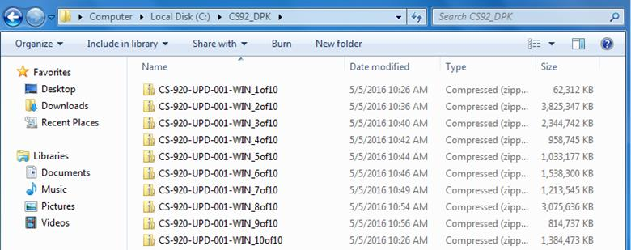
Download Files
Download the 15 zip files for the Campus Solutions 9.2 NativeOS DPK from the PUM homepage on My Oracle Support and save them to C:\CS92_DPK\

Slide 5
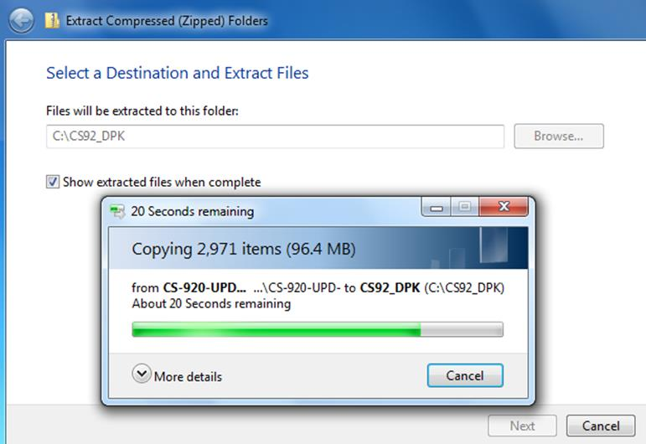
Extract 1st Zip File
Extract the contents of the CS-920-UPD-001-WIN_1of10.zip file into C:\CS92_DPK

Slide 6
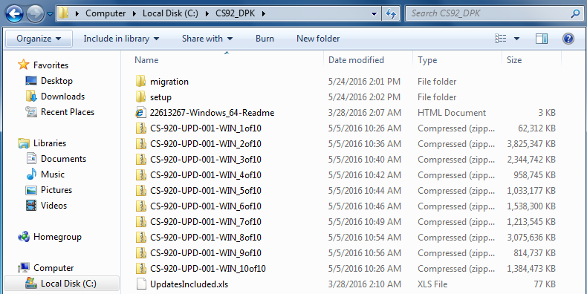
Check Directory
The C:\CS92_DPK\ directory should now look like this:

Slide 7
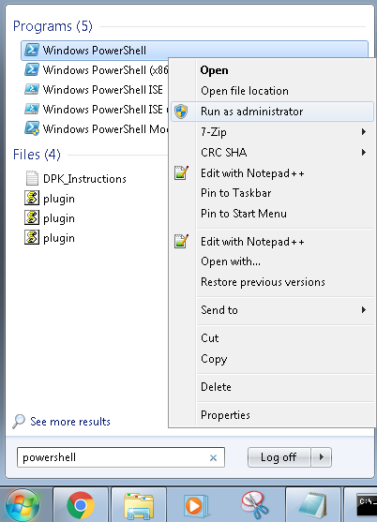
Run PowerShell
Search for the Windows PowerShell program, right click it, and run it as administrator

Slide 8
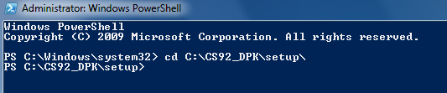
Change Directory
Change the directory to the directory that contains the setup folder.
cd C:\CS92_DPK\setup\

Slide 9
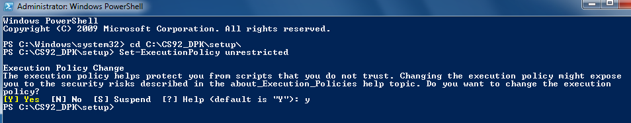
Set Execution Policy
Run the following command (prevents security access errors) and then press y.
Set-ExecutionPolicy unrestricted

Slide 10
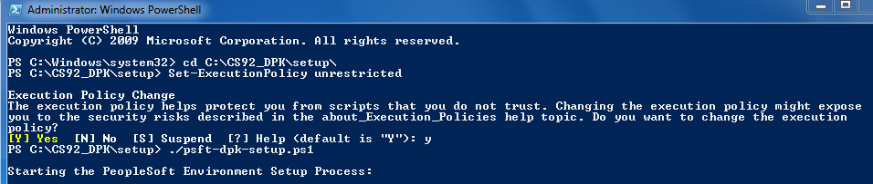
Run Script
Now run the setup script
./psft-dpk-setup.ps1

Slide 11
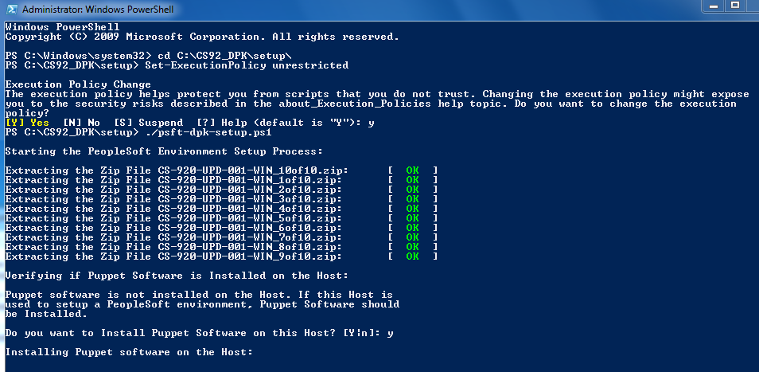
Install Puppet
Press y to install Puppet on the host

Slide 12
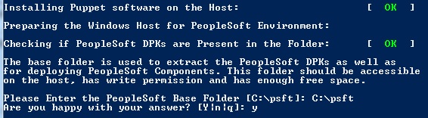
PeopleSoft Base Folder
Enter the following path for the PeopleSoft base folder and then press y
C:\psft

Slide 13
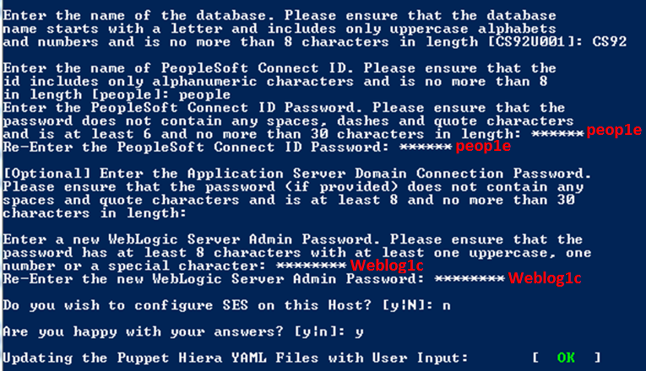
Set Environment Variables
Database Name = CS92
Connect ID = people
Connect ID Password = peop1e
App Server Domain Password (Do not set, just press enter)
Weblogic Server Admin Password = Weblog1c

Slide 14
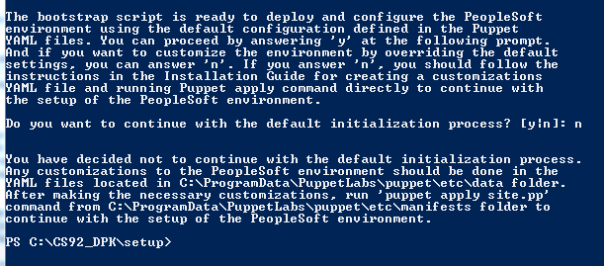
Do Not Proceed
Press n at the “Do you want to continue with the default initialization process” prompt. Then exit PowerShell and restart your machine.

Slide 15
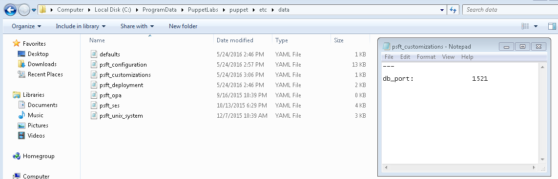
Create File
Go to C:\ProgramData\PuppetLabs\puppet\etc\data directory and create a file named psft_customizations.yaml. Open this file in a text editor, paste in the following 3 lines, and then save.
---
db_port: 1521
Alternatively, you can download the psft_customizations.yaml file from here and save it to the C:\ProgramData\PuppetLabs\puppet\etc\data directory.

Slide 16
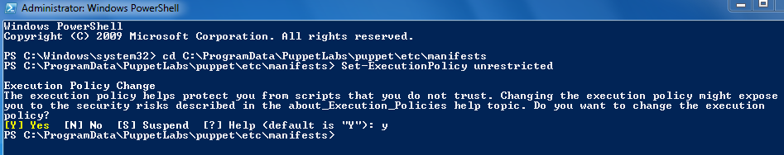
Run PowerShell
Run PowerShell as administrator. Change the directory and press enter:
cd C:\ProgramData\PuppetLabs\puppet\etc\manifests
Set the execution policy and press y:
Set-ExecutionPolicy unrestricted

Slide 17
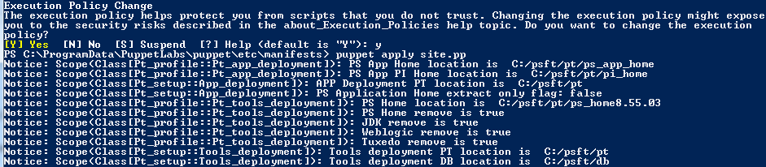
Run Puppet Apply
Run the following command to deploy the environment.
puppet apply site.pp

Slide 18
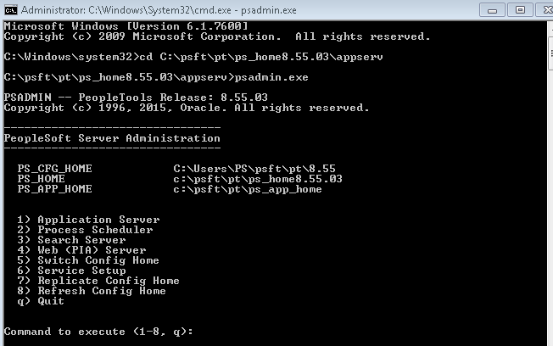
Run PSADMIN
Run the Command Prompt as administrator. Change the directory and press enter:
cd C:\psft\pt\ps_home8.55.03\appserv
Run the psadmin program
psadmin.exe

Slide 19
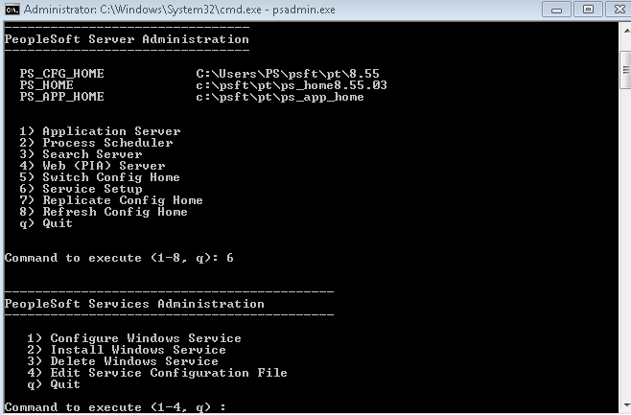
Service Startup
Press 6 for the Service Startup Menu

Slide 20
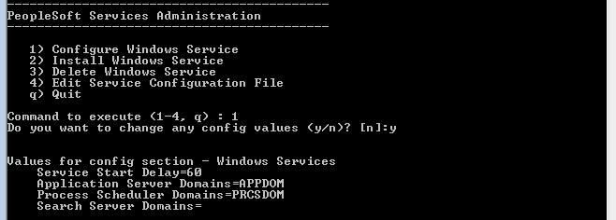
Configure Windows Service
Press 1 to Configure Windows Service and then press y

Slide 21
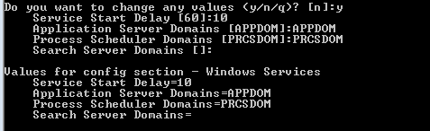
Change Values
Press y (again) to change values and set the variables to the following values:
Service Start Delay = 10
Application Server Domains = APPDOM
Process Scheduler Domains = PRCSDOM
Search Server Domains (Do not set, just press enter)

Slide 22
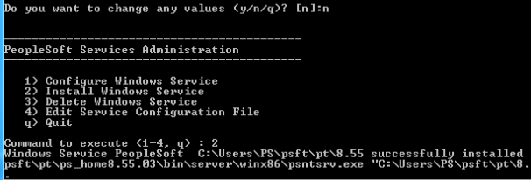
Install Service
Press n to not make anymore changes and then press 2 to Install Windows Service

Slide 23
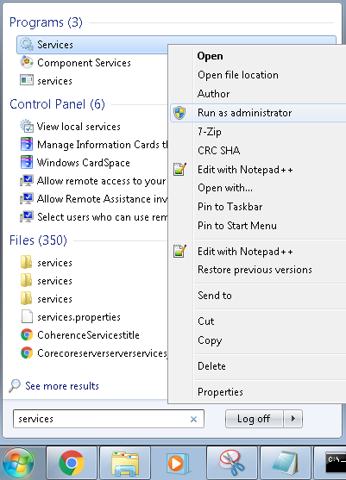
Run Services Program
Search for the Windows Services program, right click it, and run it as administrator

Slide 24
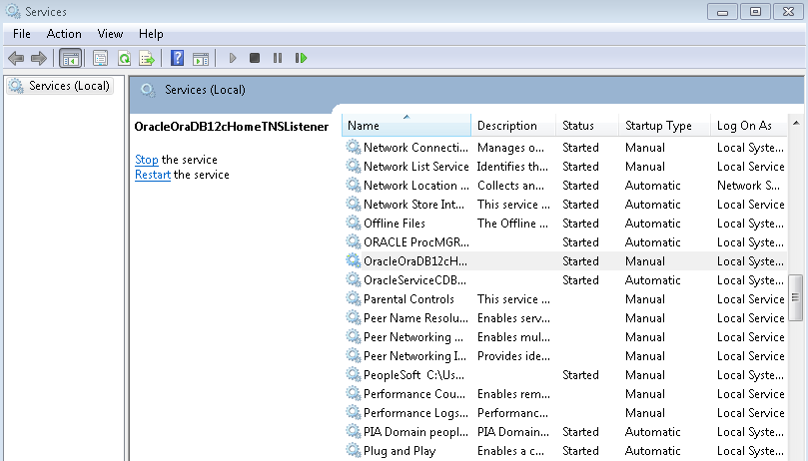
Select Service
Scroll down and double click on the service named OracleOraDB12cHomeTNSListener

Slide 25
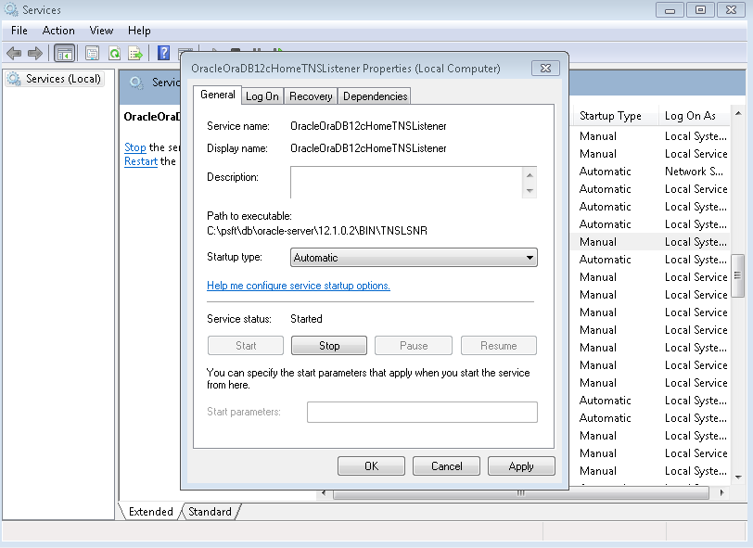
Change Startup Type
Change the Startup type to Automatic and click apply

Slide 26
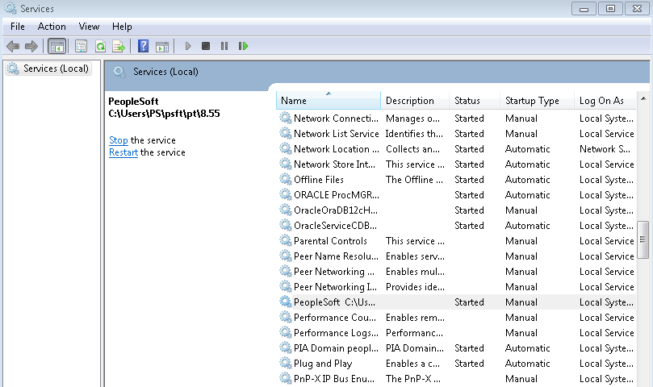
Select Service
Scroll down and double click on the service named PeopleSoft_C__Users_PS_psft_pt_8.55

Slide 27
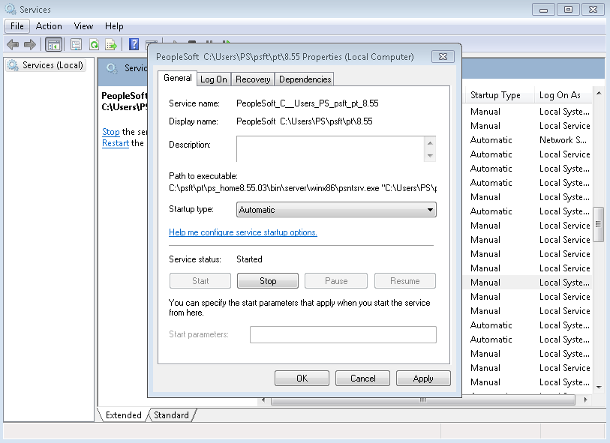
Change Startup Type
Change the Startup type to Automatic and click apply

Slide 28
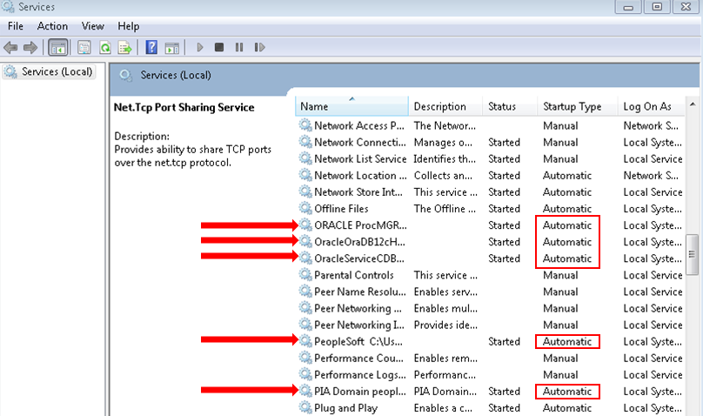
Check Services
Ensure that all of the following services have the Startup type set to Automatic:

Slide 29
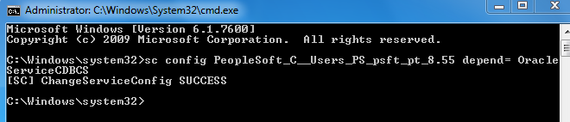
Create Dependency
Run the Command Prompt as administrator and run the following command to create a dependency for the services.
sc config PeopleSoft_C__Users_PS_psft_pt_8.55 depend= OracleServiceCDBCS

Slide 30
Restart Machine
Restart your machine and wait for all of your services to start. Once they are started you can begin to access all of the components of the full-tier PeopleSoft Campus Solutions environment. I will make different presentations that outline how to get access to the PIA, setup SQL developer, and setup Application Designer.

