Slide 1
Customizing Community Server 2007
Thomas Freudenberg

Slide 2
Agenda
What is Community Server?
Installation
AddIns (CS Modules)
Scheduler (CS Tasks)
Controls (Chameleon)
Questions?

Slide 3

What is Community Server?
CS is a commercial product
Platform for communication with customers
Fora
Blogs
Picture galleries
User management

Slide 4
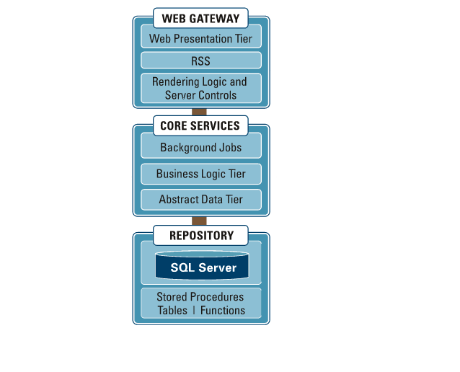
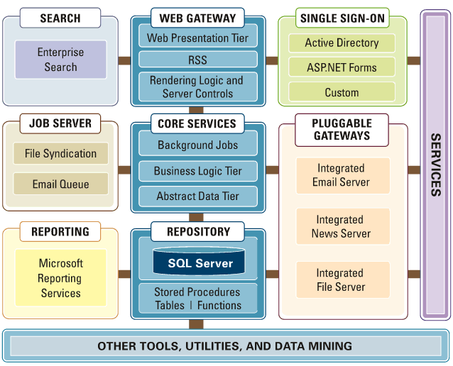
Technologies in CS

Slide 5
Installation
Four different packages:
Web for XCOPY deployment
MSI for local installation
Demo for developers and designers
SDK getting your hands dirty

Slide 6
MSI- and demo-Package
Installation

Slide 7
CSModules
“AddIns” for CS
Handling CS´ internal events
User added, deleted, updated
BeforePost/AfterPost
PreRender
…

Slide 8
FIlling a content-less news feed via web-scraping
CSModule

Slide 9
CSTasks
Community Servers “Scheduler”
For recurrent tasks
Post indexing
Statistics and reporting
Mail delivery
Feed importer
…

Slide 10
Deleting outdated posts
CSTask

Slide 11
Chameleon
Theming engine
Declarative UI description
General-purpose controls
Implicit context-senstive data binding
<CSControl:UserData Property="DisplayName" runat="server"
Text="Display name is {0}" LinkTo="Profile" />
is rendered as
Display name is Thomas

Slide 12
Layout of Blog Themes
CSControls/Chameleon

Slide 13
Writing your own CSControls
CSControls/Chameleon

Slide 14
Continuing links
Community Server | http://communityserver.org
Telligent | http://telligent.com
Telligenti´s | http://telligenti.com
CS MVPs | http://csmvps.org
Thomas Freudenberg
http://thomasfreudenberg.com

Slide 15
Questions?
That´s it

