Slide 1
Homework 4
Deep Learning for Computer Vision
NTU, Fall 2025
TA: Ting-Hsun Chi, Kenneth Yang

Slide 2
Outline
Problems & Grading
Dataset
Submission & Rules
Supplementary

Slide 3
Problems – Overview
Problem 1: Can Generative Video Models Help Pose Estimation? (50%)
Problem 2: Sparse-View 3D Gaussian Splatting (50%)

Slide 4
Problem 1: Can Generative Video Models Help Pose Estimation?

Slide 5
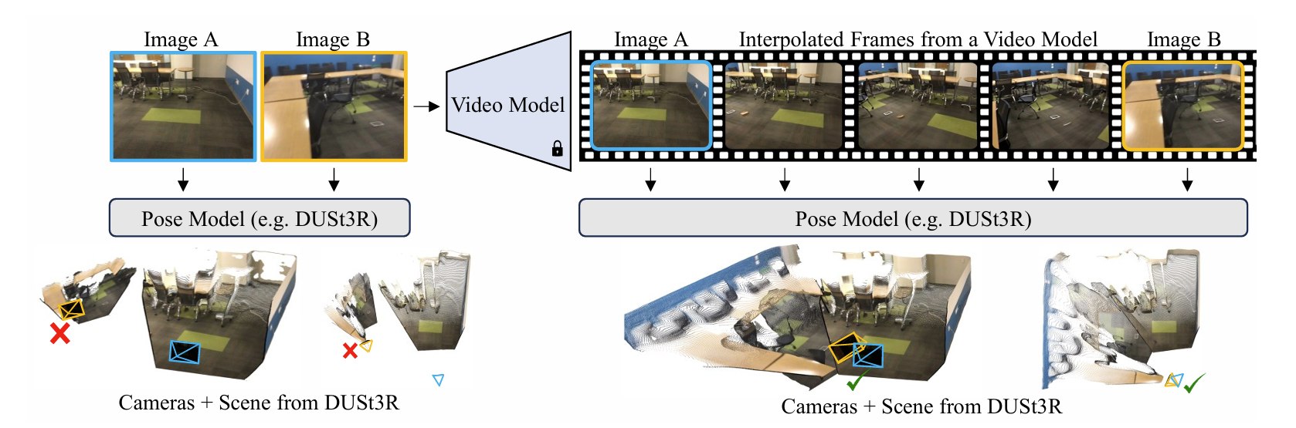
Problem 1: Can Generative Video Models Help Pose Estimation?
Task description
  Recent groundbreaking models like DUSt3R perform impressively in standard scenarios.
  Limitation: They often fail when applied to wide-baseline image pairs.
  InterPose [CVPR'25 highlight] found that using video generative models to interpolate wide-baseline pairs can drastically boost performance.
  In this problem, you will run DUSt3R on both the original wide-baseline pairs and the provided interpolated sequences, and then analyze the resulting performance difference.

Slide 6
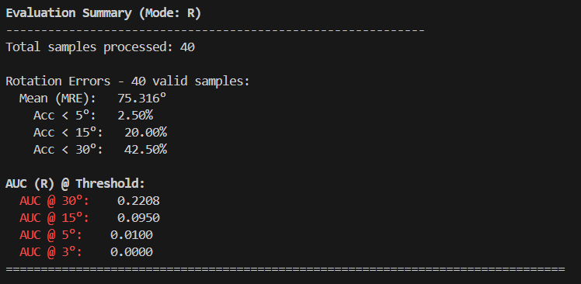
Problem 1: Evaluation [11/16 Updated]
Evaluation Script:
bash scripts/dust3r/public/run_check_metrics.sh
Metric:
Mean Rotation Error (MRE), R_{Acc} , AUC
[11/16 updated]
You are only required to implement the TODO section within the inference_one_scene function in dust3r_inference.py.
If implemented correctly, your code will produce the same results as the TA's solution when run in the TA's environment. Due to variances in hardware (device) and package versions, you may observe minor differences when executing the code on your end.

Slide 7
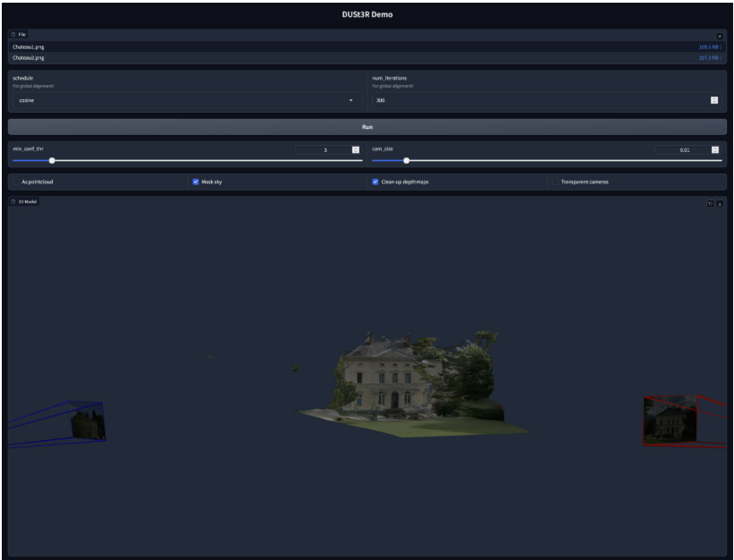
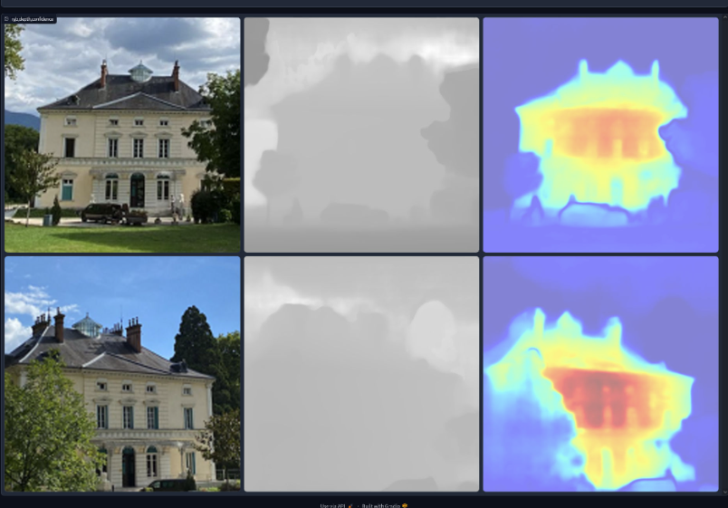
Problem 1: Grading – Report (30%)
Q1 (10%)
  Explain the DUSt3R and VGGT models and analyze their key differences. (5%)
  Run a demo of DUSt3R using your own image sequence and present the results. (5%)

Slide 8
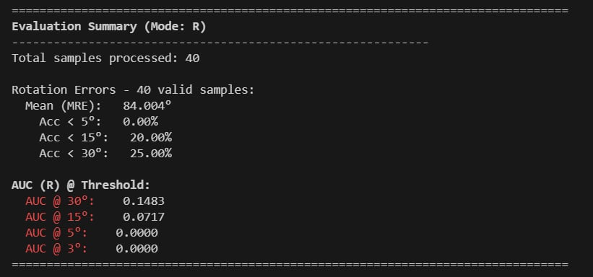
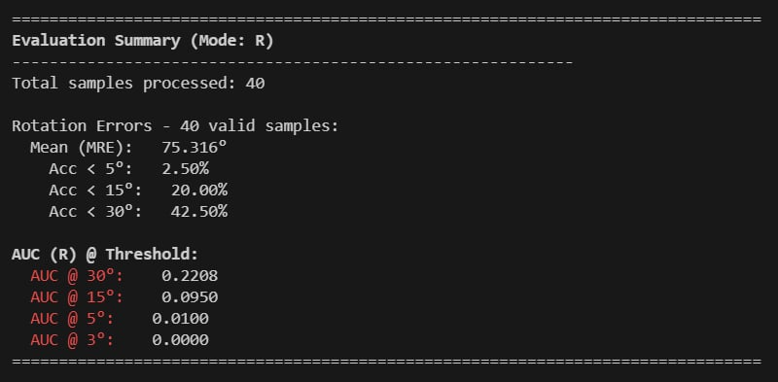
Problem 1: Grading – Report (30%) [11/16 Updated]
Q2 (10%)
(1) Quantitative Evaluation (On Public Dataset) (5%)
Run DUSt3R on the original wide-baseline pairs and the interpolated sequences .
Report the final evaluation summary for both runs.
[11/16 updated]
Due to variations in device or package versions, the execution results may exhibit minor discrepancies. However, you should still observe a clear performance gap between Pair Input and Video Input.

Slide 9
Problem 1: Grading – Report (30%) [11/14 Updated]
Q2 (10%)
(2) Case Study: idx 3781 PnP Solver Failure (5%):
The interpolated sequence for sample idx 3781 (from the public dataset) is known to fail during the PnP solving step.
Present the MRE for both the original pair and the interpolated sequence relative to the ground truth.
Use visual evidence (both the DUSt3R-generated point cloud and the visual effect of the interpolated sequence itself) to analyze why the PnP solver failed for this sequence.
Hint: A PnP solver is likely to fail when the 3D points are co-planar or co-linear.

Slide 10
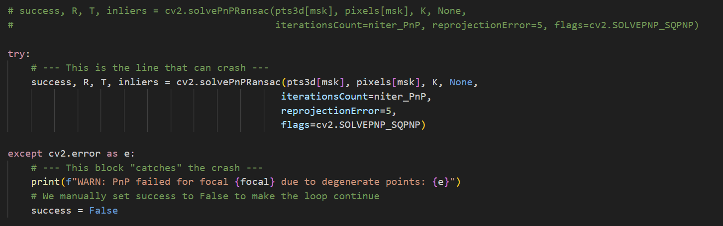
Problem 1: Grading – Report (30%) [11/14 Updated]
Q2 (10%)
(2) Case Study: idx 3781 PnP Solver Failure (5%):
The interpolated sequence for sample idx 3781 (from the public dataset) is known to fail during the PnP solving step.
Add try...except handling in dust3r/dust3r/cloud_opt/init_im_poses.py to catch the cv2.error.
(Note: You do not need to upload the dust3r folder).

Slide 11
Problem 1: Grading – Report (30%)
Q3 (10%)
  Compare the overall performance difference from your two runs.
  Analyze these quantitative results and explain your high-level hypothesis. (i.e., Why, in general, does this performance gap exist?)

Slide 12
Problem 1: Grading – Implementation (20%)
Private Run 1 (10%):
Task: Model inference on the private wide-baseline pairs.
Metric: Graded based on MRE performance.
Private Run 2 (10%):
Task: Model inference on the private interpolated sequences.
Metric: Graded based on MRE performance.
If your model is implemented correctly, you should receive full credit for these sections.

Slide 13
Problem 2: Sparse-View 3D Gaussian Spaltting

Slide 14
Problem 2:
Task description
  In this problem, you will have to train your own sparse-view 3D gaussians as explicit scene representation for the given scene.
  To be more specific, given a set of images (with camera pose) of this scene, learn the parameters of all 3D gaussians to fit this scene. After that, given the camera poses of testing images, render the test images for evaluation.
  Please refer to InstantSplat LINK

Slide 15
Problem 2: Grading – Report (50%)
Q1 (15%)
  Try to explain the difficulty of sparse-view 3DGS in your own words. (5%)
  Compare 3D Gaussian Splatting with NeRF (pros & cons) (5%)
  Which part of 3D Gaussian Splatting is the most important you think? Why? (5%)

Slide 16
Problem 2: Grading – Report (50%)
Q2 (35%) Given novel view camera pose, your 3D gaussians should be able to render novel view images. Please evaluate your generated images and ground truth images with the following three metrics (mentioned in the InstantSplat paper). Try to use at least three different hyperparameter settings and discuss/analyze the results.
  Please report the PSNR/SSIM/LPIPS on the image set.
  Different settings such as learning rate, iterations, densification, etc.
  Also attach visualization to the report and analyze the differences (additional visualization e.g. supersplat is encouraged.)
Setting | PSNR | SSIM | LPIPS (vgg)
Setting 1 (You need to write your setting) | TODO | TODO | TODO
Setting 2 (You need to write your setting) … | TODO | TODO | TODO

Slide 17
Dataset

Slide 18
Tools for Dataset
Download the dataset
  Manually download the dataset
  https://drive.google.com/drive/folders/1QnxUnuygh6d9zIDGS8y83spoaugLG5Np?usp=drive_link

Slide 19
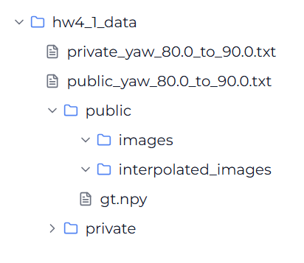
Problem 1
The dataset consists of 40 public image pairs and 10 private image pairs.
Format:
# 10 image pairs
# 40 image pairs
# ground truths for public dataset

Slide 20
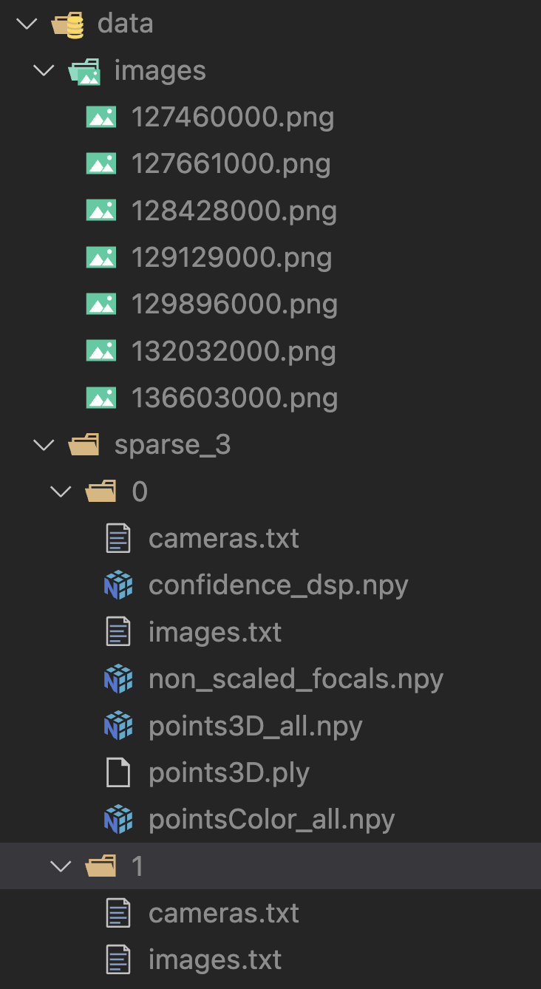
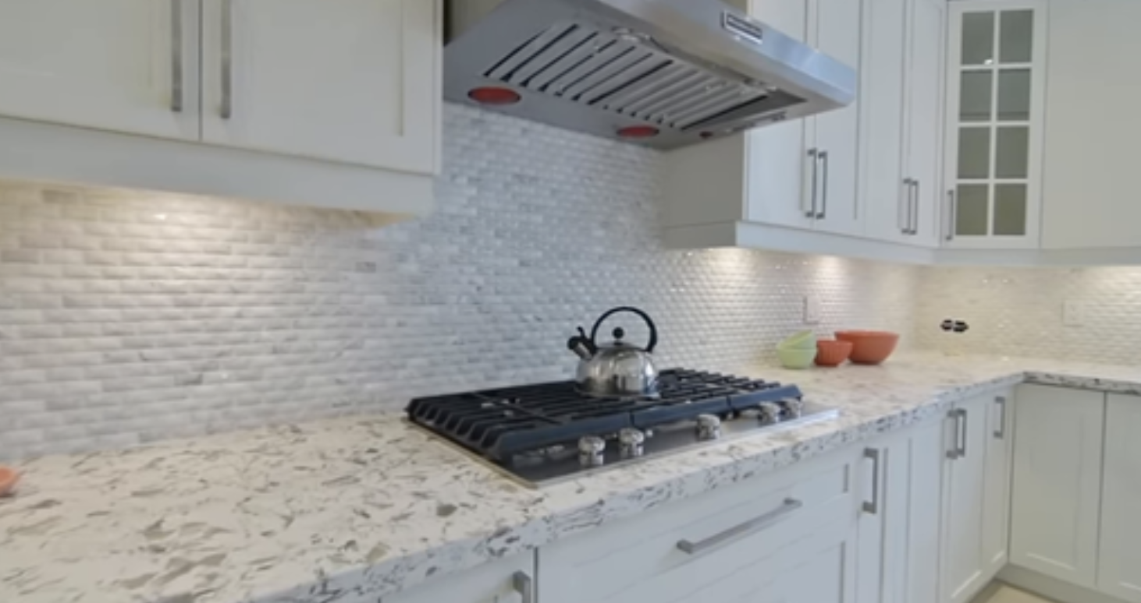
Problem 2
Folder structure
data/
images/ # training + public test images (7 images)
{id}.png
sparse_3/
0/
cameras.txt
confidence_dsp.npy
images.txt
non_scaled_focals.npy
points3D_all.npy
points3D.ply
pointsColor_all.npy
1/
cameras.txt # public testing set (4 images)
images.txt
You CANNOT use testing data for training purposes.

Slide 21
Submission & Rules

Slide 22
Submission
Click the following link to get submission repo with your GitHub account:
https://classroom.github.com/a/4AUGnMVG
  You should connect your Github account to the classroom with your student ID
  If you cannot find your student ID in the list, please contact us (ntu-dlcv-2025-fall-ta@googlegroups.com)
By default, we will grade your last submission (commit) before the deadline. Please e-mail the TAs if you’d like to submit another version of your repository and let us know which commit to grade.
We will clone the main branch of your repository.

Slide 23
Submission
Your GitHub repository should include the following files
  hw4_<studentID>.pdf (report)
  hw4_1_1.sh (for Problem 1)
  hw4_1_2.sh (for Problem 1)
  Python files (e.g., training code & inference code & visualization code)
  Model files (can be loaded by your python file)
<other notes>
Don’t push the dataset to your repo.
If any of the file format is wrong, you will get zero point.

Slide 24
Bash Script - Problem 1
TA will run your code as shown below
Note that you should NOT hard code any path in your file or script.
Your testing code have to be finished in 30 minutes.
Inference on Original Pairs
Inference on Interpolated Sequences
  bash hw4_1_1.sh $1 $2 $3 $4
    $1: Path to the TXT file containing the index.
    $2: Path to the original image pair directory.
    $3: Path to the model checkpoint.
    $4: Path for the output prediction file.
  bash hw4_1_2.sh $1 $2 $3 $4 $5
    $1: Path to the TXT file containing the index.
    $2: Path to the original image pair directory.
    $3: Path to the interpolated sequence directory.
    $4: Path to the model checkpoint.
    $5: Path for the output prediction file.

Slide 25
Bash Script - Problem 2
TA will run your code as shown below
  bash hw4_2.sh $1 $2
    $1: path to the folder containing test data and train data (e.g. hw4/p2_data/), will be exactly the same folder structure as the given dataset, with public test images/cameras changed to private images/cameras.
    $2: path to the output png files (e.g. hw4/output_p2/), you only have to render test images
Note that you should NOT hard code any path in your file or script.
Your testing code have to be finished in 3 minutes.

Slide 26
Rules – Bash Script
You must not use commands such as rm, sudo, CUDA_VISIBLE_DEVICES, cp, mv, mkdir, cd, pip or other commands to change the environment.
In your submitted script, please use the command python3 to execute your testing python files.
  For example: python3 test.py $1 $2
We will execute you code on Linux system, so try to make sure you code can be executed on Linux system before submitting your homework.

Slide 27
Rules – Download Checkpoints
If your checkpoints are larger than GitHub’s maximum capacity (50 MB), you could download them in hw3_download.sh
  TAs will run `bash hw4_download.sh` prior to any inference if the download script exists, i.e. it is NOT necessary to create a blank `hw4_download.sh` file.
Do NOT delete your model checkpoints before the TAs release your score and before you have ensured that your score is correct.
Your download script have to be finished in 10 minutes.

Slide 28
Rules – Download Checkpoints (cont’d)
Please use wget to download the model checkpoints from cloud drive (e.g. Dropbox) or your working station.
  You should use -O argument to specify the filename of the downloaded checkpoint.
Please refer to this Dropbox Guide for a detailed tutorial.
Google Drive is a widely used cloud drive, so it is allowed to use gdown to download your checkpoints from your drive.
  It is also recommended to use -O argument to specify the filename.
  Remember to set the permission visible to public, otherwise TAs are unable to grade your submission, resulting in zero point.
  If you have set the permission correspondingly but failed to download with gdown because of Google’s policy, TAs will manually download them, no worries!!

Slide 29
Rules – Environment
Ubuntu 22.04.4 LTS
NVIDIA RTX A4500(20 GB)
GNU bash, version 5.1.16(1)-release

Slide 30
Rules – Environment (cont’d)
Ensure your code can be executed successfully on Linux system before your submission.
Use only Python3 and Bash script conforming to our environment, do not use other languages and other shell during inference.
You must NOT use commands such as sudo, CUDA_VISIBLE_DEVICES to interfere with the environment; any malicious attempt against the environment will lead to zero point in this assignment.
You shall NOT hardcode any path in your python files or scripts, while the dataset given would be the absolute path to the directory.

Slide 31
Packages (problem1)
check DUSt3R for packages and versions
Others if you need (e.g., tqdm, gdown, glob, yaml, etc.)
Any dependencies of above packages, and other standard python packages
* E-mail or ask TAs first if you want to import other packages.

Slide 32
Packages (problem2)
check InstantSplat for packages and versions
Others if you need (e.g., tqdm, gdown, glob, yaml, etc.)
Any dependencies of above packages, and other standard python packages
If you use the official 3DGS repo and your GPU has higher CUDA version, you can install corresponding Pytorch version
* E-mail or ask TAs first if you want to import other packages.

Slide 33
Ohter Reminders & Common Problems
When using wget, surround the url with quotation marks (“) to prevent running in background.
Use os.path.join to deal with path as often as possible.
Avoid making assumptions about the arguments (such as paths or filenames).
If you train on GPU ids other than 0, remember to deal with the “map location” issue when you load model.

Slide 34
Deadline and Academic Honesty
Deadline: 2025/12/2 (Tue.) 11:59 PM (GMT+8)
Late policy : Up to 3 free late days in a semester. After that, late homework will be deducted 30% each day.
Taking any unfair advantages over other class members (or letting anyone do so) is strictly prohibited. Violating university policy would result in F for this course.
Students are encouraged to discuss the homework assignments, but you must complete the assignment by yourself. TA will compare the similarity of everyone’s homework. Any form of cheating or plagiarism will not be tolerated, which will also result in F for students with such misconduct.

Slide 35
Reproducibility
If we cannot execute your code, TAs will give you a chance to make minor modifications to your code. After you modify your code,
  You can not train a new model as a modification.
  If we can execute your code, you will still receive a 30% penalty in the score corresponding to the modified code.
  If we still cannot execute your code, no point will be given.

Slide 36
DOs and DONTs for the TAs & Instructor
Do NOT send messages to TAs via their individual emails / social media.
TAs are happy to help, but they are not your tutors 24/7.
TAs will NOT debug for you, including addressing coding, environmental, library dependency problems.
TAs do NOT answer questions not related to the course.
If you cannot make the TA hours, please email the TAs to schedule an appointment instead of stopping by the lab directly.

Slide 37
How to Find Help
Google or ChatGPT!
Use TA hours (please check course website for time / location).
  Please seek help from the TAs in charge of this assignment as possible as you can.
Post your question under HW4 discussion section on NTU COOL.
Contact TAs by e-mail: ntu-dlcv-2025-fall-ta@googlegroups.com
  Title should start with [DLCV 2025 Fall HW4]
  Email with the wrong title may be filtered and not be replied.

