Slide 1
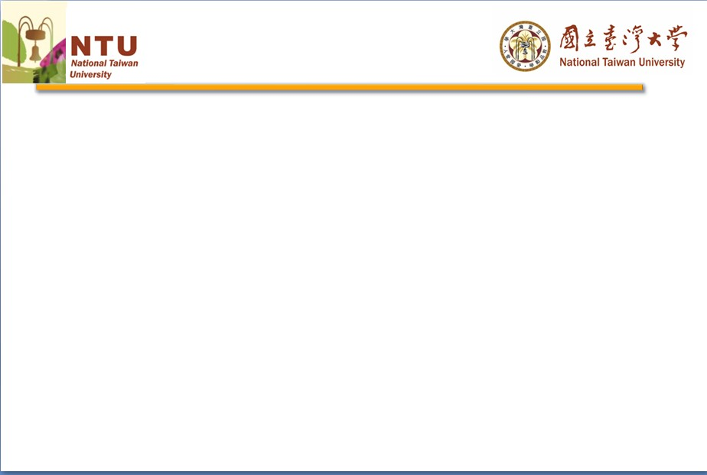
Euro’s a Quarter Century
YEH, Kuo-chun
http://homepage.ntu.edu.tw/~kuochunyeh/
Professor, Graduate Institute of National Development, NTU
Coordinator, Program of China Studies, College of Social Sciences, NTU
2017-18 Taiwan Chair, Ghent University and University of Groningen
EU Jean Monnet Chair, 2021-

Slide 2
A new future for Europe - Welcoming the euro banknotes and coins by Wim Duisenberg (December 31, 2001)
But why did Europeans have that dream…It is this: I, too, was once a child.
And the Europe into which I was born was a very different place from the Europe of today. It was part of a world suffering from a terrible economic depression. It was a continent whose nations were about to learn the terrible lessons of war for a second time in less than half a century. Out of the folly of dictatorship and the errors of protectionism was born a new determination among Europeans to work with, instead of against, each other, and to respect each other's differences and to learn from them…

Slide 3
Milton Friedman (1997.8.28)
….The drive for the Euro has been motivated by politics not economics. The aim has been to link Germany and France so closely as to make a future European war impossible, and to set the stage for a federal United States of Europe. I believe that adoption of the Euro would have the opposite effect. It would exacerbate political tensions by converting divergent shocks that could have been readily accommodated by exchange rate changes into divisive political issues. Political unity can pave the way for monetary unity. Monetary unity imposed under unfavorable conditions will prove a barrier to the achievement of political unity.

Slide 4
EU的經濟三難選擇 (tri-lemma)
固定匯率
加入MU理論上可以克服tri-lemma (?)
資金自由移動
貨幣政策自主

Slide 5
EU的政治三難選擇 (tri-lemma)
民主
區域或全球化
國家自決

Slide 6
Aggregate demand and supply in France and Germany
France (Greece)
Germany
P_{F}
P_{G}
S_{G}
S_{F}
D_{F}
Y_{F}
Y_{G}

Slide 7
Effects of monetary expansion in France and monetary restriction in Germany
France
Germany
P_{G}
Y_{F}
Y_{G}

