Slide 1
Upper Body Ground Truth
Ryan Lenart
Vincent Ju
Tianxiang

Slide 2
Context
Control of upper body is limited after a traumatic injury or stroke
Necessary to perform exercises to retrain the brain
Caregivers want to monitor how often exercises are being done

Slide 3
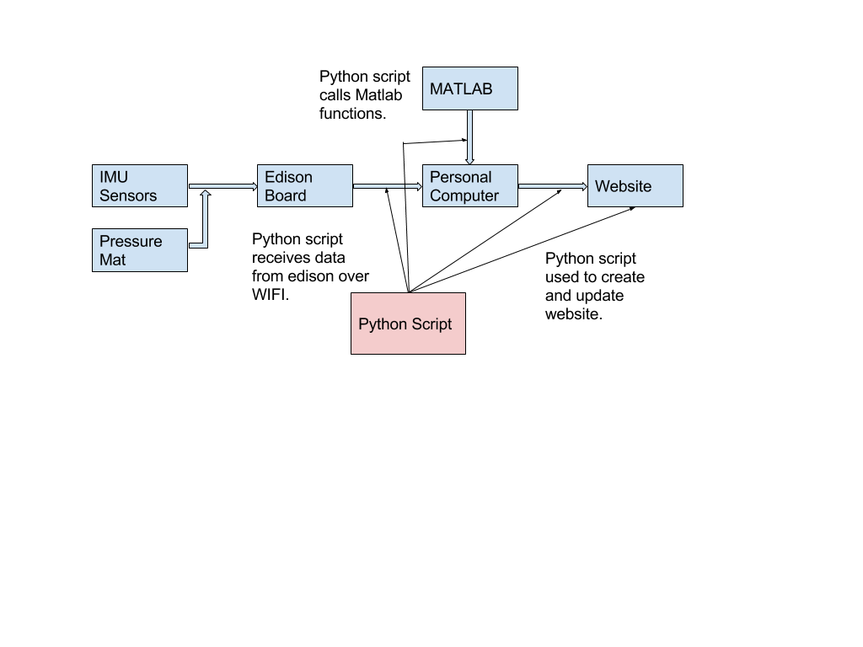
Basic Design

Slide 4
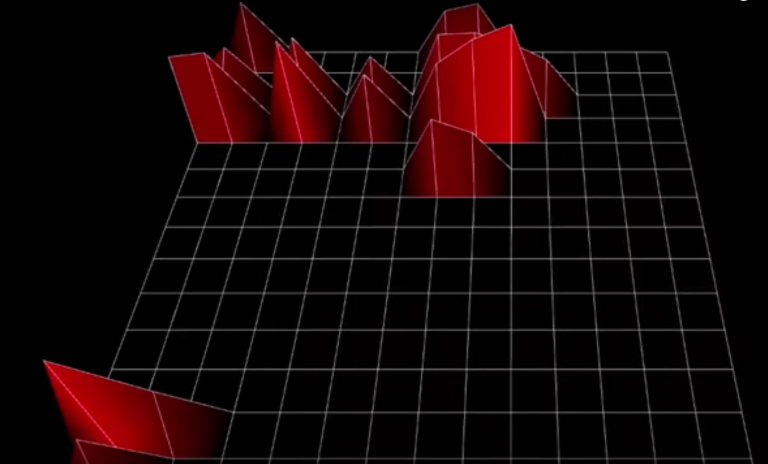
Experimental Verification
Pressure Mat
Registers a signal
Noisy
Needs refining

Slide 5
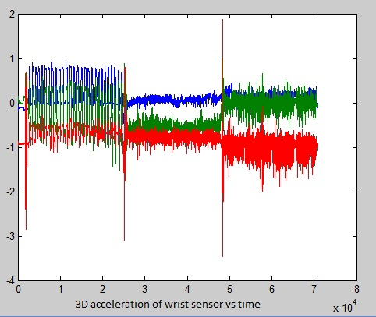
Sensor data and Matlab calculations
The peaks signify starting point for each activity. It is created by rapid hand shakes.
Three distinctive activities are visually observable.
2 min of drinking + 2 min of writing + 2 min of typing
Fig. 4 -1 Three Axis Acceleration Plot of WHI wrist sensor for 6 min of activity

Slide 6
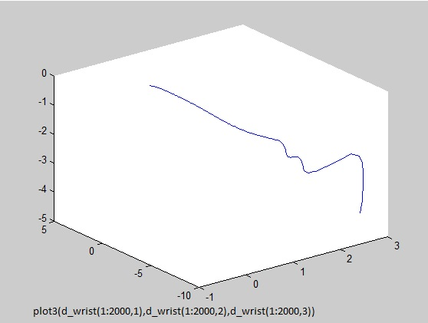
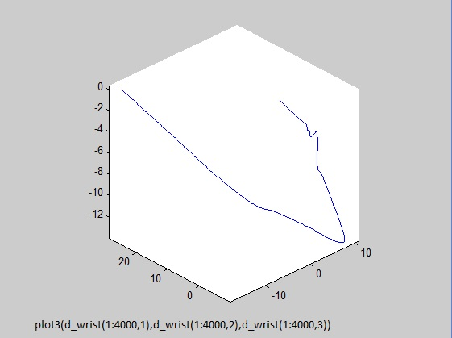
Result of Trajectory Calculations
Fig. 4-2 Initial 20 seconds of displacement data for WHI wrist sensor
Fig. 4-2 Initial 20 seconds of displacement data for WHI wrist sensor

Slide 7
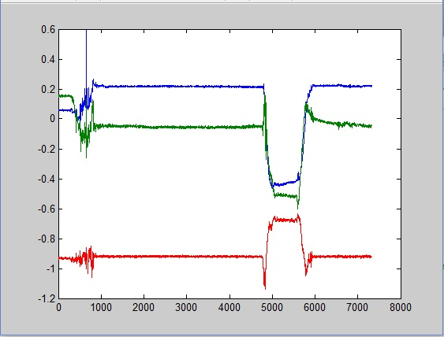
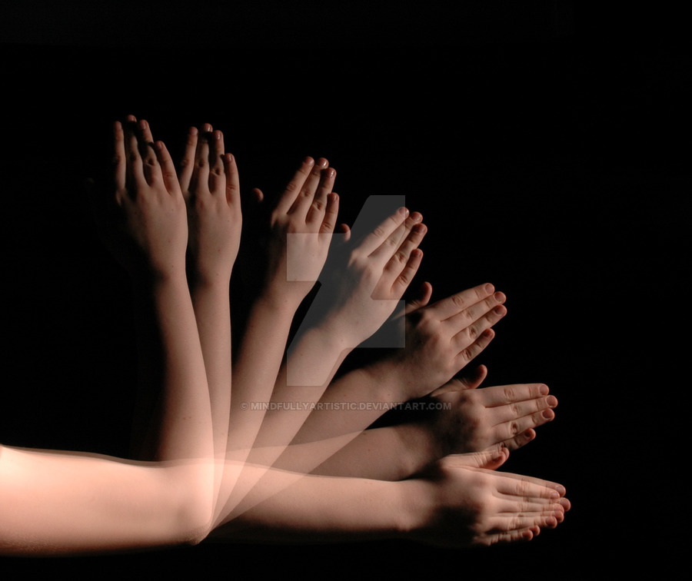
Simple Test
This test involves raising hand from rest up and then return hand back to starting position
Fig.4-4 simple test 3D acc data

Slide 8
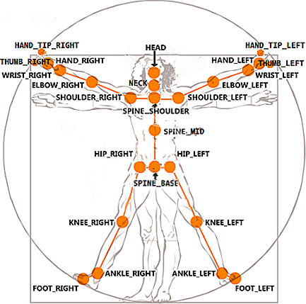
Retrieving data from Kinect Sensor
Major joints on human body was labeled in the Kinect SDK
By specify the joint #, we can use Kinect to track the movement of selected joints
For example, in our data, we track #9 ElbowRight and #10 WristRight, where IMU sensors were tied there respectively.

Slide 9
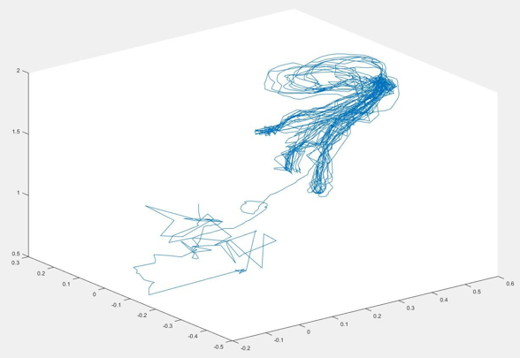
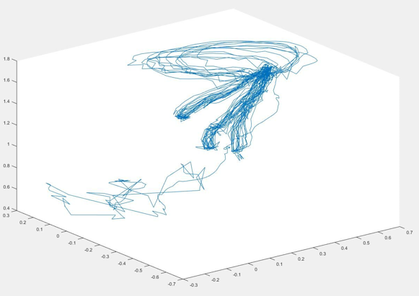
Retrieving data from Kinect Sensor
joint #9 ElbowRight
joint #10 WristRight

Slide 10
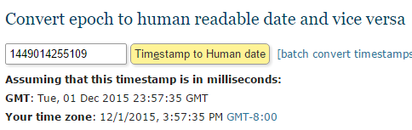
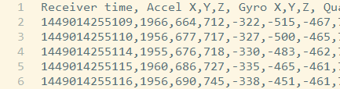
Problems Encountered and Workarounds
Mapping trajectory from IMU
Synchronize data from 3 sensors
IMU, Kinect Sensor and Pressure mat
Using UTC time stamp
Visualizing Kinect data?
OpenCV would be the simplest way.

Slide 11
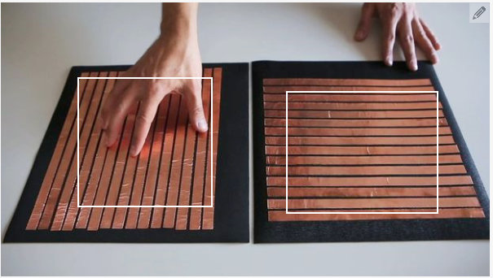
Problems Encountered and Workarounds
Deformation of pressure mat
Conduct due to wrinkles
Rigid insulating board
No glue language?
Using Python to communicate between sensors
And create our web interface.

Slide 12
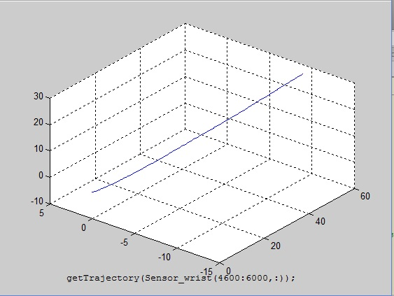
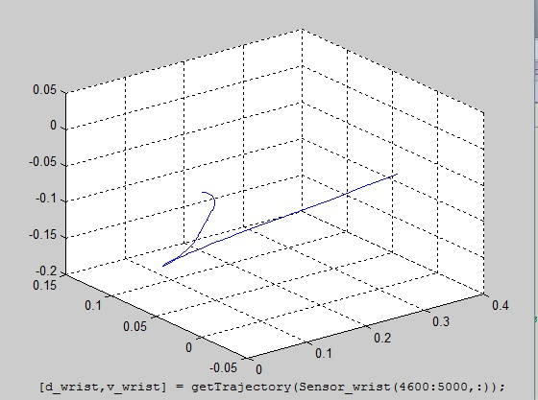
Analysis of possible error
Fig. 4-5 wrongful trajectory of full activity segment
Fig. 4-6 Correct trajectory of first ½ of activity

Slide 13
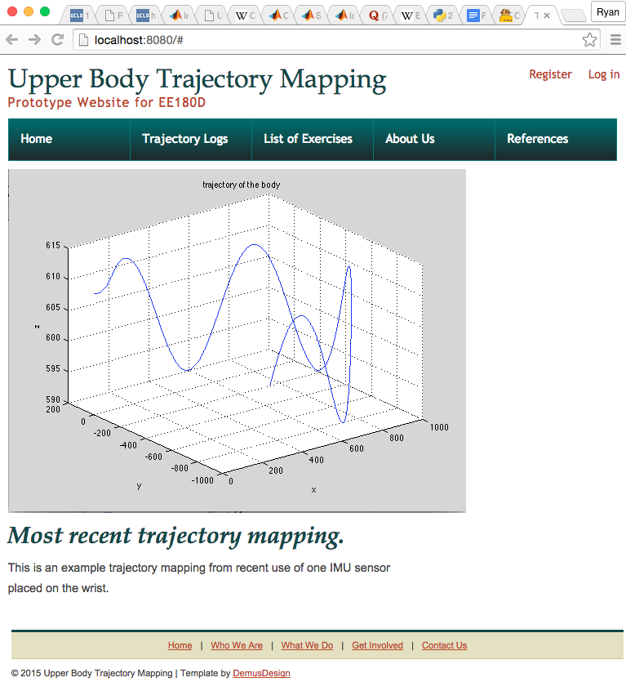
Web Application
Web.py and MATLAB Engine for Python Frameworks
Web.py for web interface
MATLAB Engine for data processing

Slide 14



Future Plan
Developing the Python application to handle:
organizing and updating patient’s exercise data on website
answer to doctor’s query of a certain patient’s certain progress
new exercise assignment page and doctor patient discussion area.

Slide 15
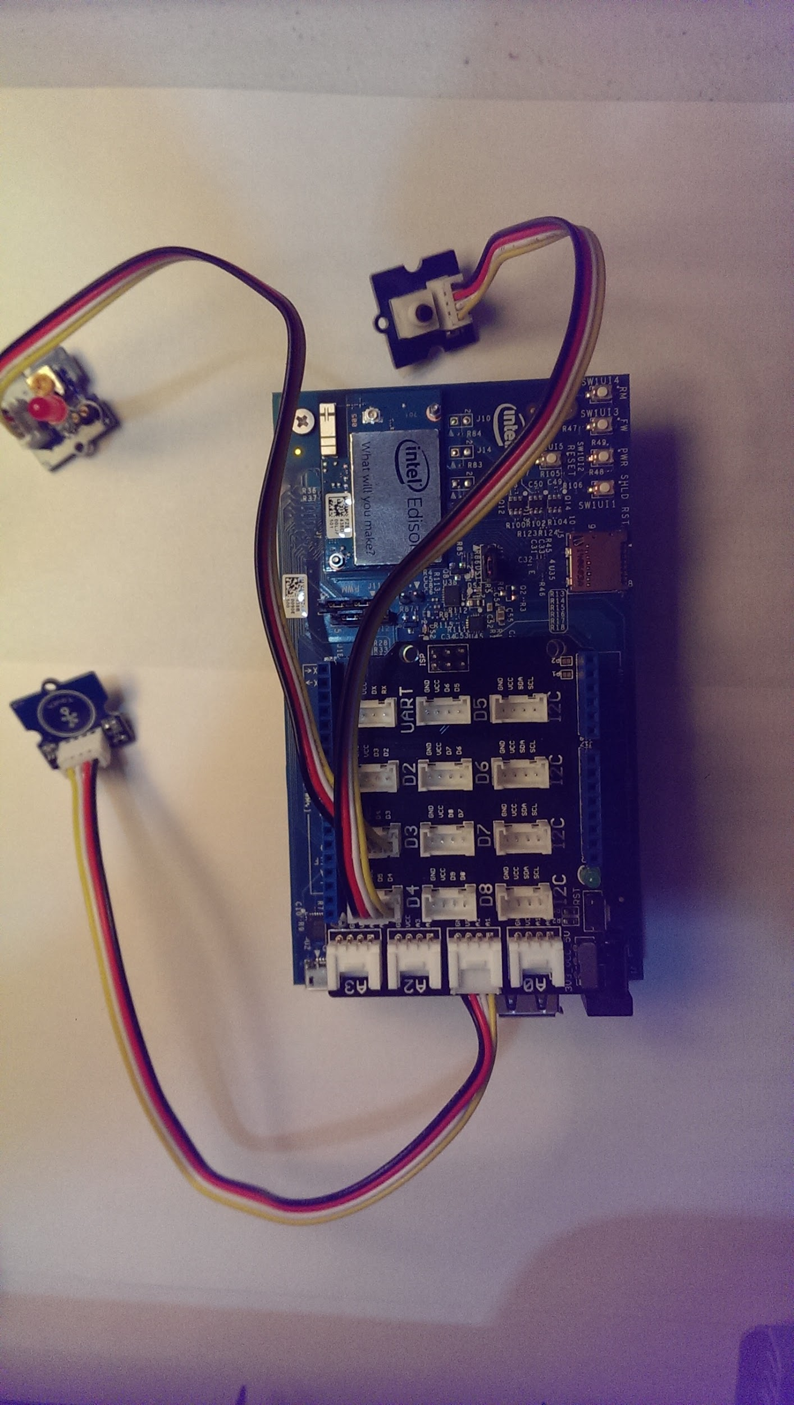
Combining Edison Board w. Pressure Mat
Control pressure mat and sensor combination using one application either using edison board or computer programs to do data collection and trajectory analysis.(presumably python)
+

Slide 16
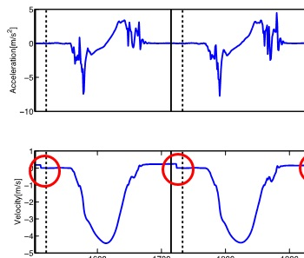
Calibration – Algorithm to Make Predictions
Once ground truth data acquisition are within reasonable range of accuracy, we can move on to algorithms of trajectory searching or analysis and other models that can predict patient’s activities
Fig.4-7 An Illustration of ZUPT

Slide 17
Calibration – Accumulation of errors
MEMS Gyroscope and Accelerometer has intrinsic error
Many reasons, e.g. Temperature
Integration accumulates this error through time
There is no way to correct by itself
The accumulated error can be huge

Slide 18
Calibration – Accumulation of errors

Slide 19
Calibration – Zero Velocity Update
Zero Velocity Update: set the velocity to zero when foot is stationary and smooth the velocity in between before being integrated for position.
Zero
Velocity
Update

Slide 20
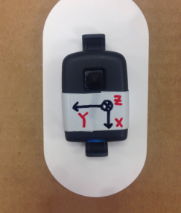
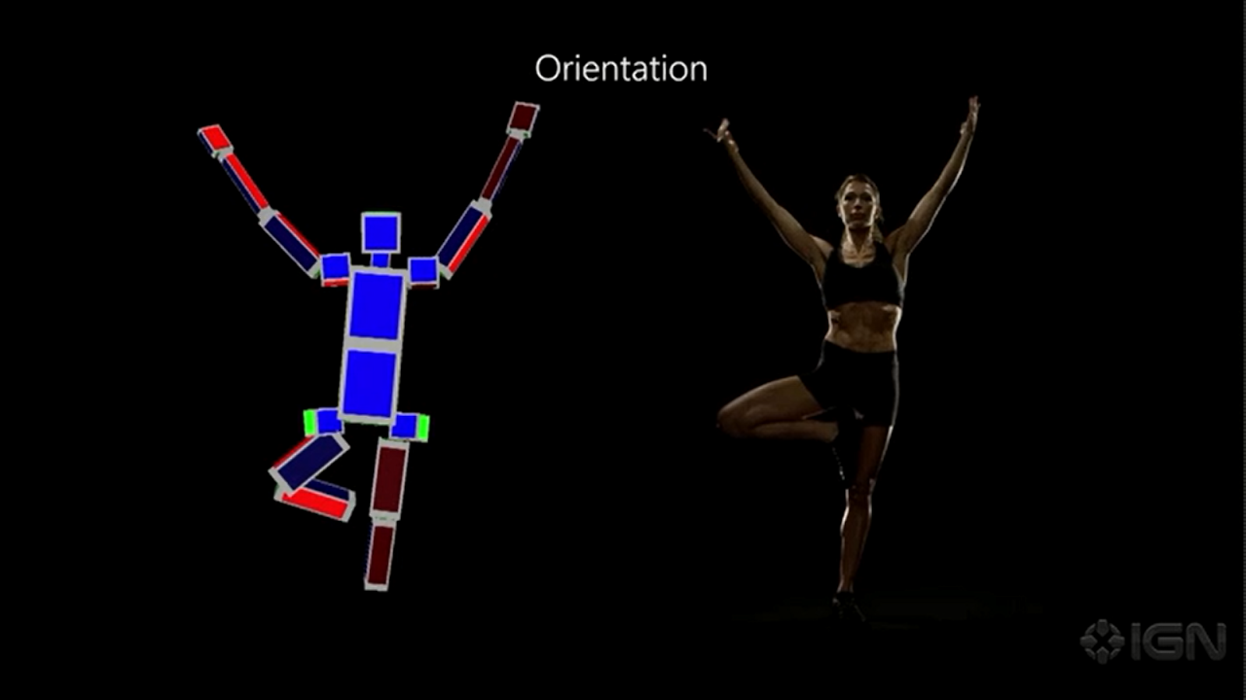
Calibration – Constraints and Kinect
The IMU could provide ridiculous data
e.g. My elbow in the 4th floor, but my wrist in the 7th floor.
Length of my arm is a constant.
Each data point has an error range
We are only interested in sane data
So only sane data should be saved
Training the sensor by Kinect
Position coordinates directly gathered.
Satisfactory resolution
Only interested in sane data, or track data as well.
Machine learning algorithm could be utilized
Supervised learning

Slide 21
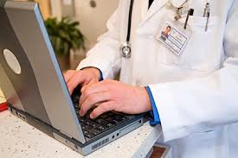

Development of User End Features
Developing of patient end functionalities that will guide patient through designated exercise while collecting data with sensor-pressure mat device.
Doctor: Did you…
Patient: Yeah, of course…
Doctor: Well, let’s see what the computer thinks, OK?
Patient: Zzzzzz

Slide 22
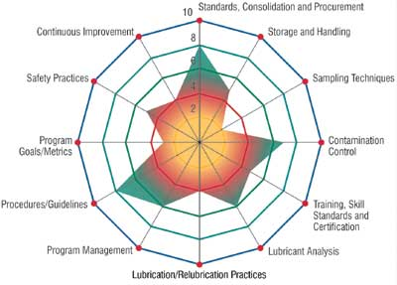
User Feedback and Interaction Functions
The app should also ideally have a GUI that can provide guidance for exercises, output interactive audio visual contents and provide preliminary performance data for patients’ own feedback.
Fig 4-8 An Example of Spider Chart

