Slide 1
Inertial-Kinect Fusion for upper body ground truth
Based on feedback system accomplished by complimentary filter and real-time integration of Kinect-provided body tracking data in nullifying gravity in IMU-provided acceleration data.

Slide 2
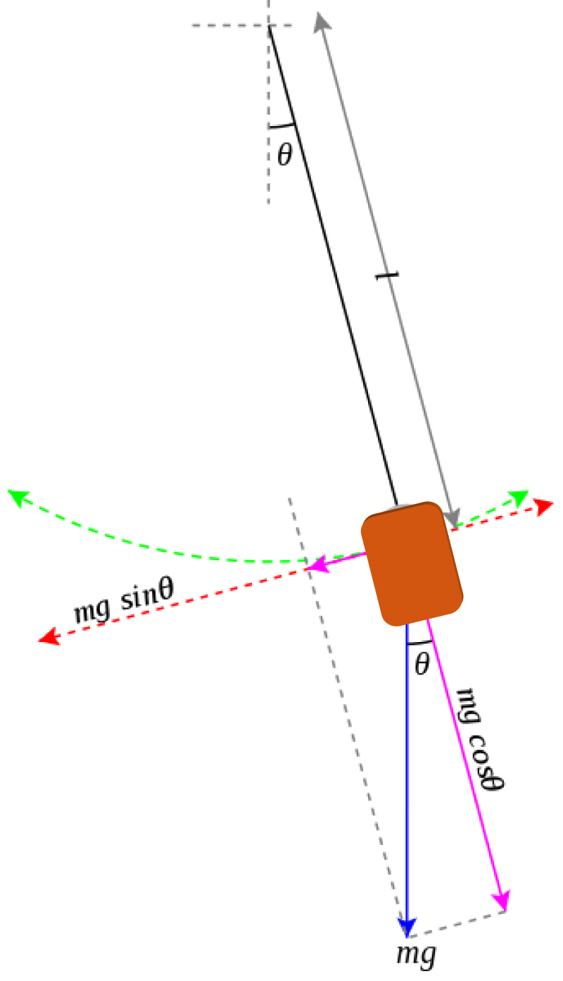
Problem: IMU error
is omnipresent
Basically, the IMU unit is not well-aligned with the package.
None of the three axes is parallel or perpendicular to any surface of the IMU package
Nor the quaternion the IMU provided is reliable…
Drift of angular acceleration is persistent
The quaternion provided is relative – no absolute reference frame
Just because the IMU unit the EE dept. provided is incredibly cheap…

Slide 3
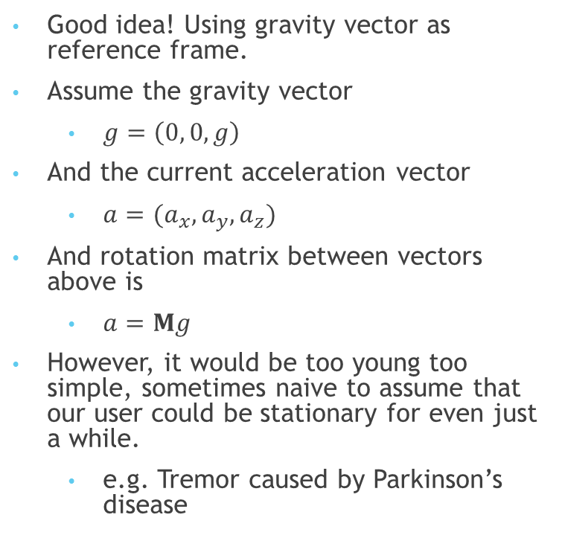
One solution: use rest as reference quaternion
Good idea! Using gravity vector as reference frame.
Assume the gravity vector
$g=\left(0, 0,g\right)$
And the current acceleration vector
$a=(a_{x},a_{y},a_{z})$
And rotation matrix between vectors above is
$a=Mg$
However, it would be too young too simple, sometimes naive to assume that our user could be stationary for even just a while.
e.g. Tremor caused by Parkinson’s disease

Slide 4
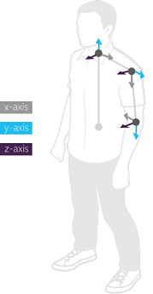
What we need is just a absolute attitude
That’s what Kinect for!
However, Microsoft cancelled the function providing absolute bone orientation in Kinect SDK v2.0
Instead, Microsoft provided a function that provides bone orientation relative to the base joint as in the hierarchy
This is probably not a good idea…
If there would be a 2% error in Kinect data and there are 6 joints between “Hand Left” and “Hip Center”
The error could accumulate to 12%
Nevertheless, we will put this result.

Slide 5
Brute-force for orientation
The good news is, we always have the absolute coordinates of related joints.
So we can just use the difference between these two joint coordinates as vector of bone.
And the difference between the bone vector and normal vector to the ground would be the rotation matrix between bone and –g.
And tie the IMU parallel to the bone…
That’s what we need! Attitude of IMU for absolute reference frame.
Then use this attitude to nullify the gravity vector.

Slide 6
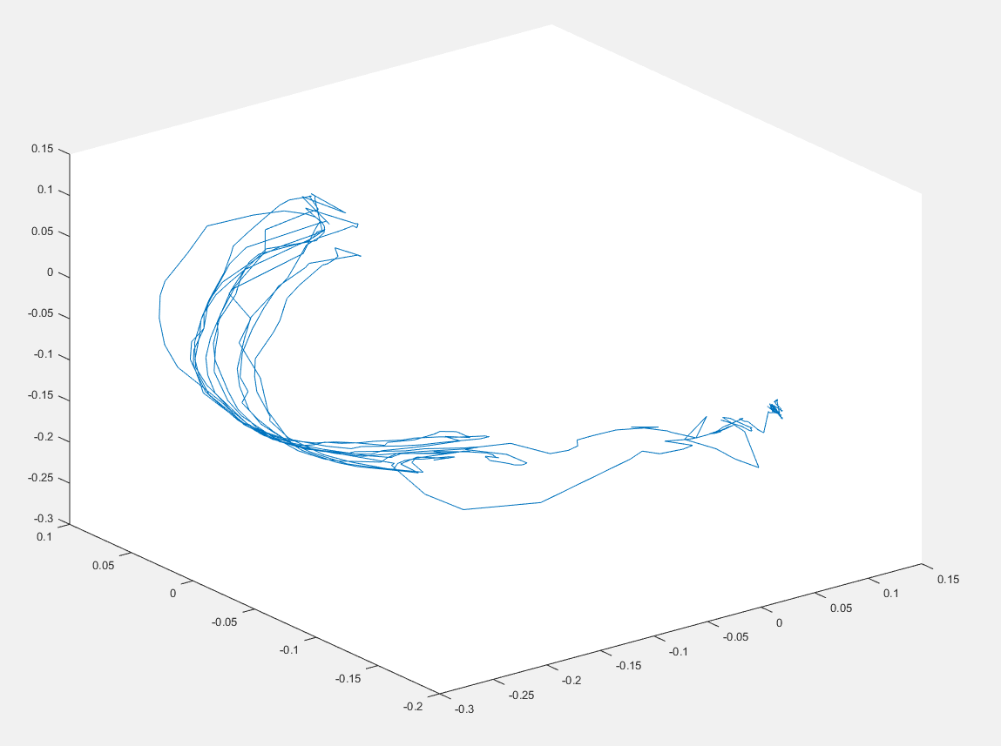
Reference arm vector trajectory from Kinect

Slide 7
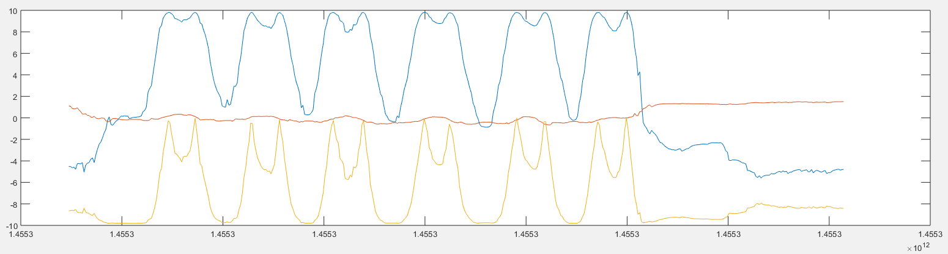
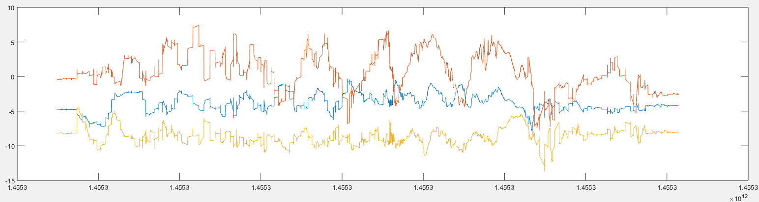
Arm vector adjustment
Figure: proposed gravity vector corresponding to the arm vector
Figure: IMU raw data

Slide 8
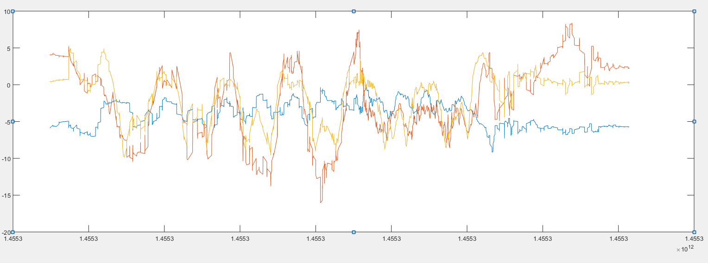
Acceleration after arm vector adjustment
Figure: IMU raw data

Slide 9
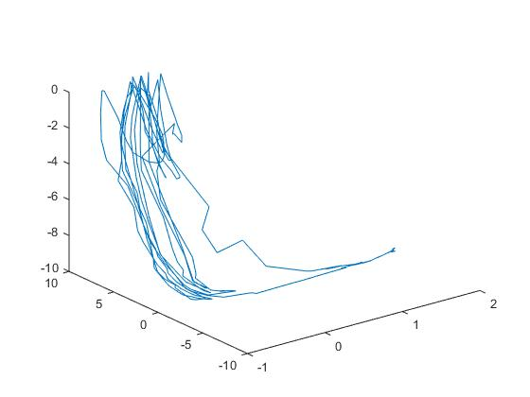
Acceleration after arm vector adjustment

Slide 10
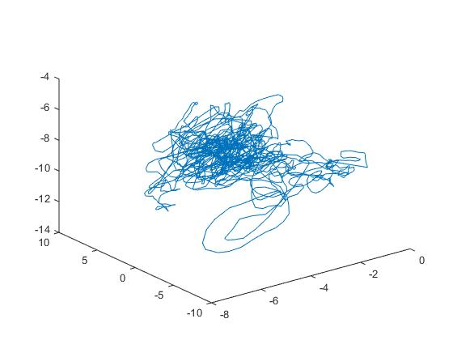
Acceleration after arm vector adjustment

Slide 11
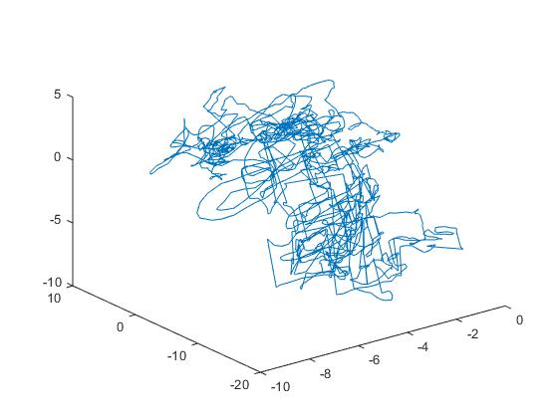
Acceleration after arm vector adjustment
Right is the Δa
Probably not recommending this…
However, there is a strong correspondence between the Kinect-calculated gravity and IMU-measured gravity.
Indicates that our calculation is right.
Prof. Pottie thinks that it is probably due to the IMU is not attached to the wrist very well.

