Slide 1
Homework 3: Backdoor Attack
助教：张吉哲
邮箱：jizhe.zhang@stu.pku.edu.cn

Slide 2
CONTENTS
01/ Brief Introduction

Slide 3
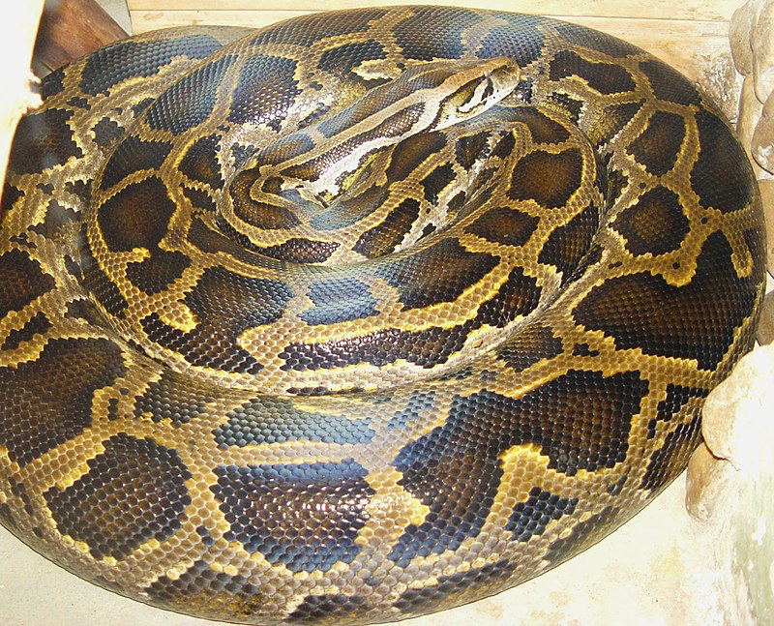
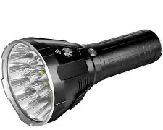
01
Brief Introduction
Brief Introduction:
Points
Language and wheel
Backdoor Attacks(15 points: 12+3)
Adversarial Neuron Pruning (10 points: 6+4)
Python
PyTorch
Contents included by the *.zip
- All python file
- Log
- report
Requirements
Word/pdf/markdown is ok.
Write a report (at most 8 pages).
Send your report and code to
In Chinese/ English
trustworthy_ai@163.com
Theme: Homework3-name-ID
Due: 5/29 23:59
Notes:
DB-ENGINES

Slide 4
CONTENTS
01/ Brief Introduction
02/ Backdoor Attack

Slide 5
02
Backdoor Attack
Main files:
train_backdoor.py
data/poison_cifar.py
generate_clb_attack.py
Objectives:
Generate BadNets, Blend, Clean-Label Attacks and Train a ResNet 18 with 0.1 Poison Rate. The expected results for each attack:
 | Final_epoch ASR | ACC
BadNets | 100% | >91%
Blend | 100% | >91%
Clean-Label | >80% | >91%
Notes:
DB-ENGINES

Slide 6
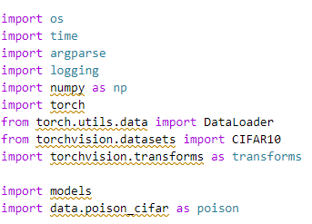
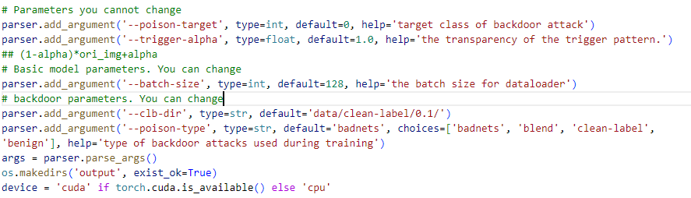
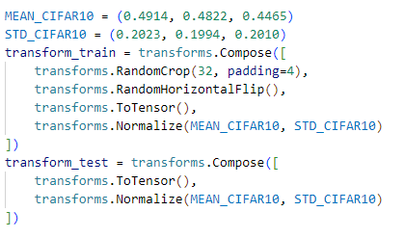
02
Backdoor Attack （train_backdoor）
Import package
Hyper-Parameters
Load Data
Notes:
DB-ENGINES

Slide 7
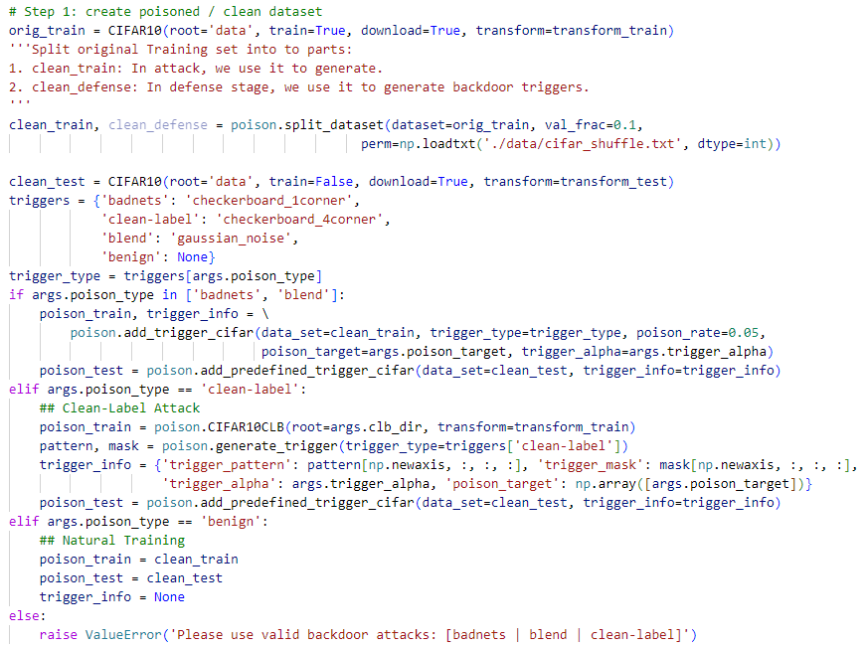
02
Backdoor Attack （train_backdoor）
Generate Backdoor Images
Need to complete the code in “data/poison_cifar.py”
Need to complete the code in “generate_clb_attack.py” to generate backdoor training data(data.npy) first.
Notes:
DB-ENGINES

Slide 8
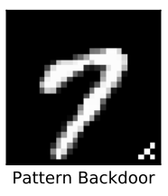
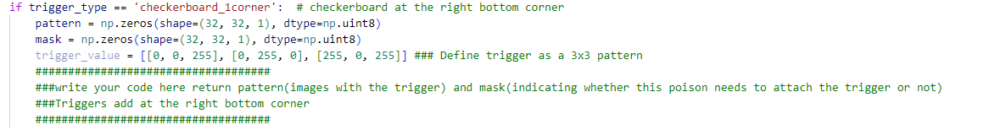
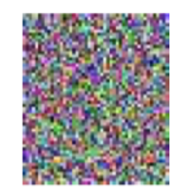
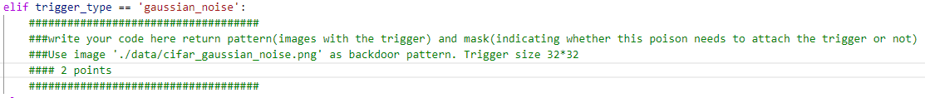
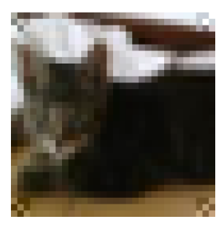
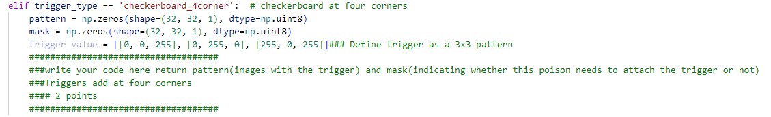
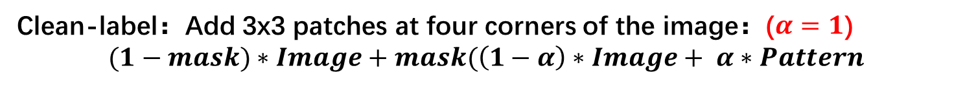
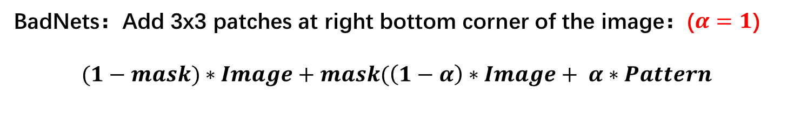
02
Generate Patterns
BadNets：Add 3x3 patches at right bottom corner of the image：($α=1$)
$$(1−mask)∗Image+mask(\left(1−α\right)∗Image+ α∗Pattern$$
Blend: Add 32x32 patches at image with: ($α=0.2$)
$$\left(1−α\right)∗Image+α∗Pattern$$
Clean-label：Add 3x3 patches at four corners of the image：($α=1$)
$$(1−mask)∗Image+mask(\left(1−α\right)∗Image+ α∗Pattern$$
Notes:
DB-ENGINES

Slide 9
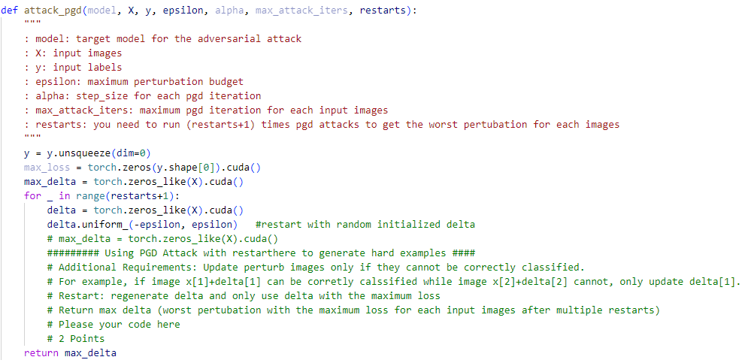
02
Generate Poison Train
Clean Label： Generate Adversarial Examples first
Notes:
DB-ENGINES

Slide 10
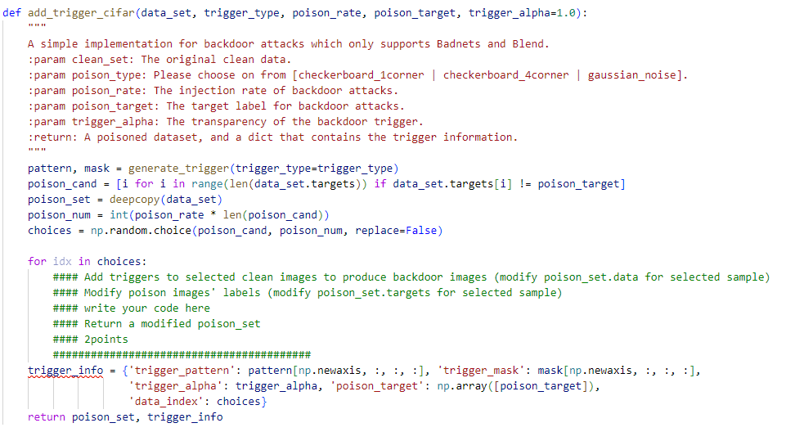
02
Generate Poison Train
Add Trigger for selected data(Train Data):
Notes:
DB-ENGINES

Slide 11
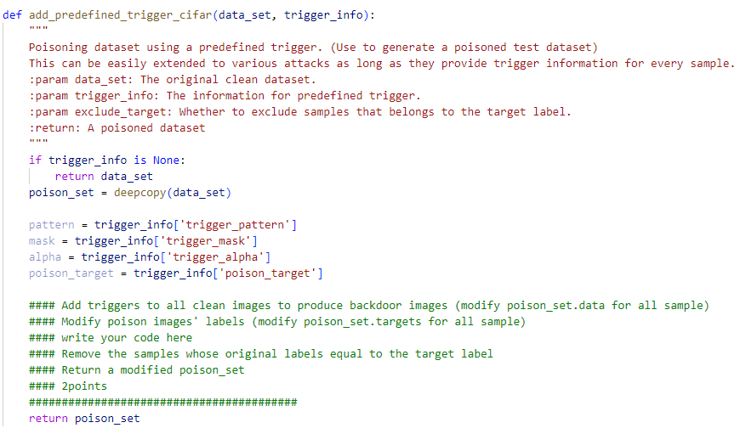
02
Add Triggers
For all data(Poison Test Data):
Notes:
DB-ENGINES

Slide 12

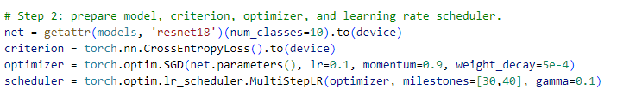
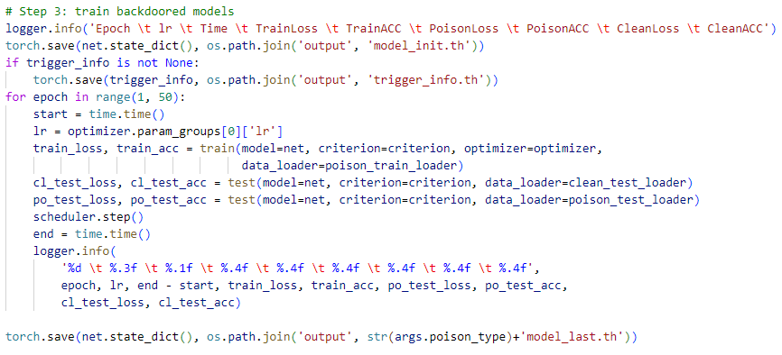
02
Train with poison data
Prepare DataLoader
Train and Validate
Notes:
DB-ENGINES

Slide 13
02
Results
Report: Tell how your code works: 3 points
Correctness of Code: 12 points(2*6)
Besides the report, you should also hand in your code and training log.
You don’t need to hand in your checkpoint.
Notes:
DB-ENGINES

Slide 14
CONTENTS
01/ Brief Introduction
02/ Backdoor Attack
03/ Backdoor Defense

Slide 15
03
Backdoor Defense with ANP
Main files:
generate_mask.py
prune_network.py
badnetsmodel_foranp.th: The poisoned model
trigger_info_foranp.th: Trigger Information for testing
Objectives:
Use ANP to purify a poisoned model.
Notes:
DB-ENGINES

Slide 16
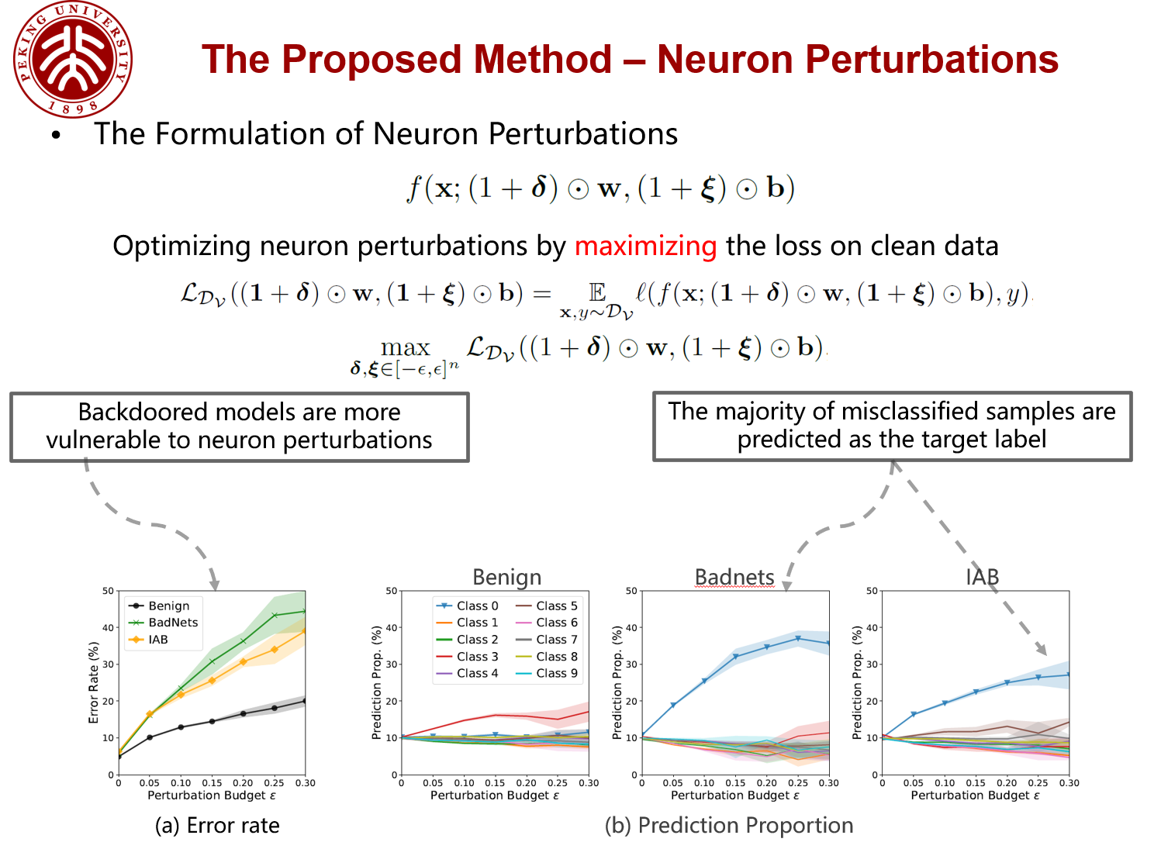
03
Backdoor Defense with ANP
Notes:
The neurons that are sensitive to neuron perturbations are strongly related to the injected backdoor

Slide 17
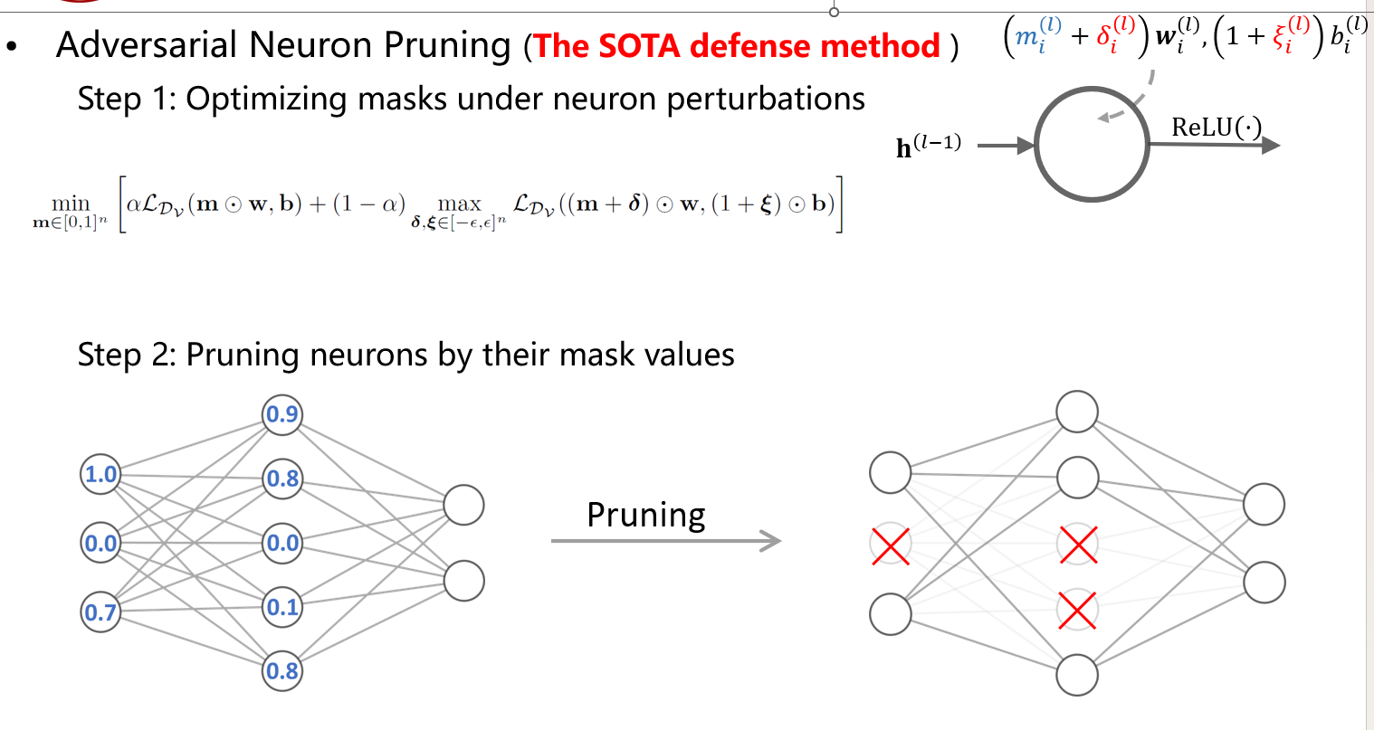
03
Backdoor Defense with ANP
generate_mask.py
prune_network.py
Notes:
DB-ENGINES

Slide 18
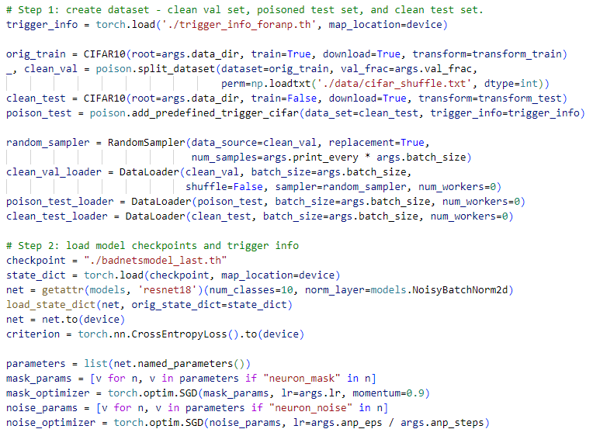
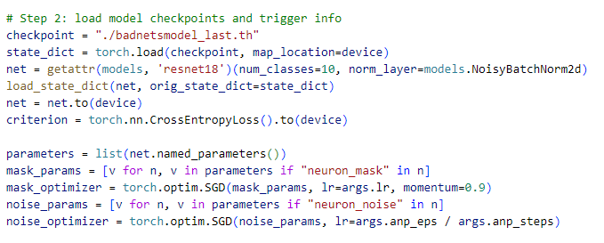
03
Backdoor Defense with ANP
generate_mask.py
Load Dataset
Load Model and prepare mask parameter
Notes:
DB-ENGINES

Slide 19
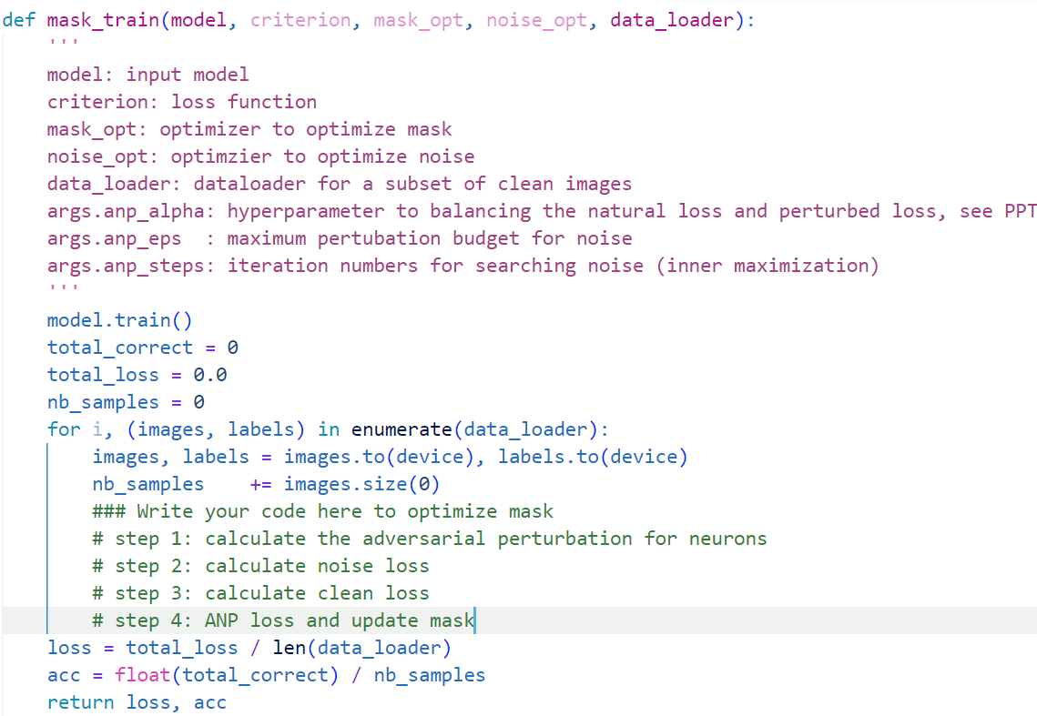
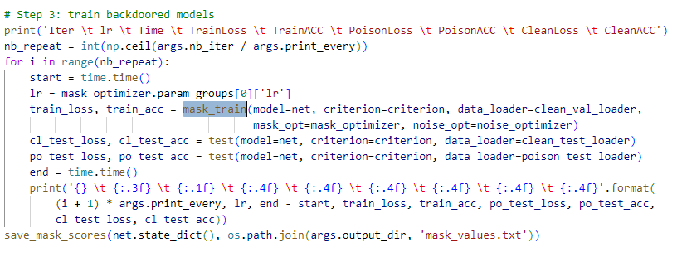
03
Backdoor Defense with ANP
Train Mask
You can use our pre-defined operators
Report: 3 point (Tell me how your code works)
The correctness of the code: 3 point
Notes:
DB-ENGINES

Slide 20
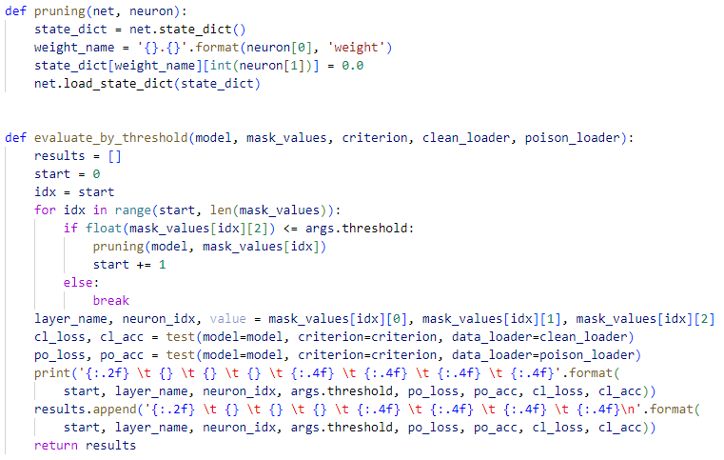
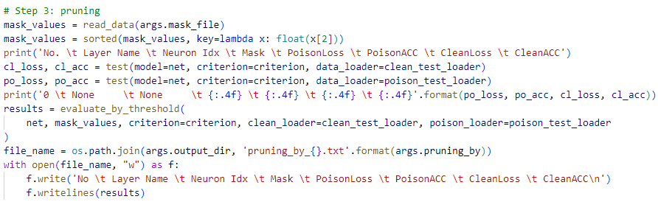
03
Backdoor Defense with ANP
prune_network.py: prune by threshold
Notes:
DB-ENGINES

Slide 21
03
Backdoor Defense with ANP
prune_network.py: prune by threshold
Report(4 point):
Tune anp_alpha and threshold(0-1) to make the pruned models ASR <5% and ACC>92% (2 point)
Tell me anp_alpha’s influence on ASR and ACC (1 point)
Tell me threshold’s influence on ASR and ACC (1 point)
Notes:
DB-ENGINES

Slide 22
论文列表
[1] BadNets: Identifying Vulnerabilities in the Machine Learning Model Supply Chain
[2] Clean-Label Backdoor Attacks
[3] Targeted backdoor attacks on deep learning systems using data poisoning
[4] Adversarial Neuron Pruning Purifies Backdoored Deep Models
Notes:
DB-ENGINES

Slide 23
Q&A

Slide 24
Thanks

