Slide 1
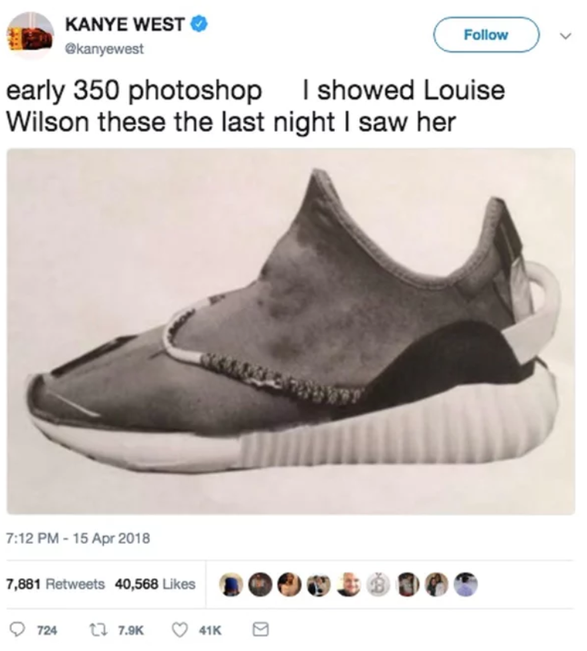
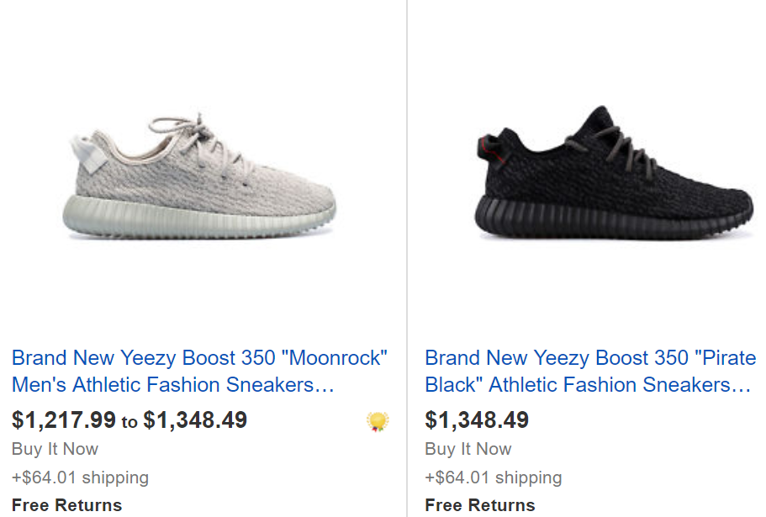
Shoe Resale Market Model From Fashion Trends
Social Model of Demand
Market Model of Shoe Supply

