Slide 1
IS609: Final Projects
Partha Banerjee, Rohan Fray & Vincent Ying
MSDA, CUNY SPS
December 10, 2014

Slide 2
Project 1
Craps Game Simulation
(#5.3.3 Page 201)

Slide 3
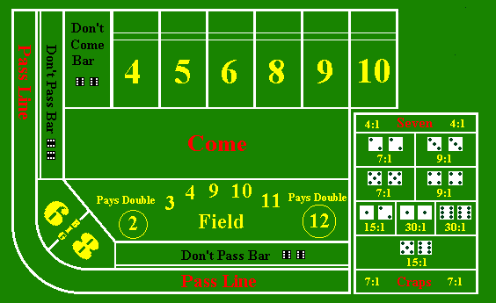
Problem Definition
Construct and perform a Monte Carlo simulation of the popular casino game of craps.
There are two basic bets in craps, pass and don't pass. In the pass bet, you wager that the shooter will win; in the don't pass bet, you wager that the shooter will lose. Conduct of the game:
Roll a 7 or 11 on the first roll: Shooter wins (pass bets win and don't pass bets lose)
Roll a 12 on the first roll: Shooter loses (boxcars; pass and don't pass bets lose)
Roll a 2 or 3 on the first roll: Shooter loses (pass bets lose, don't pass bets win)

Slide 4
Problem Definition [contd…]
Roll 4, 5, 6, 8, 9, 10 on the first roll: This becomes the point. The object then becomes to roll the point again before rolling a 7.
The shooter continues to roll the dice until the point or a 7 appears. Pass bettors win if the shooter rolls the point again before rolling a 7. Don't pass bettors win if the shooter rolls a 7 before rolling the point again.
Write an algorithm and code it in the computer language of your choice. Run the simulation to estimate the probability of winning a pass bet and the probability of winning a don't pass bet. Which is the better bet? As the number of trials increases, to what do the probabilities converge?

Slide 5
Solution – Mathematical Approach
Craps involves the rolling of two dice. The assumption is that
The dice are fair and
The outcomes of the various rolls are independent.
Simple Mathematics:
The possible totals obtained from rolling two dice are as below:
 | 1 | 2 | 3 | 4 | 5 | 6
1 | 2 | 3 | 4 | 5 | 6 | 7
2 | 3 | 4 | 5 | 6 | 7 | 8
3 | 4 | 5 | 6 | 7 | 8 | 9
4 | 5 | 6 | 7 | 8 | 9 | 10
5 | 6 | 7 | 8 | 9 | 10 | 11
6 | 7 | 8 | 9 | 10 | 11 | 12

Slide 6
Solution [contd…]
Now let us examine the rules:
Roll a 7 or 11 on the first roll (“natural”): Shooter wins
Now the probability of getting 7 or 11 is 8/36, or about 22.22%.
Roll a 2 or 3 or 12 on the first roll (“craps”): Shooter loses
The probability of getting 2 or 3 or 12 is 4/36 , or about 11.11%.
Roll 4, 5, 6, 8, 9, 10 on the first roll: This becomes the point. The Shooter then becomes to roll the point again before rolling a 7
The probability of rolling 4 is 3/36 . Once Shooter has rolled the 4, the only cells that matter are the cells containing 4 and 7. All other cells can be ignored. There are 9 cells containing 4 or 7 of which only 3 cells are favorable to Shooter. Hence the probability of Shooter rolling another 4 before a 7 is 3/9. Therefore, the probability of rolling a 4, and then rolling a 4 before a 7 is 3/36 × 3/9 or about 2.78%.

Slide 7
Solution [contd…]
Table below summarizes the winning probabilities of Shooter in craps:
Initial Roll | Probability of Winning | Probability in Decimal
4 | 3/36 x 3/9 | 0.027778
5 | 4/36 x 4/10 | 0.044444
6 | 5/36 x 5/11 | 0.063131
7 | 6/36 | 0.166667
8 | 5/36 x 5/11 | 0.063131
9 | 4/36 x 4/10 | 0.044444
10 | 3/36 x 3/9 | 0.027778
11 | 2/36 | 0.055556
 | Total: | 0.492929

Slide 8
Solution [contd…]
Hence the probability of the Shooter wins = 49.29%
Implied the probability of the Shooter loses = 50.71%
Back to Craps Problem
Here we have 2 types of bets with 3 types of results
In the Pass bet, the gambler wins only when Shooter wins
In Don’t Pass bet the gambler wins only when Shooters loses except the Boxcars
Boxcars (Roll a 12 on the first roll) when no one wins

Slide 9
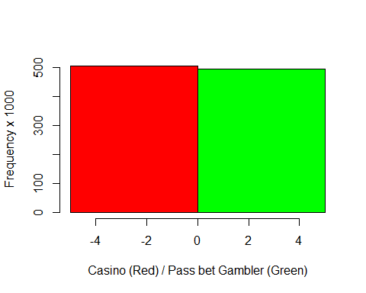
Solution [contd…]
Hence, for the Pass bet gambler, the winning probability is: 49.29%
And for the Casino (or house), the winning probability is: 50.71%
Thus, the house has an advantage of about 1.4% on any Pass bet.
.5
.4
.3
.2
.1
0
Frequency
-1 | 0 | 1
Casino (House) | Pass bet gambler

Slide 10
Solution [contd…]
Now the probability of Boxcars = 1/36 = 2.78%
Hence, for Don't Pass bet gambler,
Event | Probability | Probability %
TIE on Don't Pass bet | 1/36 = 0.0278 | 2.78%
WIN on Don't Pass bet | 0.5071 – 1/36 = 0.4793 | 47.93%
LOSE on Don't Pass bet | 1 – 1/36 – 0.4793 = 0.4929 | 49.29%

Slide 11
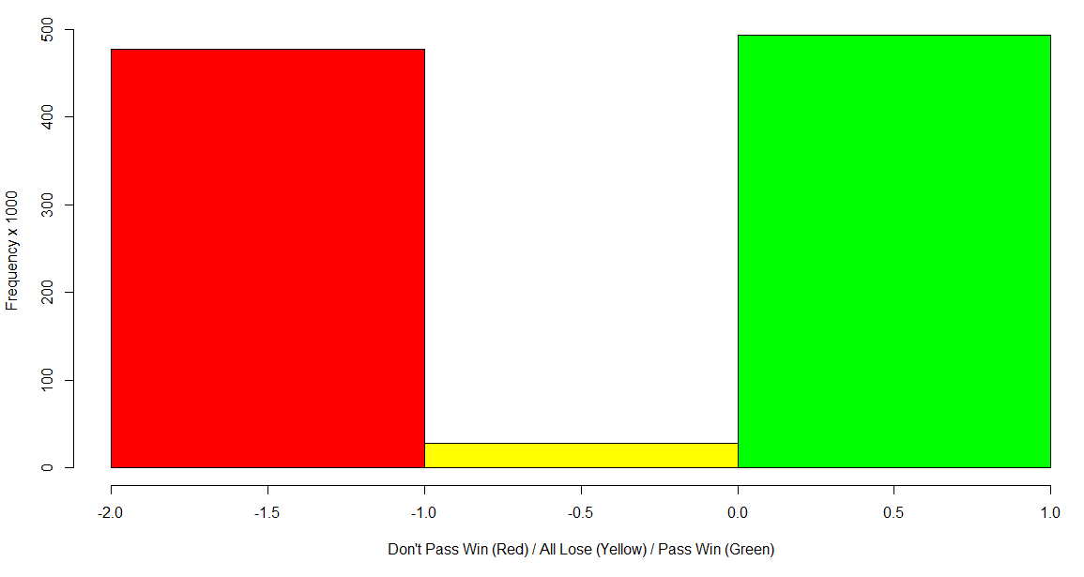
Solution [contd…]
Hence, the winning probability of
Pass bets: 49.29%
Don't Pass bets: 47.93%
Boxcars (both Pass and Don't Pass bets lose): 2.78%

Slide 12
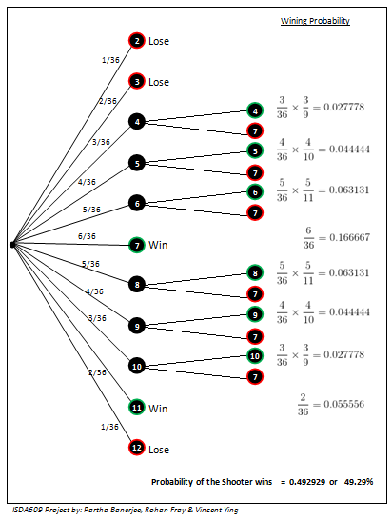
Solution: Decision Tree
The result received for Pass bet using Decision Tree is:
Pass bets: 49.29%
This is exactly the same we derived for Pass bet in the previous slides.
This proves that our calculations for Don’t Pass bet and Boxcars will also match the results derived in previous slides.
Don't Pass bets: 47.93%
Boxcars (both Pass and Don't Pass bets lose): 2.78%

Slide 13
Conclusion
Pass bets: 49.29%
Don't Pass bets: 47.93%
Craps in its simple form is the most fair game in any Casino
The Casino has only a slight edge in craps (2.78%), but the game is a money-maker for a Casino since the Casino plays on very long time
Pass bet scenario house is always in advantage
Casino maintains a 1.4% advantage over both the players

Slide 14

Project 1: Q & A

Slide 15
Project 2
Retirement and Social Security
(#9.4.2 Page 376)

Slide 16
Problem Definition
This purpose of this project is to determine the best way to maximize savings for retirement. 401K investment returns and Social Security payout from contributions will be analyzed and compared.

Slide 17
Retirement Statistics
Retirement Statistics For Americans (2014):
Average retirement age is 62 years old.
Average retirement length is 18 years.
Medical costs over a 20 year period for a couple over 65 is $215,000.
35% of Americans over 65 rely completely on Social Security.
36% of Americans don't save anything for retirement.
From the statistics gathered, a large portion of Americans are not saving enough for retirement. For those that do plan for retirement, there are a variety of ways to save and consider for retirement.

Slide 18
Social Security For Retirement
OASI (Old-Age and Survivors Insurance) Trust Fund:
The trust fund is supplied by Social Security Taxes that are involuntarily levied.
SSA Contributions:
SSA tax rate has been around 5% for the employed and 10% for the self-employed.
There is also a maximum taxable earnings, currently at $113,700 for 2013.
SSA Benefits:
Benefits payouts can start at age 62, but delayed retirement (up to age 70) can increase payout.
Benefit calculation is inflation adjusted with the past highest 35 years in earnings.
Benefit payouts are inflation adjusted and can also be claimed by spouse upon death.
Social Security is only meant to be supplemental income during retirement, but many do make use of it as their sole source of income.

Slide 19
401k For Retirement
401(k) Defined-Contribution Pension:
First established in 1978, it allows taxpayers to defer taxes on income for retirement.
401(k) Contribution:
The maximum amount that can be contributed is currently $17,500.
401K Contribution is voluntarily made with a possible company match.
401(k) Withdrawals:
Withdrawal without penalty starts at 59.5 years of age.
There is a required minimum distribution (RMD) starting at 70.5 years or start retirement.
Since contributions to 401K compound over time, it is best to for a participant to start saving early and maximize contribution into the plan whenever possible.

Slide 20
Comparison of SSA and 401k
SSA:
Since SSA is funded by payroll taxes, contribution is automatically taken care by the government.
There is a projected shortfall of the trust fund in 2037. However, increasing payroll taxes and benefit reductions would alleviate this concern.
401(k) Defined-Contribution Plan:
Since a larger portion of one's income can be contributed to a 401K, it should be the main source of income for those with access to it.
The returns of a 401K plan is dependent on the investment choices made.
Management fees with the choice of investments made also needs to be considered.

Slide 21
Modeling When to Retire
Assumptions for Modeling:
Start working at age 22 and live until the average age of 85.45.
Start contribution to 401K at 22 with initial contribution of $8,500 and $17,500 thereafter.
Effect of Early, Normal, or Delayed Retirement on SSA Benefit Amount (2012)
Age | 62 | 63 | 64 | 65 | 66 | 67 | 68 | 69 | 70
Percent Benefit | 70 | 75 | 80 | 86.66 | 93.33 | 100 | 108 | 116 | 124
Monthly Payout | 1104 | 1183 | 1262 | 1367 | 1472 | 1577 | 1703 | 1829 | 1955

Slide 22
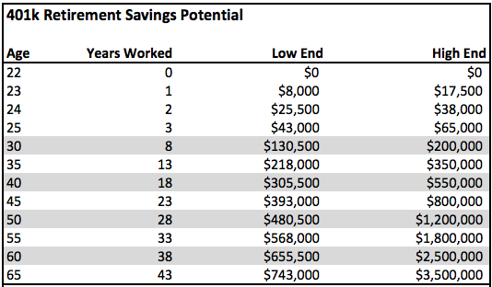
Modeling When to Retire [contd…]
401K Balance Throughout Contribution Period

Slide 23
Modeling When to Retire [contd…]
When starting withdrawal of 401K at the age of 62 :
Varying the start of withdrawal for SSA .
Combined income from SSA benefits and 401K balance
Age | 62 | 63 | 64 | 65 | 66 | 67 | 68 | 69 | 70
Monthly Payout | 3826 | 3835 | 3841 | 3851 | 3859 | 3864 | 3872 | 3876 | 3877
Total (k) | 3924 | 3932 | 3938 | 3948 | 3957 | 3963 | 3970 | 3975 | 3976

Slide 24
Modeling When to Retire [contd…]

Slide 25
Conclusion
This best way to maximize savings for retirement is to maximize contributions into a 401K account as early as possible on the planning horizon and to contribute as long as possible.
Make use of the 401K account earlier, at the start or before retirement.
Delay the start of SSA benefit payouts as long as possible (up to age 70) to maximize the payout amount throughout retirement.
The contribution and returns on Social Security, 401K, and any other retirement account needs to be considered in combination to better plan for retirement.

Slide 26
Project 2: Q & A

Slide 27
Thank you

