Slide 1
Leveraging Deep Learning Techniques for Ship Detection in Satellite Imagery
Group – 8
Team Members – Akshay Shaju (22152563), Caroline Vincent (22153926), Karthika Nair (22105522)

Slide 2
Abstract
In this rapidly advancing modern world and its technologies, Satellite imagery is one of the finest innovations that is playing a crucial role in numerous diverse industries, whether it be marketing, geo locating, banking or defence. Thus, it is understandable that satellite imagery does play a huge responsibility in making the world a better place to live in.
Here, as satellite imagery is contributing to the daily routinary functions of the society, there is a noticeable increase in the use of this techniques, it has become very hard to manually analyse all the high-resolution images that are being captured.
It is already high time to recognize the need of automating this technology. So, our project emphasizes on using deep learning techniques, CNN model to be precise and use it for the challenging task of ship detection from satellite images.
We will be using “Ships in satellite imagery” dataset from Kaggle for this study, which will help and provide us with imagery data of ships from satellite images.
Through this project, our aim is to contribute to a system which can improve maritime security and its related search and rescue operations, environmental surveillance and most importantly, improving shipping route system by developing an effective system to detect the ships.

Slide 3
Introduction
In this dynamic and innovative world, each and every technology seems to rapidly evolve as the time is progressing. One of the finest technologies that humans discovered was satellite imagery which is used by diverse industries around the world and has become one of the prominent factors for the world to function smooth and effective. The satellite imagery system captures high resolution images of the different things that happens on the earth’s surface.
But as the time evolved, the number of industries that are using satellite imagery function has also increased in big numbers. Because of this factor, capture of these vast amounts of data has become a very big burden for humans to analyse manually.
Research question – "How can the utilization of deep learning techniques improve the efficiency and accuracy of ship detection in high-resolution satellite imagery.”
Motivation – Our motivation and goal for the project is to explore the efficiency of deep learning techniques to build an effective system that can automate the challenging task of detecting ship images from satellite imagery.

Slide 4
Methodology
Data Collection
Exploratory Data Analysis
Data Preprocessing
Splitting of Data
Model Building
Confusion Matrix Analysis
Model Evaluation

Slide 5
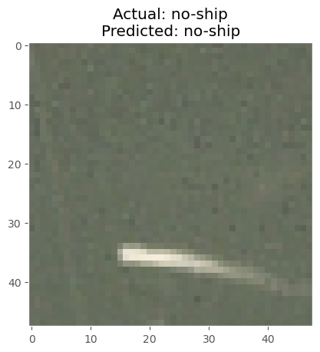
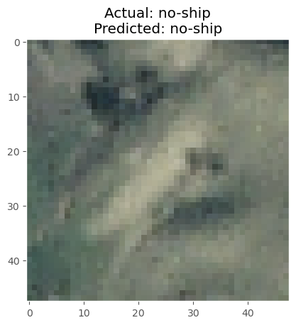
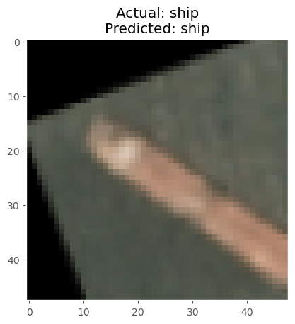
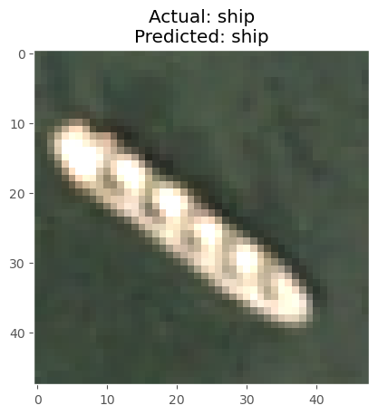
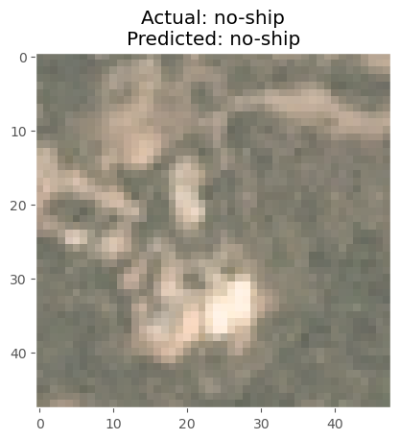
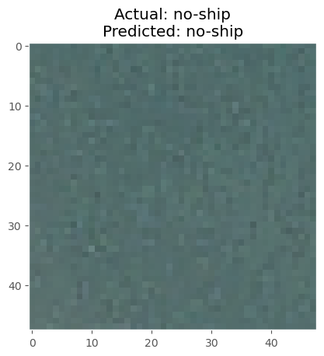
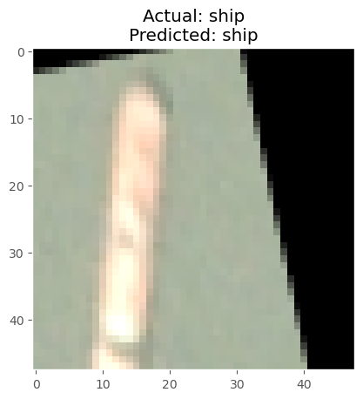
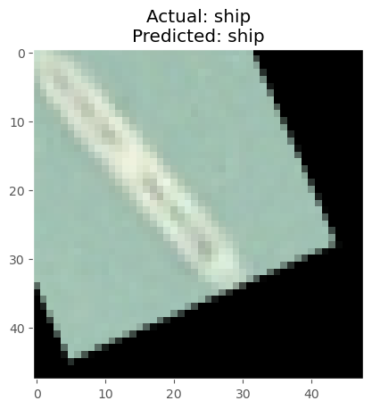
Data Visualisation and Results
Detection of ships in Satellite Imagery

Slide 6
Data Visualisation and Results (contd.)
The developed model went through a rigorous training process to understand the distinguishes between “ship” and “no-ship” classes. A random selection of 10 images from the dataset is chosen for the qualitative analysis of the model’s performance.
Each image detected is displayed it with corresponding actual and predicted class label, which emphasizes the model’s ability to accurately classify the classes as “ship” or “no-ship”.

Slide 7
Conclusion
In conclusion, our project has presented a very detailed report showing the potential of deep learning techniques, particularly the Faster R-CNN model. For this, we used “Ships in Satellite imagery” dataset which provided us with the data for this project.
Here, our goal was to build an effective system which will rewrite the manual accessing system of the satellite imagery and replace it with an automated ship image detection system which have the potential to create a breakthrough in the rapidly advancing satellite imagery system which is already used by tons of companies in various industries.
The evaluation of our studies has provided us with promising results. Our system was well able to categorize between images that had ship in it and that did not have any. The model shows the effective accuracy in detecting the ships from satellite images.

