Slide 1


ShopEase – E-Commerce Web Application
Project Presentation

Slide 2

Team members
Names Register Numbers
P.Manasa 22PA1A05D7
N.Vincentia Harshini 23PA5A0518
S.Jagadeesh 22PA1A05F0
P.Raghu Ramayya 22PA1A05C8
GitHub Link : https://github.com/Manasa0109/shopease-ecommerce-master

Slide 3
1. Project Overview
• Full-stack web app replicating online stores like Amazon/Flipkart.
• Users can browse products, manage cart, place orders.
• Admins manage inventory and orders.

Slide 4
2. Objective & System Architecture
• Objective: Intuitive and responsive shopping experience.
• Frontend: React.js
• Backend: Node.js, Express.js
• Database: MongoDB Atlas

Slide 5
3. Key Features
User Features:
• Register/Login, Search & Filter Products
• Add to Cart, Checkout, Responsive UI
Admin Features:
• Secure Login, Manage Products
• View & Manage Orders

Slide 6
4. Technology Stack
• Frontend: React.js, Tailwind CSS, JavaScript
• Backend: Node.js, Express.js
• Database: MongoDB + Mongoose
• API: REST APIs using Axios
• Auth: JWT & bcrypt

Slide 7
5. User Roles & Flow
Customer Flow:
Register → Browse → Cart → Checkout
Admin Flow:
Login → Manage Products → Handle Orders
Secure JWT Auth for protected routes

Slide 8
6. Key API Endpoints
Authentication:
• POST /api/auth/register
• POST /api/auth/login
Products:
• GET/POST/PUT/DELETE /api/products
Orders:
• POST /api/orders, GET /api/orders (admin)

Slide 9
7. How to Run the Project
1. Clone Repo: git clone <repo-url>
2. Backend: npm install → setup .env → npm start
3. Frontend: npm install → npm start
4. Access:
• Frontend: http://localhost:3000
• Backend: http://localhost:5000

Slide 10
8. Future Enhancements
• PDF Invoices
• Order Tracking
• Wishlist Feature
• Email Notifications
• Multi-language Support
• Category Pages

Slide 11
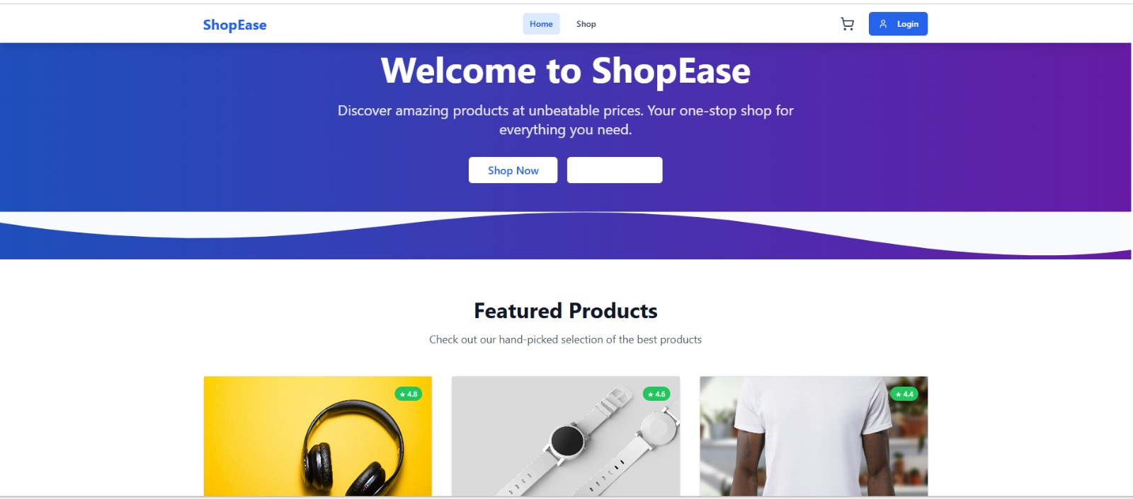

Slide 12
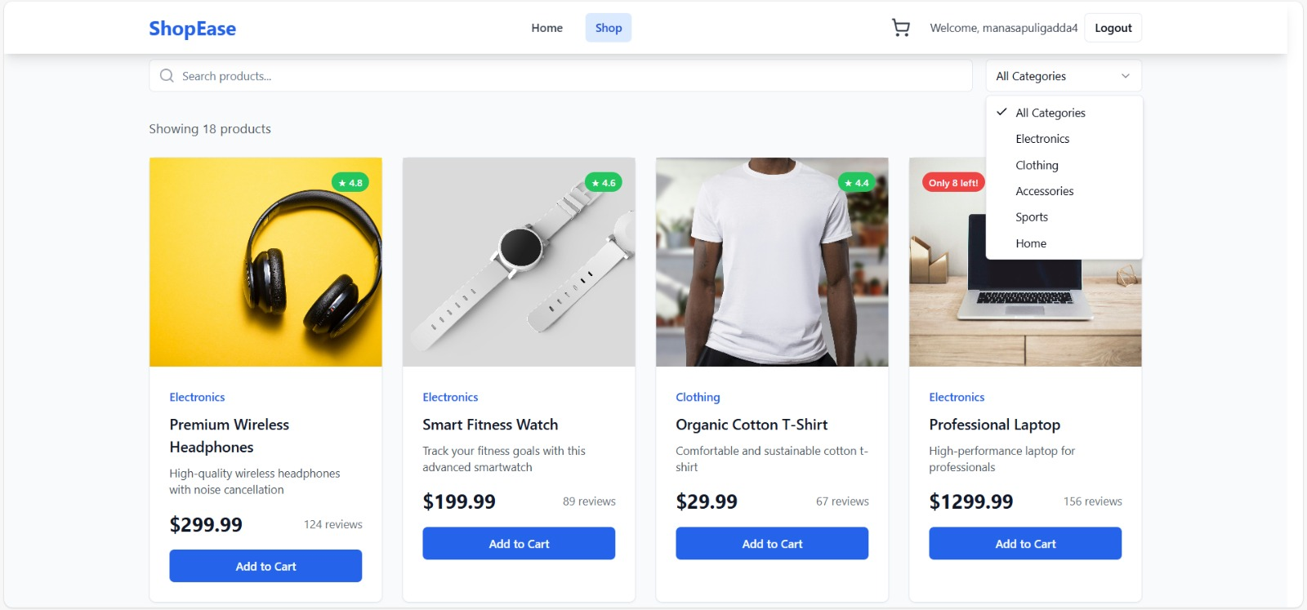

Slide 13
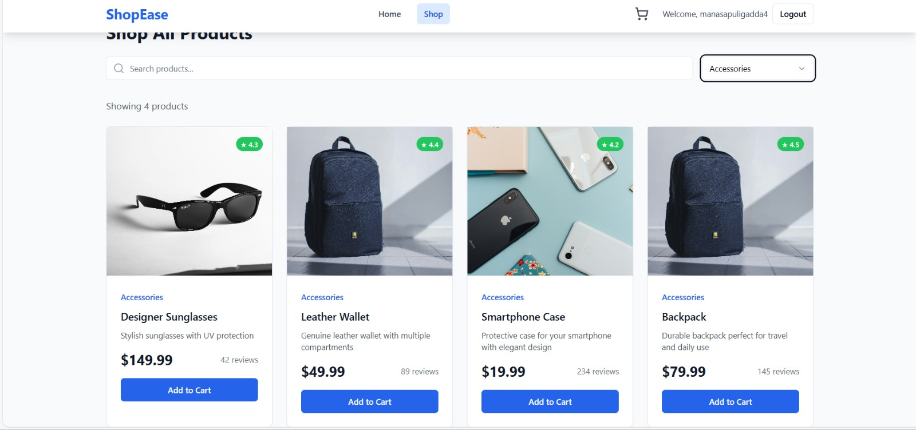

Slide 14
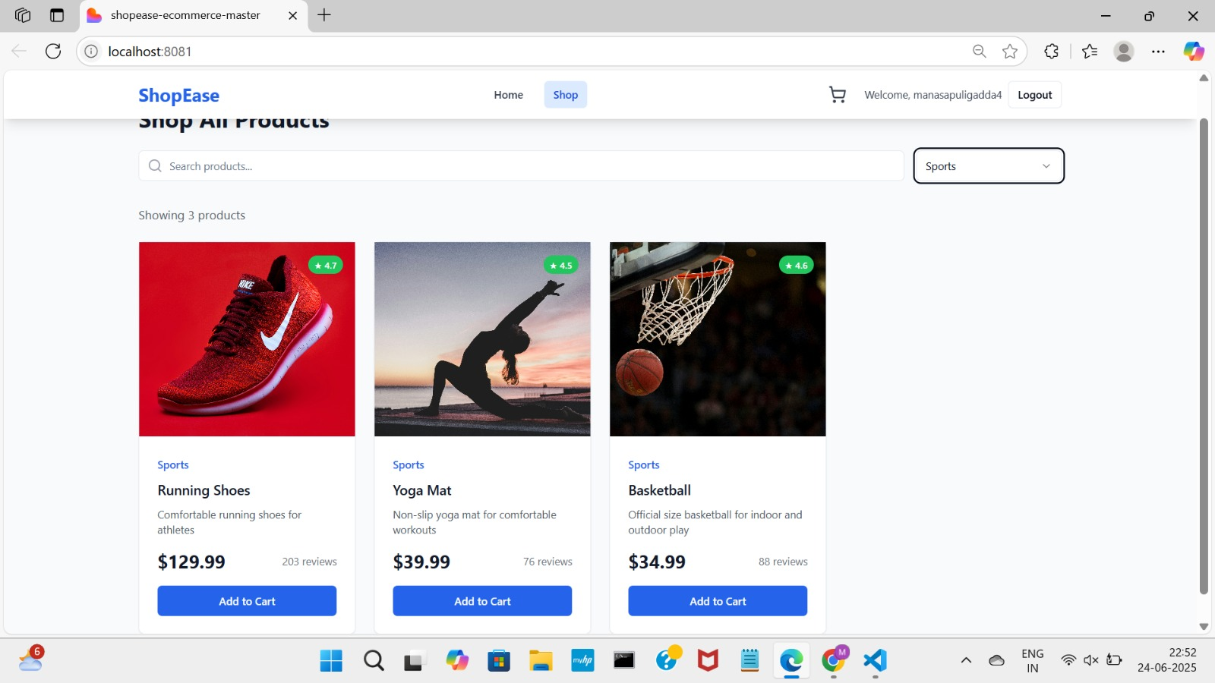

Slide 15
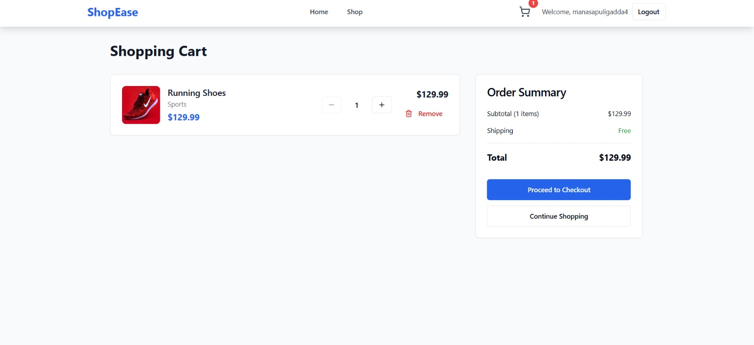

Slide 16


Thank you

