Slide 1
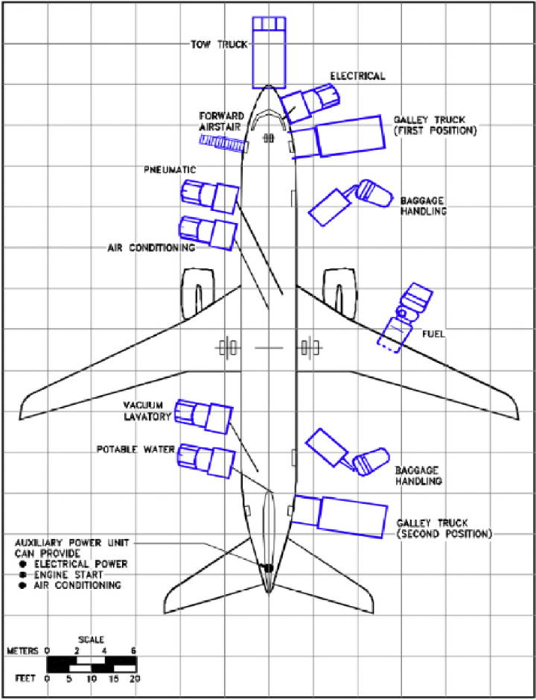
GSE operations
Cabin and ramp activities

Slide 2
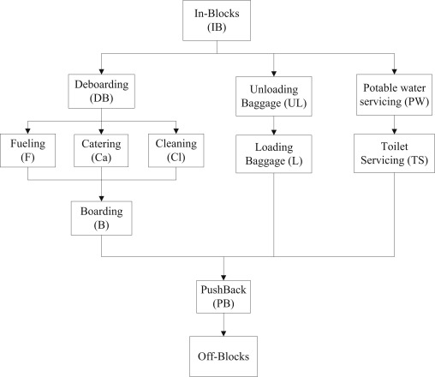
GSE operations
Order of operations
Nr of vehicles (baggage/cargo)
Time per task

Slide 3
GSE operations
The ground handling equipment for the aircraft ground handling of the Boeing 737-800:
1x Tractor with GPU,
2x Mobile stairs for boarding and alighting of passengers,
1x Fuel truck with JET-A1,
1x Water truck,
1x Lavatory truck,
1x Special baggage unloading vehicle with built-in belt conveyor,
1x Belt conveyor for baggage loading,
1x Tractor with trolleys for departure baggage,
1x Catering vehicle.

Slide 4
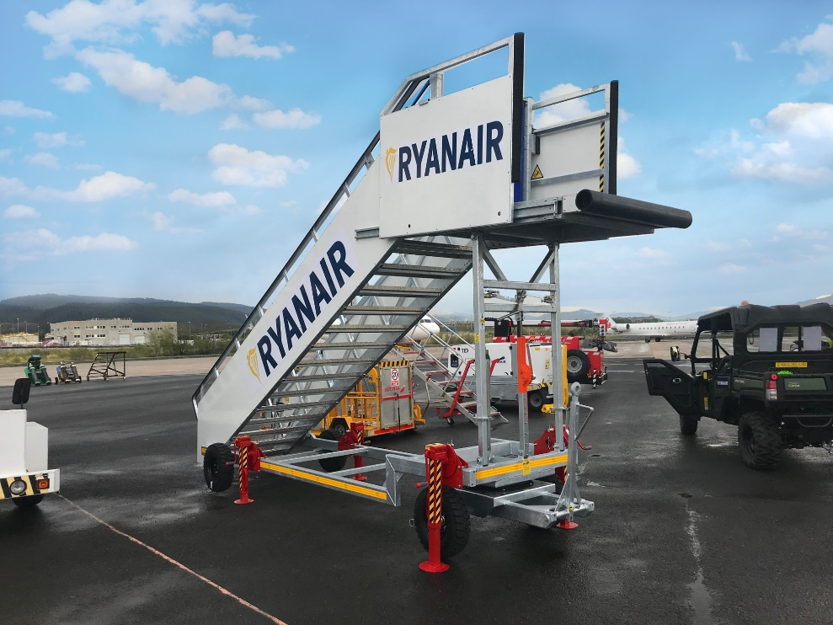
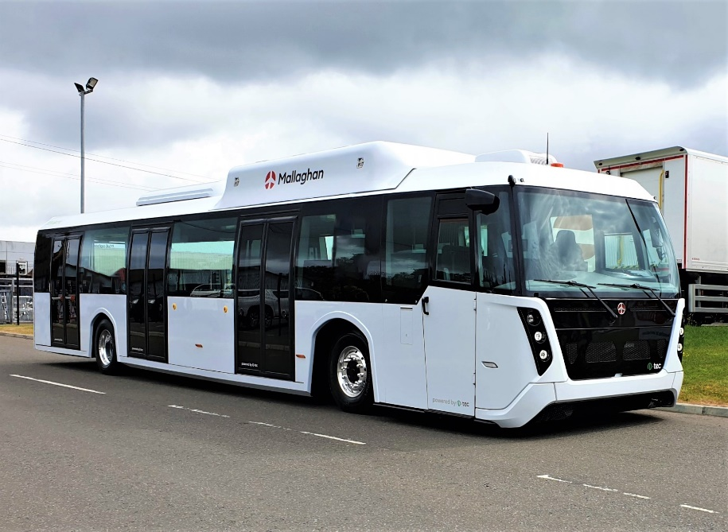
GSE operations
vs

Slide 5
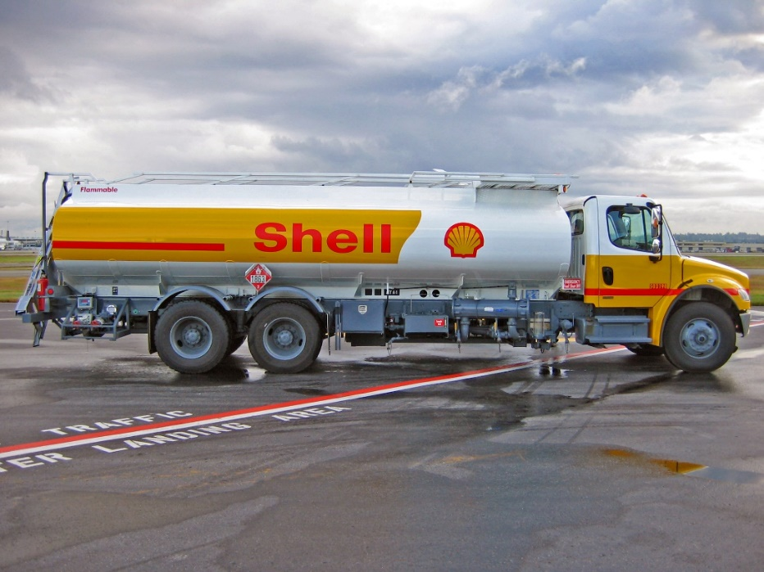
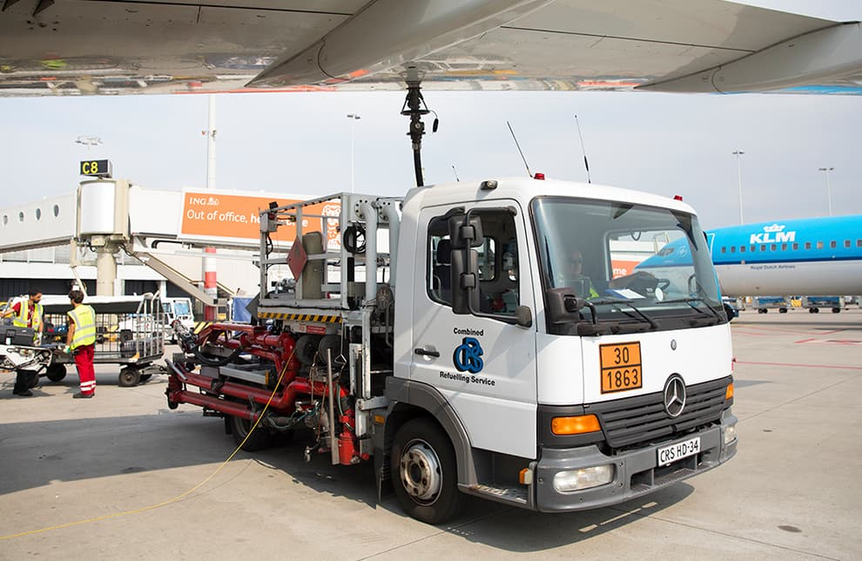
GSE operations
vs

Slide 6
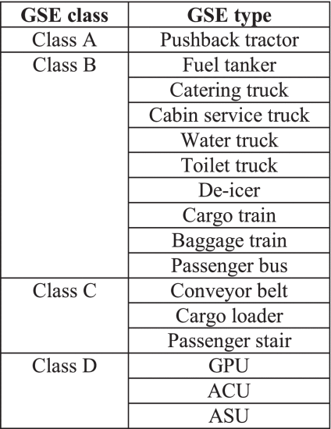
List of GSE
Pushback tractor
Cabin service truck
Catering truck
Waste water truck
Potable water truck
Baggage/cargo
Fuel truck

Slide 7
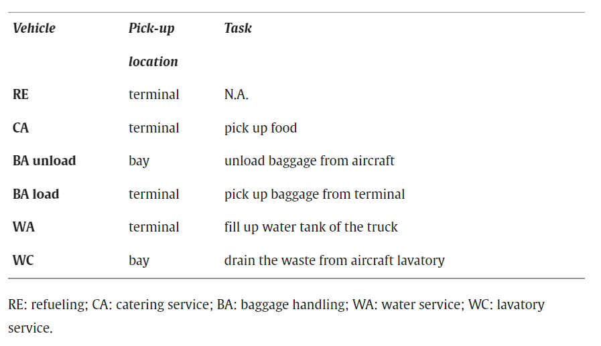
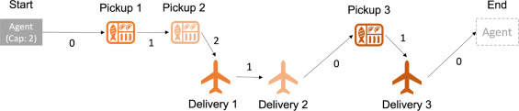
Agent based modelling
Centralized versus decentralized
Auction based framework
Game theory approach
Reinforcement learning

Slide 8
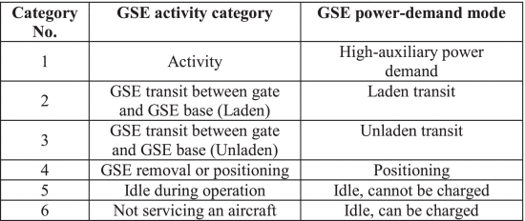
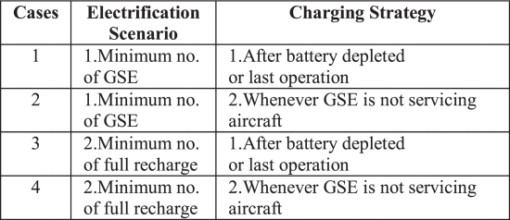
Charge scheduling of GSE
Standardised or real-world duty cycles for GSE are not available in the reviewed literature
Over-night charging (ONC)
Intermittent Opportunity Charging (IOC)
Currently charged ‘when not in use’

Slide 9
Research gap
Combination of ground tasks with charging for a fully electric ground fleet while accounting for the charging infrastructure.
Assumptions often made:
Not including refueling/charging
Each vehicle has a charging station
Simplified ground operations

Slide 10
What will we do?
Model (part of) ground operation on apron level
Use real data to simulate the ground operations
Optimize the utility of the GSE by:
3a. Minimizing downtime / minimize nr of GSE
3b. Smart charge scheduling
3c. Optimize the ground support operations
While accounting for:
4a. Delays
4b. Varying price of electricity / grid demand
4c. Charging infrastructure

