Slide 1
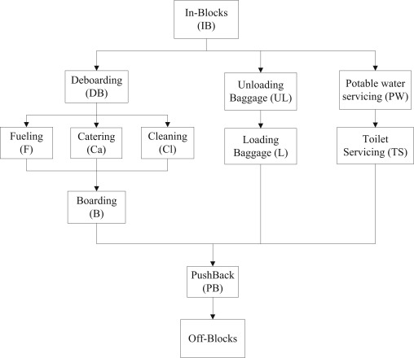
Ground support equipment
Complex operations
Challenges charging full electric fleet
Notes:
Order of operations
Nr of vehicles (baggage/cargo)
Time per task
Where charge
When charge
Efficient as possible

Slide 2
What will we do?
Model (part of) ground operation on apron level
Use real data to simulate the ground operations using agent-based modelling
Optimize the utility of the GSE by:
3a. Minimizing downtime / minimize nr of GSE
3b. Smart charge scheduling
While accounting for:
4a. Varying price of electricity / grid demand
4b. Charging infrastructure

Slide 3
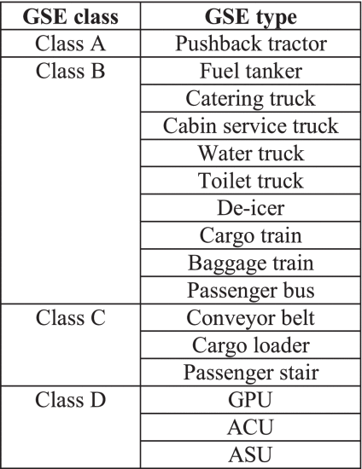
List of GSE
Pushback tractor
Cabin service truck
Waste water truck
Potable water truck
Baggage/cargo tractor
Fuel truck

Slide 4
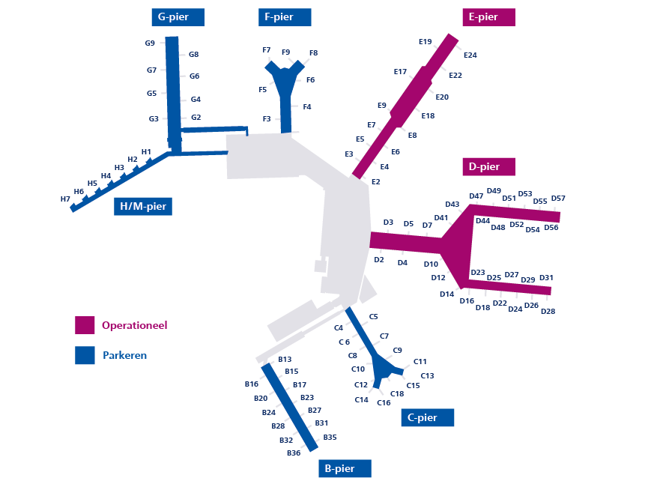
Schiphol piers

Slide 5
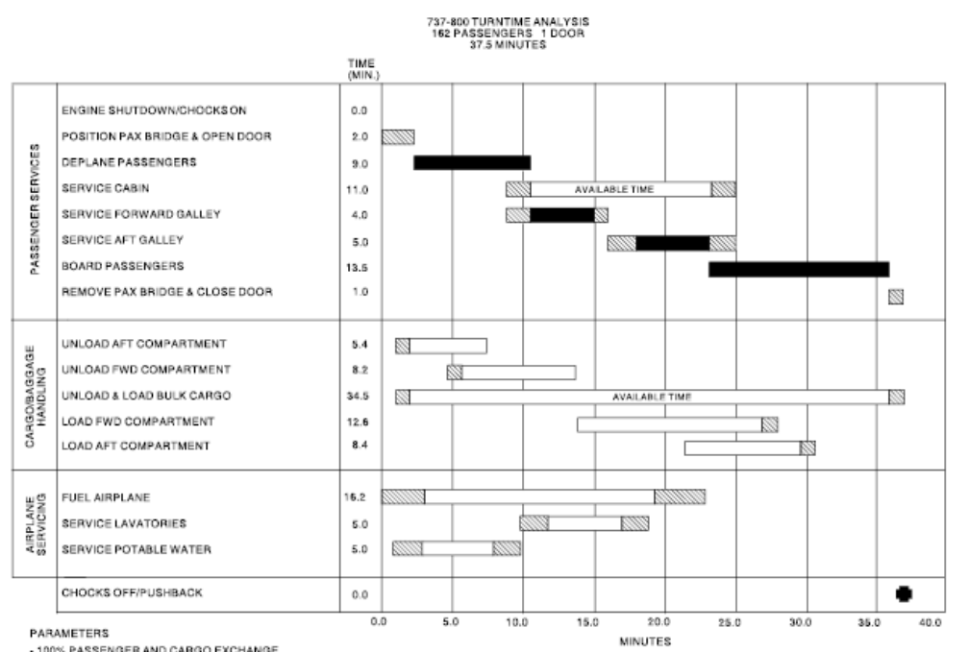
Turnaround time
KLM
Boeing 737-800

Slide 6
Comments on current model
Scheduling of agents
Assumptions on vehicle speed and task time
Charging model/infrastructure

Slide 7
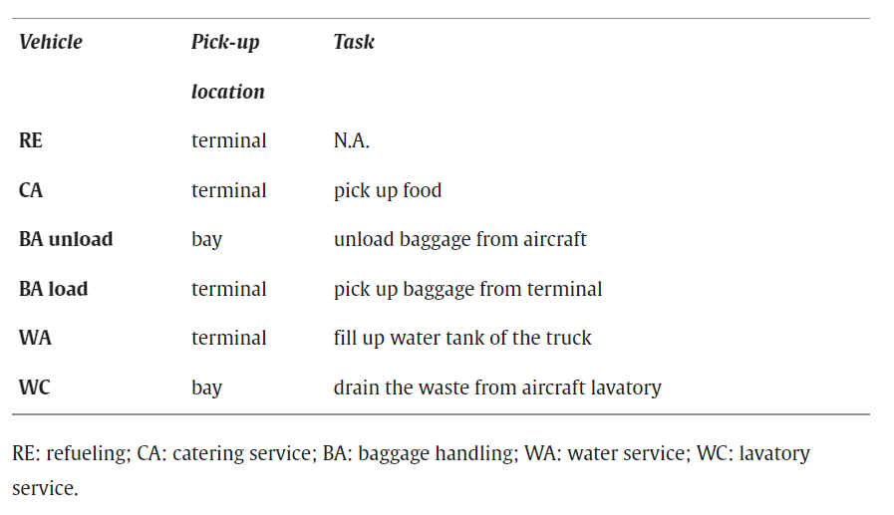
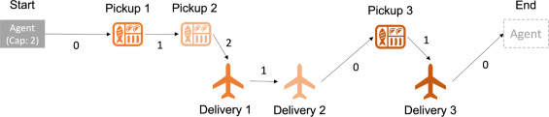
Agent based modelling
Centralized versus decentralized
Auction based framework
Game theory approach
Reinforcement learning

Slide 8
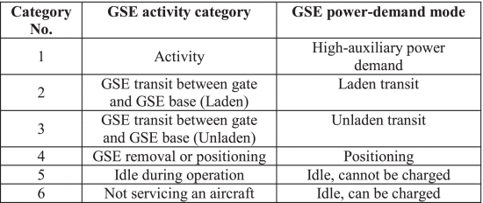
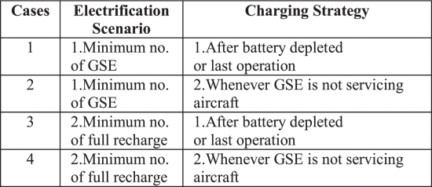
Charge scheduling of GSE
Standardised or real-world duty cycles for GSE are not available in the reviewed literature
Over-night charging (ONC)
Intermittent Opportunity Charging (IOC)
Currently charged ‘when not in use’

