Slide 1


LaiYin
Programmed by Noob Team

Slide 2
1
About Our Team
part

Slide 3

Part 2 ABOUT OUT TEAM
About Out Team
Noob Team
苏一豪
Team Leader

Slide 4
2
Introduction of the project
part

Slide 5
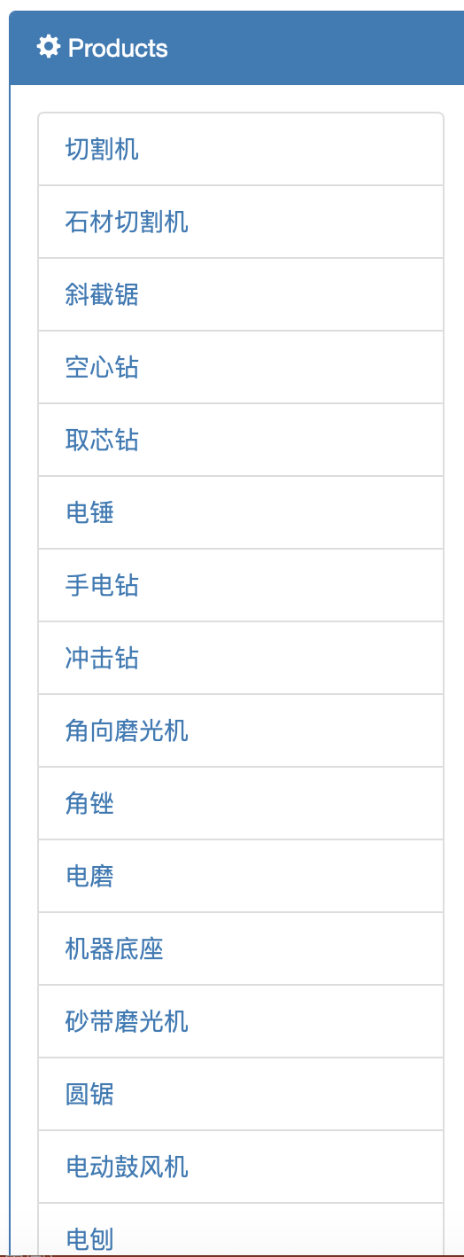

Part 1 INTRODUCTION OF THE PROJECT
产品介绍
.

Slide 6
3
Functions of the system
part

Slide 7
Part 3 FUNCTIONS OF THE SYSTEM
BootStrap
Jsp
Servlet
JDBC

Slide 8
4
Future of the system
part

Slide 9
Part 4 FUTURE OF THE SYSTEM
After many years
2020
Have a large number of users
2019
The system become maturity
2018
Add more functions suggested by the users
The system has finished development

Slide 10
Thanks For Listening
Programmed by Noob Team

