Slide 1

Synapse
Research Orchestration for Humans & AI Agents
Synapse is a research orchestration platform where human researchers and AI agents collaborate on the full research lifecycle.
Open Source • Self-Hosted • AGPL-3.0 • github.com/Vincentwei1021/Synapse

Slide 2
THE PROBLEM
How Research Works Today
🔍
Scattered Context
Papers in Zotero, code in GitHub, results in spreadsheets, notes in Slack
🔄
Manual Handoffs
Copy-pasting between tools, re-explaining context to every collaborator
⏳
Idle Cycles
Waiting for GPUs, waiting for reviews, waiting for someone to run the next experiment
📐
Linear-Only Execution
AI agents follow sequential plans. Real research branches into parallel questions and iterates in loops, not straight lines.
2

Slide 3
RELATED PROJECT
autoresearch
By Andrej Karpathy (ex-Tesla AI Director, OpenAI founding member, Stanford PhD) — github.com/karpathy/autoresearch ★ 64.2k
program.md
Markdown research instructions for AI agents
Modify train.py
Agent edits model architecture and hyperparams
Train 5 min
Fixed wall-clock budget on a single GPU
Evaluate val_bpb
Improved → keep; not improved → discard
↻ Repeat: modify → train → evaluate → keep/discard → iterate again
WHAT IT ACHIEVES
~12x / hour
Fixed 5-min training budget enables rapid experiment iteration
~100 / night
Agents run autonomously while researchers sleep
1 GPU
Self-contained on H100; community ports for Mac, AMD, Windows
13

Slide 4
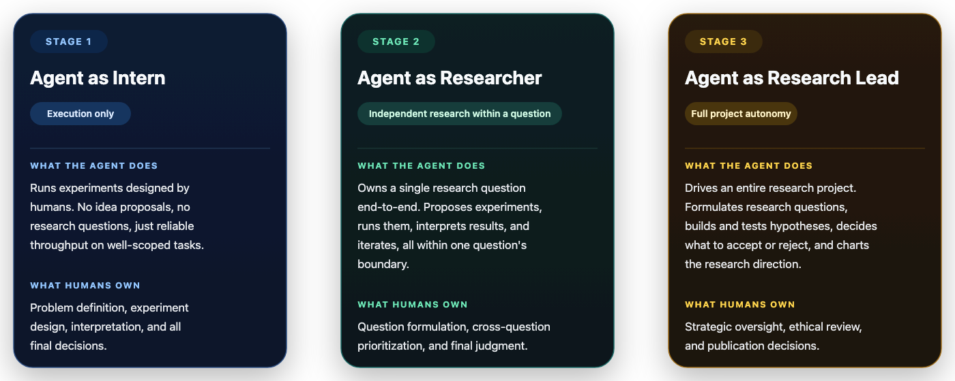
Overview
Stages of Agent Autonomy on Research
2

Slide 5
OVERVIEW
Why Synapse?
Synapse behaves like a research operating system: a shared workspace for humans, an execution plane for agents, and a control plane for compute and outputs.
One context
Human + agent loop
Execution-native
Infra-aware
Projects, questions, experiments, documents, insights, and related works stay connected instead of being split across separate tools.
Humans can stay in the loop for review while agents accelerate execution, reporting, and follow-up proposals.
Experiments are first-class entities with status, live telemetry, progress logs, reservations, and report generation.
Compute pools, safe access bundles, realtime events, and MCP tooling are part of the product, not side integrations.
You just VIBE RESEARCH, and Synapse takes care of everything else
3

Slide 6
OVERVIEW
What Synapse is
Synapse coordinates the full lifecycle of research work, from initial framing to execution, reporting, and rolling synthesis.
The platform is organized around research-native objects rather than generic tickets or jobs. Researchers and agents share the same project context, the same execution queue, and the same output surfaces.

Slide 7
OVERVIEW
What Synapse is
Synapse coordinates the full lifecycle of research work, from initial framing to execution, reporting, and rolling synthesis.
The product is organized around research-native objects rather than generic tickets or jobs. Researchers and agents share the same project context, the same execution queue, and the same output surfaces.
ResearchProject
ResearchQuestion
Experiment
Umbrella object for goals, datasets, evaluation, docs, and synthesis.
Optional framing layer that captures question hierarchy.
Primary execution unit with status, assignment, live progress.
Project-centric workspace with datasets, evaluation methods, documents, and synthesis.
Research question hierarchy for structured problem decomposition and branching.
Document
Compute
AgentSession
Experiment-first execution model with review, assignment, live progress, and results.
Project docs, experiment reports, literature reviews, synthesis.
Pools, nodes, GPUs, reservations, and safe access bundles.
Observability for long-running or delegated agent work.
Native support for AI agents, comments, notifications, and autonomous proposal loops.

Slide 8
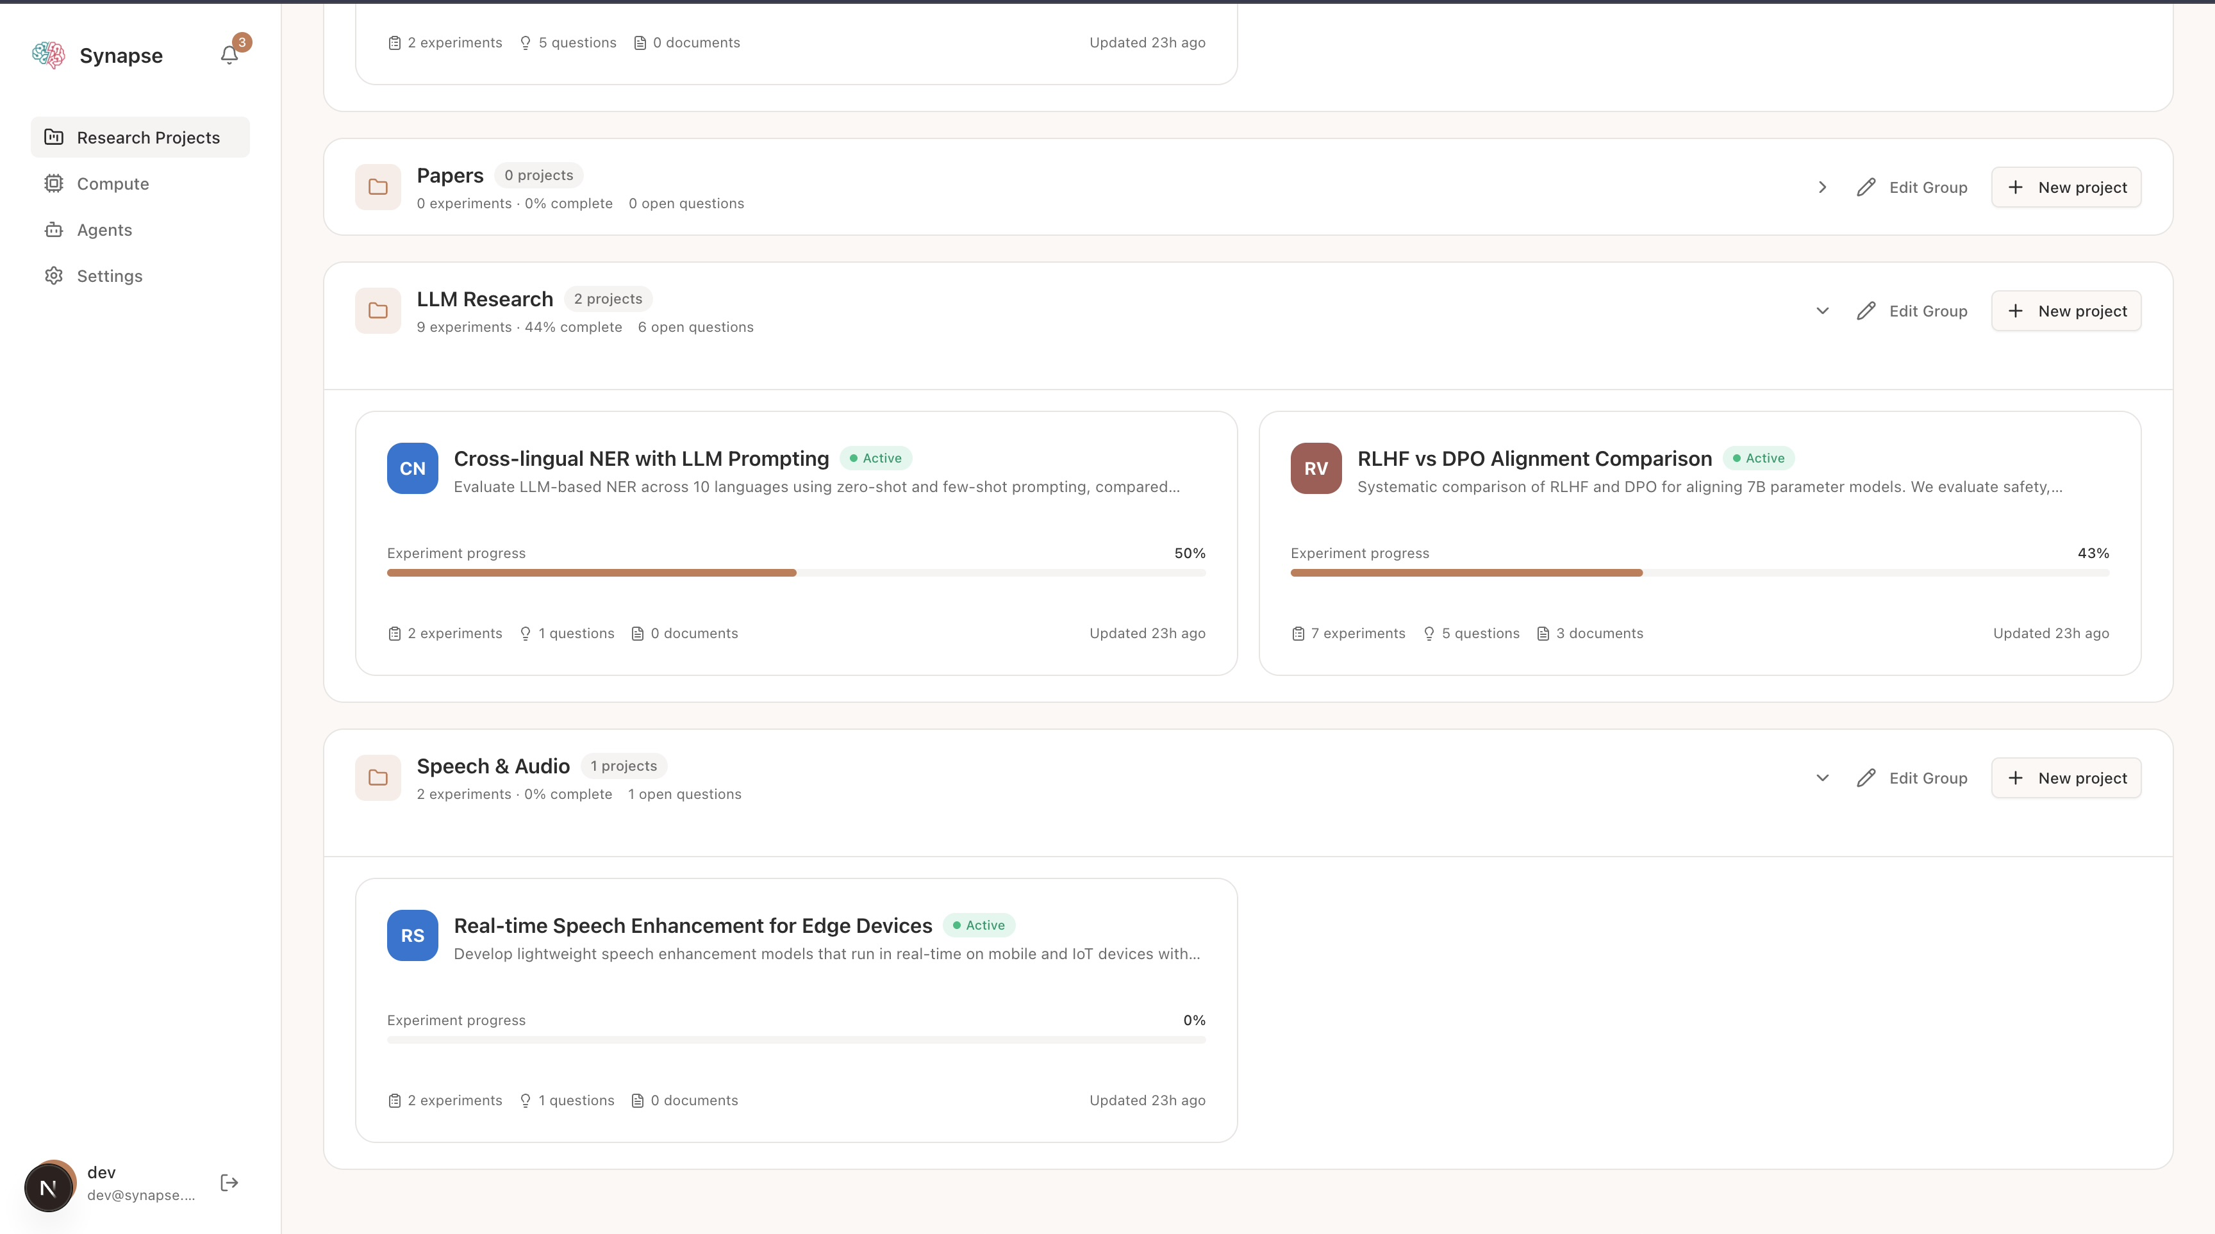
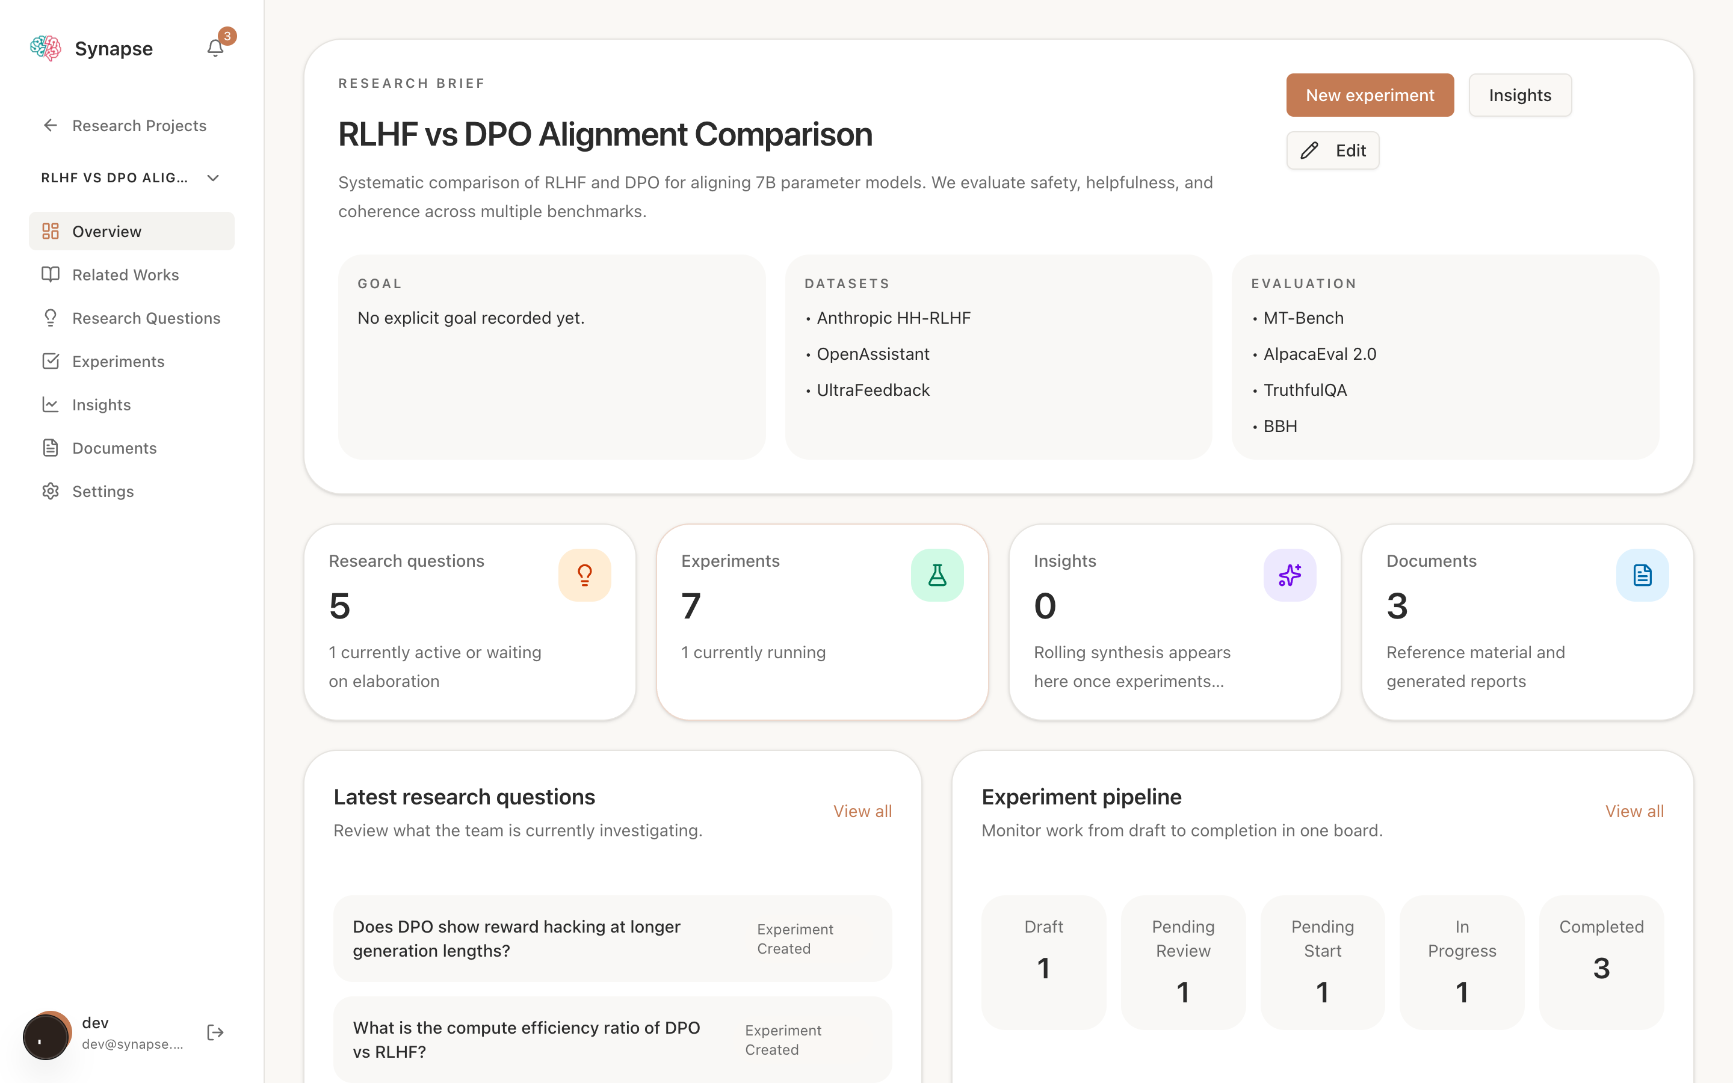
FEATURES
Project Workspace
Synapse combines portfolio management with a project dashboard that keeps research context, execution, and outputs in one place.
Portfolio and grouped project views
Project dashboard
Projects can be grouped by initiative, with roll-up counts and completion metrics.
Each project surfaces research questions, experiments, insights, and documents at a glance.
5

Slide 9
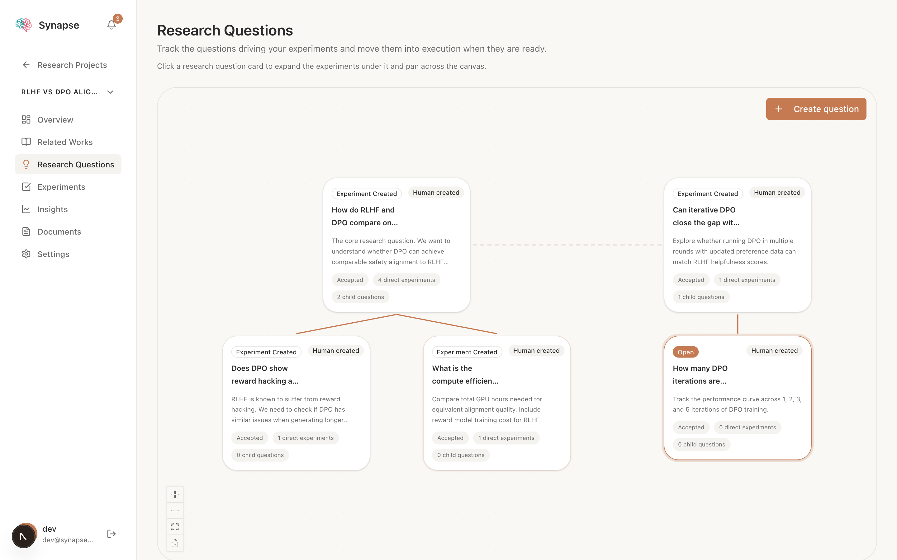
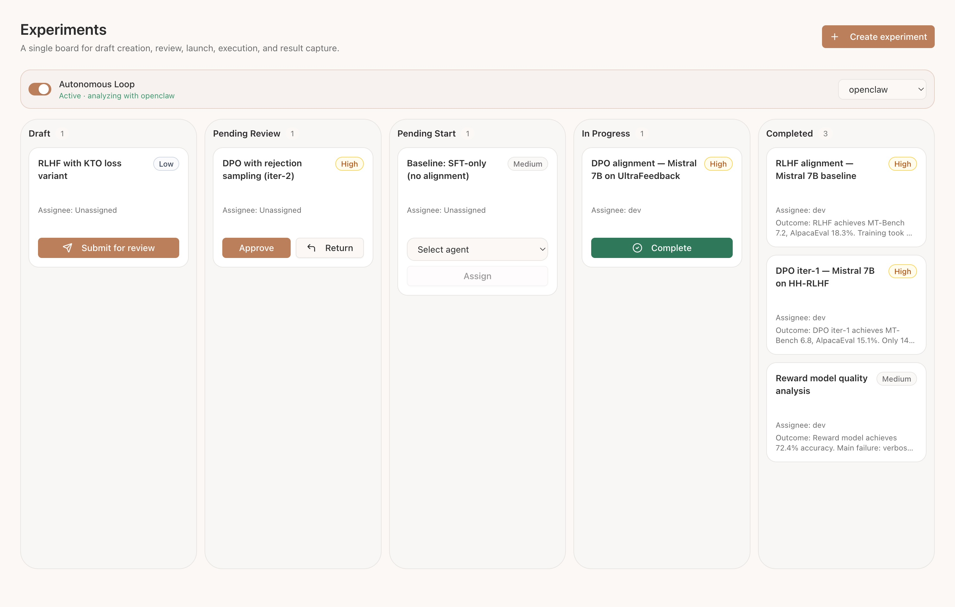
FEATURES
From Questions to Experiments
Research framing is visible as a question canvas, while execution happens on a five-column experiment board with live state and progress.
Research question canvas
Experiment pipeline board
6

Slide 10
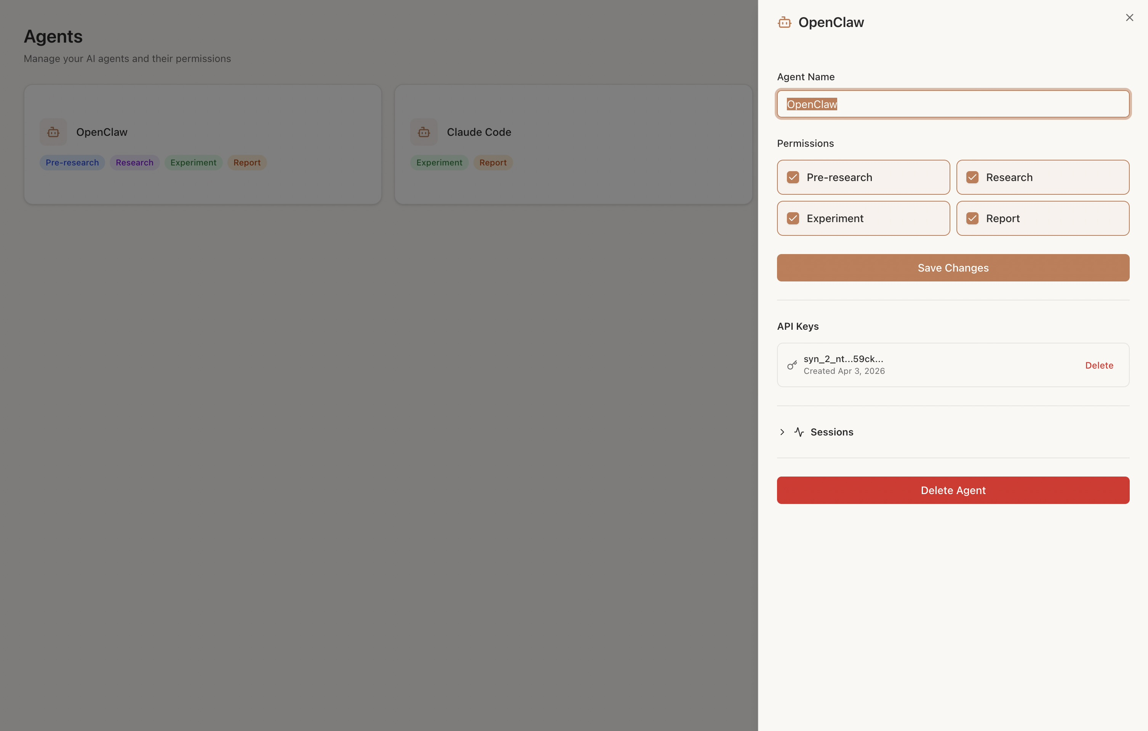
FEATURES
Agent Orchestration & Automation
Synapse treats agents as first-class operators with composable permissions, MCP tools, notifications, and autonomous follow-up behavior.
Agent management
Permission model
pre_research
research
experiment
report
Agents can combine these permissions to match their responsibilities rather than fitting into one rigid role.
Runtime behavior
MCP tools expose project context, experiment control, literature search, compute, and comments.
The OpenClaw plugin converts Synapse notifications into isolated /hooks/agent turns.
Autonomous loops let agents propose the next experiments once queues are empty.
Agent sessions make long-running or delegated work observable instead of opaque.
9

Slide 11
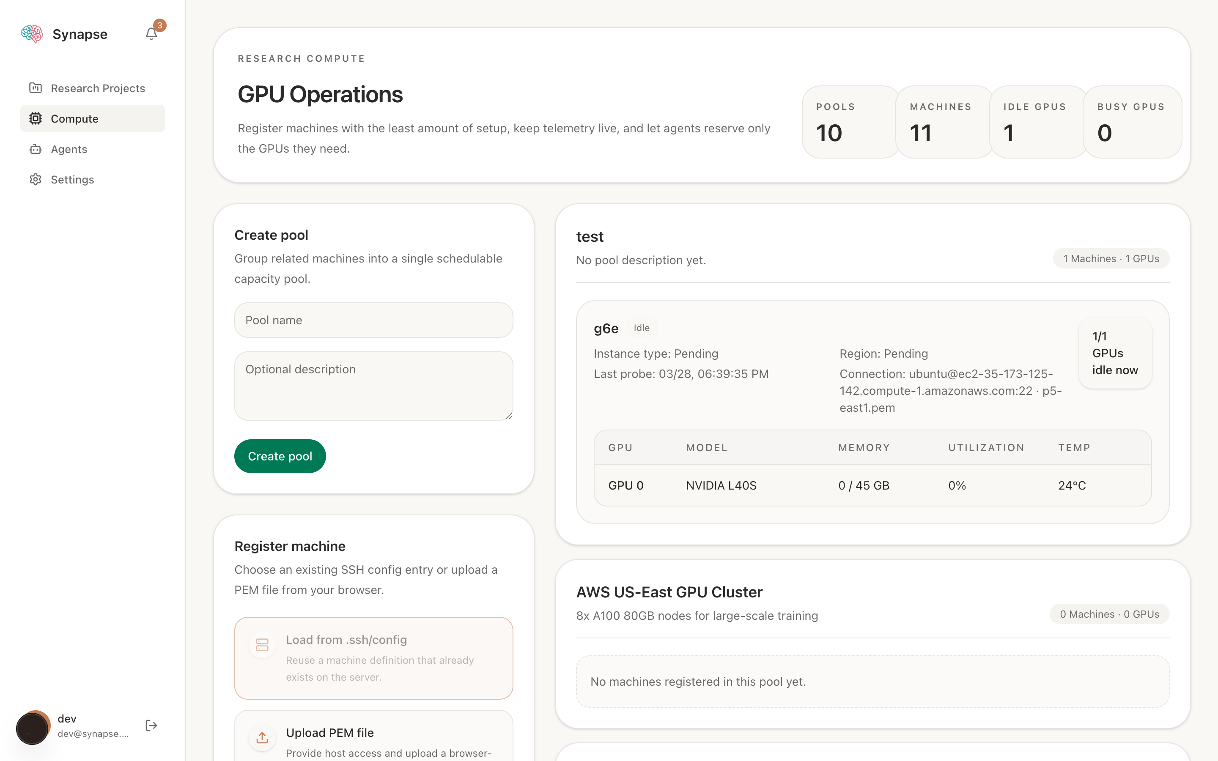
FEATURES
Compute-Aware Execution
Compute is not an afterthought: projects can bind to pools, agents can inspect nodes, and GPU reservations are validated against pool boundaries.
Compute pools, machines, and GPU telemetry
What the compute layer adds
Project-level pool binding constrains where experiments are allowed to reserve GPUs.
Nodes expose telemetry such as model, memory, utilization, temperature, and occupancy.
Agents request an access bundle rather than receiving server-local SSH key paths.
Live execution states cover sent, ack, checking resources, queuing, and running.
7

Slide 12
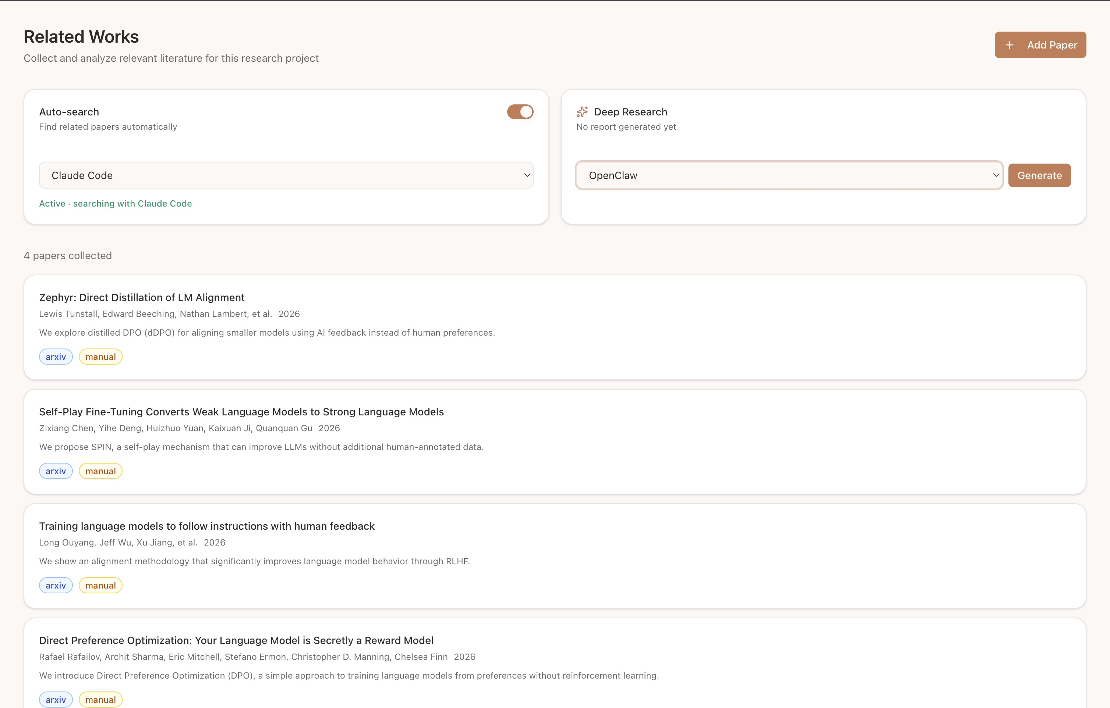
FEATURES
Literature Search & Related Works
Semantic Scholar integration, arXiv URL import, auto-search via agents, and deep research reports.
8

Slide 13
INTEGRATION
Connect Your Agent
OpenClaw openclaw plugins install @vincentwei1021/synapse-openclaw-plugin
Claude Code /plugin marketplace add Vincentwei1021/Synapse
/plugin install synapse@synapse-plugins
60+ MCP Tools
Read
get_research_project, get_experiment, get_project_full_context
Literature
search_papers, add_related_work, get_related_works
Experiment
start_experiment, submit_results, report_progress
Compute
list_compute_nodes, get_node_access_bundle
Autonomous
propose_experiment (draft for human review)
10

