Slide 1

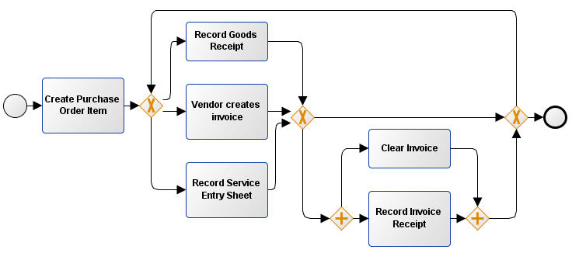


3-way match: invoice after goods receipt
With SRM
Service
Standard
Without SRM
Service
Standard
Subcon. /
3rd Party

Slide 2


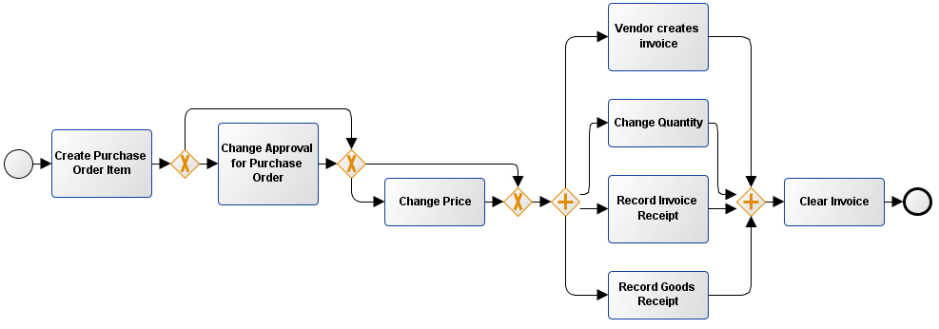

With SRM
Standard
Without SRM
Standard
Subcontracting
Subcontracting

Slide 3


2-way match
Limit
Consignment
Consignment

