Slide 1
Interesting Research Findings
David ZHU

Slide 2
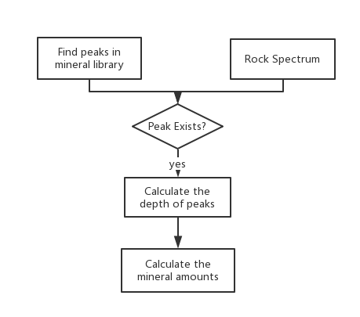
Workflow:

Slide 3
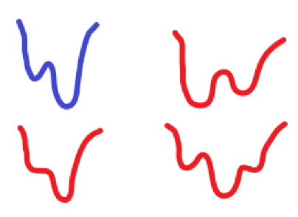
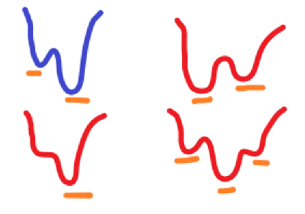
From the 4 library spectrums, the main three obvious depth is notable.
Just use the Bastnaesite mineral and test only with three windows of [(138-219), (219-298), (298-401)]
So if the library is shown as the blue one, then the red ones are the possible spectrum and the detected peaks also shown. With so many different peaks, I only use the deepest peaks in the library in each windows. And find the detected peaks in the rock no matter its depth.
If the location
|Libpeakloc - Rockpeakloc| < Threshold
then the peak will exist.
Since the peak distance is not so far away from each other, then just use the same location and weights to different windows [0.45, 0.45, 0.1] to calculate the possible scaling value.
Blue: Library Spectrum;
Red: Possible Spectrum;
Orange: Detected Peaks

Slide 4
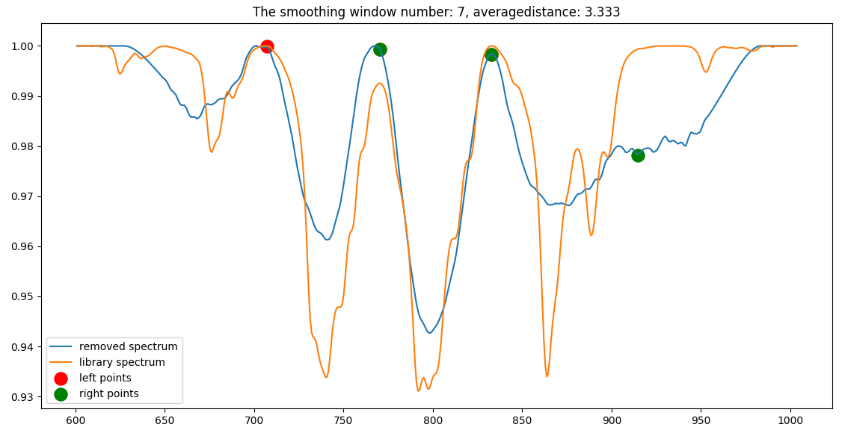
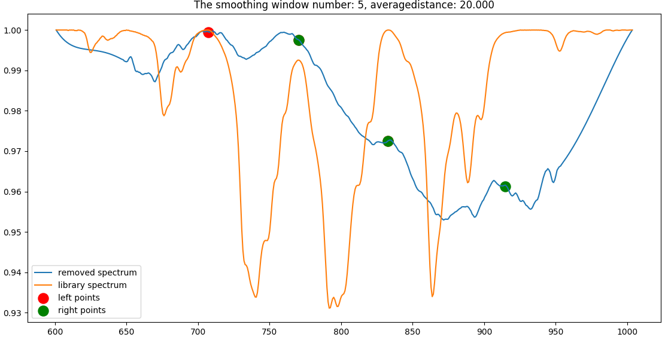
Output possible or impossible according to the averagedistance.

Slide 5
Results:
Table1: the ratio of sum of scaling and mineral amount with different average distance threshold
Table2: the ratio of percent of exist pixel and mineral amount with different average distance threshold

Slide 6
Problems:
Since I only use the deepest of the library, it will lose many information of other peaks, also the noise of the original one is quite large but when I only focus on the peaks it can ignore other information.
Only using three windows may ignore other very important information.
The weights are set manually, we can’t know which parts are more important.

Slide 7
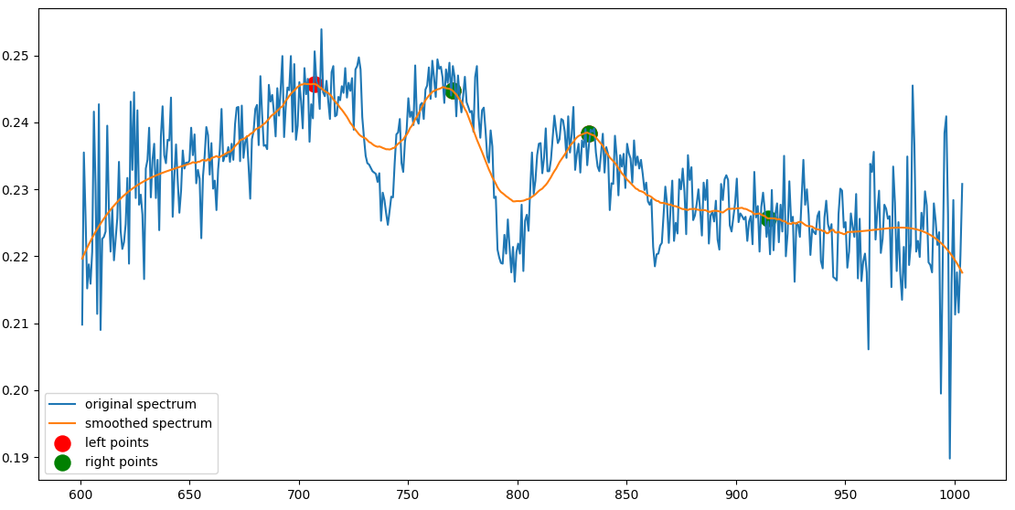
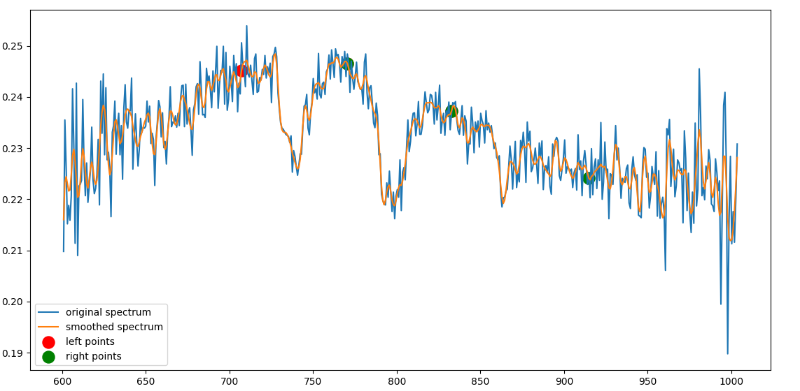
Smooth with different parameters, but the second one has more other peaks will influence the judge results. The first one can find the obvious peaks and the location is not far away from each other.

Slide 8
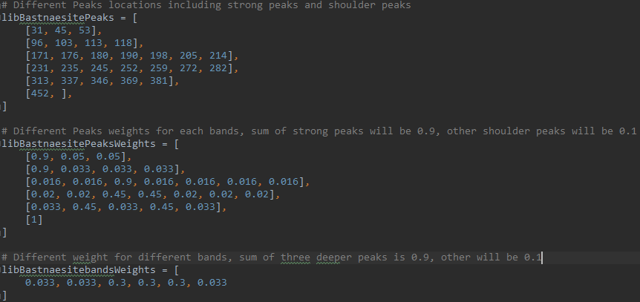
Problems:
Since I only use the deepest of the library, it will lose many information of other peaks, also the noise of the original one is quite large but when I only focus on the peaks it can ignore other information.
Only using three windows may ignore other very important information.
The weights are set manually, we can’t know which parts are more important.
However, after I try to add more information or change the smooth ones, the plot is worse than before.

Slide 9
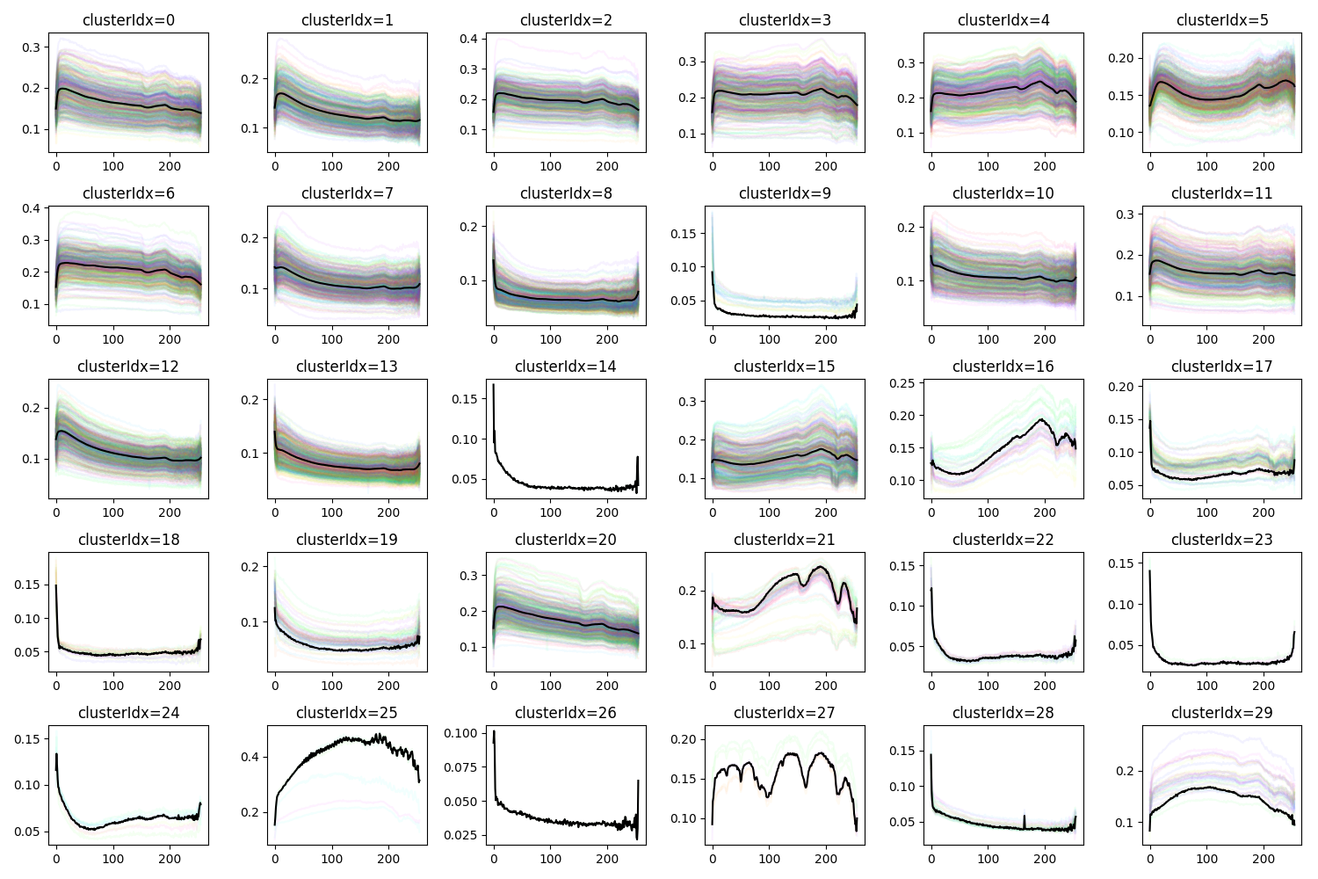
Clustering Analyze:
Clustering original rock spectrums
Calculate R-Square of each cluster group
Choose highest R-Square and analyze group
Find the possible pattern of the average spectrum
Thanks to Matt’s Picture.

Slide 10
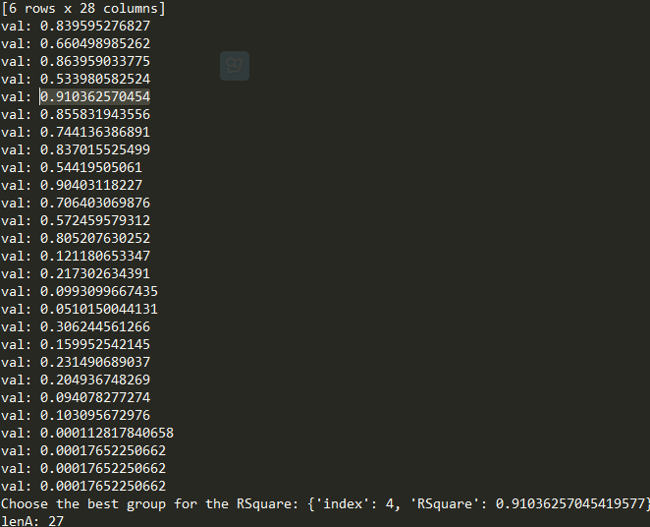
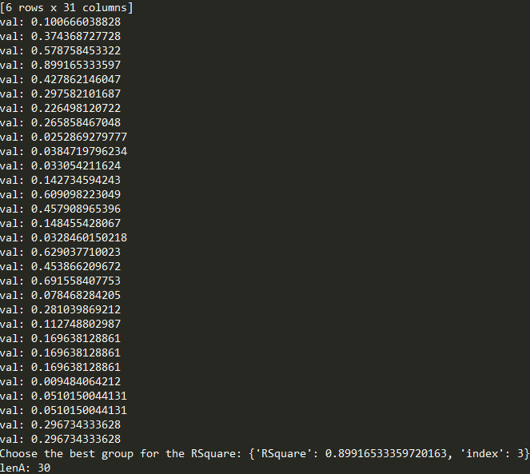
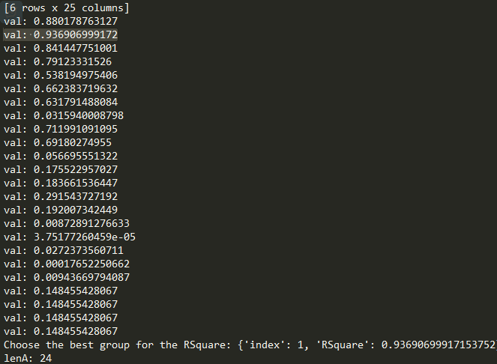
Three layers’ clustering with highest R-Square.
Angle Threshold is [0.1, 0.06, 0.04]

Slide 11
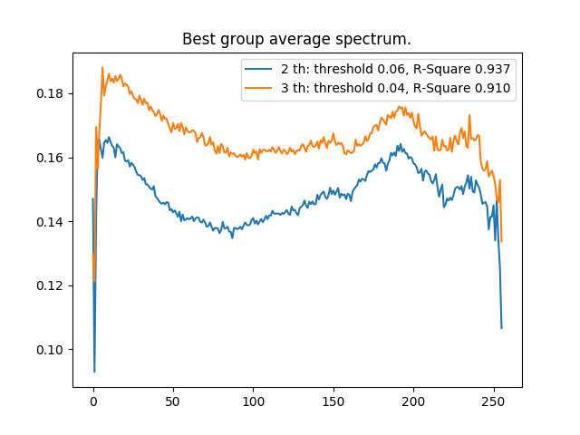
Possible solution:
We can think the average spectrum is related to the element amount.
It is possible if we can just use different rocks original spectrum to compare with this ones and think they will exist minerals.
It is also possible that we can find the possible patterns in the average spectrums (like the Gaussian functions to fit? ) but I haven’t come up any other ideas.

