Slide 1

RARE EARTH ELEMENT ESTIMATION FROM HYPERSPECTRAL IMAGING SPECTROSCOPY
Vincent Yao, Undergrad, Summer Intern

Slide 2
Outline
1. REE-Mineral Amount Estimation
1)Method and Workflow:
Possibility and Similarity Checking
2)Result:
Different Similarity method
2. Multiple Gaussian Modeling Result.
1)Modified Gaussian Modeling
2)Result.

Slide 3
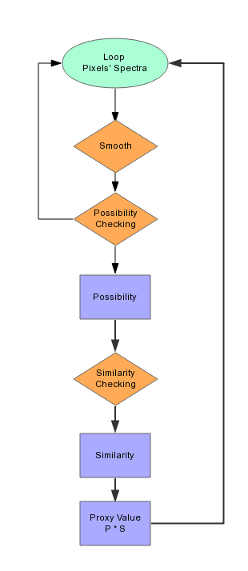
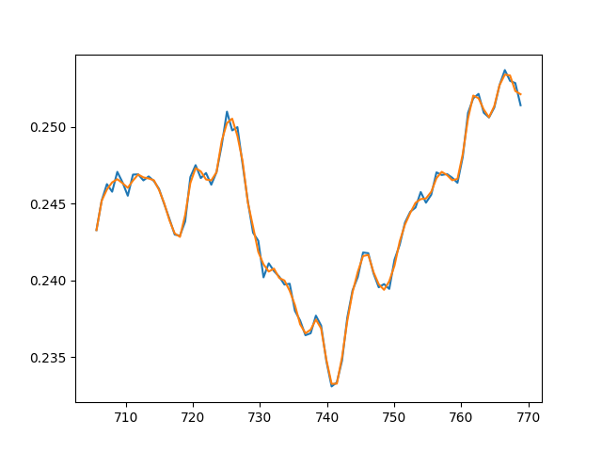
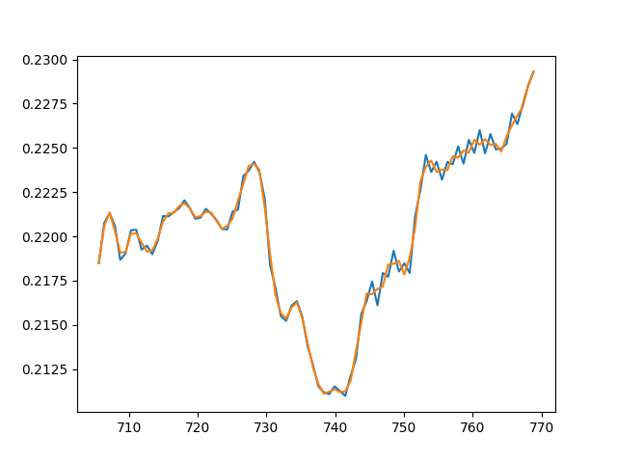
Smooth: Remove noises, for better possibility checking res.

Slide 4
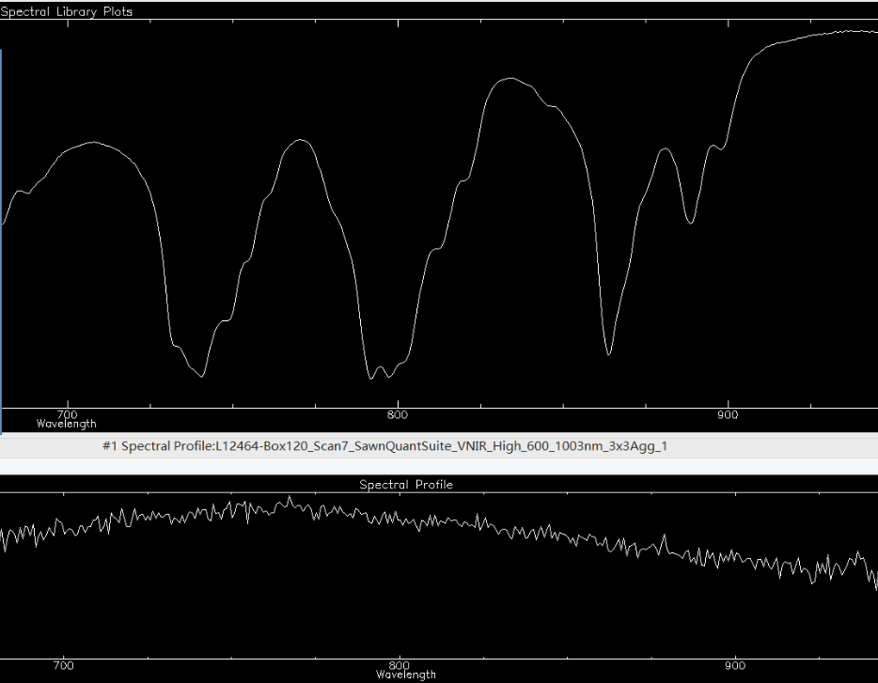
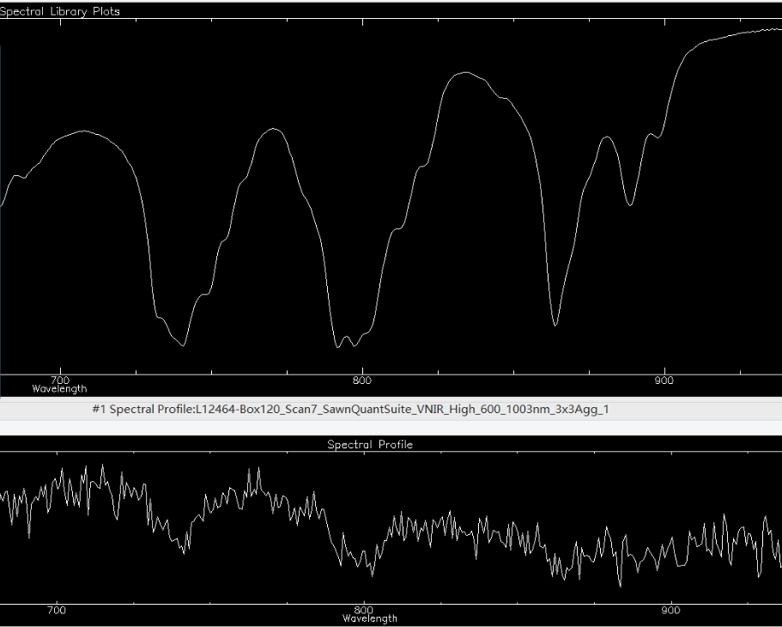
Possibility Checking: Whether this pixel is possible to be Mineral-X
Impossible (Low Possibility)
Possible (High Possibility)

Slide 5
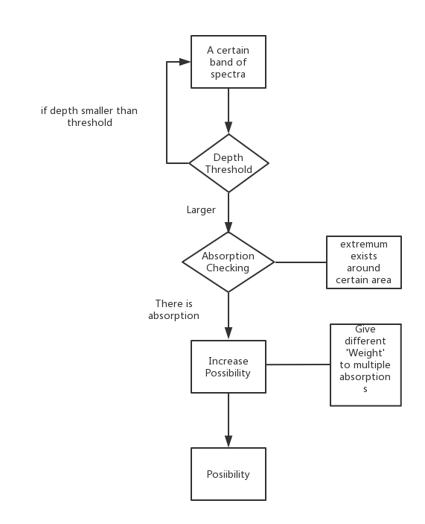
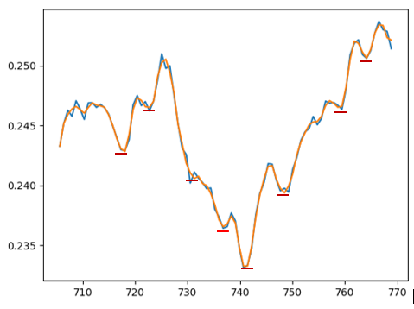
Possibility Checking: Whether this pixel is possible to be Mineral-X
Now use 0.0075(DT’s Test)
2%
2%
2%
2%
2%
90%
Around: 740 +- 2nm

Slide 6
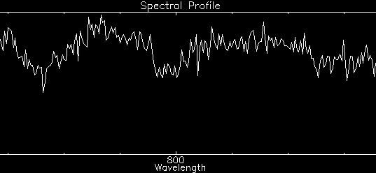
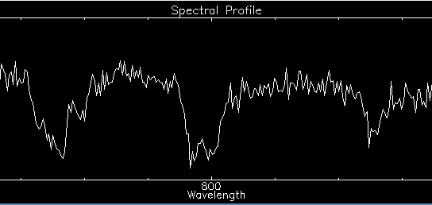
Similarity Checking: between pixels’ spectra and reference spectra
Smaller Similarity
Larger Similarity

Slide 7
Similarity Checking: between pixels’ spectra and reference spectra
Methods for measuring the Curve Similarity in Math or Signal Processing:
1)Frechet distance
2)Hausdorff distance
3)Correlation Coefficients
4)Dynamic Time Wrapping
Problem: Cannot differentiate the possible spectra.
Want: (Maybe) 0.4 and 0.8;
Actually, their ‘similarity’ are nearly equal, like 0.9 and 0.9

Slide 8
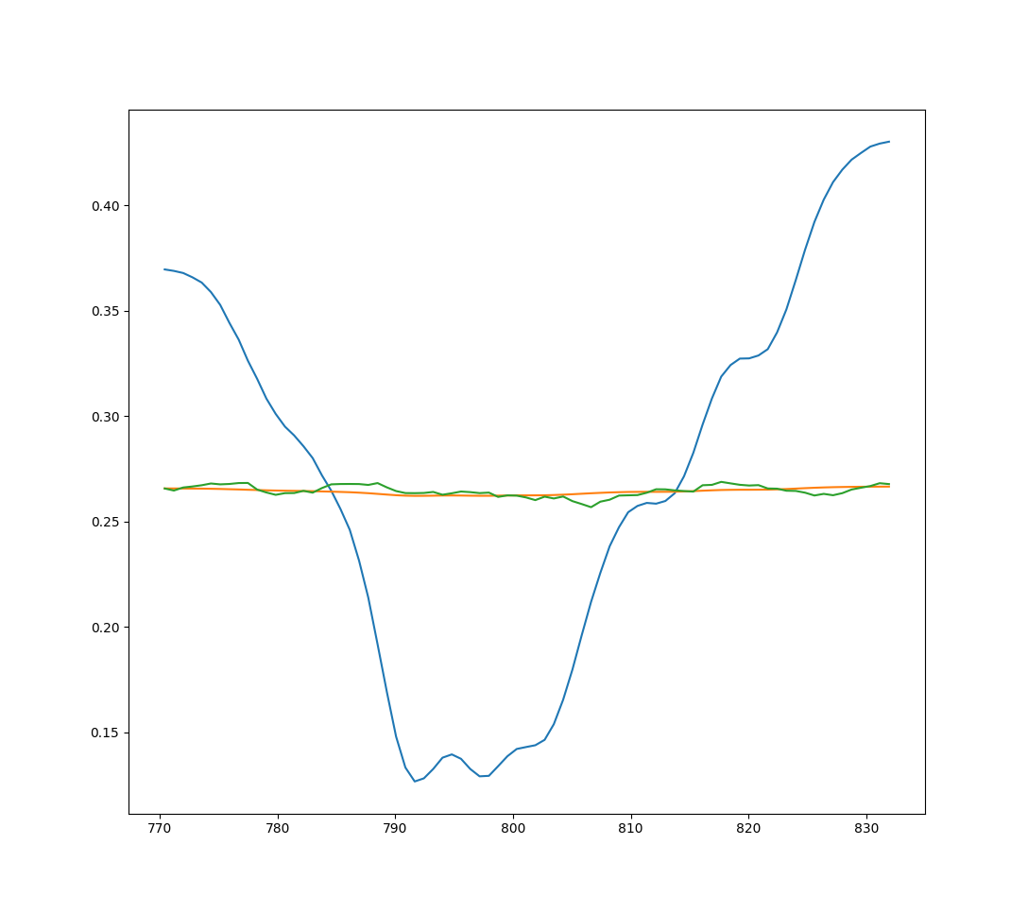
 | Band1(705 - 769) | Band2(770-832) | Band3(854-879)
General | 0.9234 | NAN | 0.8761
Frechet | 0.923 | NAN | 0.8474
Hausdorff | 0.9226 | NAN | 0.8462
Corrcoef | 0.8562 | 0.8465 | 0.8384
Possibility alone | 0.921 | NAN | 0.8424
Problem:
The Similarity Checking didn’t work, and Possibility Checking is kind of good.
Still searching solutions.

Slide 9
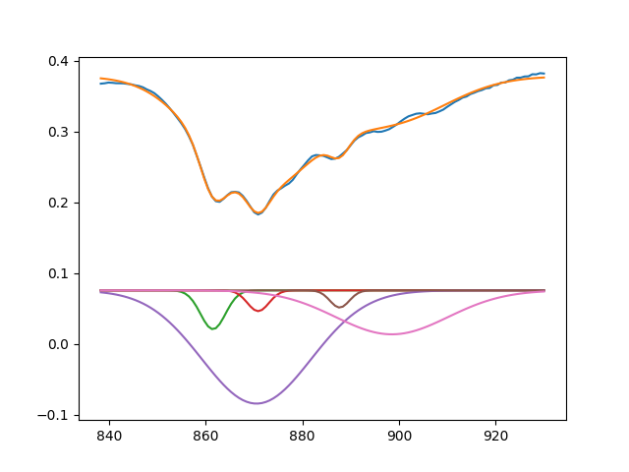
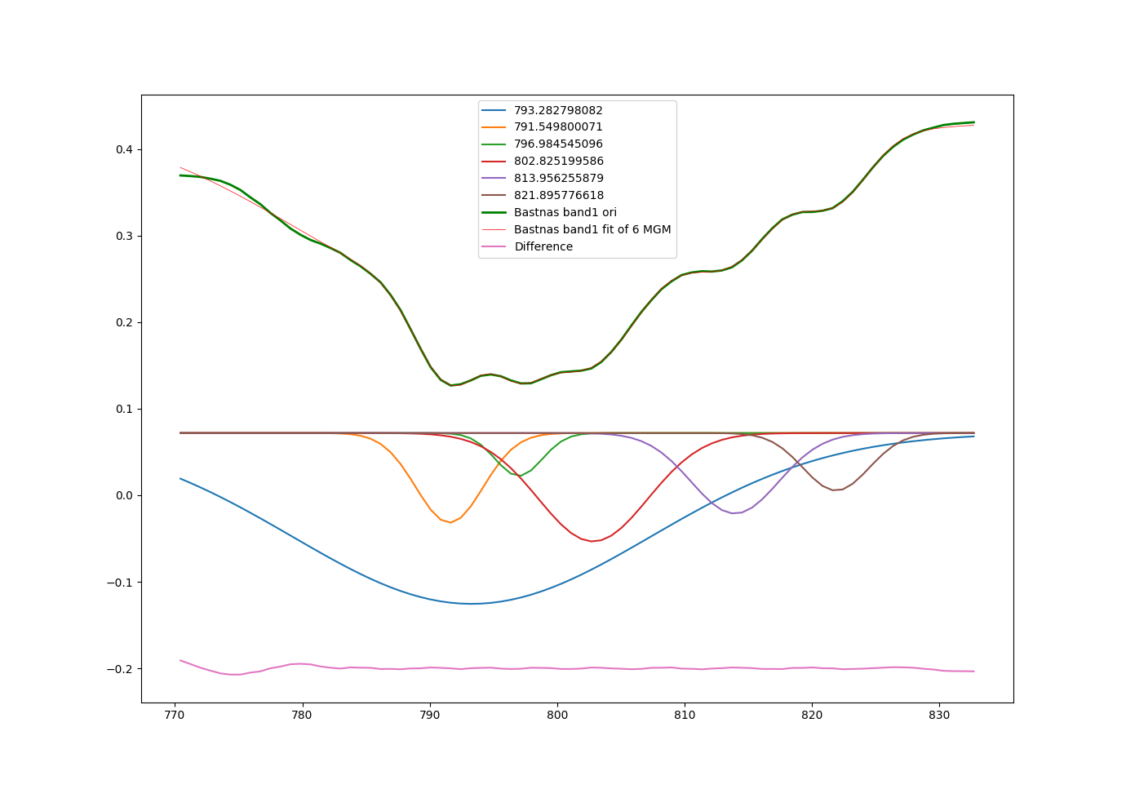
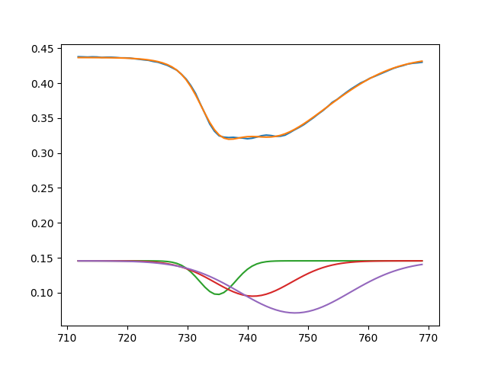
Gaussian Modeling:
1.Use multiple Guassian Model to fit the reference curve(4 sp in SpectraForAbsorptionFitting.hdr)
2.Result is Good, so didn’t use ‘modified Gaussian model’ in paper.
3.Lacking ‘DT’s custom Library of REE Minerals’ to do more test.
Monazite (840- 920)
Bastnaesite Band2(793-821)
Mosandrite (710-770)

Slide 10
Weight/R-Squared | Band1(705-769) | Band2(770-832) | Band3(854-879)
0.2 | 0.91216 | 0.071895 | 0.885929
0.3 | 0.91416 | 0.033532 | 0.885799
0.4 | 0.91604 | 0.032402 | 0.885551
0.5 | 0.917807 | 0.031371 | 0.885206
0.6 | 0.919467 | 0.017485 | 0.884784
0.7 | 0.921027 | 0.016399 | 0.884301
0.8 | 0.922493 | 0.014054 | 0.883768
0.9 | 0.923869 | 0.013094 | 0.883197
1.0 | 0.925163 | 0.012257 | 0.882596

Slide 11
Questions:
DT’s Opinion about REE-Mineral Amount Prediction & Spectra Unmixing.
How to ‘use’ multiple Gaussian fitting result(parameters)

