Slide 1
In Defense of Unsoundness
Ben Livshits, Manu Sridharan, Yannis Smaragdakis, and Ondřej Lhoták

Slide 2
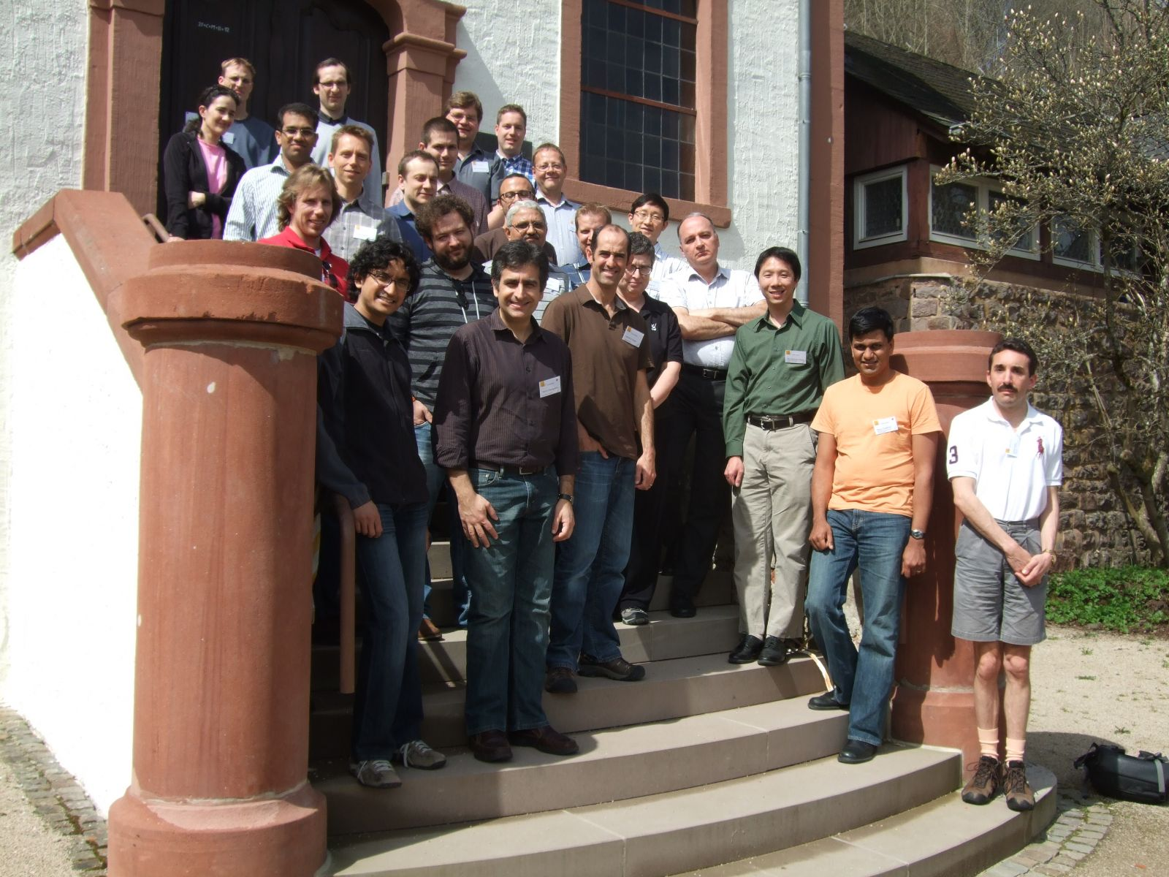
April 14 – 19, 2013, Dagstuhl Seminar 13162 Pointer Analysis

Slide 3
Are Static Analysis (papers) Sound?
Sound: capture all program behavior
Must analysis results hold during program execution?
Of course not!
Virtually all recent whole program analyses for realistic languages are unsound

Slide 4
Unsoundness is Everywhere!
Omit conservative handling for common language features
Unsoundness lurks in the shadows
caveats only mentioned off-hand in an “implementation” or “evaluation” section.

Slide 5
Nasty Language Features
Typical (published) whole-program analysis extolls its scalability virtues and briefly mentions its soundness caveats.
Java: reflection and JNI
JavaScript: eval and dynamically computed properties
C/C++: assumptions about memory region and pointer arithmetic

Slide 6
Can These Language Features be Ignored?
Most of the time the answer is no
These language features are nearly ubiquitous in practice.
"Assuming the features away" excludes the majority of input programs.
For example, very few JavaScript programs larger than a certain size omit at least occasional calls to eval.

Slide 7
Could all these Features be Modeled Soundly?
In principle, yes.
In practice, destroys the precision of the analysis
Must be highly over-approximate.
Huge imprecise result = useless.
Imprecision destroys scalability

Slide 8
Soundness is not Even Necessary!
Many clients can tolerate unsoundness.
IDEs (auto-complete systems, code navigation)
General purpose bug detectors
Automated refactoring tools
Even hints for runtime optimization

Slide 9
Should We Even Try?
Soundness is extremely hard to achieve for a whole-program analysis in a realistic, modern language, due to programming language features that are very hard or even impossible to analyze precisely.
Even if achieved the precision is likely to be destroyed.
What is a reasonable middle ground?

Slide 10
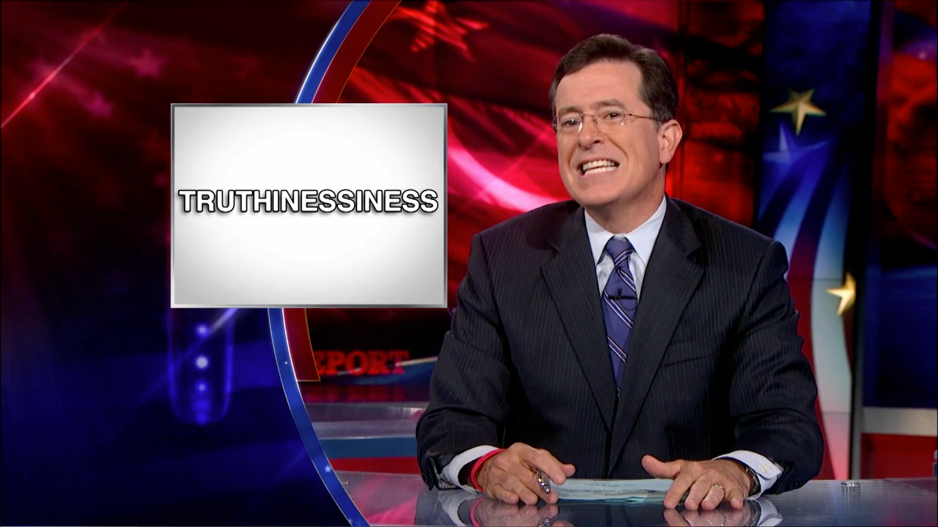
Soundiness
Sound modulo inevitable unsoundness
“best-effort soundness”
“sound except for the things we all know about”

Slide 11
Middle Ground: Soundiness
We draw a distinction between
a soundy analysis, which aims to capture all dynamic behaviors within reason, and
an unsound analysis that deliberately ignores certain behaviors
We argue that soundiness is a good line in the sand to draw in order to avoid abuse of the observation that "everyone's analysis is unsound."

Slide 12
Moving Forward
Soundy is the new sound, de facto, given the research literature of the past decades.
Papers on unsound analyses should explain the implications of their unsoundness.
For nasty features, more studies should be published to characterize how extensively they are used in typical programs.
As a community, we should provide guidelines on how to write unsound analysis papers.
The PL research community should embrace unsound analysis techniques and tune its soundness expectations.

