Slide 1

Data Science and Management Project
Studente: Vincenzo Cappalonga
Matricola: 201458
Predictive Maintenance

Slide 2
DataFrameS:
Telemetry: the processing parameters of the machines are reported, hour by hour, relating to vibrations, pressure, energy consumption and rotation.
Maint: maintenance of the individual components of all the machines is reported. Maintenance occurs both when failures occur and in advance to prevent failures from occurring.
Errors: five types of errors are reported, which do not interrupt the processing of the machines.
Failures: failures of the four main components are reported, all present in all the machines. These types of failures stop the processing of the machines.
Machines: all information relating to the model and age of the machines is reported.

Slide 3
merging the dataframeS
df_unito : by merging the dataframes with telemetry and eliminating the duplicates I obtained a dataset that, hour by hour, reports for each component and for each machine if there has been a failure, a mainteinence or an error, with a 1 in the specific columns if in that hour there has been one of the previous significant events;
tabella_tot : the analysis of the total number of failures, errors and maintenance for each machine, making the difference between maintenance for failures and preventive maintenance.
Then, other features were added to «tabella_tot»:

Slide 4
Working attributes
efficiency_rotate : the rotation with which the tool is made to work determines the efficiency of the processing, the higher it is, the more the machine will work without difficulty;
volt_consume : the energy consumption increases when the machine has difficulty in processing;
general_inefficiency : the ratio between pressure, vibration and consumption and their maximums represents the inefficiency of the machines since these are parameters that represent difficulties in processing;
pressure_fatique : the more resistant the material will be to processing, the more the tool will have difficulty;
vibration_instability : the vibration of the entire machine and the processing platform.

Slide 5
Time attributes
last_time_since_fail : the max number of hours that occurs between two failure of the same component;
last_time_sice_mait : the max number of hours that occurs between two maintainence of the same component;
last_time_since_error : the max number of hours that occurs between two error of the same tipe;

Slide 6
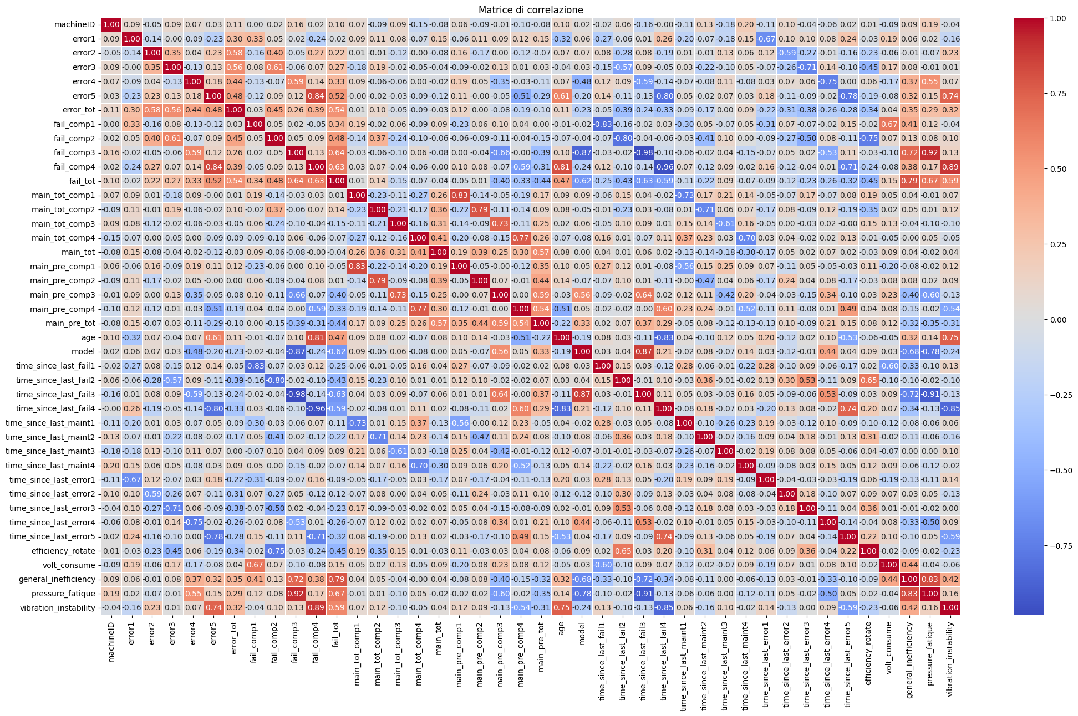
Correlation matrix
Component no. 1 has a number of failures that increases with energy consumption (0.67), as well as slightly with general inefficiency (0.41). It is probably connected to the electronic resistances of the machine or to the digital controls;
Component no. 2 is correlated with the efficiency of the rotation (-0.75), so if the number of failures increases the efficiency decreases. It is probably very close to the tool used in the processing or to the devices connected to it;

Slide 7
Correlation matrix
Component no. 3 is correlated with pressure (0.92), the more the failures to it increase and the more, probably, the resistance of the material to processing would increase;
Component no. 4 is correlated with instability due to vibrations (0.89), the more the failures to the component increase and the more unstable the machine is.

Slide 8
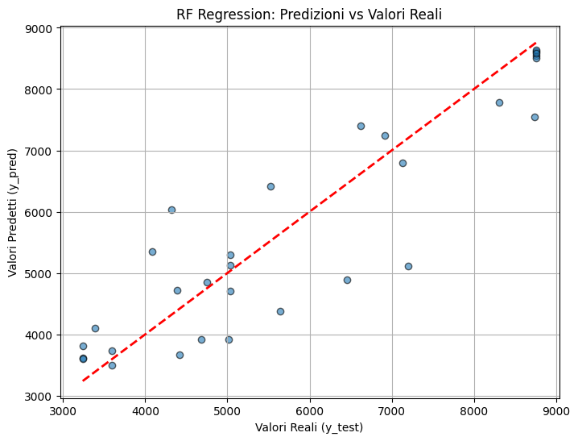
Predictive Model
Random Forest with Param Grid and GridSearchCV: Random Forest (RF) is an ensemble learning method that operates by constructing multiple decision trees during training and averaging their predictions to improve accuracy and reduce overfitting.

Slide 9
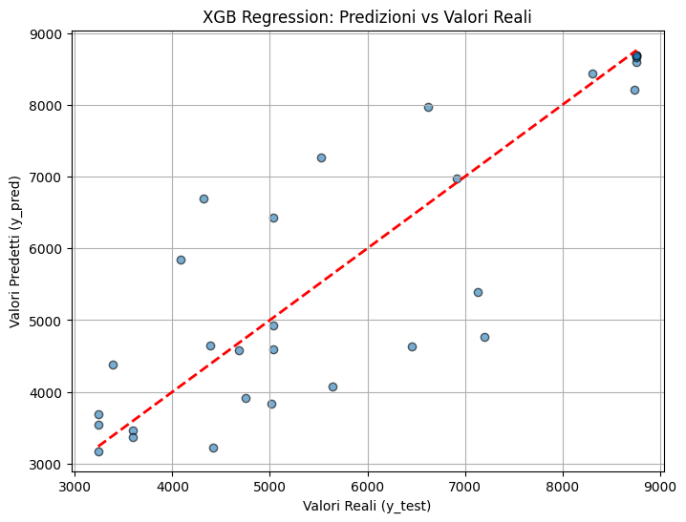
Predictive Model
XGBoost with Param Grid: XGBoost (Extreme Gradient Boosting) is a powerful gradient boosting algorithm that optimizes the standard Gradient Boosting framework by incorporating additional regularization techniques, parallelization, and a more efficient handling of missing values.

Slide 10
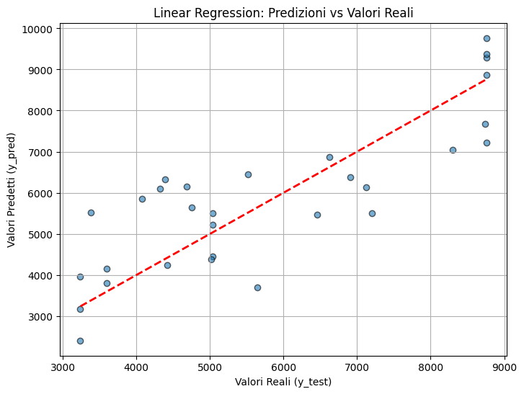
Predictive Model
Linear Regression: Linear Regression (LR) is a fundamental regression technique that models the relationship between a dependent variable and one or more independent variables by fitting a linear equation to the observed data.

Slide 11
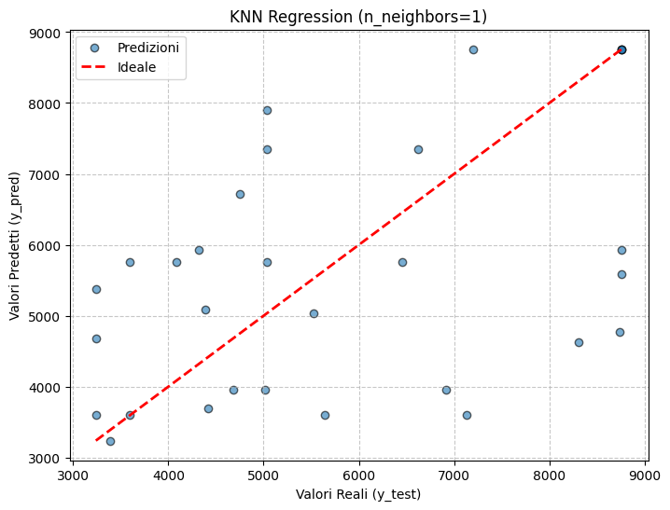
Predictive Model
K-Nearest Neighbors Regressor (KNN): KNN Regressor is a non-parametric, instance-based learning algorithm that predicts the target value of a new data point by averaging the target values of its K nearest neighbors in the feature space. The similarity between data points is commonly measured using Euclidean distance.

Slide 12
Results
Comp.1 | MAE | MAPE | MSE | R2
RF | 37.45 | 0.19 | 52311.42 | 0.72
XGB | 31.68 | 0.16 | 38600 | 0.79
LR | 47.46 | 0.23 | 71938.19 | 0.62
KNN | 68.65 | 0.29 | 171594.8 | 0.08

Slide 13
Results
Comp.2 | MAE | MAPE | MSE | R2
RF | 39.01 | 0.23 | 51366.54 | 0.65
XGB | 37.19 | 0.22 | 46022.11 | 0.69
LR | 43.85 | 0.23 | 86223.15 | 0.41
KNN | 52.94 | 0.28 | 133500 | 0.09

Slide 14
Results
Comp.3 | MAE | MAPE | MSE | R2
RF | 8.28 | 0.04 | 9363.91 | 0.96
XGB | 7.01 | 0.04 | 5336.31 | 0.98
LR | 21.25 | 0.09 | 19316.62 | 0.91
KNN | 31.5 | 0.17 | 118379.8 | 0.46

Slide 15
Results
Comp.4 | MAE | MAPE | MSE | R2
RF | 13.98 | 0.1 | 15919.39 | 0.95
XGB | 16.72 | 0.11 | 16907.57 | 0.94
LR | 24.9 | 0.15 | 29778.62 | 0.90
KNN | 19.18 | 0.13 | 29591 | 0.90

Slide 16
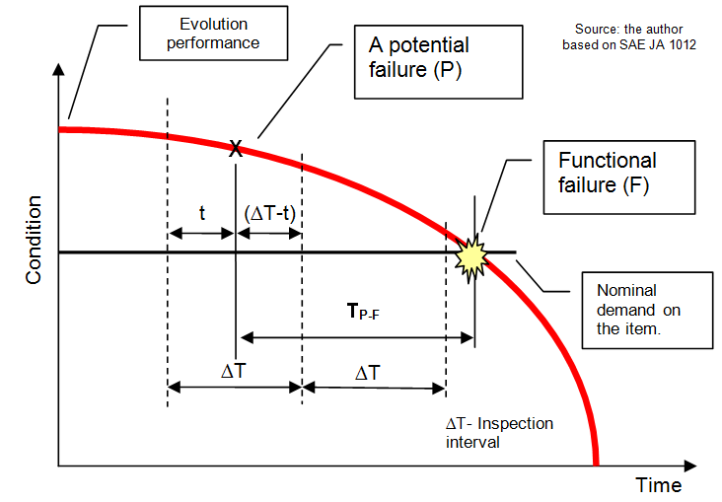
Possible Improvements and Refinements:
Having more information about the machines would help to identify the most important characteristics and to measure and analyze them correctly, such as: more info on the output of the machines or on the cost of maintenance.
Analysis on the Efficiency curve - Times between events.

