Slide 1
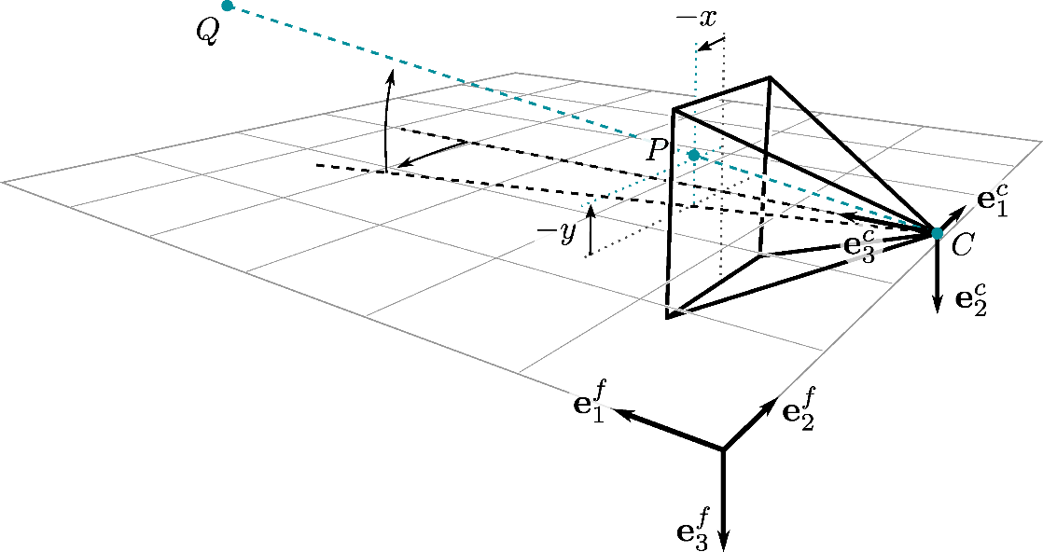
Ego-motion Subtraction: Pinhole Camera Model
Assuming a moving pinhole camera views a stationary point in the scene. The position vector of expressed in the sensor fixed reference frame is,
According to the camera model, is projected to the image plane at point . Its position expressed in the image frame is,
The position vector can be written in terms of ,
is focal length
is the image coordinate of point
Example:
Image plane

